Slide 1
Perspectives on the initial results of the OSSSE’s for a US Wind Lidar space mission
Lars Peter Riishojgaard^{1,2}, Zaizhong Ma^{1,2}, Michiko Masutani³, Jack Woollen^{3,} Dave Emmitt⁴, Sid Wood⁴, Steve Greco⁴
¹Joint Center for Satellite Data Assimilation
²University of Maryland Baltimore County
³NCEP Environmental Modeling Center
⁴Simpson Weather Associates

Slide 2
Overview
NWP and wind observations
OSSE setup
Interpretation of initial results
A word about observation errors
Possible future directions
Summary and conclusions

Slide 3
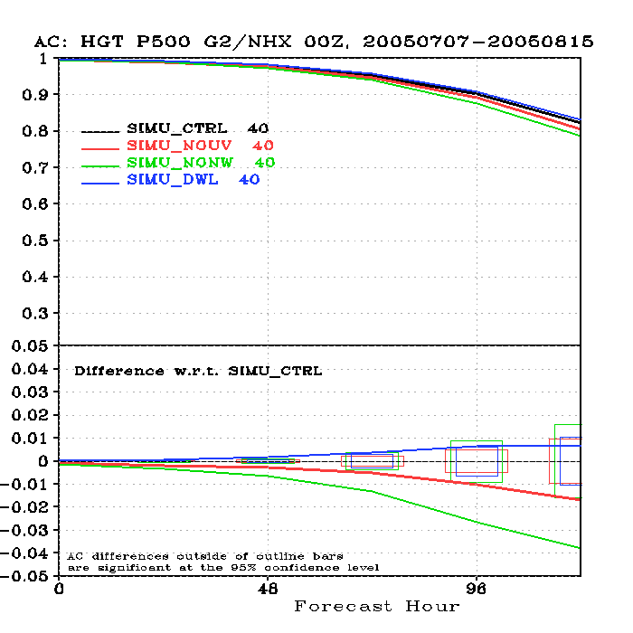
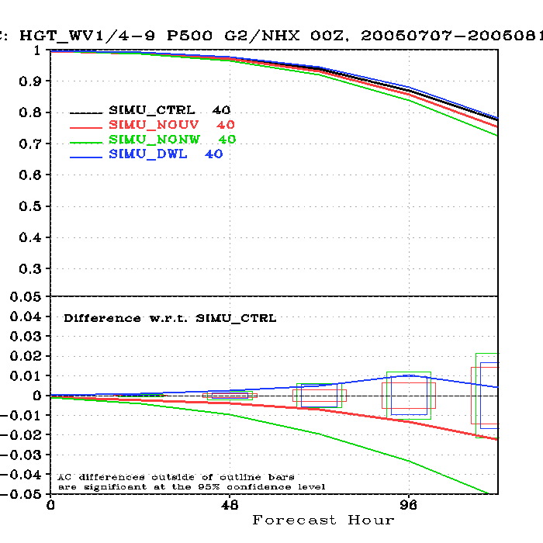
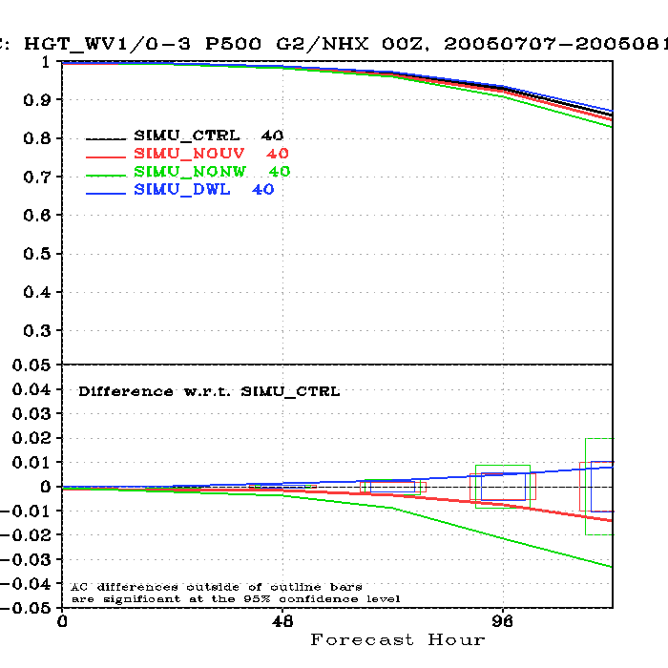
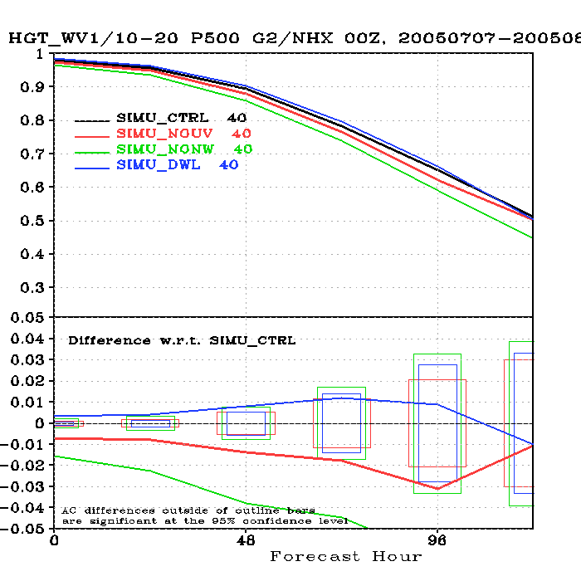
500 hPa anomaly correlation coefficients, NH
w4-9
w0-3
w10-20

Slide 4
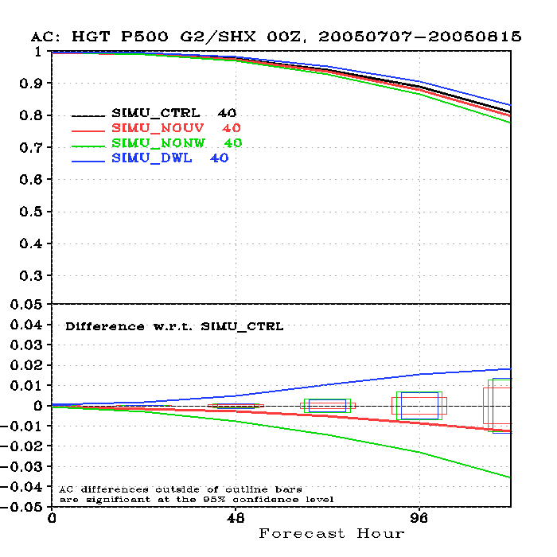
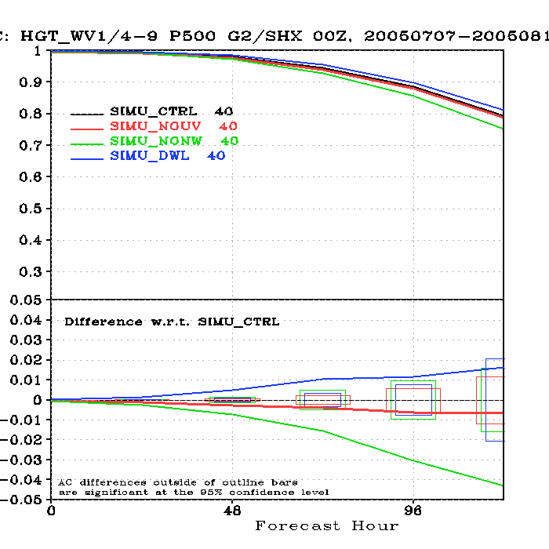
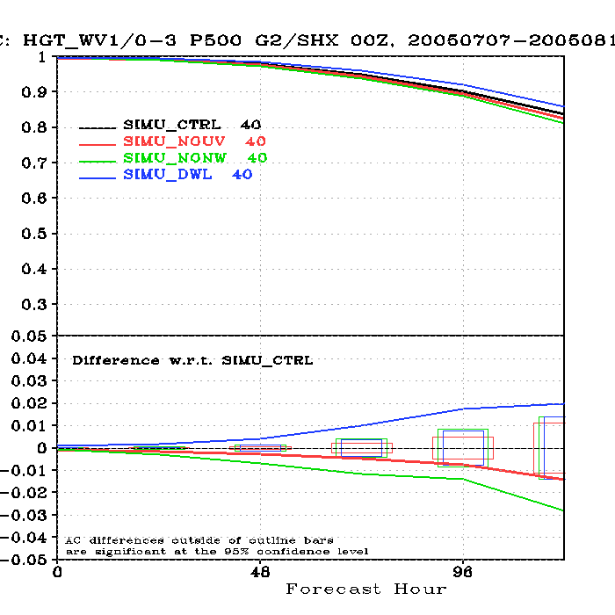
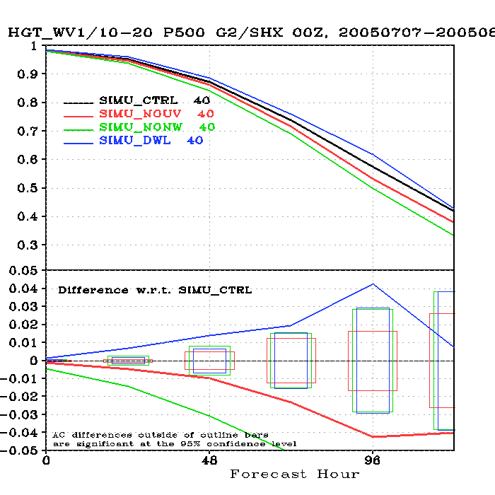
500 hPa anomaly correlation coefficients, SH
w4-9
w0-3
w10-20

Slide 5
Should the LWG (or anyone else) be pleased with a one-point improvement?
(Experiments still run at low resolution, so there is hope that results will improve)
However, before attempting to answer this, one may want to consider:
  Economic value of weather forecasting
  General rate of progress in NWP
  Implications for other measures of skill
  Impact of other observing systems

Slide 6
I. Economic value of weather forecasting
Department of Commerce: “20% of overall US economy is weather sensitive”: ~$3 trillion/year
  Impact to air and surface transportation, agriculture, construction, energy production and distribution, etc.
Assume that half of this is “forecast sensitive”: $1.5 trillion/year

Slide 7
Value of weather forecasting (II)
Assume that the potential savings due to weather forecasting amount to 5% of the “forecast sensitive total”: ~$75B/year
Assume that the savings are distributed linearly over the achieved forecast range for the global NWP system:
  0 h useful forecast range => $0 in savings
  336 h useful forecast range => $75B in savings
This implies that the value to the United States economy of NWP is >200M per hour of forecast range per year !

Slide 8
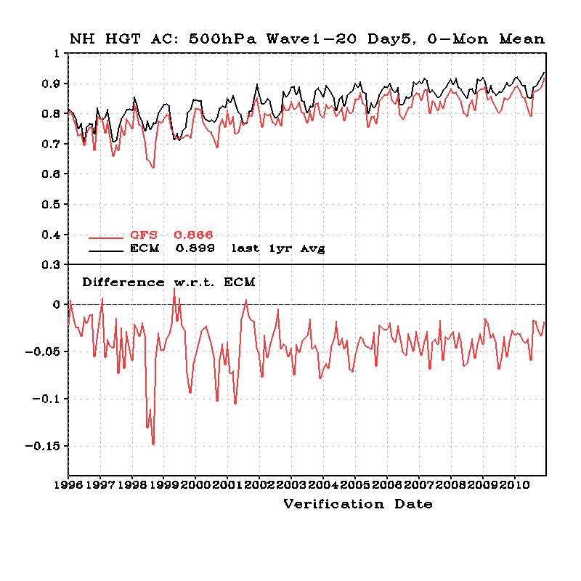
II. Overall rate of progress in NWP skill
Day-5 AC increase of 10 points over 15 years. Rate of progress is ~0.7 points/year

Slide 9
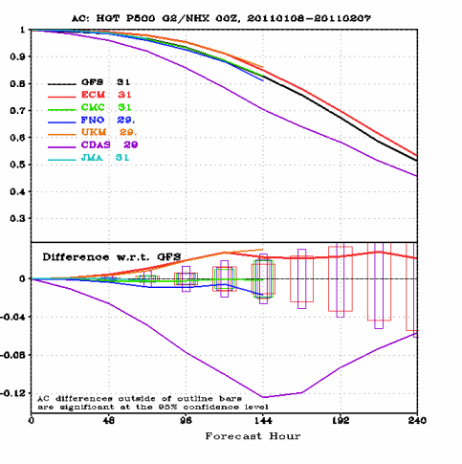
In the latter part of the useful forecast range the AC score drops by roughly 15 points over 48 hours, or ~0.3 points/hour

Slide 10
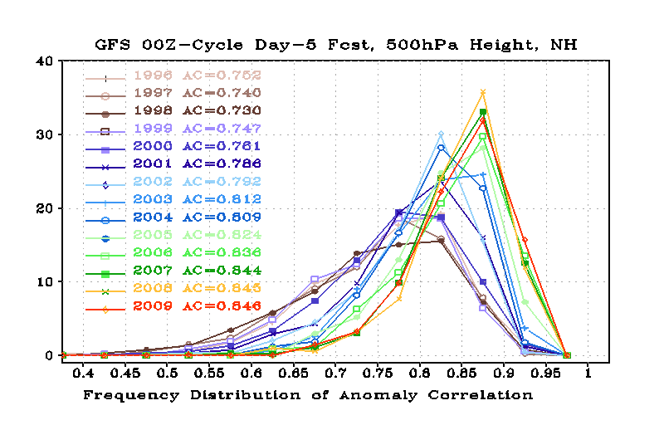
Slide from Lord and Yang, EMC
III. Impact on other measures of skill
Look at the history of extremes in the distribution
  Scores <0.7 (dropout criterion)
  Excellent forecasts (>0.9)

Slide 11
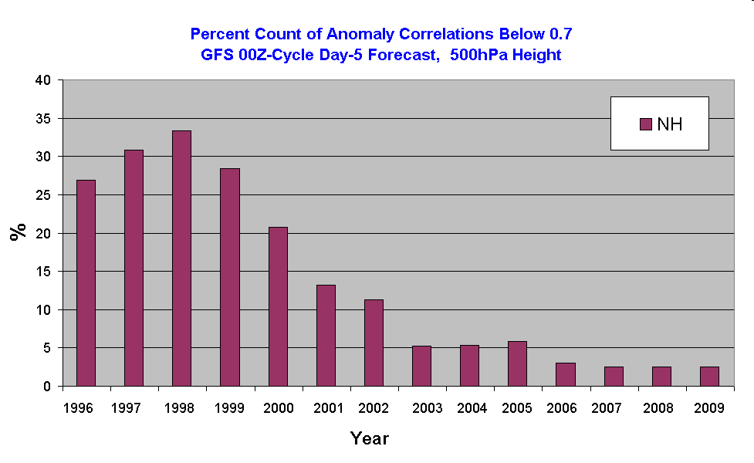
Slide from Lord and Yang, EMC
Percentage of Poor (Busted) Forecasts
1999: Mean AC score ~.75
A four-point increase was associated with cutting the frequency of bust in half!
2001: Mean AC score ~.79

Slide 12
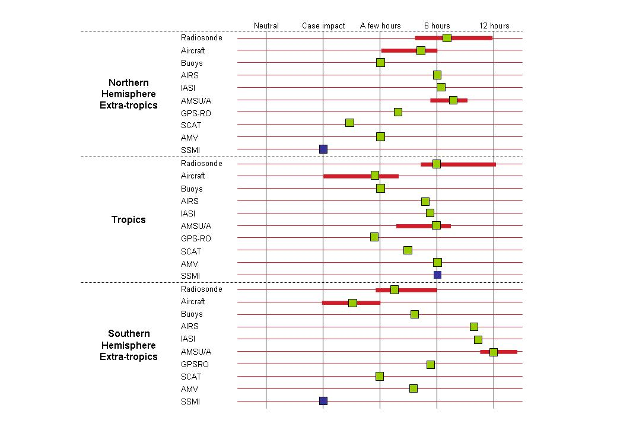
4th WMO Impact Workshop (Geneva, May 2008)
Overall impact (“marginal skill”) on short/medium range global NWP

Slide 13
“Why does each observing system contribute so relatively little?”
Marginal skill is very different from initial skill!
Several observing systems (e.g. RAOBS, AMSU, AIRS, SATWINDS, AMDAR) could probably provide the first three days of skill on their own
  (e.g. ECWMF have shown that they can run somewhat skilful 4D-VAR forecasts using surface pressure observations alone)
Extending the useful range in the presence of all the existing components of the GOS is far more difficult than providing skill in the first part of the range!

Slide 14
What is one NH point worth?
A one-point increase corresponds to the average total progress in skill over 18 months due to ALL factors (improvements in model and data assimilation algorithms, horizontal and vertical resolution, computing, and all components of the global observing system)
It represents an extension of the useful forecast range by ~3h
  This is arguably worth $600M/year to the US economy
It can have a significant impact on frequency of busts

Slide 15
Future plans
JCSDA alone
Increased horizontal resolution (T-382 and higher)
Detailed case studies
Separate assessments of the impacts of Direct Detection and Coherent Detection
Impact of one, two or four telescopes on spacecraft
Impact on applications other than NWP, e.g. chemical transport models
Impact of and methodology for observation error assignment
SWA involvement
Extend simulation into hurricane season (several Atlantic hurricanes in Nature Run “Oct 2005”)
Experiment in opposite season (NH winter/SH summer)
Other orbits, e.g. different altitude, lower inclination

Slide 16

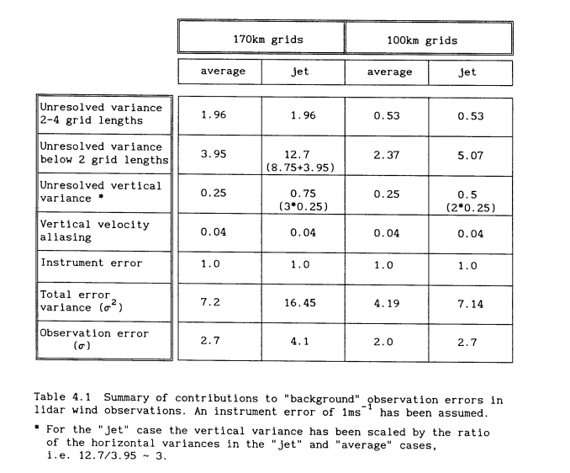
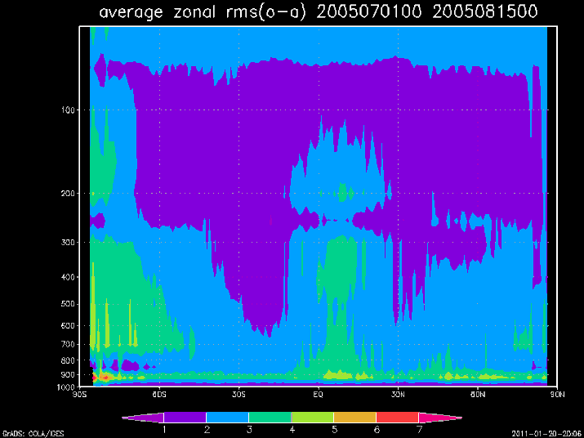
An estimate of LIDAR observation error from several points of view
Estimate of lidar observation error from theoretical arguments. See Lorenc,A.C., Graham,R.J., Dharssi,I., MacPherson,B., Ingleby,N.B., Lunnon,R.W.,1992, Preparation for the use of a Doppler wind lidar information in meteorological assimilation systems, ESA-CR(P)-3454
Practical estimates of lidar observation errors from fits to an assimilation of those data. This field represents a lower bound of the observation error, including representativeness, if the assimilation is “efficient” in filtering signal from the observations (Lorenc,1981, Hollinsworth and Lonnberg, 1985).
The test assimilation at t126 (~140km grid) would generate a theoretical
average ob error of ~ 2.4m/s, which agrees reasonably well with the estimate
of lower bounds of the error from the (o-a) field.

Slide 17
Summary and conclusions
The initial T-126 experiments using a simulated GWOS on top of the existing (2005) Global Observing System indicate the following impact:
  1-point improvement in the NH 5-day 500 hPa ACC
  2-point improvement in the SH 5-day 500 hPa ACC
The SH and tropical impacts are very good
Even the NH impact would be very significant if it were to hold up in future tests (and yes, we should be pleased about it!)
Results from additional studies and higher resolution experiments eagerly anticipated

