Slide 1
Updates on Single Frequency 2 µm Laser Sources
Timothy Shuman
Laser Scientist
Fibertek, Inc.
Program Manager: Floyd Hovis

Slide 2
Acknowledgements
FIBERTEK
NASA LANGLEY RESEARCH CENTER
Kevin Andes
Ti Chuang
Joel Edelman
Joe Rudd
Tom Schum
Jirong Yu
Mulugeta Petros
Upendra Singh

Slide 3
Outline
Motivation for 2 µm laser sources
2 µm Risk Reduction Laser Transmitter (RRLT)
Program overview
Key design features
Latest results
2 µm single frequency CW seed laser overview
Summary

Slide 4
Motivation
Airborne and space-based wind measurements are needed:
Critical to improving global weather forecasting and weather hazard warnings
Important to climate change research
2 µm sources are used in the coherent channel of hybrid wind systems
Determined the optimum system to perform these measurements
Requires not only hardened high energy pulsed lasers but also hardened CW lasers to seed them for single frequency operation

Slide 5
2 µm Risk reduction laser transmitter (rrlt) for airborne & space-based doppler wind lidar

Slide 6
Program Background
NASA, NOAA and the DoD all have been pursuing global wind measurements since the 1970s
A hybrid system utilizing coherent and direct detection is optimum
The coherent channel needs a high energy pulsed 2 µm laser source
NASA LaRC successfully advanced 2 µm laser technology from 20 mJ to 1.2 J per pulse by Dec. 2005 via internal funding
Purpose of this program to build a risk reduction laser incorporating all of LaRC’s lessons learned in an engineered “space-like” breadboard (TRL 6)
Understand laser behavior
Demonstrate the shot lifetime needed for space
Meet the performance required for a hybrid wind LIDAR system
Phase 3 SBIR cost sharing program with funding split between NASA LaRC and Fibertek

Slide 7
Performance Targets
Parameter | Value
Pulse Energy | >250 mJ
Repetition Rate | 10 Hz
Pulsewidth | >200 ns
Linewidth | Single frequency
Beam Quality | M² < 1.2
Diode Current | 30% derating from maximum operating current
Cooling | Conduction cooled gain modules
Volume | <0.075 m³
Weight | <30 kg

Slide 8
Design Features
Tm,Ho gain medium
2 µm emission without nonlinear conversion
Compatible with diode pumping with an absorption peak near 792 nm
Optimum performance at low temperatures
Observed 2X gain in energy at -26°C
MOPA configuration using 3 side-pumped gain modules
Oscillator and 2 amplifiers
5 sided pumping
3 m cavity using a multi-fold telescopic resonator
Acousto-optic Q-switch
Injection seeded with a commercially available single frequency source (Lockheed Martin Coherent Technologies Meteor)
The cavity length is dithered via a PZT
Electronics fire the Q-switch when a cavity resonance is detected

Slide 9
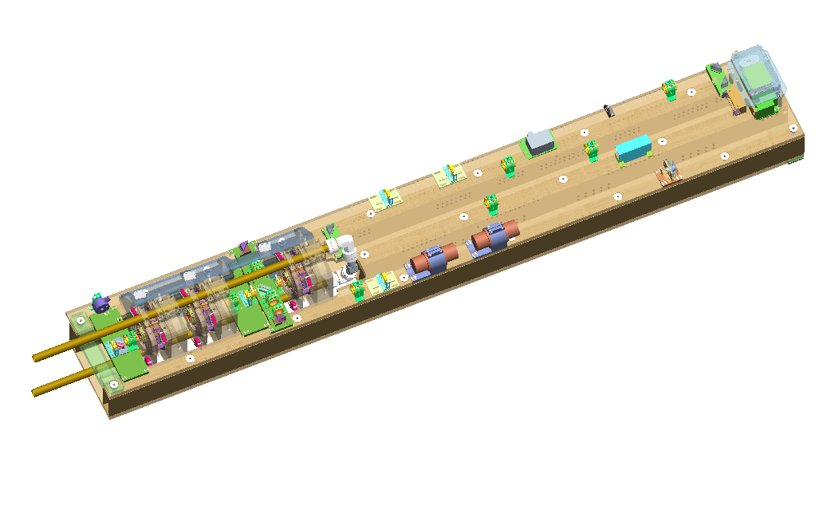
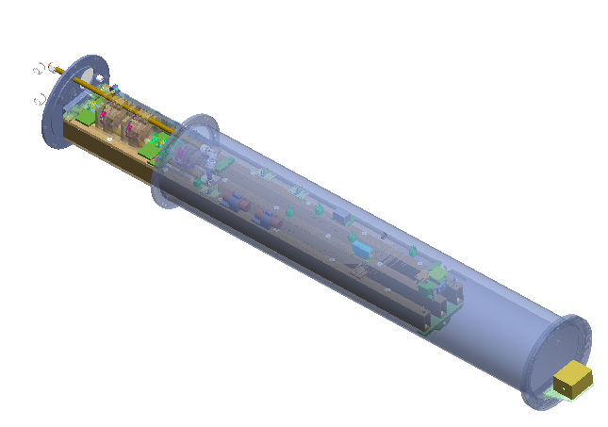
Laser Concept
Laser path
(solid) – 3 m
Round trip
PZT
Oscillator
Amplifiers
Seed path
(dashed)
Source not shown
Isolators
Laser bench
Installed inside
cylindrical housing
Coolant lines
or heat pipes
Bench and housing designed for
maximum mechanical strength
and stability

Slide 10
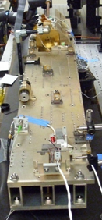

Laser Bench – Oscillator Configuration
Bench Dimensions: 45.5” L x 6.45” W x 2.75” H
Volume = 0.13 m³
Oscillator
Q-Switch
PZT
Seed fold
mirror
Isolator
Seed laser
fiber output
Alignments performed
with lockable Risley prisms

Slide 11
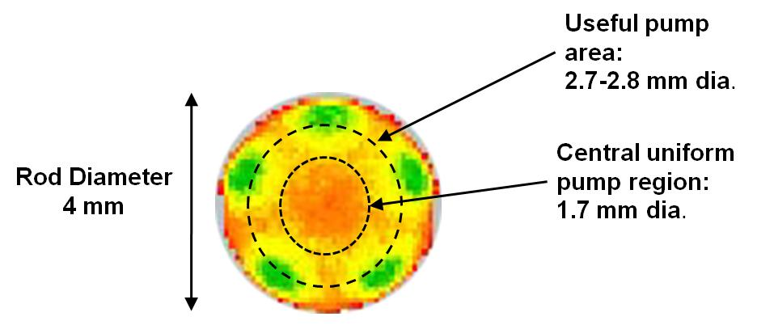
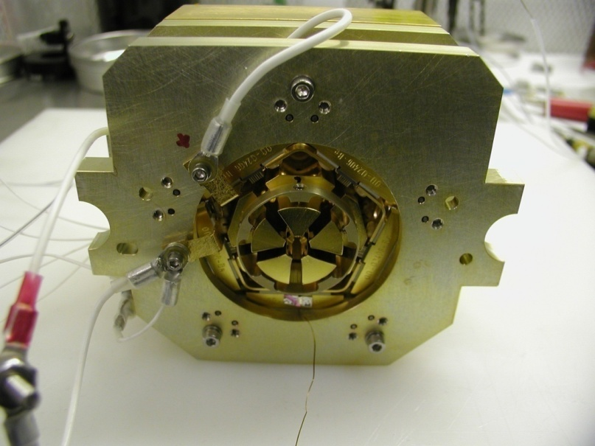
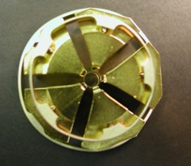
Pump Module Design
Rod held
By 5 heat sinks
Diode light
Coupled into rod
Between heat sinks
Assembled Oscillator
Pump Module

Slide 12
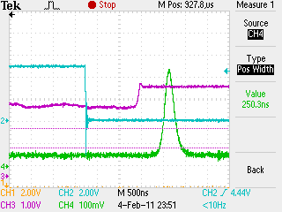
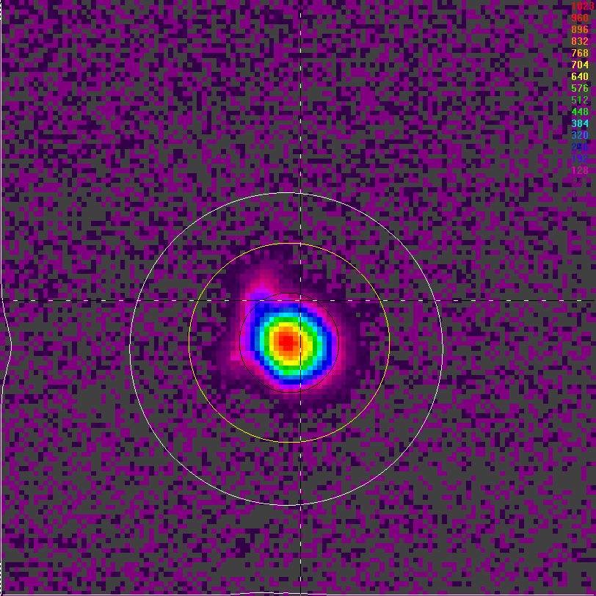
Optimum Performance to Date 1 Hz, 750 µs, 79 A, 5°C
1.9 µs build-up time
250 ns pulsewidth
Single Frequency
37” from OC
 | Pulse Energy (100 pulse avg.)
Long Pulse | 97 mJ
Q-Switched | 47.5 mJ
49% Q-switching Efficiency

Slide 13
Additional Performance Notes
<3% RMS energy stability
~30% derating from peak current
5°C operating temperature
Single frequency determination made from clean profile recorded using a 500 MHz detector and 200 MHz oscilloscope
Longitudinal mode spacing ~50 MHz

Slide 14
SINGLE Frequency LASERS for space based wind & aerosol lidar

Slide 15
Program Background
Phase 2 NASA SBIR
Two separate CW laser builds:
Multiwavelength seed laser (1064, 532, 355 nm) frequency locked to an iodine cell (using the 532 nm output) to provide a multiwavelength single frequency source
Delivering hardened brassboard laser with a frequency locking module
2 µm seed laser
Delivering proof of concept hardened breadboard
No frequency control required for this program

Slide 16
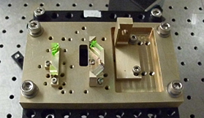
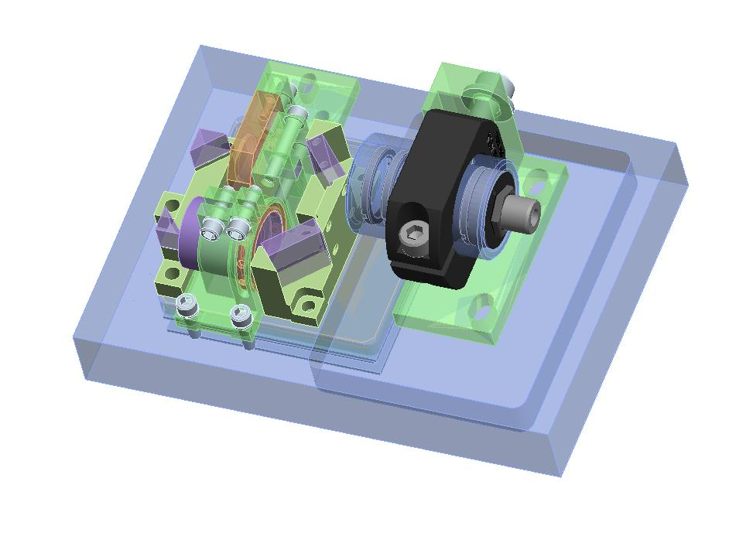
2 Micron Seed Laser
Compact Tm,Ho ring laser
Diode pumped
Designed for PZT cavity dithering, as applied on RRLT
Using ruggedized package concepts
Scheduled for completion in June 2011

Slide 17
Summary
Fibertek is advancing the state of the art for multiple classes of 2 micron sources
First, hardened high pulse energy single frequency sources are under development to enable space-based wind measurements using coherent detection techniques
Second, CW lasers suitable for seeding the above high energy pulsed sources are under development
Will allow Fibertek to provide a complete single frequency 2 micron source compatible with airborne and space-based applications

Slide 18
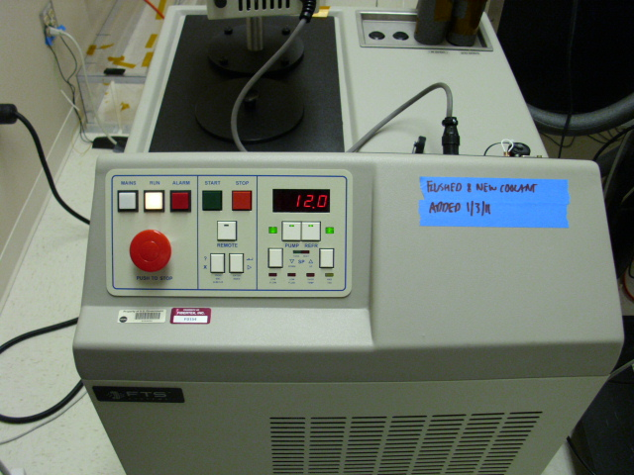
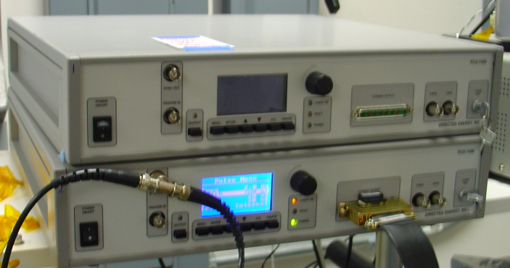
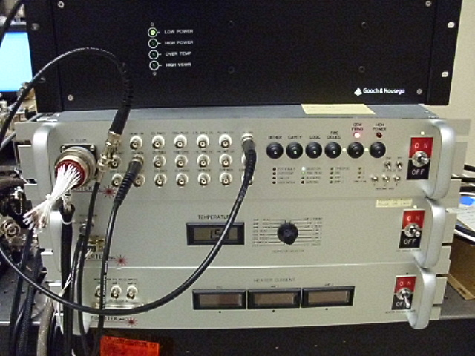
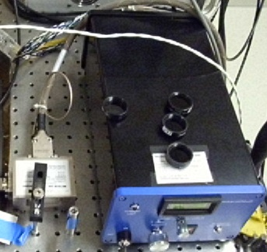
Support Equipment
Directed Energy Diode Drivers
FTS Low Temperature Chiller
(On Loan from NASA)
Amplifier (1 of 2)
Oscillator
NEOS Q-Switch Driver
Meteor Seed Laser
Control & Monitoring
Electronics
Laser Head
Controller

Slide 19
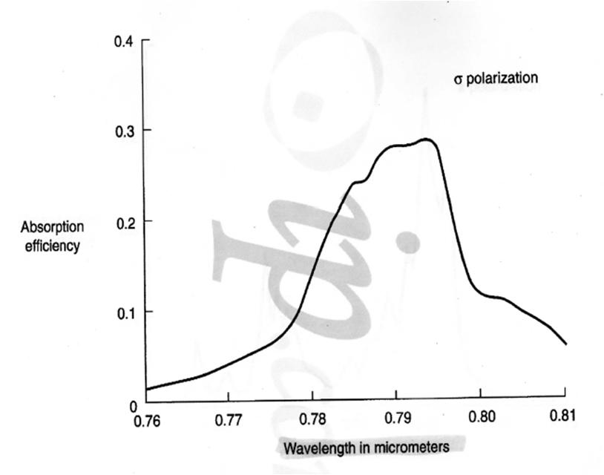
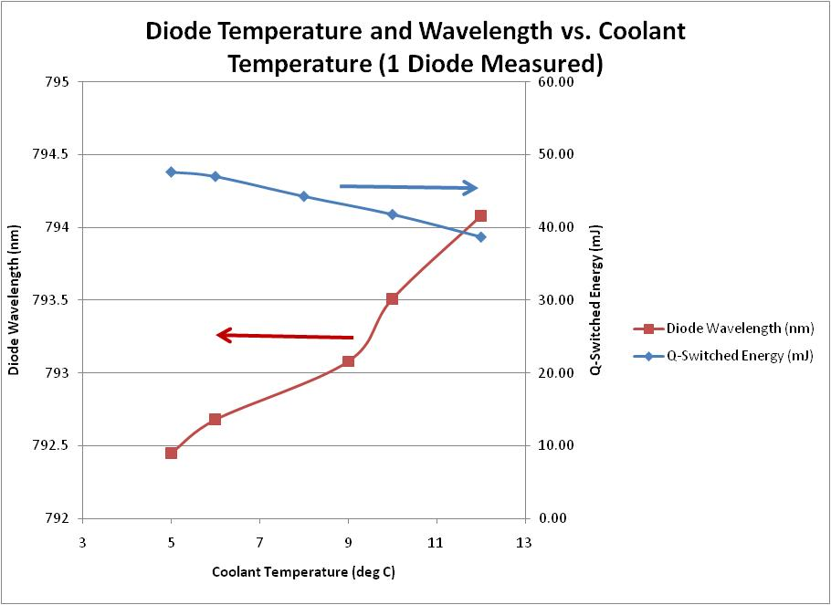
Energy & Diode Wavelength vs. Temperature
Diodes sitting on
absorption peak
NOTE: The diode temperature measured is its mounting
plate and not the diode submount (isolation required).
Actual temperatures may be higher than these
measurements and the increased energies due to
walking the wavelength onto the peak.

Slide 20
Next Steps
Quantify the alignment sensitivity of the current cavity configuration
Quantitatively measure the laser linewidth
Install thermistors on a selection of diodes to track their temperature
Combine with OSA measurements to allow prediction of diode wavelength at any operating temperature
Install a dry box on the laser to allow operation at lower temperatures without the risk of condensation
Begin construction of the amplifier modules

