Slide 1
DATA ASSIMILATION FOR HURRICANE PREDICTION Experimental system and results of semi-operational implementation during the 2010 Atlantic Hurricane Season
Tomislava Vukicevic¹ ,
Altuğ Aksoy^{1,2}, Kathryn Sellwood^{1,2} , Sim Aberson¹, Sylvie Lorsolo^{1,2}, XueJin Zhang^{1,2} and Frank Marks¹
¹NOAA/AOML Hurricane Research Division
²U. Miami/RSMAS Cooperative Institute for Marine & Atmospheric Studies
³Science Applications International Corporation

Slide 2
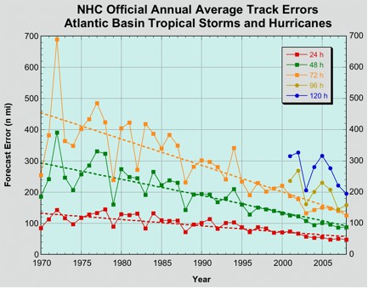
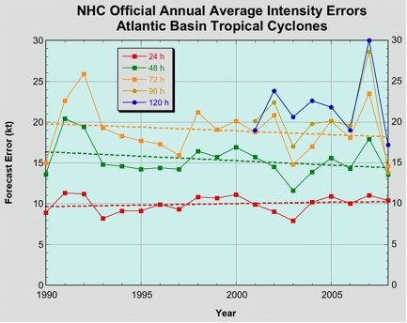
Motivation and Objective
There have been few advances in hurricane intensity
prediction in the past 20 years.
NOAA’s Hurricane Forecast Improvement Program (HFIP) goal is to reduce hurricane intensity and track forecasts by 20% by 2016 and 50% by 2021
High quality in-situ, vortex scale observations are obtained during NOAA, HRD’s annual hurricane field program
Currently no inner-core data is assimilated in operational forecast models
In HRD/AOML research is conducted on assimilation of airborne and other observations into HWRFx model to reduce forecast errors due to poor representation of the initial conditions on vortex scales
*Figure from www.nhc.noaa.gov

Slide 3
Data Assimilation technique Ensemble Kalman Filter (EnKF)
Data assimilation combines model background with observations to obtain a best estimate of atmospheric conditions to initialize a model run
An ensemble of short-range forecasts provides the flow-dependent background covariance information
For the assimilation of obs, use covariances
sampled from the ensemble of forecasts
Subsequent forecast cycle is
initialized from the previous
analysis ensemble
Instead of a single state that represents the initial state of the atmosphere …
Analysis uncertainty becomes the initial
condition uncertainty for the new forecast cycle
… Start with an ensemble of states (ensemble members)
that better represent the
initial uncertainty about the
“mean” state
EnKF
Observations
t = t₀
t = t₀+Δt
t = t₀+2Δt

Slide 4
HRD’s experimental Hurricane Ensemble Data Assimilation System (HEDAS)
Forecast model:
HRD’s Experimental HWRF (HWRF-X)
2 nested domains (9/3 km horizontal resolution, 42 vert. levels)
Static inner nest to accommodate covariance computations
➔ Inner nest size: ~10x10 degrees
Explicit microphysics on inner nest
Data assimilation:
Square-root ensemble Kalman filter, EnKF (Whitaker and Hamill 2002) with covariance localization (Gaspari and Cohn 1999)
Assimilates inner-core aircraft data on the inner nest
➔ NOAA P-3, NOAA G-IV, USAF, PREDICT G-V
Ensemble system:
Initialized from semi-operational GFS-EnKF (NOAA/ESRL) ensemble
30 ensemble members

Slide 5

2010 HEDAS Semi-Real-Time Runs for HFIP: DA Cycling Workflow
Only ran when Doppler radar wind data was available from NOAA P-3 flights (➔ 19 cases)
Used 1452 processors on NOAA’s tJet cluster (supported by HFIP)
T – 6 h
T
T + 126 h
Ensemble
Spin-up
DA Cycling
with EnKF
Deterministic HWRF-X Forecast from Ens. Mean
1-hour Cycles
Ensemble
Initialization from T-6h GFS-EnKF
Real-Time
Observation
Pre-Processing
Mean of Final Analysis Assumed Valid for T

Slide 6


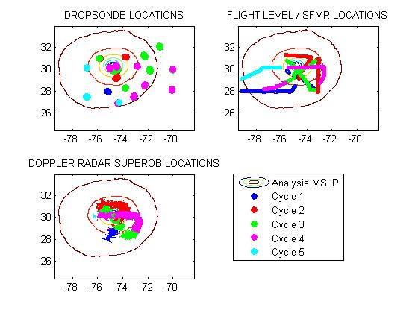
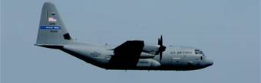
Observations
2 NOAA Orion P-3
Dropsonde + Flight level
+ Tail Doppler Radar
1 NOAA Gulfstream G-IV
Dropsonde
Data types
flight level: wind temperature and humidity + SFMR surface wind
GPS dropwindsonde: wind, temperature, humidity and pressure
Tail Doppler Radar: radial winds.
Approximate vertical location
Orion P3: ~ 3 km
G-IV : 1300 - 1400 km and
U.S. A.F. C-130’s: 10km maximum with a minimum 2000ft. vertical separation from the P3’s
Observation distribution
(9/02/2010 02Z analysis)
U.S.A.F WC-130J
Flight level + Dropsonde

Slide 7
2010 HEDAS Semi-Real-Time Runs for HFIP: Summary of Cases
A total of 19 cases were run (when NOAA P-3’s collected Doppler radar data)
Number of Observations Assimilated per Cycle
Number of Observations
Number of Cycles

Slide 8
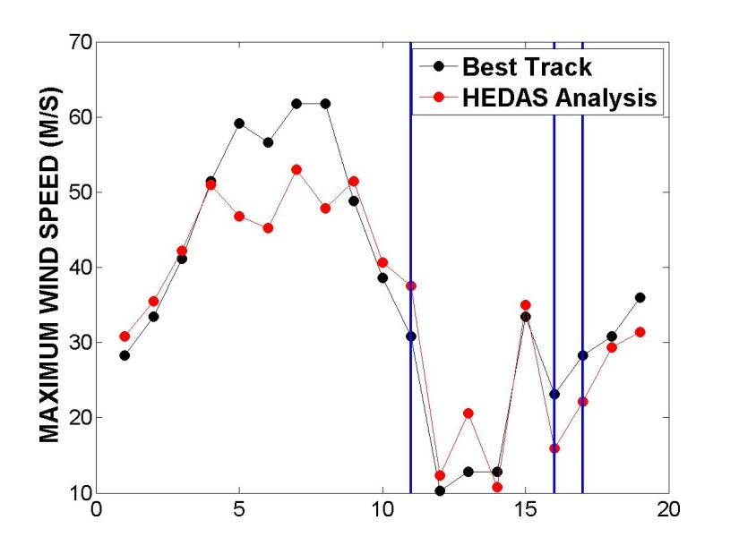
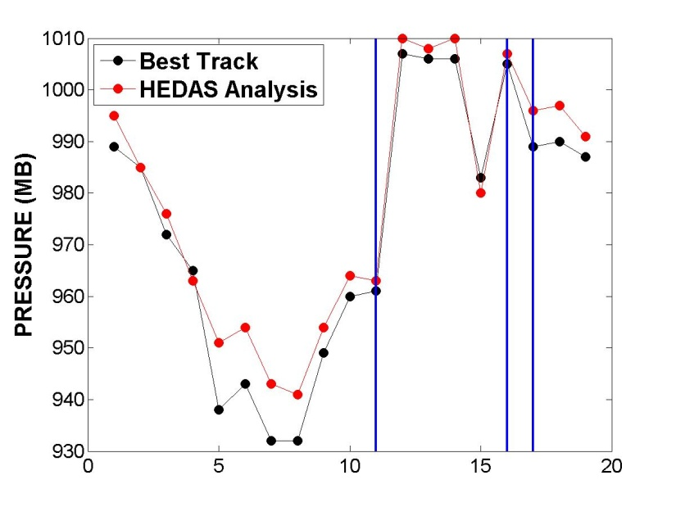
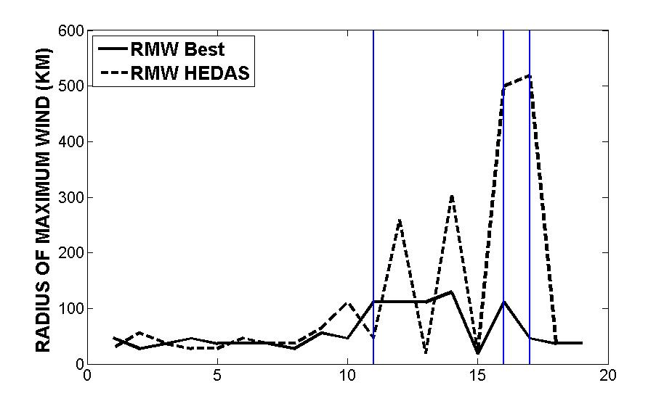
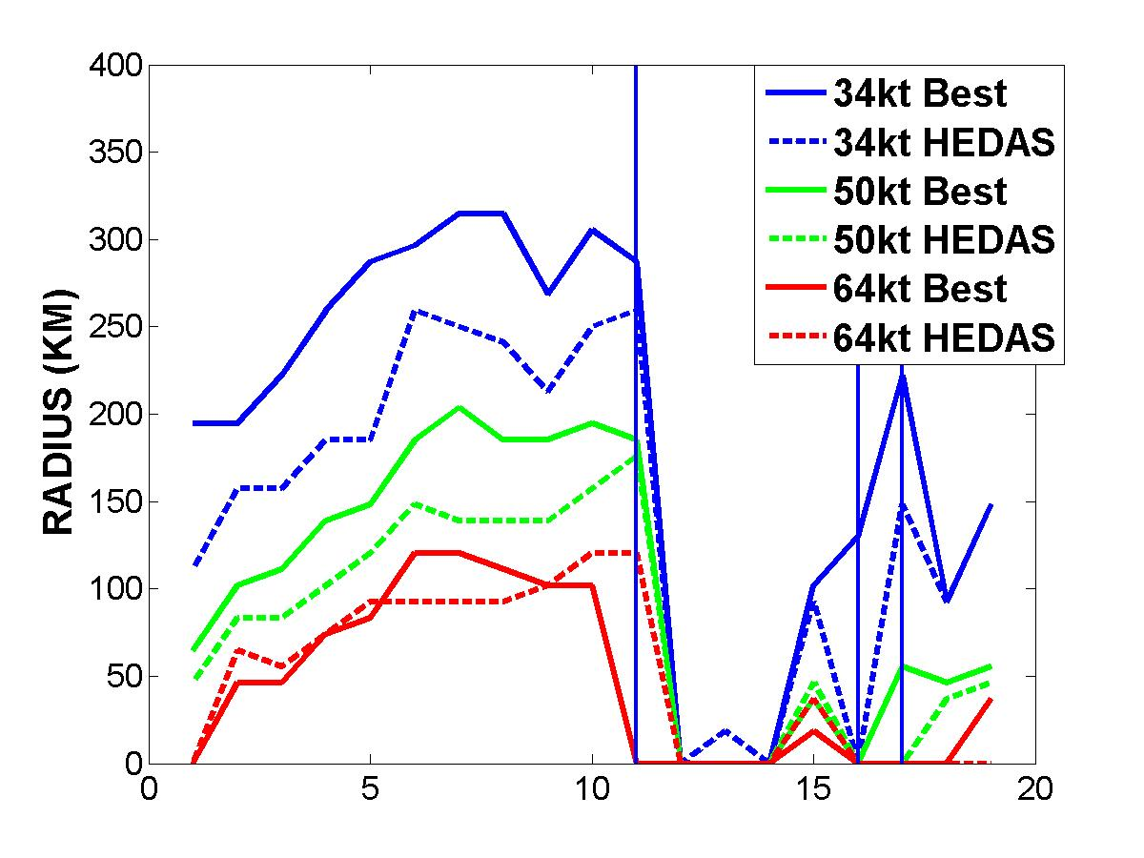
Storm size and Intensity in HEDAS Analyses
Earl
Karl
Richard
Tomas
Weak System

Slide 9
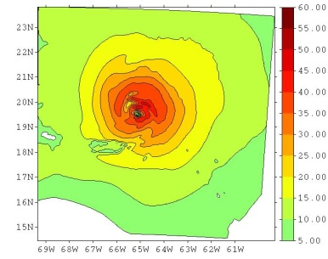
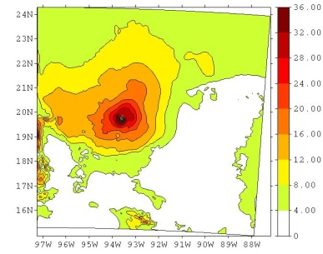
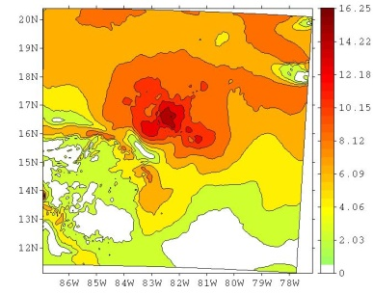
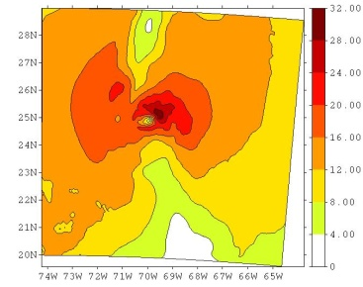
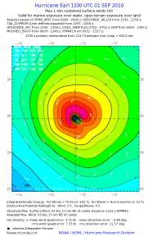
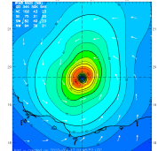
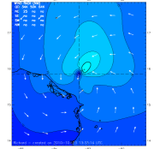
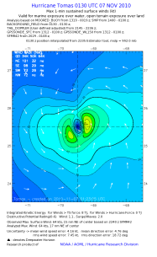
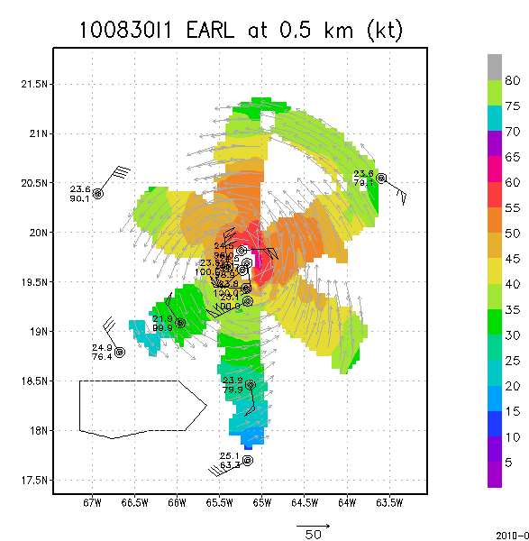
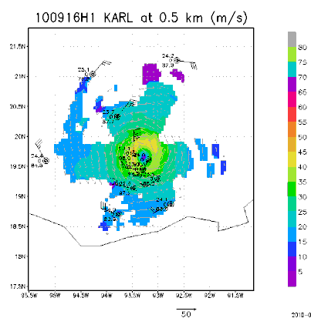
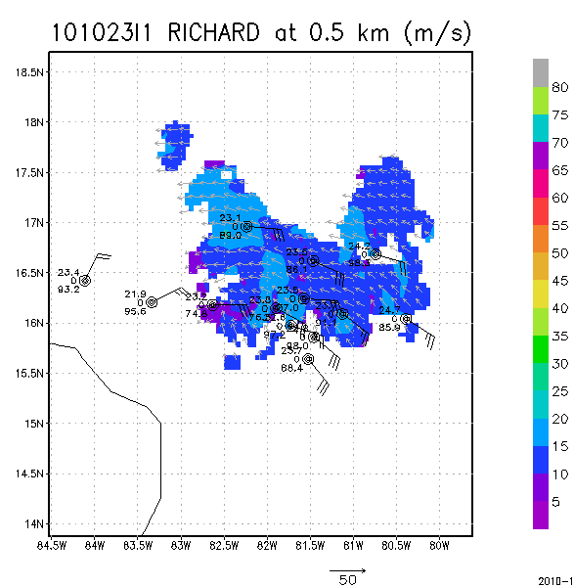
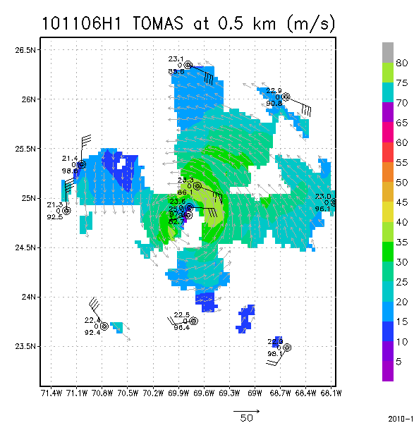
EARL KARL RICHARD TOMAS
Aug. 31 00Z Sep. 17 00Z Oct. 23 06Z Nov. 7 00Z
(11 cases) (4 cases) (1 case) (3 cases)
HEDAS
Analysis
H*Wind
Analysis
Radar
Dropsonde
Composite
MaxV = 46.7 m/s MaxV = 35.2 m/s MaxV = 16.2 m/s MaxV = 31.2 m/s
Max V = 58.1 m/s MaxV = 42.2 m/s MaxV = 19.5 m/s MaxV = 32.9 m/s
H*WIND (Powell et al. 1996) is an objective analysis of the wind speed distribution in hurricanes from a variety of observational platforms

Slide 10
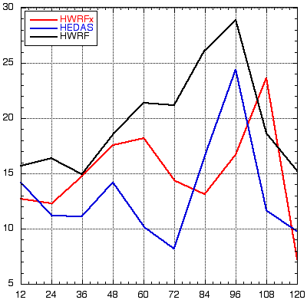
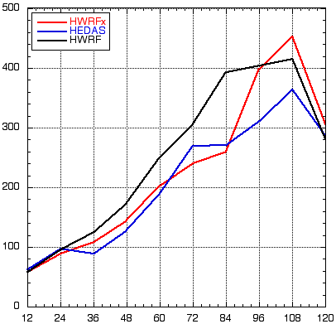
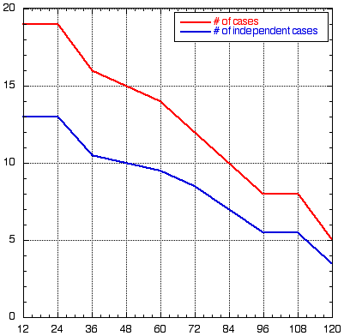
Overall Forecast Performance in 2010 from HEDAS Analyses
Intensity Error (kt)
Track Error (km)
Number of Cases
HEDAS (in blue) performs better in intensity and comparably in track (to HWRF and HWRFx)

Slide 11
Summary of HEDAS Performance during year 1, 2010:
Improved 3D atmospheric mesoscle state analysis, consistent with independent 3D Doppler radar wind and operational hurricane surface wind analyses and the airborne observations of temperature, humidity and wind at vortex scale
Initial conditions from HEDAS mean analysis in average produced better intensity forecasts at lead times longer than 18 hours compared to the operational HWRF forecasts and semi-operational HWRFx forecasts but with the operational initial condition
The analyzed maximum surface wind was underestimated in HEDAS’ analysis during periods with strong and intensifying hurricane (the cases of hurricane Earl while category 3 and 4)
Similar to the results with other regional hurricane forecast systems, the short-term intensity forecast errors were large in average
Notes:
The analyzed maximum surface wind was significantly underestimated in HEDAS analysis during periods with strong and intensifying hurricane (the cases of hurricane Earl while category 3 and 4)

Slide 12
Challenges to overcome Modeling uncertainties and limitations in observations
Diagnostic analysis of cases with largest intensity errors in the HEDAS analysis indicates that the forecast model deficiencies in PBL parameterization together with insufficient amount of observations in the PBL are likely cause of the errors
Including the model error representation in HEDAS and additional observations are needed to further improve the analysis
Notes:
The analyzed maximum surface wind was significantly underestimated in HEDAS analysis during periods with strong and intensifying hurricane (the cases of hurricane Earl while category 3 and 4)

