Slide 1
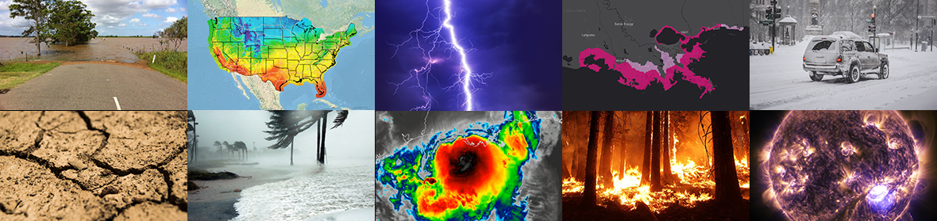
Current use and plans for assimilation of
wind data in NWP at NCEP
Andrew Collard¹, Brett Hoover², Iliana Genkova², Emily Liu¹
Workshop on Space-based 3D Winds, 19-20 February 2025
¹NOAA/NCEP/EMC ²Lynker@NOAA/NCEP/EMC

Slide 2
Outline
Overview of modelling system
Data assimilated in the current system
  Most recent upgrade Nov 2023
Potential new data sources
New assimilation techniques

Slide 3
Outline
Overview of modelling system
Data assimilated in the current system
  Most recent upgrade Nov 2023
Potential new data sources
New assimilation techniques

Slide 4
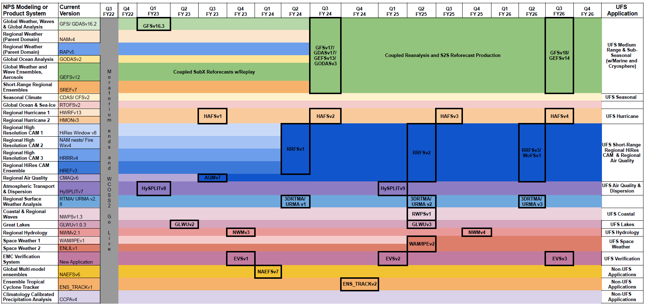
Notional Timeline for NCEP Modeling Suite

Slide 5
Overview of NCEP Global Data Assimilation
Year | 1991 | 1995 | 1998 | 2007 | 2012 | 2014 | 2015 | 2016 | 2017 - 2018 | 2019 - 2020 | 2021 | 2022
Analysis | Spectral Statistical Interpolation |  |  | Gridpoint Statistical Interpolation (GSI)
Algorithm | 3DVar |  |  |  | Hybrid, 3DEnVar T574/T254 L64 EnSRF, 80 ensembles |  |  | Hybrid, 4DEnVar T574/T574 (39 km) L64 EnSRF, 80 ensembles |  | Hybrid, 4DEnVar T766/T766 (25 km) L64 EnSRF, 80 ensembles | Hybrid, 4DEnVar T766/T766 (25 km) L127 LETKF, 80 ensembles
 |  |  |  |  |  |  |  |  | Near Sea Surface Temperature (NSST) Analysis - 3DVar for foundation temperature since 2017
Balance |  |  |  | Tangent-linear Normal Model Constraint (TLNMC)
Satellite Data | NESDIS Retrievals | Direct Radiance Assimilation Clear-sky Radiance Assimilation |  |  |  |  |  | Direct Radiance Assimilation Correlated obs error for Hyperspectral IR sensors (2021) All-sky Framework for MW sensors All-sky Assimilation for AMSU-A (2016) and ATMS (2019) Non-precipitating cloud affected radiances are assimilated Cloudy scenes are assumed to be overcast |  |  |  | Direct Radiance Assimilation Correlated obs error for Hyperspectral IR All-sky Framework for ATMS/AMSU-A Precipitation-affected data assimilated Fractional cloud coverage accounted for Consistent use of cloud microphysics assumptions between model and DA
Obs Operator |  | Community Radiative Transfer Model (CRTM) |  | CRTM Scattering Solver Advanced Doubling & Adding Method (ADA) |  |  |  | CRTM with Scattering Solver (ADA) + Simulation under Fractional Cloud Coverage (2017) Cloud Overlap (Total Cloud Cover) Two-column Radiance Calculation
Bias Correction | Offline |  | Two-step Bias correction VarBC for air-mass predictors Time-moving average of O-F for scan angle predictors |  |  | Variational Bias Correction (VarBC) for all predictors
Forecast | Spectral Model Sigma Eulerian T126 L18 (1991) L28 (1993) |  | Spectral Model Hybrid Semi-Lagrangian (2007) Zhao-Carr Microphysics(cloud water and ice) T170 (105km) L42 (1998) T574 ( 23km) L64 (2010) |  |  |  |  | Spectral Model Hybrid Semi-Lagrangian Zhao-Carr Microphysics T1534 (13km) L64, Model Top 55km |  | FV3 Dynamic Core GFDL Microphysics 5 Hydrometers T1534 (13km) L64, Model Top 55km | FV3 Dynamic Core GFDL Microphysics 5 Hydrometers T1534 (13km) L127, Model Top 80km
 |  |  |  |  |  |  | Stochastic Physics Parameterization for Ensembles since 2015: SPPT (tendency), SHUM (moisture), and SKEB (winds)
Initialization |  |  |  | Digital Filter Initialization (DFI) |  |  |  |  |  | No DFI | 4D Incremental Analysis Update (IAU)
Notes:
accomplishments, gaps, plans, challenges

Slide 6
Atmospheric Analysis Problem
The cost function used in data assimilation is:
Background
Bias Correction
Observation

Slide 7
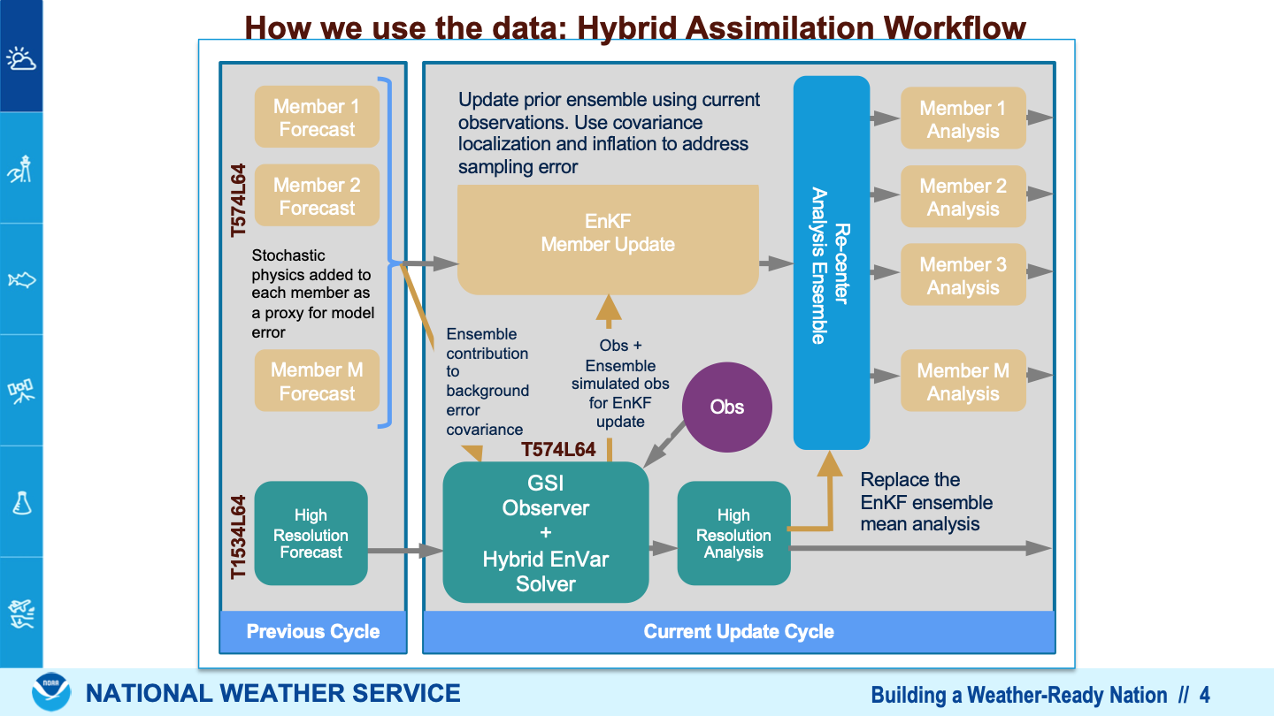

Slide 8
Outline
Overview of modelling system
Data assimilated in the current system
  Most recent upgrade Nov 2023
Potential new data sources
New assimilation techniques

Slide 9
Observations used in GFS
Radiances (*all-sky)
AMSU-A* (NOAA-15, -18, -19, Metop-B, -C)
MHS (Metop-B, -C)
ATMS* (S-NPP, NOAA-20)
SSMIS (DMSP-17)
IASI (Metop-B, -C)
CrIS (S-NPP, NOAA-20)
AVHRR (Metop-B)
ABI (GOES-16)
SEVIRI (Meteosat-8, -11)
AHI (Himawari-8)
Derived Motion Winds (DMWs, aka AMVs)
Water Vapor Clear, WV Cloudy, IR cloudy
Geostationary: GOES-16,-18, ABI, AHI
Polar (AVHRR, VIIRS, MODIS)
LEO-GEO
Scatterometer Winds
ASCAT (Metop-B,-C)
Ozone Retrievals
OMPS-NP (S-NPP), OMI (Aura)
GPSRO Bending Angles
Multiple systems including Metop GRAS and Formosat COSMIC-2. Commercial data too.
“Conventional Data”
Radiosondes
Surface obs (ocean: ships, fixed buoys, drifting buoys)
Aircraft
RED means instrument measures wind
Microwave has surface wind sensitivity via the ocean surface emissivity model
All instruments indirectly affect wind via background error cross-covariances.

Slide 10
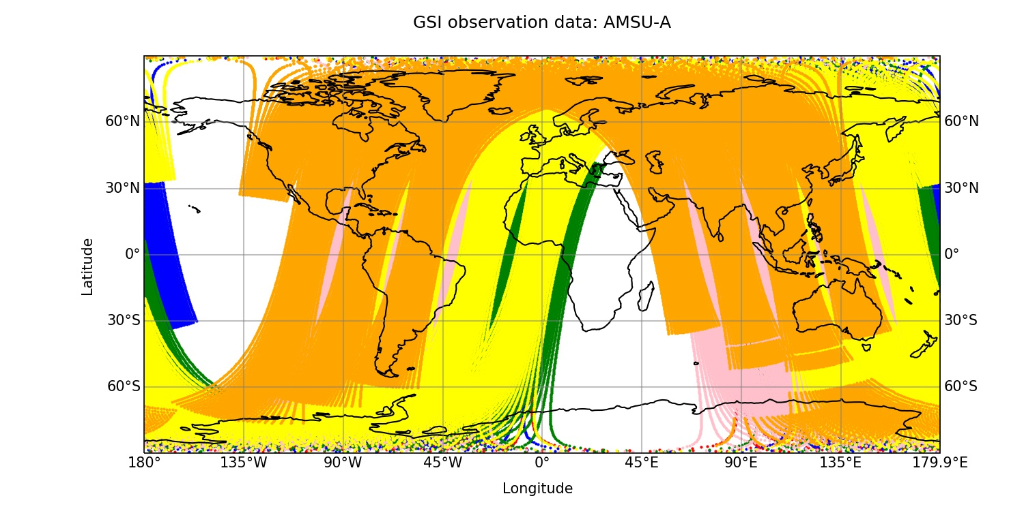
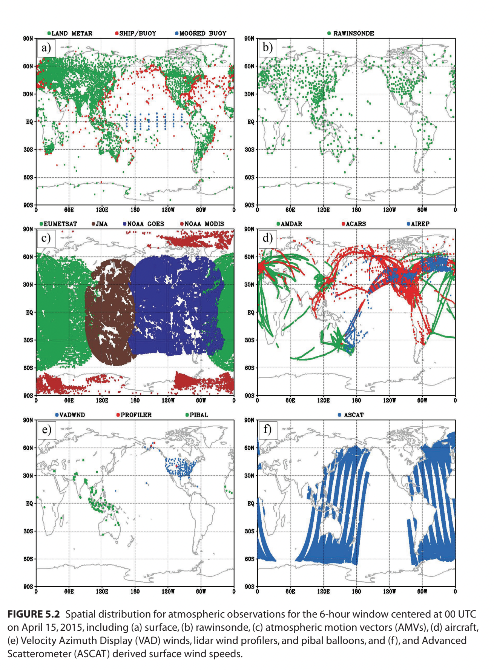
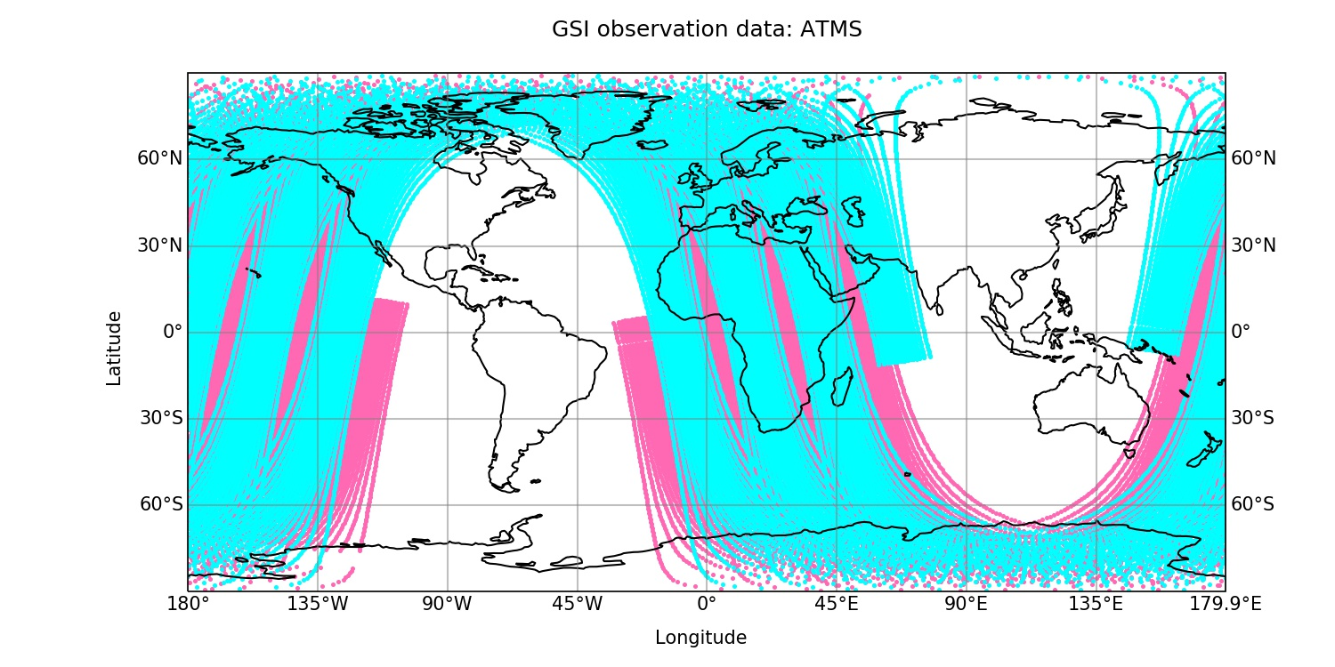
Data Coverage
AMSU-A
Surface
Upper Air
ATMS
Geostationary
Aircraft

Slide 11
Outline
Overview of modelling system
Data assimilated in the current system
  Most recent upgrade Nov 2023
Potential new data sources
New assimilation techniques

Slide 12
Satellite Winds Upgrades in Nov 2023
Atmospheric Motion Vectors (AMVs)
New Data Type
Geo-Leo winds - High-latitude winds from combined Geostationary and Polar-orbiting imagery
Existing Data Types
VIIRS AMVs - revised due to up-stream cloud algorithm change (enterprise)
AVHRR MetOp-B/C - revised due to BUFR format change and retrieval algorithm update
Advanced Scatterometer Winds (ASCAT)
Minimization issue caused by ASCAT in the operations
Revised data thinning and observation error

Slide 13
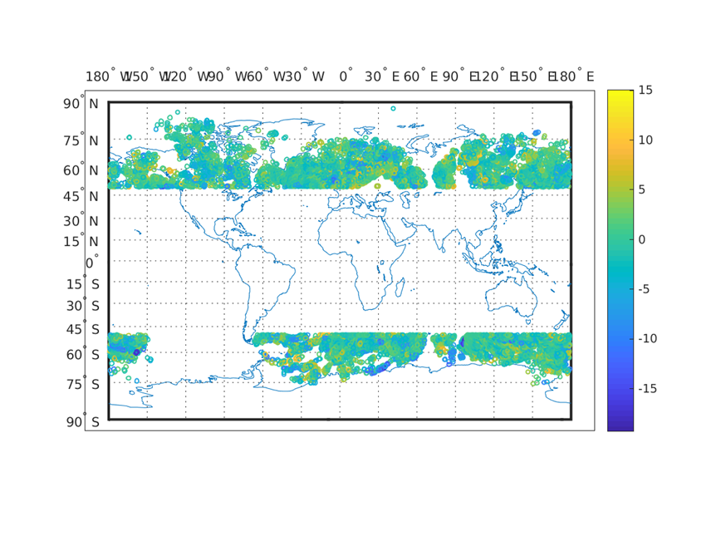

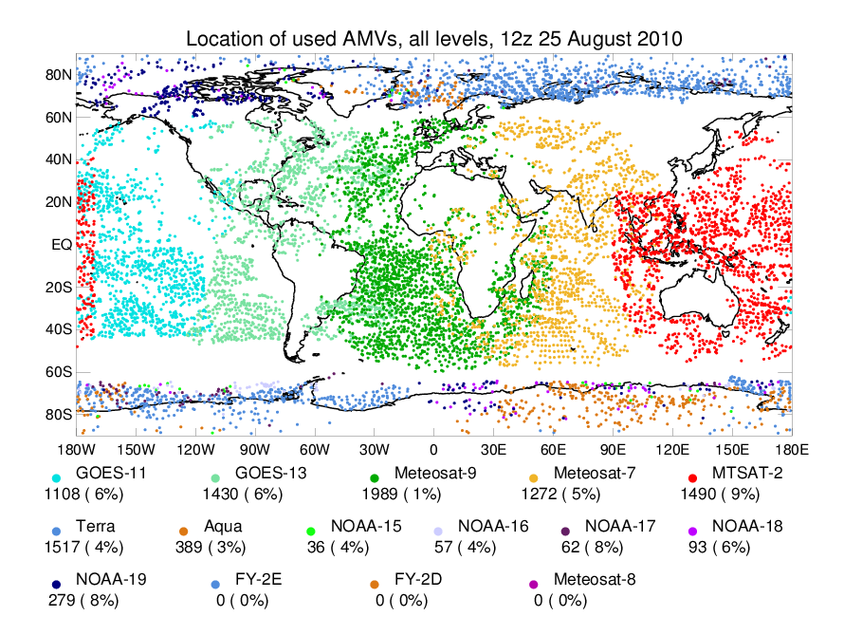
Leo-Geo Atmospheric Motion Vectors
High-latitude winds from combined geostationary and polar-orbiting satellite imagery
Fills data-gaps in AMVs coverage (10 degree band)
Add to observation sparse region near polar jet stream
Obs - Simulated Leo-Geo AMVs
Location of Used AMVs
50º
50º

Slide 14
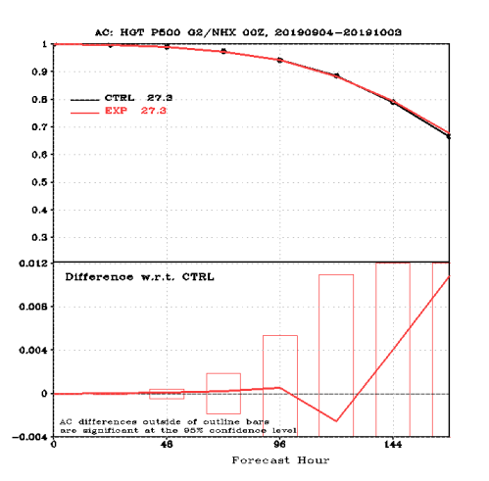
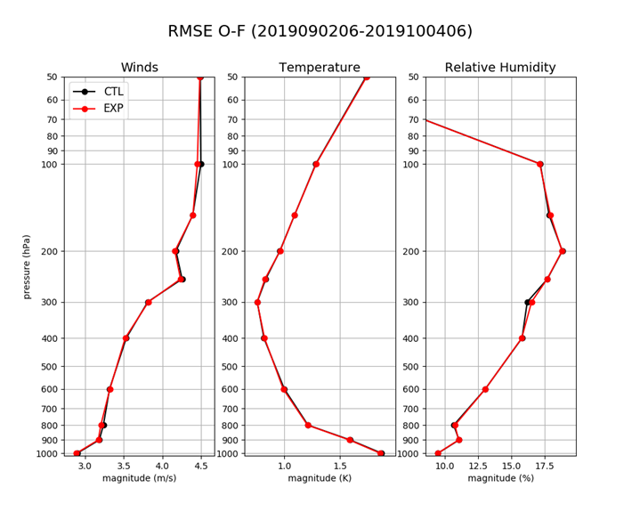
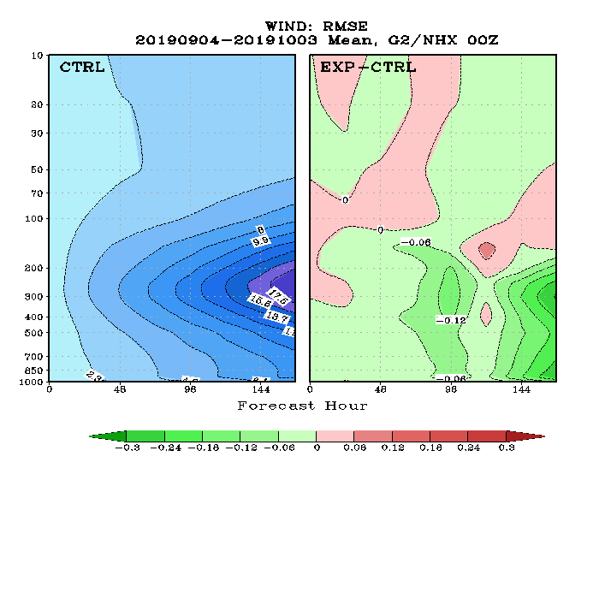
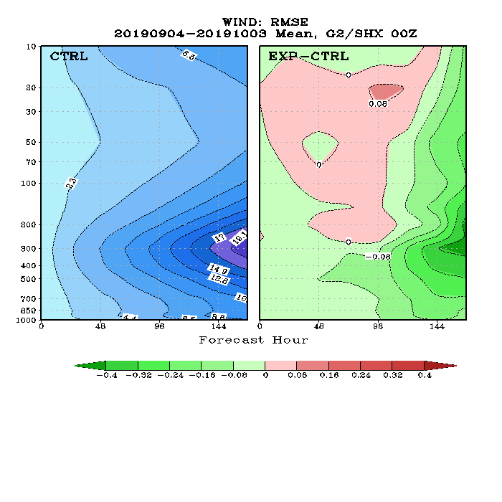
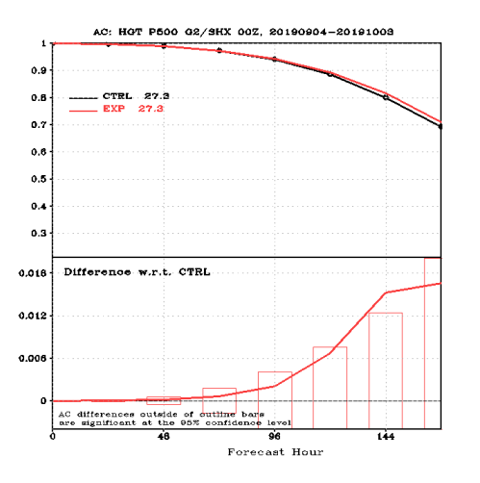
Impact of LEO-GEO AMVs
Fit to
Radiosondes
500 hPA ACC
LEO-GEO AMVs has a positive impact
on the winds in the Southern Hemisphere.
Impact is neutral in most other locations and variables.
NH
Vector Wind RMSE
NH
SH
SH
Forecast Hour
Forecast Hour

Slide 15
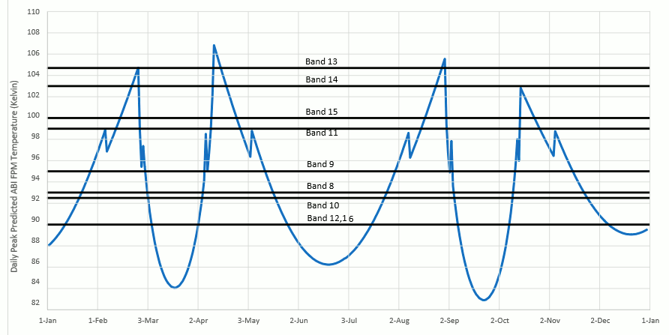
Assimilation of Revised GOES-16/17 AMVs
What’s in the Revised AMV Winds for testing
Retrieved GOES-16 and 17 AMV winds based on the new Enterprise algorithm which includes updated cloud top phase, cloud top height, and cloud mask
  LWLR : Long-wave IR AMVs (cloud-top)
  WVCT : Cloud-top WV AMVs (cloud-top)
  WVDL : Deep-layer WV AMVs (clear-air)
Mitigated GOES-17 AMVs - strategy for producing AMVs during periods when normal channels are unavailable
GOES-17 ABI has issue with its cooling system
  The loop heat pipe (LHP) subsystem, which transfers heart from the ABI electronics to the radiator, is not operating at its designed capacity
  As a result, the ABI detector can not be maintained at their intended temperatures under certain orbital conditions. This is preventing adequate cooling for some of the IR channels leading to noisy/stripy imagery
  The LHP problem has seasonal impact: before and after the vernal and autumnal equinoxes)
  Use alternative IR channels for wind retrievals
GOES-17 Predicted Daily Maximum Temperatures of the ABI Focal Plan Module (FPM)
vernal equinox
autumnal equinox

Slide 16
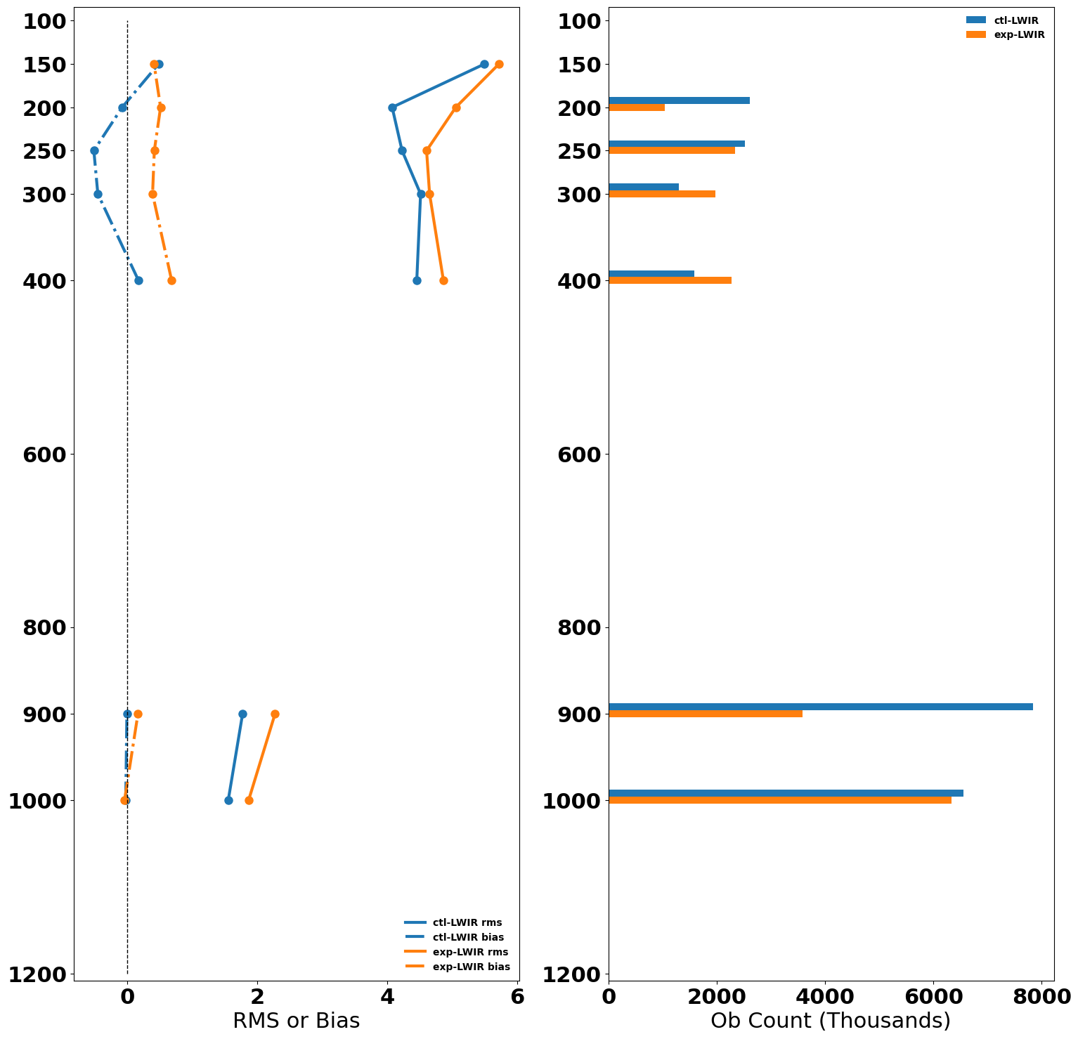
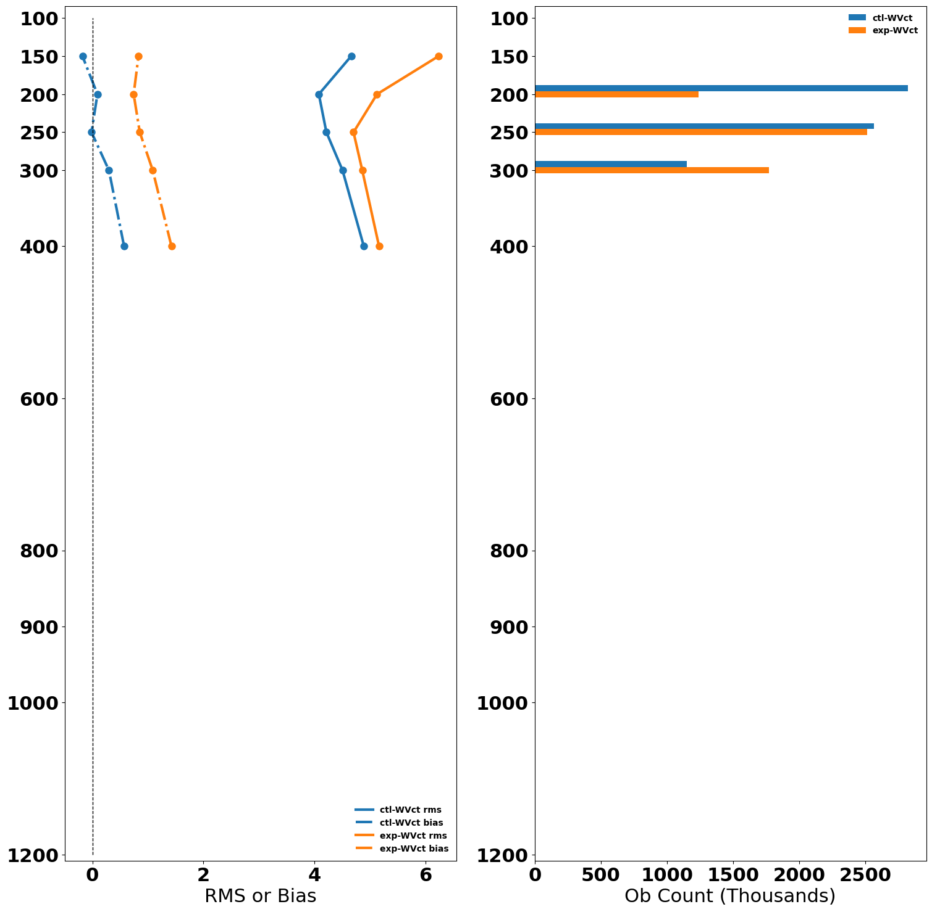
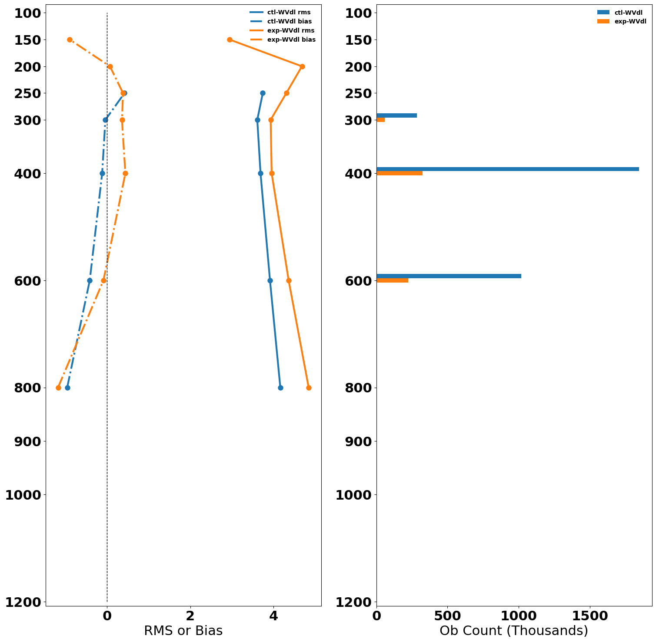
LWIR
WVCT
WVDL
BIAS
RMS
Bias
RMS
Bias
RMS
Control
Experiment
The AMVs in the Experiment have consistently higher O-B RMS than in the Control for most levels
The O-B biases, in general, are larger and more positive in most levels
Overall, There are fewer AMVs assimilated in the Experiment than the Control
The very low assimilated observation counts of WVDL winds
  Roughly 95 % of the WVDL winds are rejected in QC and ~ 92% of those rejected are due to winds failing a quality indicator (QI) check of QI >= 90
  QI value is missing entirely from the BUFR (filled with missing value)

Slide 17
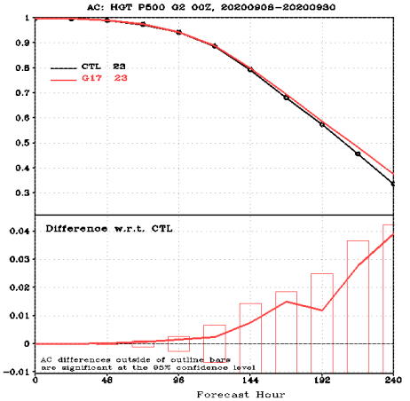
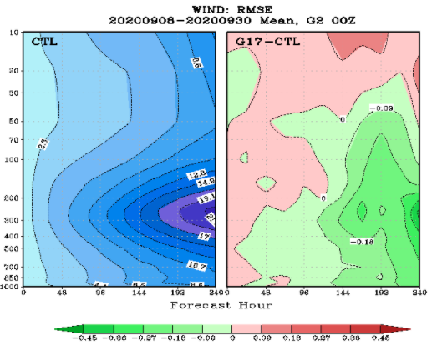
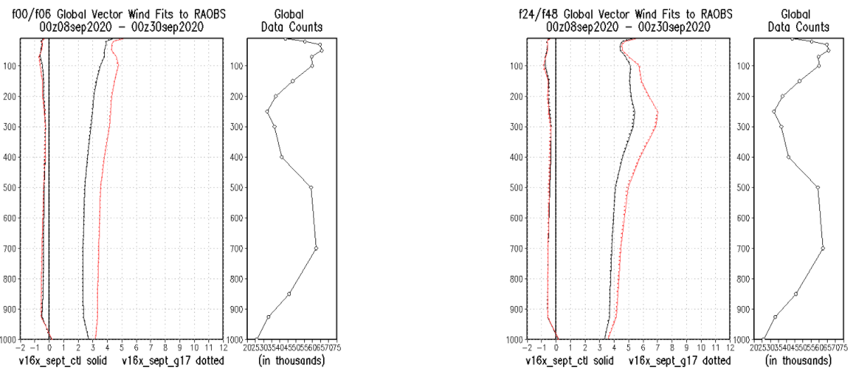
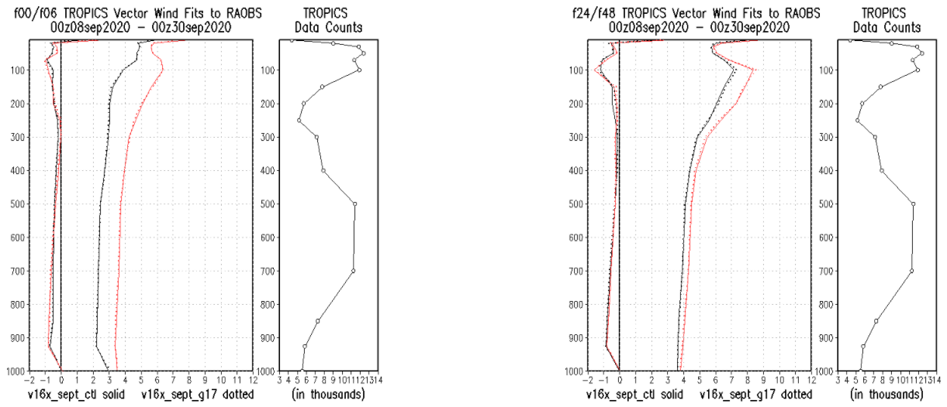
Height AC @ 500 hPa
Wind Vector RMSE
Height anomaly and Wind RMSE are largely neutral but trending positive in NH, SH, and Global
Wind fit-to-obs is neutral global
Wind fit-to obs in tropics is neutral, but some small degradation around the tropopause
20200908-20200930
RMSE Difference (EXP-CTL)
Wind Fits to RAOB (Global)
Wind Fits to RAOB (Tropics)
CTL —
EXP …
f00/f06
f24/f48
f00/f06
f24/f48

Slide 18
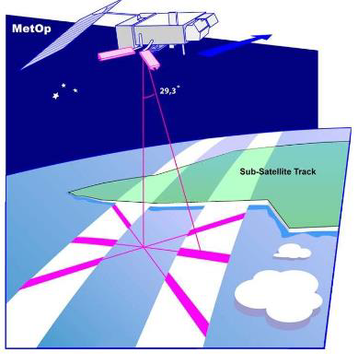
Updated Utilization of ASCAT Winds
Observation
ASCAT is a real aperture radar, operating at 5.255 GHz
It transmits MW toward the sea surface and the backscattered signals received by the instrument carry information about the surface wind speed and direction over the sea
Assimilation Configuration in Operational GDAS
Level-2 ASCAT winds with 50 km resolution from MetOp-A and MetOp-B are assimilated in operational GFS with the following configuration:
  No data thinning
  Observation Error is 1.5 m/s
  Ocean only
The EFSOI (Ensemble Forecast Sensitivity Observation Impact) diagnostics indicated that the analysis is drawing to much towards the ASCAT due to the large amount of data and possibly puts too much weight on ASCAT
Revised Configuration
  Data thinning with 75 km box
  Observation Error is set to 2.5 m/s

Slide 19
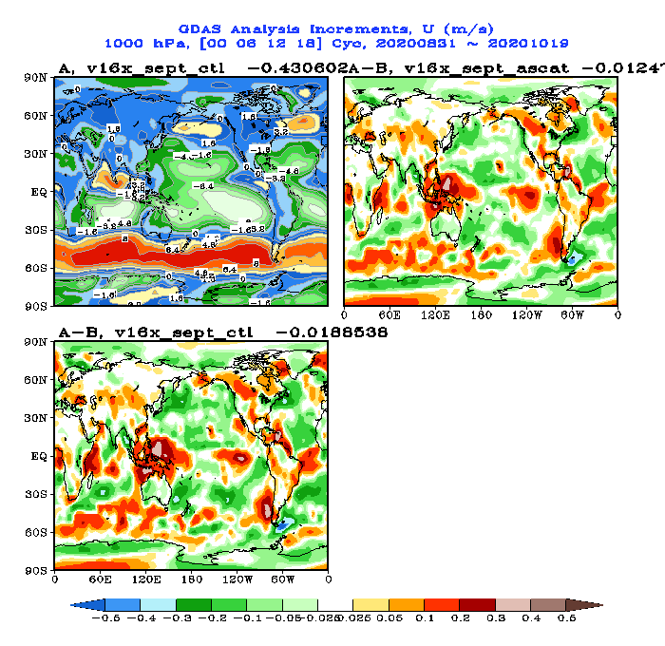
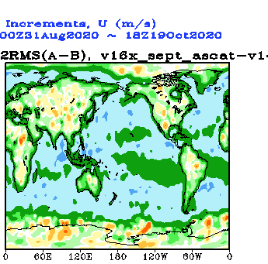
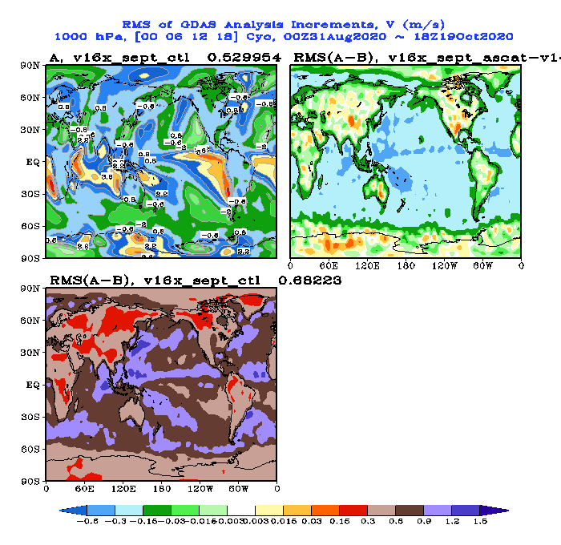
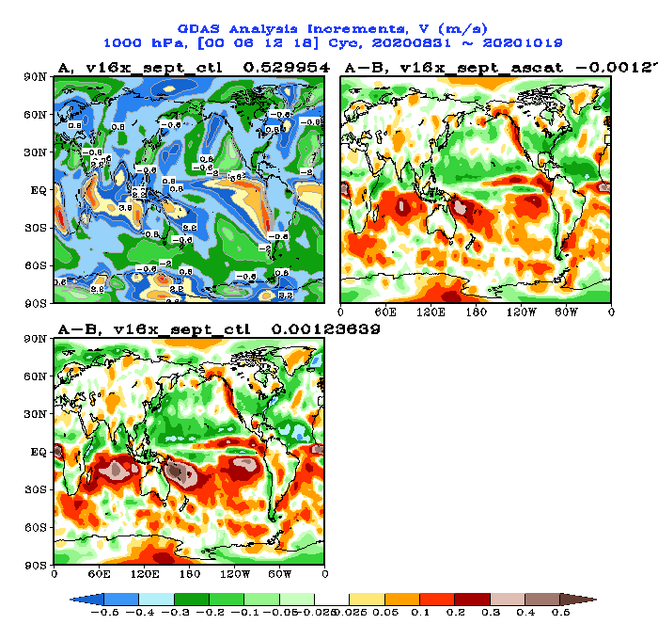
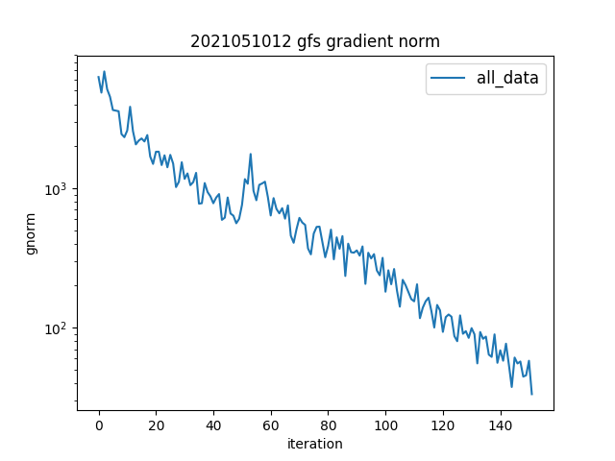
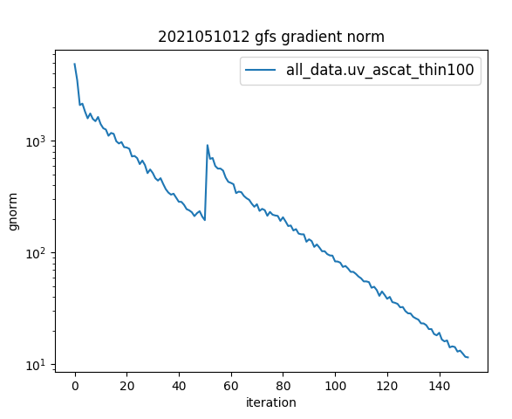
U (m/s) Mean Analysis Increment (A-B)
2020083100 - 2020101918
U RMS Difference
EXP - CTL
V RMS Difference
EXP - CTL
CTL
EXP
Magnitude of Increment is smaller in the Experiment
V (m/s) Mean Analysis Increment (A-B)
2020083100 - 2020101918
Gradient Norm vs Iteration
CTL
EXP
CTL
EXP
Minimization behaves much better in the Experiment

Slide 20
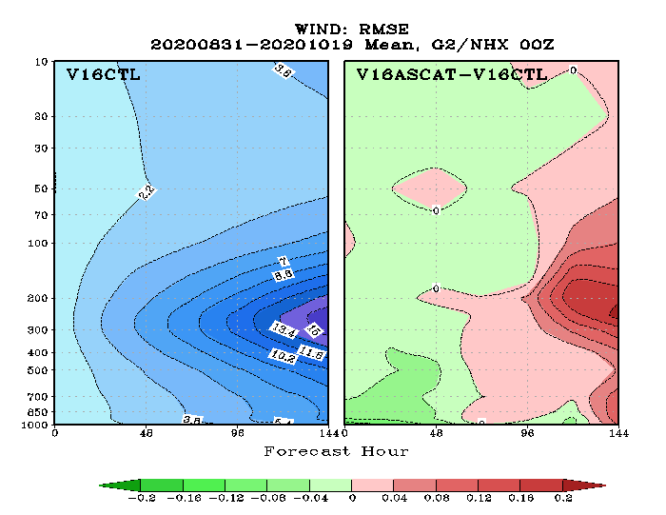
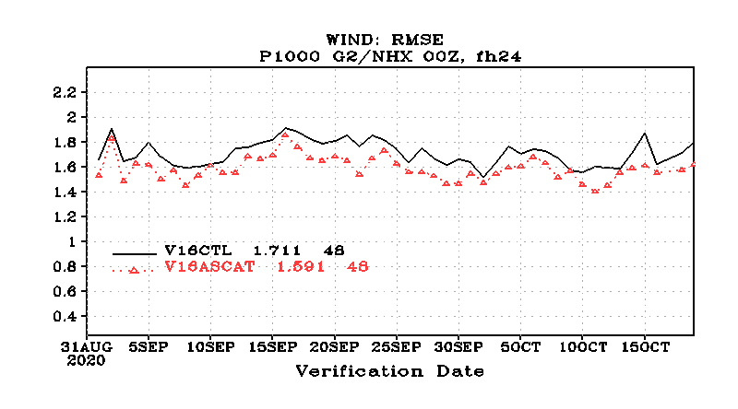
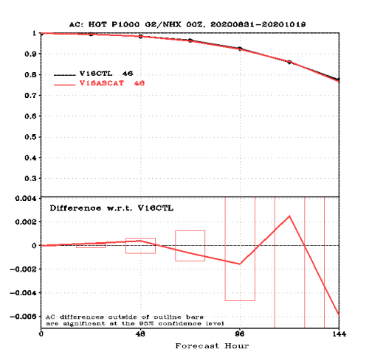
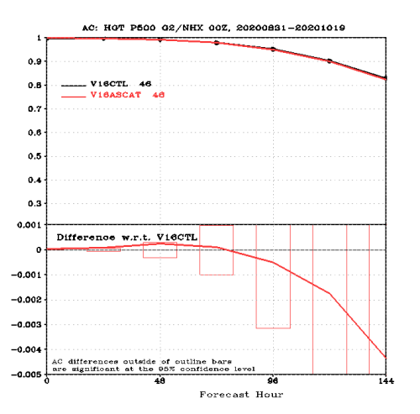
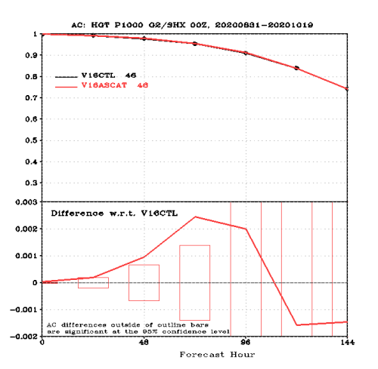
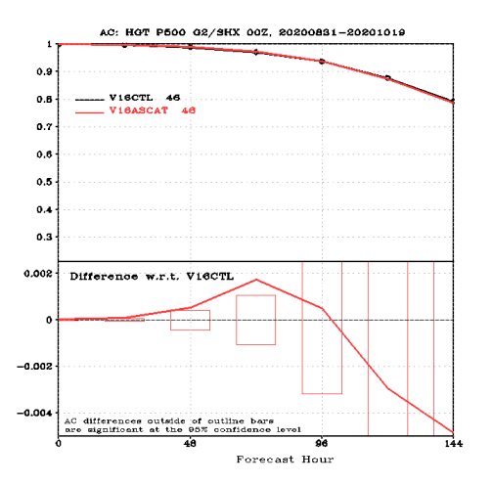
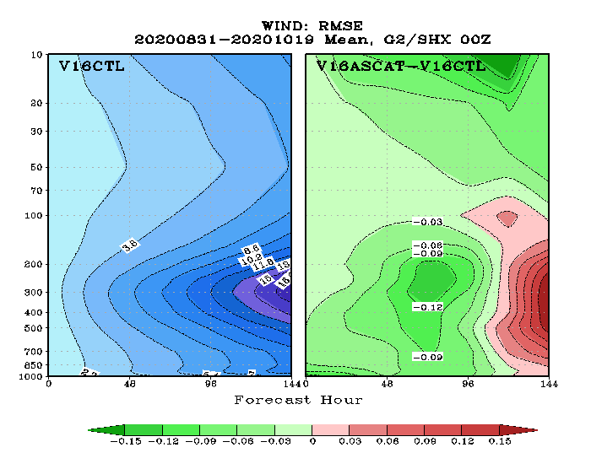
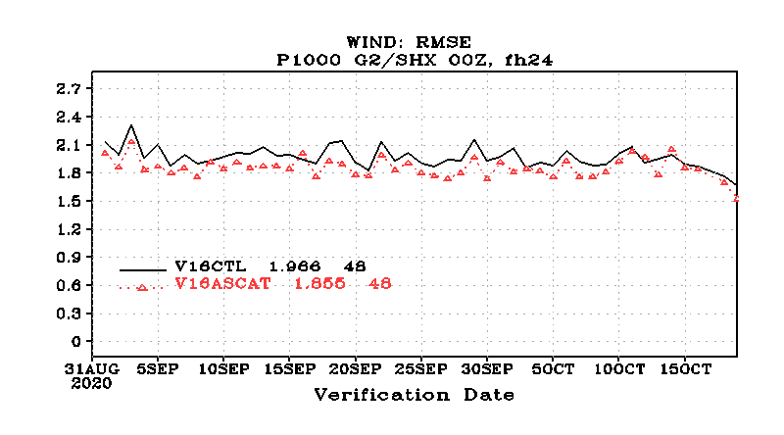
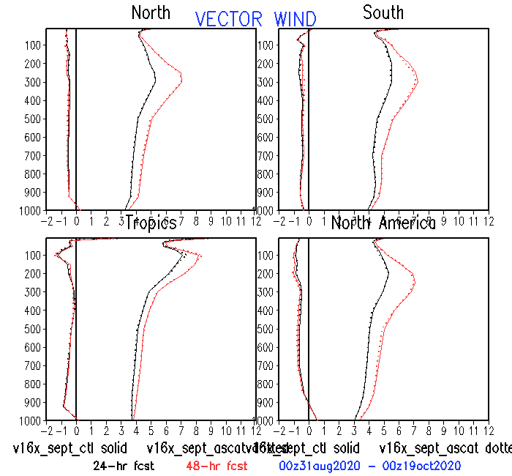
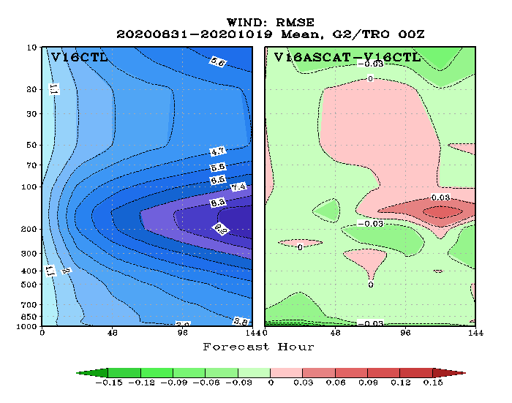
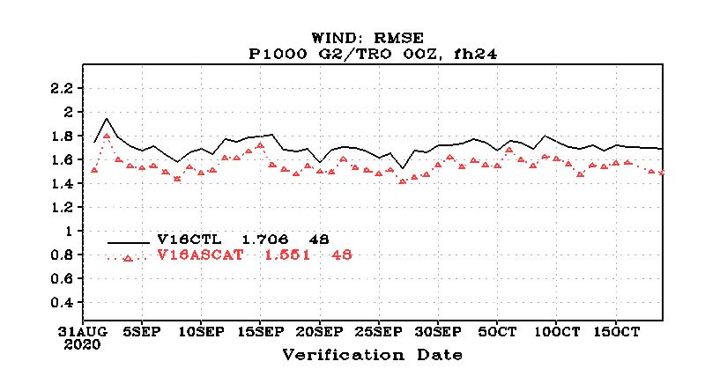
Height Anomaly Correlation
Wind RMSE Diff (EXP-CTL)
Wind RMSE @ 1000 hPa
NH
1000 hPa
500 hPa
NH
1000 hPa
500 hPa
SH
SH
Significant Impact in Height AC scores in SH for all levels up to 72-hour forecast
TR
Slightly better forecast fit to raob wind
Reduce the wind RMS error of 24-hour forecast at lower levels

Slide 21
Outline
Overview of modelling system
Data assimilated in the current system
  Most recent upgrade Nov 2023
Potential new data sources
New assimilation techniques

Slide 22
New Data Sources
Doppler Wind Lidars – Aeolus 2
  Due to the expected short lifetime of ADM-Aeolus we never used this instrument in operations.
  But we have an observation operator for this type of measurement and would aim to exploit any such instruments in future…
MetOp Tandem AMVs
  … in preparation for MTG-IRS
Stereo Winds
MTG-I and GOES-19

Slide 23
Outline
Overview of modelling system
Data assimilated in the current system
  Most recent upgrade Nov 2023
Potential new data sources
New assimilation techniques

Slide 24
Toward more direct use of observations
In data assimilation we usually wish to use observations with minimal processing (e.g., radiances not retrievals)
It is known that when using 4D variational techniques the ”tracer effect” can convert raw measurements into wind fields.
  To take full advantage of this requires the ability to assimilate clouds – so it is still a long way off.
Similarly ECMWF and others are looking into direct assimilation of backscatter (sigma_0) rather than retrieved scatterometer winds.

Slide 25
AI/ML
Artificial Intelligence/Machine Learning has the potential to be used in multiple ways.
  Replacing individual components
  Replacing the entire data assimilation system
    Could be a way to realize direct extraction of wind information from radiances.
    ECMWF use sigma_0 in their AI-DOP system.

Slide 26
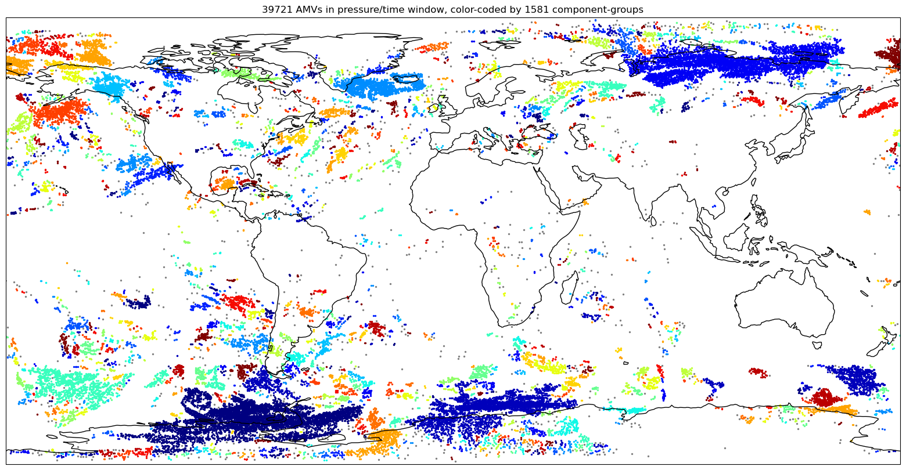
Using AI/ML for clustering/superobbing

Slide 27
GFSv17 Overview – Coupled Modelling
5-way weakly coupled system
  Atmosphere
  Ocean
  Sea ice
  Land
  Waves
GEFS will also couple to aerosol
  Undecided if all members or just control member
GFS and GEFS will be separate systems
  Infrastructure will be as unified as possible
  Evaluations and code deliveries are separate
  Implementation day planned to be the same day
UFS Driver
Atmosphere:
UFS ATM
FV3 dycore
CCPP Physics
NOAH-MP
Ocean:
MOM6
Mediator:
CMEPS
Aerosols:
GOCART
Ice:
CICE6
Waves:
WAVEWATCH III

Slide 28
Summary

Slide 29
Summary
We use multiple sources for wind observation in operational NWP
… including Geostationary, Polar and LEO-GEO AMVs
We are looking forward to new data sources such as MTG-I, MTG-IRS, GEOXO???
Ultimately we would like to make more direct use of measurements in the model, but that is likely many years away still.

Slide 30
Thankyou

