Slide 1

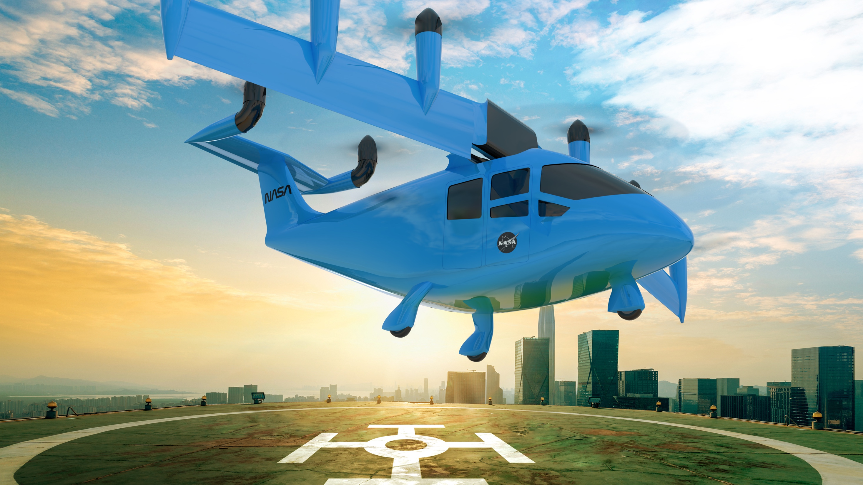
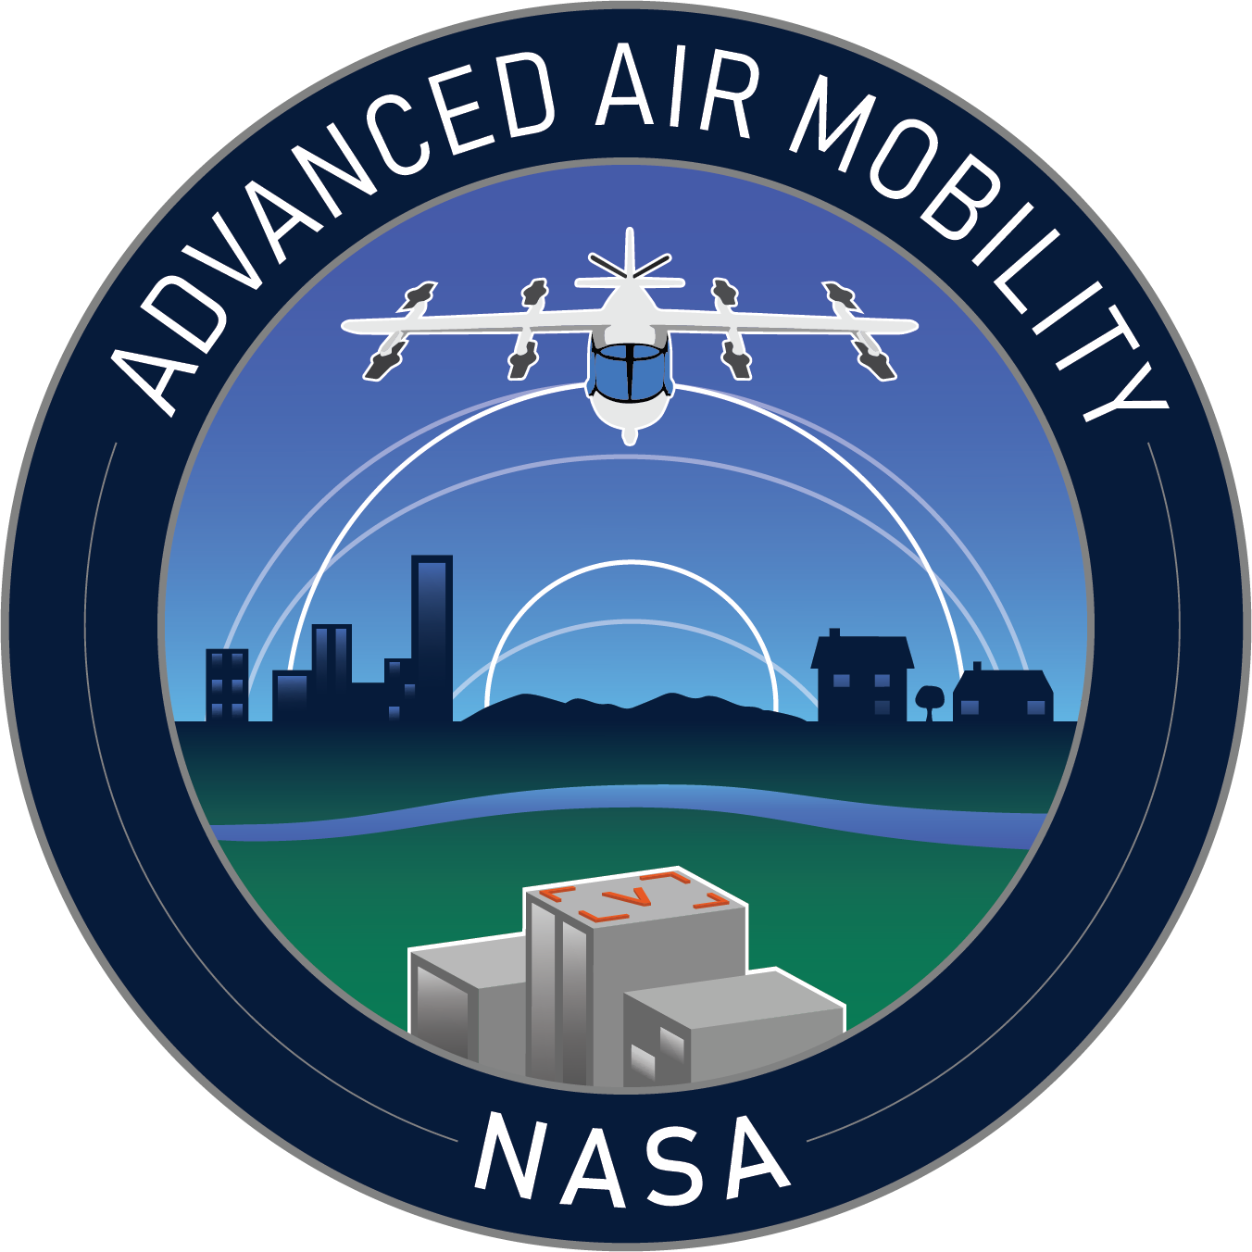
NASA Advanced Air Mobility (AAM) Overview
Nancy Mendonca
Deputy Mission Integration Manager, Advanced Air Mobility

Slide 2
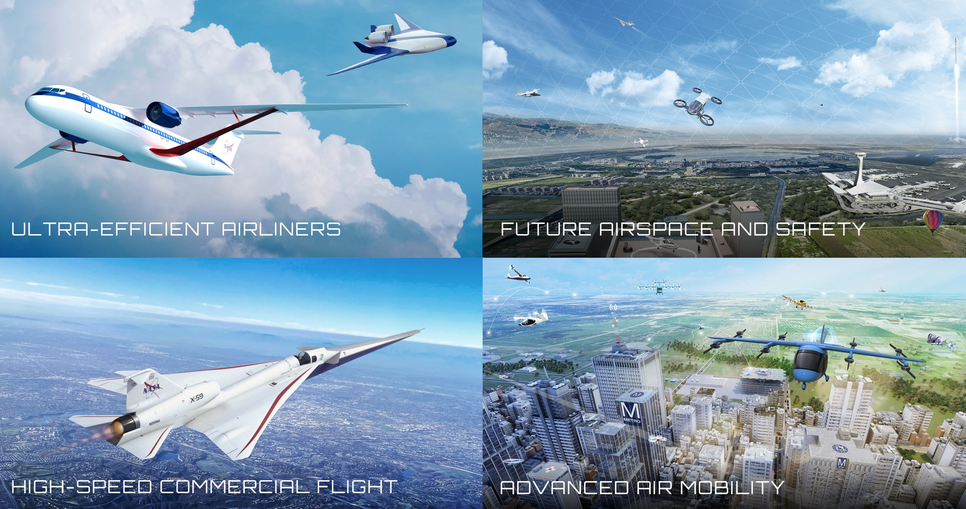

Four Transformations for Sustainability, Greater Mobility, and Economic Growth
Four Aviation Transformations
www.nasa.gov |
2
Notes:
NASA is leading transformation of aviation in four technical areas.
Each of these transformation areas is enhanced and advanced by a fifth transformational area, our Innovation Ecosystem, which produces new knowledge/ideas to lead to new transformation areas.
Ultra-Efficient Airliners: We are accelerating the ability of the next generation of large commercial aircraft to use less energy and use cleaner energy. Our work is a major contribution to the U.S. goal for net-zero greenhouse gas emissions by 2050.
Key message – SFNP is a partnership to mature technology by late 2020s to keep the U.S. as leaders for next generation transports – the heart of the aviation system. Sustainable aviation system growth, increased airline travel, excellent engineering and manufacturing jobs, and economic growth will all result from achieving SFNP objectives and benefits.
Future Airspace and Safety: Continuing to advance airspace and safety are foundational elements to the future of aviation – sustainability, traditional airline operations, advanced air mobility, and high speed. NASA research enables FAA and industry to keep pace with required change and enable aviation to safely grow at the expected pace.
We are working with partner FAA to continue evolution of our national airspace system to safely integrate all types of air vehicles in an increasingly complex environment, and to do so more sustainably – using digital technologies on the ground and on board vehicles to enable more efficient trajectories that use less energy.
Advanced Air Mobility: Advanced Air Mobility will revolutionize urban and regional mobility, opening up a new dimension for economic growth and opportunity. NASA has been and will continue to be a fundamental enabler for this new market, especially in the areas of airspace integration and use of autonomy.
With nearly 100 industry partners, we are working to enable an economically viable and safe system in which aircraft from drones to air taxis can fly new missions over the most rural countryside to the dense urban landscape – missions such as passenger transport, medical deliveries, utility inspections, disaster response. Our Advanced Air Mobility mission is working with the aviation community to solve challenges in vehicle development and operations, airspace design and operations, and community integration.
High-Speed Commercial Flight: Enabling sustainable, commercial supersonic flight can be a long-term game changer for U.S. and global mobility, but major hurdles must be overcome.
We are potentially removing a key barrier to commercial supersonic flight over land by proving that we can get rid of the sonic boom, while also exploring solutions to local noise and emissions associated with supersonic flight. With our federal partners we are also investigating the potential of even higher speed flight such as high-supersonic and hypersonic speeds.

Slide 3
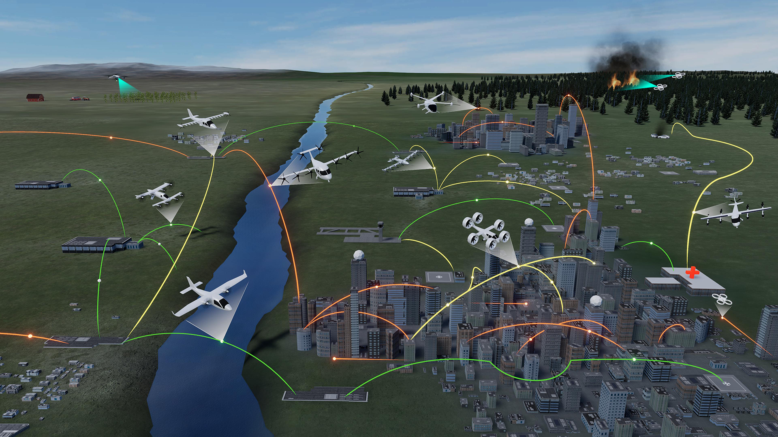
Advanced Air Mobility
Wildland Firefighting
Operations
Rural Operations
On Demand
Air-Taxi
Urban Operations
Regional
Network
Cargo
Delivery
Inter-city
eC/STOL
Cargo
Delivery
Inter-city
eVTOL
Airport
Transfer
Air
Ambulance
Medical
Supply Delivery
Fleet
Operations
Inter-city
eCTOL
Small
Package Delivery
Cross-metro
Transfer
Safe, sustainable, affordable, and accessible aviation
for transformational local and intraregional missions
Notes:
Definition of AAM is not standardized. NASA looks primarily from technology perspective. FAA tends to look from regulatory standpoint
Lots of challenges
KEY MESSAGE: NASA’s work in Advanced Air Mobility will revolutionize urban and regional mobility, economic growth and opportunity. NASA has been and will continue to be a fundamental enabler for this new market, especially in the areas of airspace integration and use of autonomy. ​
Includes “rural” and “urban” applications
Cargo transport, pax-carrying, aerial work, etc.
eVTOL, sUAS, eCTOL, hybrid-electric, etc.
Urban Air Mobility (UAM) as a challenging use-case with high benefit
Enabled by electrification and automation
Does not include:
Supersonic or hypersonic transport
Existing hub-and-spoke air service with large transport aircraft

Slide 4
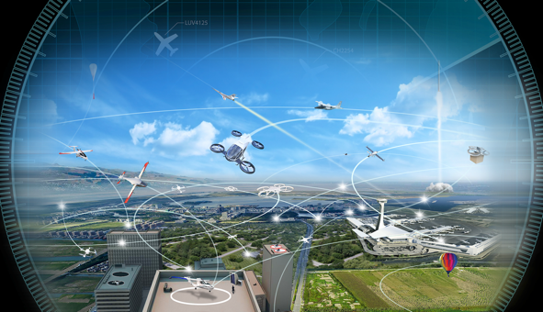
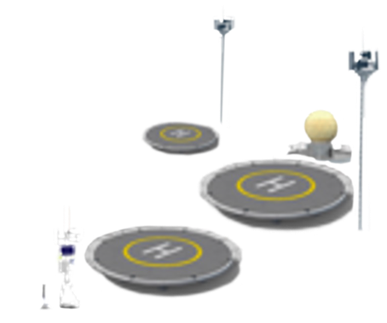


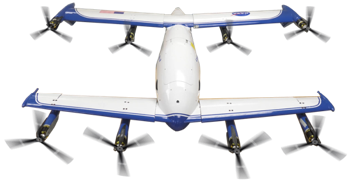



AAM Architecture System of Systems
Airspace
Management
Vertiport/Airport Management
FAA Aircraft Network Security Program
Fleet Management
Aircraft Technologies and Automation
Infrastructure
Communication, Navigation, Surveillance, Weather
In-Time Aviation Safety Management Systems
Notes:
If you remember nothing else, know that we are working to help architect what the future system-of-systems around AAM may look like. We are partnering with other govt agencies (most notably the FAA), state/local govts, and industry
There are a million ways to slice this space.

Slide 5



AAM Research Areas
Airspace
Aircraft
Community Integration

Slide 6
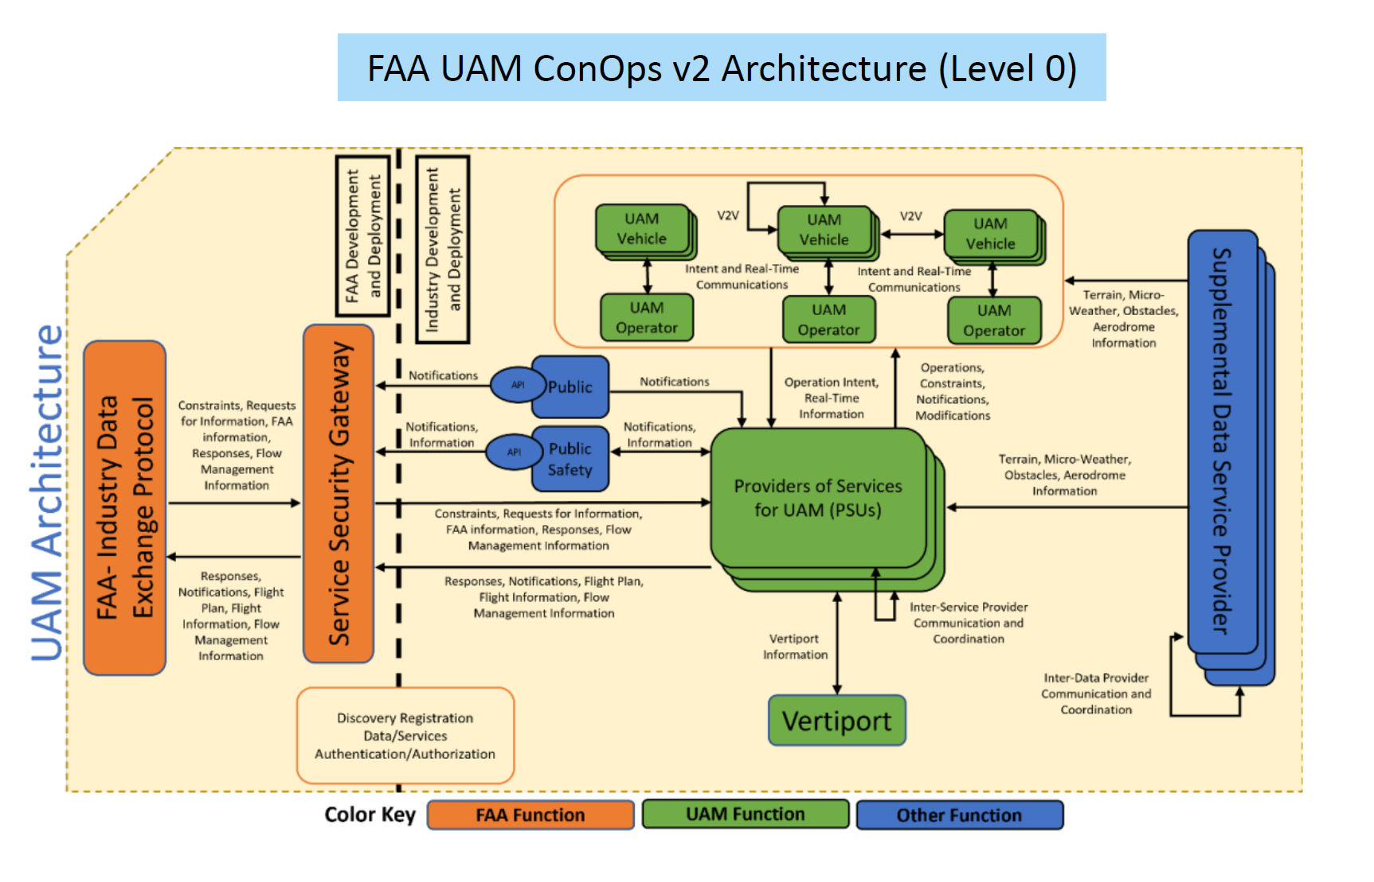

Slide 7
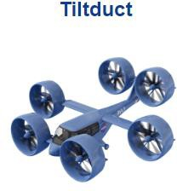
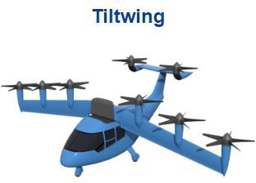
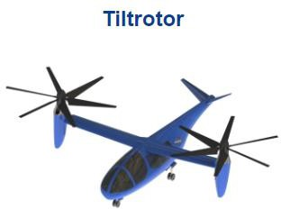
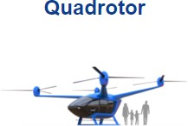
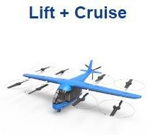
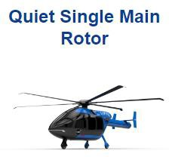
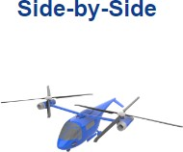
NASA’s Passenger Carrying Reference Vehicles
Vertical Flight Society is tracking over 1000 eVTOL designs
4

Slide 8
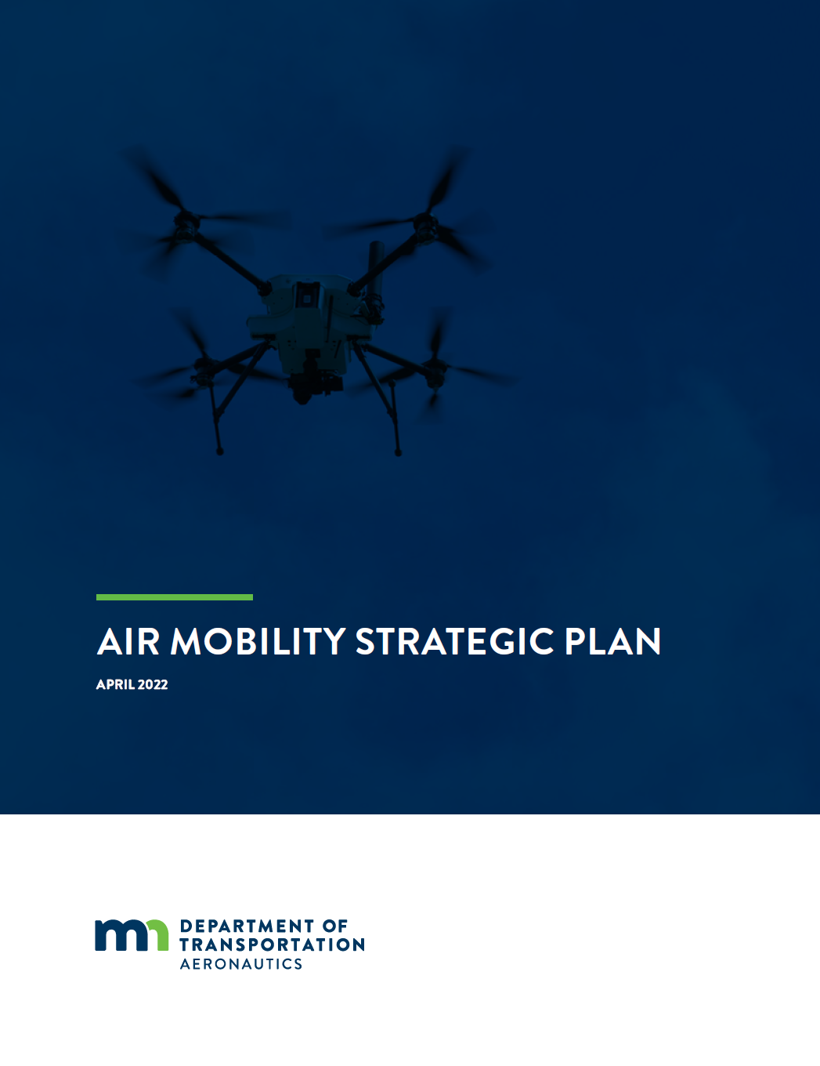
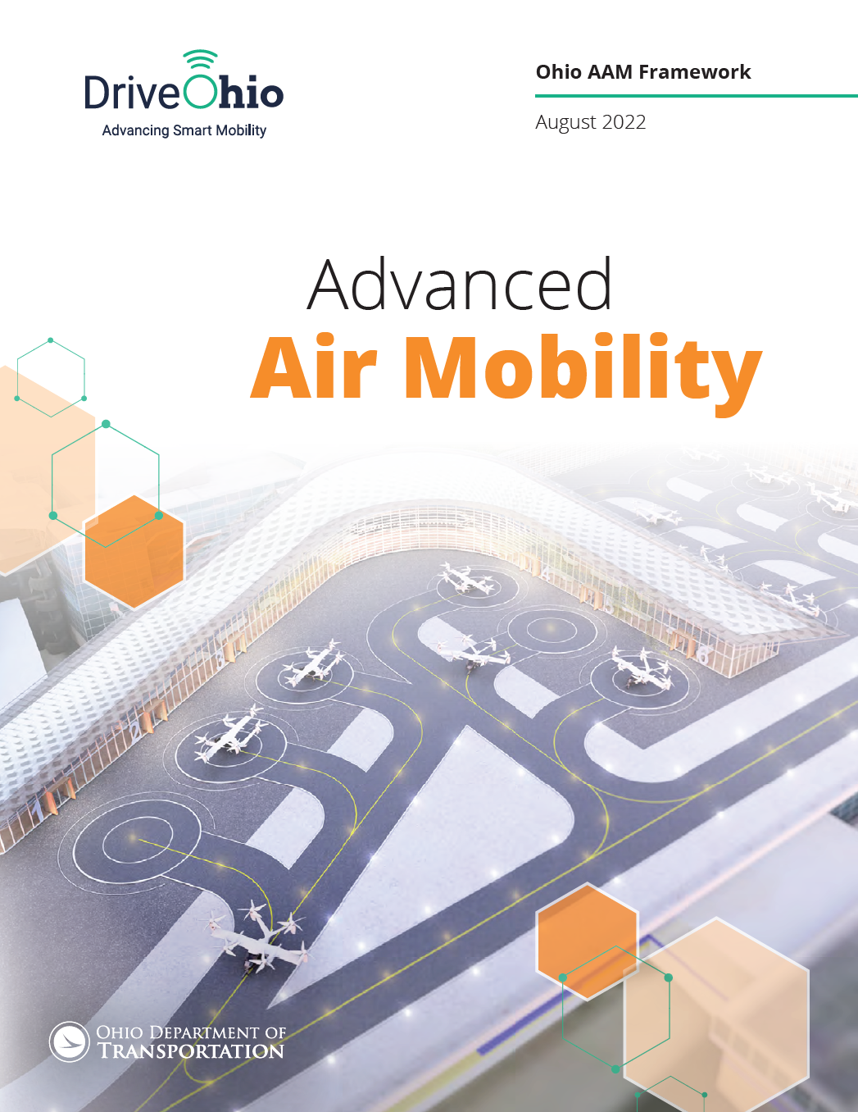
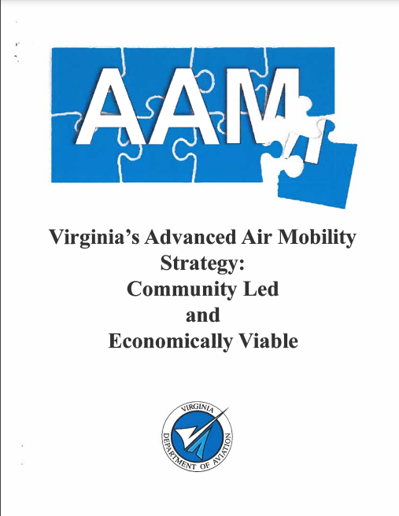
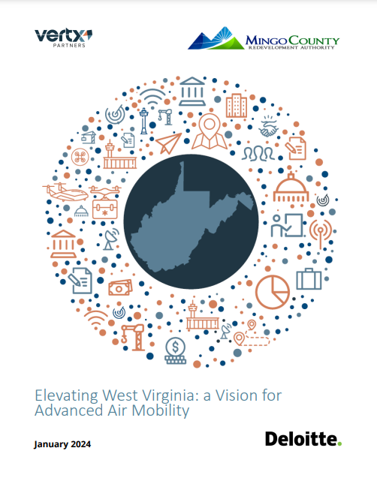
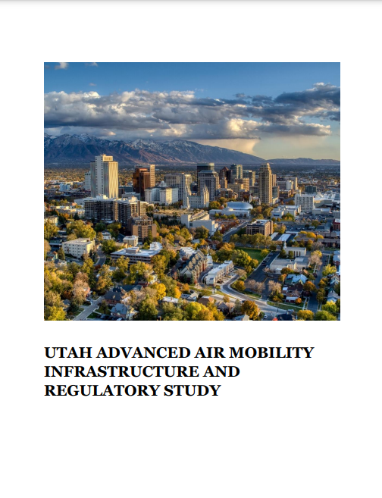

Community Documents
National Association of State Aviation Officials AAM Collaborative
National League of Cities AAM Forum
Maryland AAM Council
Texas AAM Advisory Council
Massachusetts AAM Integration Task Force
Cross-pollination supports a harmonized national implementation

Slide 9
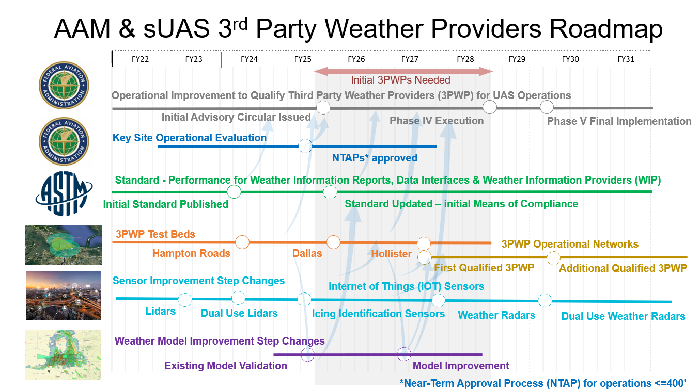

Slide 10
NASA’s Advanced Air Mobility (AAM) research will help transform our communities by bringing the movement of people and goods off the ground and into the sky.
Notes:
Partnership opportunities

