Slide 1
Workshop on 3D Winds Space-Based Measurements
Joint Venture Partnership (JVP) Program
Feb 19 - 20, 2025

Slide 2
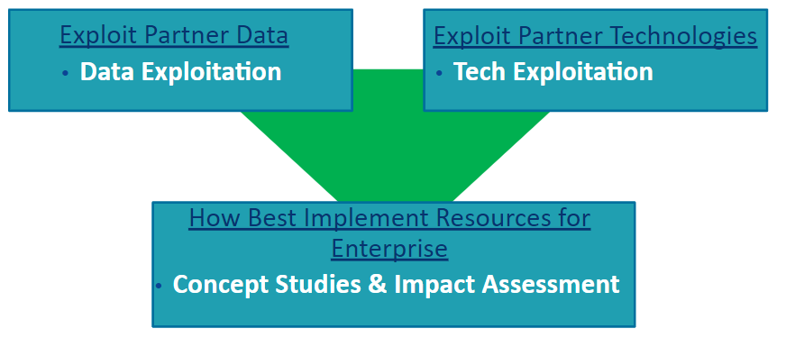
Joint Venture Partnerships: Advancing NOAA’s Mission
Engaging Industry and other Agency Partners to:
leverage new data sources
explore new and innovative technologies that may develop NOAA’s next-generation capabilities
  Provide confidence that an emerging technology can be used in an operational environment
  Reduce risk for new technologies
  Demonstrate the appropriate reliability

Slide 3
Why 3D Winds measurement is important to NOAA?
Multiple studies have been performed and concluded that 3D Winds measurement is a major gap in our space-based observing system and is deemed to have a great potential to improve the performances of several NOAA environmental prediction systems including global Numerical Weather Prediction (NWP)
Better understanding of 3D wind requirements and implementation result will benefit NOAA’s the next generation space architecture planning
Notes:
One of the areas we have been focusing since 2022 is 3D winds profiling. The measurement of the vertical distribution of the atmospheric wind from space, therefore with global coverage and with accurate vertical resolution, has been identified as perhaps the single most important gap in our Earth observation enterprise. This was highlighted in the World Meteorological Organization (WMO) Integrated Global Observing System (WIGOS) 2040 vision, in the National decadal survey of 2017, as well as the NOAA Satellite Observing Systems Architecture (NSOSA) study.

Slide 4




NOAA/NESDIS BAA Study – 3D Winds Profiling
Exploring technologies that allow for the measurement of atmospheric wind profiles (3D winds) from space
BAA objectives:
    Objective A: Technology Demonstration - Observe 3D Winds from sub-orbital platforms
    Objective B - Concept Studies - looking at different sensors, different constellations on different sensors and provide concept of different approaches.
Notes:
Via BAA we are exploring technologies that allow for the measurement of atmospheric wind profiles (3D winds) from space. The BAA objectives are to explore the status of current 3D wind technologies, how they are projected to evolve in the near future, and their potential value to NOAA’s mission.
Objective A: Technology Demonstration
Assess the capabilities of different technologies that currently exist to observe 3D winds from sub-orbital platforms (e.g., airborne, stratospheric balloon-based, etc.) to assess these technologies and the characteristics of their measurements to meet NOAA performance needs
Objective B: Concept Studies
Studies in this category would look at different sensors, different constellations, on different platforms
Perform studies to provide concepts of different approaches to measure 3D winds from space to meet NOAA performance needs
3D Winds field campaign data will allow NOAA to understand the strengths and weaknesses of the different technologies available and the characteristics of their measurements to meet NOAA performance needs

Slide 5
LEO - Observational Objectives
The Office of LEO Observations includes both the JPSS and NEON programs.
JPSS instruments contribute to the constellation of opportunity that supports 3D wind analysis
NEON Program plans to use a disaggregated architecture to continue and expand on JPSS observations using NOAA-owned and partner missions.
LEO Formulation will:
  Use JV studies to identify solution-specific platforms and constellation needs
  Understand the gaps in the constellation and seek solutions
  Employ technology solutions based on the prioritizations provided by SAE and users
    User needs documented in the COURL flow to the NEON Observation Objectives. 3D Winds Requirements are fueled by the NSOSA SPRWG report.
Atmospheric Wind Vertical Profiles
NEON Observational Objectives
System Capability | Threshold | Objective
Horizontal Resolution | 400 km | 15 km
Vertical Resolution | 4 km | 0.5 km
Accuracy (Direction) | 30 Deg or 20% | 10 Deg or 10 %
Accuracy (Speed) | 10 m/s | 2 m/s or 10%
Latency | 165 min | 30 min
Refresh | 24 hr | 3 hr
Coverage | Global (within 4 days) | Global (within 1 day)
EORES ID: 407166, 407167

Slide 6
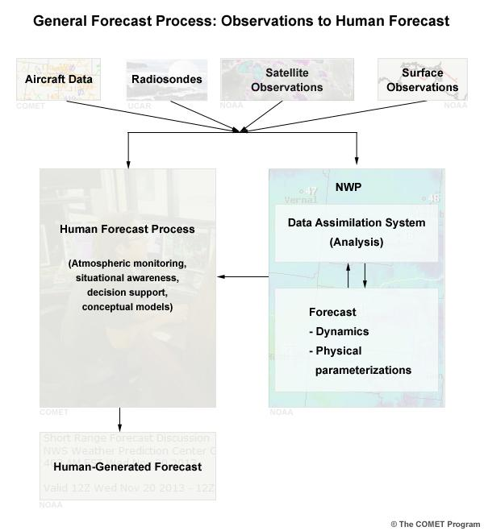
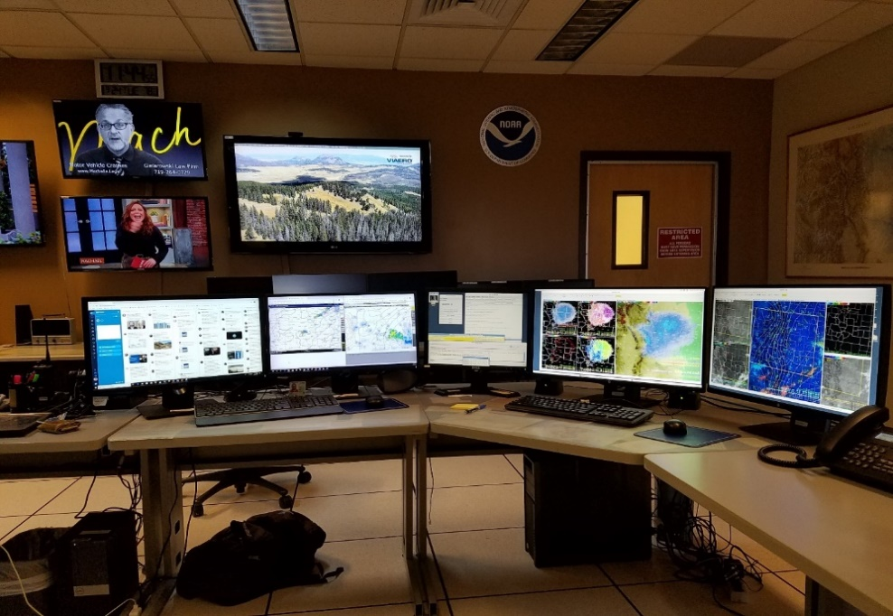

Status NOAA/NESDIS Operational Satellite Winds
Fulfill a Critical Need for Tropospheric Winds
Satellite derived winds are a key component of the Global Observing System (GOS)
Need for timely, high quality tropospheric winds for use in operational global and regional Numerical Weather Prediction (NWP), human forecasting process, flight planning
Users
NWS: Weather Forecast Offices (WFOs), National Centers for Environmental Prediction (NCEP) – NCO, EMC, NHC, OPC, AWC, WPC
U.S. DoD: USAF, Navy
International NWP Centers: ECMWF, MetOffice, CMC, JMA, DwD, Meteo-France, BoM, KMA
Industry: U.S. and International Airlines, Weather Services
NWS

Slide 7
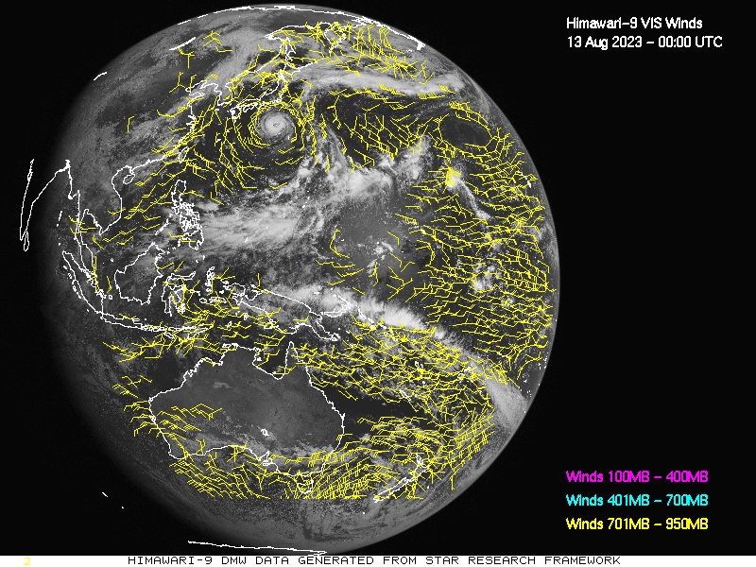
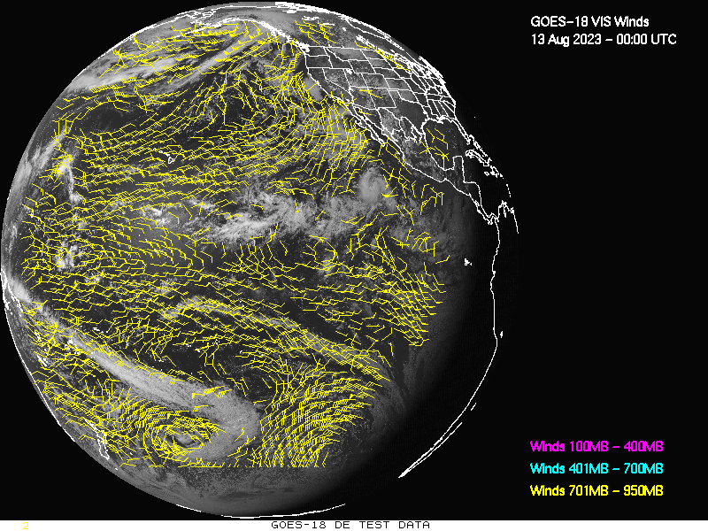
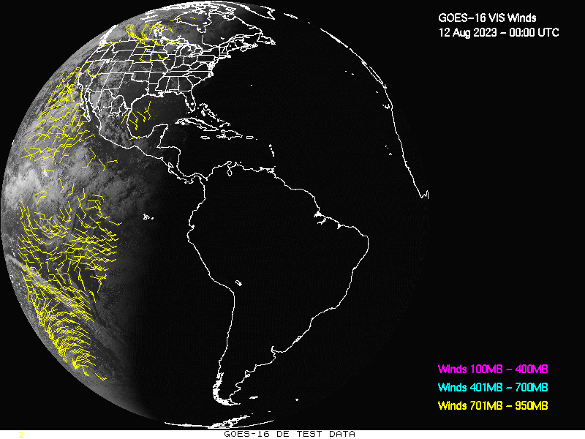
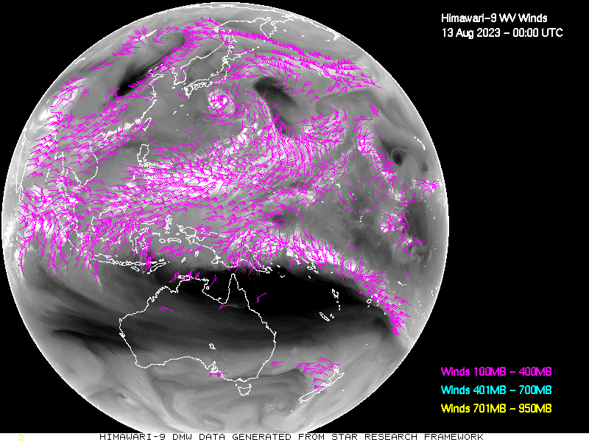
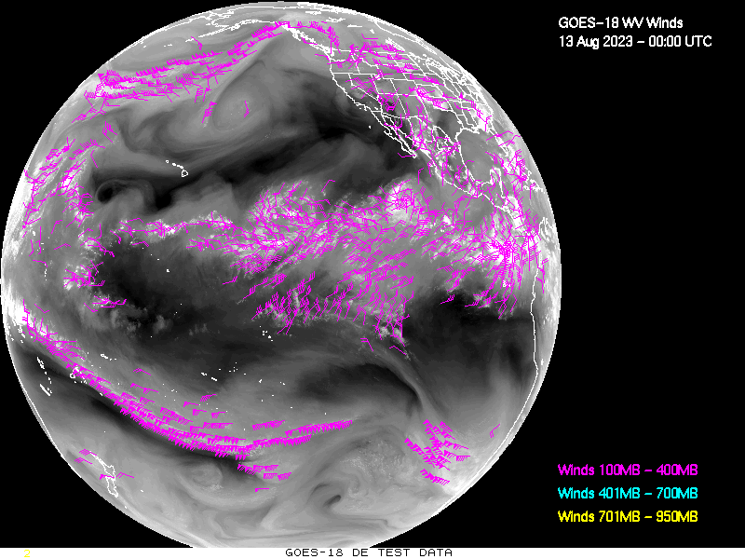
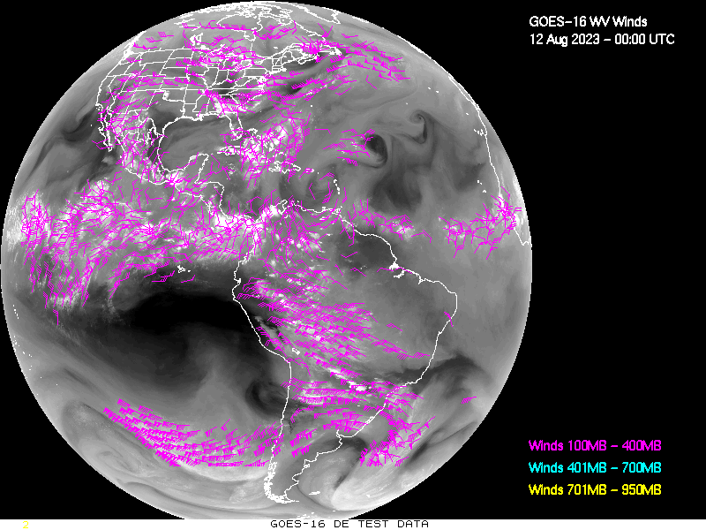
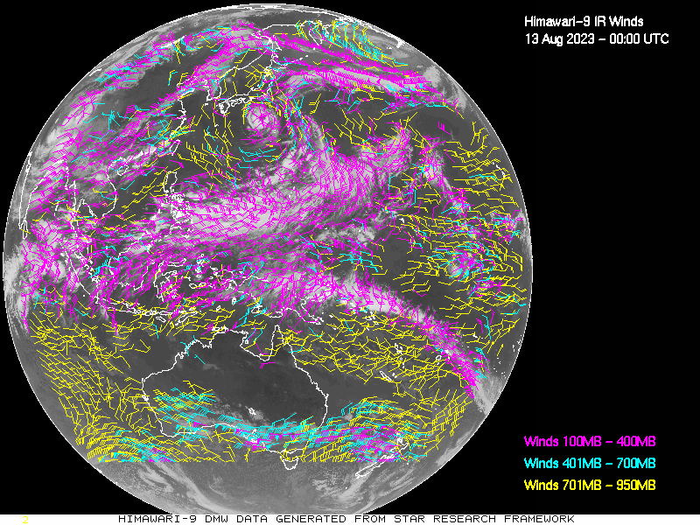
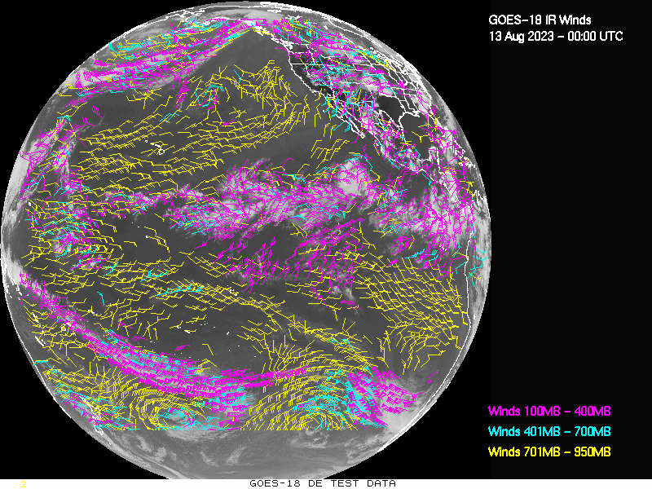
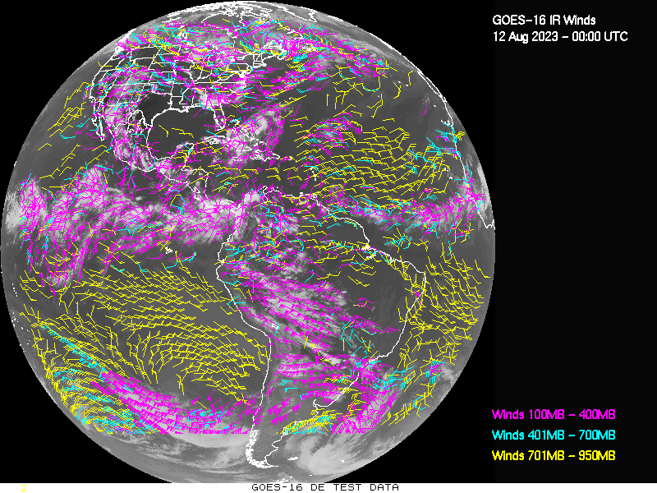
NOAA/NESDIS Operational Satellite Winds
GEO Atmospheric Motion Vectors (AMVs)
Fulfill a Critical Need for Tropospheric Winds
Himawari-9
GOES-18
GOES-16
Satellite derived winds are a key component of the Global Observing System (GOS)
Need for timely, high quality tropospheric winds for use in operational global and regional Numerical Weather Prediction (NWP), human forecasting process, flight planning
“Visible” Winds
Users
“Cloud-top
WV”
Winds
NWS: Weather Forecast Offices (WFOs), National Centers for Environmental Prediction (NCEP) – NCO, EMC, NHC, OPC, AWC, WPC
U.S. DoD: USAF, Navy
International NWP Centers: ECMWF, MetOffice, CMC, JMA, DwD, Meteo-France, BoM, KMA
Industry: U.S. and International Airlines
“LWIR”
Winds

Slide 8
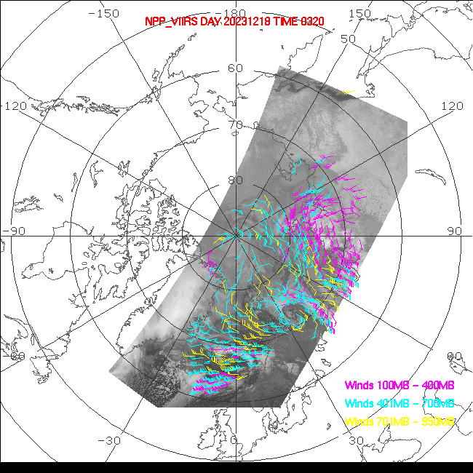
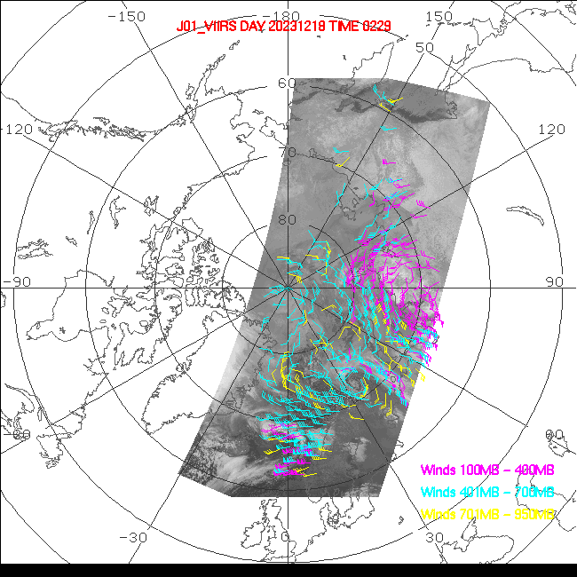
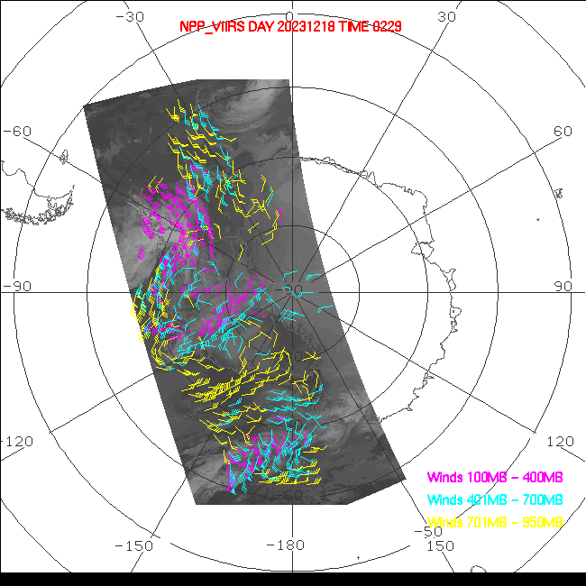
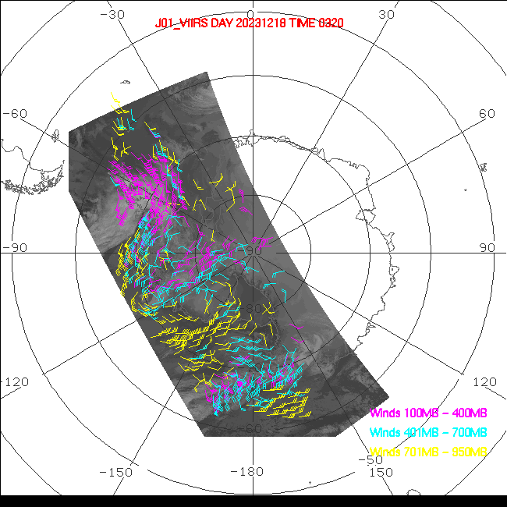
NOAA/NESDIS Operational Satellite Winds
LEO Atmospheric Motion Vectors (AMVs)
Fulfill a Critical Need for Tropospheric Winds
VIIRS LWIR Polar Winds (Arctic)
December 18, 2023
Satellite derived winds are a key component of the Global Observing System (GOS)
Need for timely, high quality tropospheric winds for use in operational global and regional Numerical Weather Prediction (NWP), human forecasting process, flight planning
S-NPP
N20
Users
VIIRS LWIR Polar Winds (Antarctica)
NWS: Weather Forecast Offices (WFOs), National Centers for Environmental Prediction (NCEP) – NCO, EMC, NHC, OPC, AWC, WPC
U.S. DoD: USAF, Navy
International NWP Centers: ECMWF, MetOffice, CMC, JMA, DwD, Meteo-France, BoM, KMA
Industry: U.S. and International Airlines
S-NPP
N20
NESDIS also generates operational polar winds from NOAA-15/18/19 and Metop-B/C

Slide 9
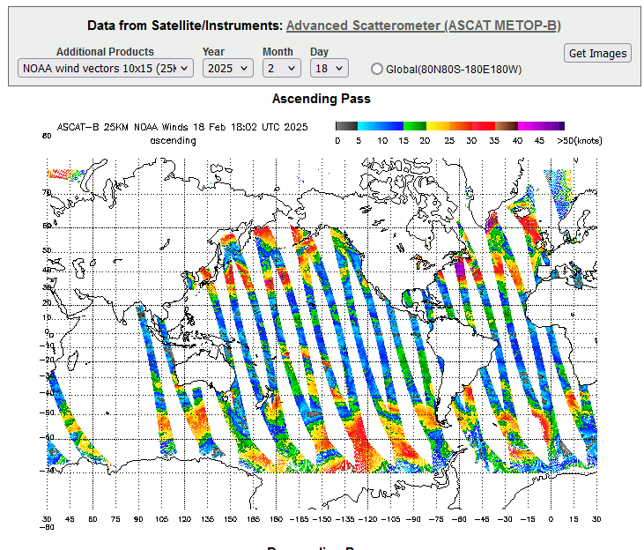
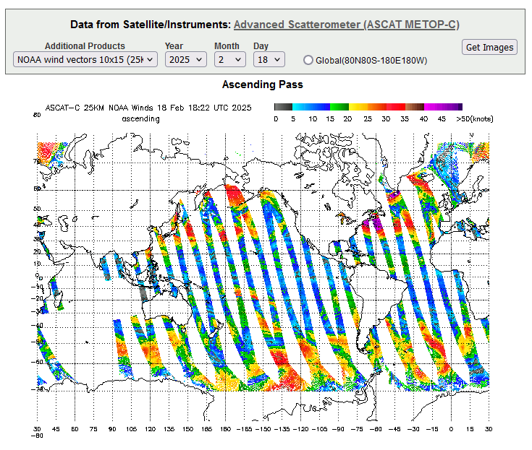
Ocean Surface Vector Winds
● Metop-B and C 25km and 50km Ocean Surface Winds in NetCDF, BUFR, and BINARY
● Metop-B and C Ultra High Resolution Winds Imagery for Tropical Storms in NetCDF and GIF
Notes:
● Metop-B and C 25km and 50km Ocean Surface Winds in NetCDF, BUFR, and BINARY
● Metop-B and C Ultra High Resolution Winds Imagery for Tropical Storms in NetCDF and GIF

Slide 10
Satellite Wind* Development Drivers
Challenges Approach
  AMV height assignment
  Limited vertical coverage
  Improve the utilization and impact of AMVs in global and regional NWP
  Improve the utility of satellite-derived winds to weather forecasting/nowcasting
    Improve IR-based cloud height retrieval approaches
    Develop stereographic methods (in progress at NOAA/NESDIS))
    Improve quality control methods
    Leverage hyperspectral sounder instruments from GEO and LEO satellites and retrieve vertical wind profiles from retrieved vertical Q (or O3) profiles
    Develop alternative feature tracking approaches (ie., Optical Flow)
    Improve overall AMV quality; improve quality control
    Improve AMV coverage (horizonal, vertical, temporal)
    Improve characterization of AMV errors and DA quality control
    Close collaborations between wind/cloud science teams and NWP DA teams
    Develop alternative feature tracking approaches (ie., Optical Flow)
    Develop new approaches to visualize high resolution wind information
* Atmospheric Motion Vectors (AMVs)

Slide 11
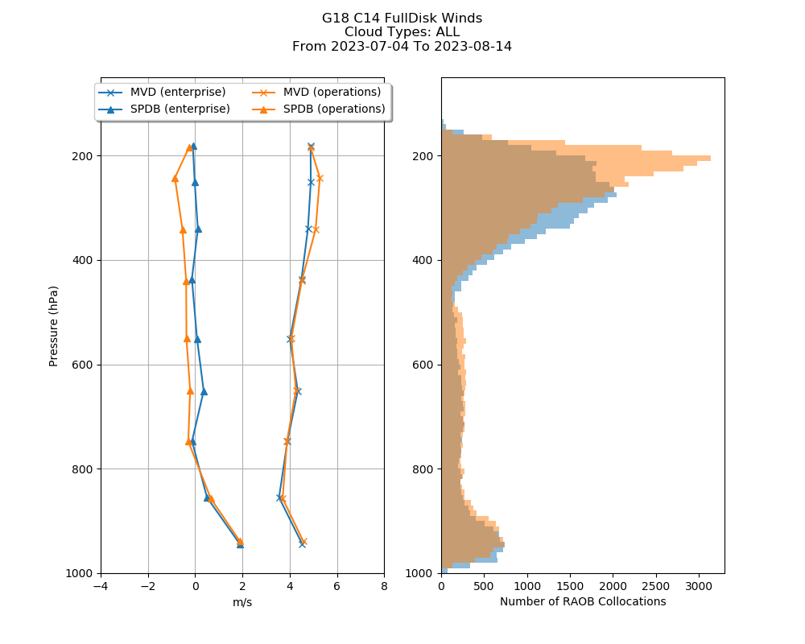
Impact of Updated Cloud Height Algorithm on AMV Quality
GOES-18 FD LWIR Winds vs Radiosonde Winds
7/4/2023 – 8/14/2023
Current operational cloud & wind algorithm versions (2024)
Baseline cloud & wind algorithm versions (2010)
Cloud height algorithm tuned to improve AMV quality
Upper level height assignments associated with the winds nudged downward in the atmosphere
Reduction in the Mean Vector Difference above 400 hPa
Reduction in speed bias throughout the troposphere
Speed Bias (Sat-Raob) (Left);
Mean Vector Difference (MVD) (Right)

Slide 12
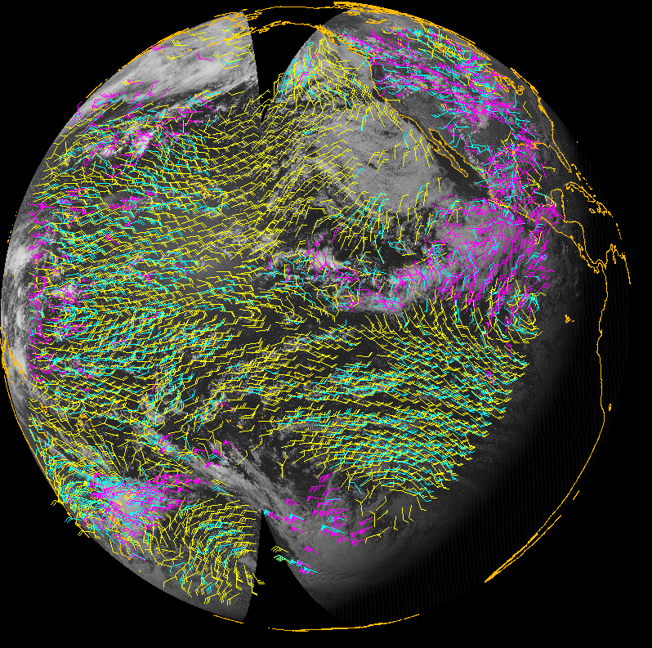
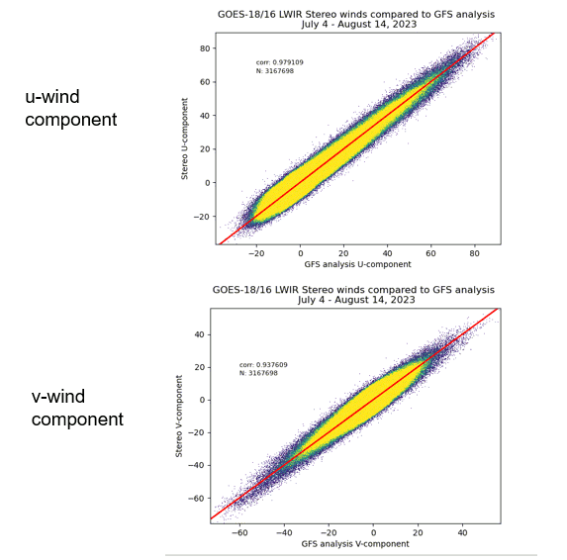
GEO-GEO Stereo Winds
Stereo winds generated from pairings of
  G18-ABI/H9-AHI Visible (0.65um) Imagery (Left)
  G18-ABI/G16-ABI Visible (0.65um) Imagery (Right)
The combined geographic coverage of these GEO-GEO stereo winds over the Pacific Ocean is excellent
July 8, 2023 18 UTC
G18/H9
G18/G16
Stereo vs GFS Analysis
Winds: 0 - 3000 m
Winds : 3000 - 7000 m
Winds: 7000 -16000 m
Notes:
2023189.1800

Slide 13
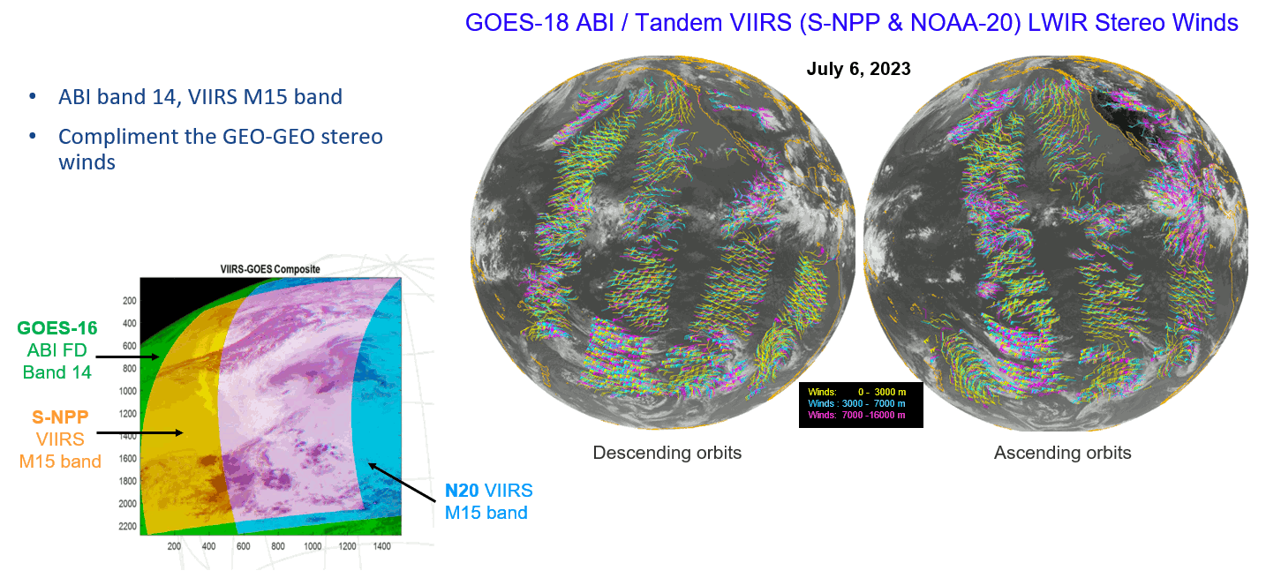
GEO-LEO Stereo Winds
Stereo Winds Coverage

Slide 14
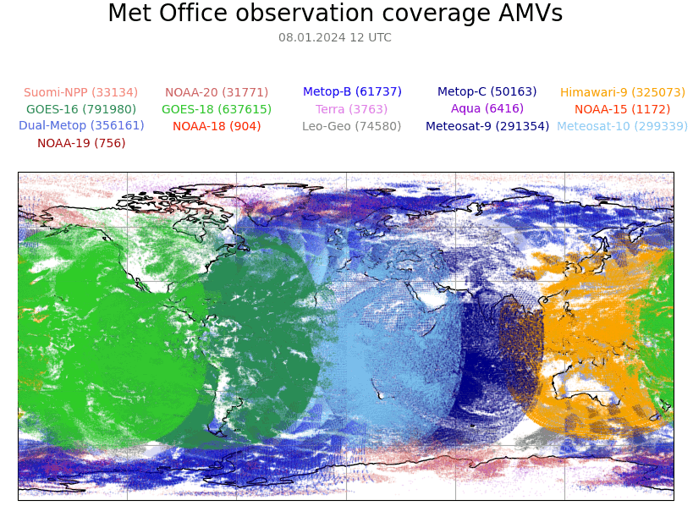
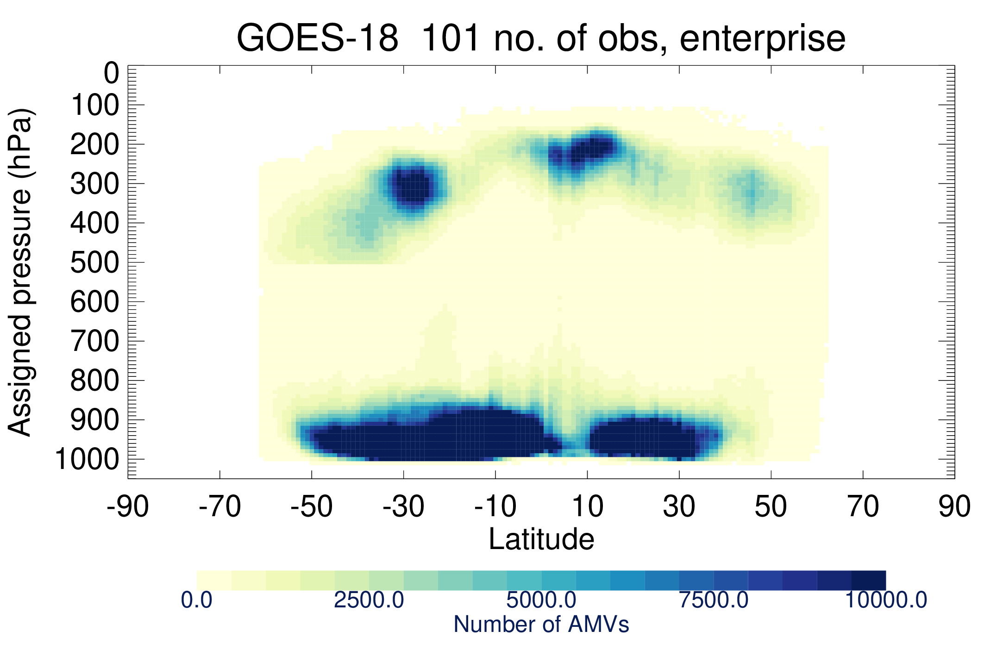
3D Winds – Filling a Critical Data Gap
There is a critical need to fill in data void regions (horiz & vertical) over oceanic, tropical, and polar regions of the globe.
U.S. National Research Council (NRC) 2007 report: “Tropospheric winds are the number-one unmet measurement objective for improving weather forecasts.”
National Acadamies 2018 Report: “Thriving on Our Changing Planet: A Decadal Strategy for Earth Observation from Space”:
  3D winds in troposphere/planetary boundary layer (PBL) for transport of pollutants/carbon/aerosol and water vapor, wind energy, cloud dynamics and convection, and large-scale circulation
  Candidate Measurement Approach: Active sensing (lidar, radar, scatterometer); or passive imagery or radiometry-based atmospheric motion vectors (AMVs) tracking; or lidar*
Spatial Distribution: Atmospheric Motion Vectors (AMV)
Zonal View of GOES-18 LWIR AMVs
Limited
coverage
From Francis Warrick, ECMWF)

Slide 15
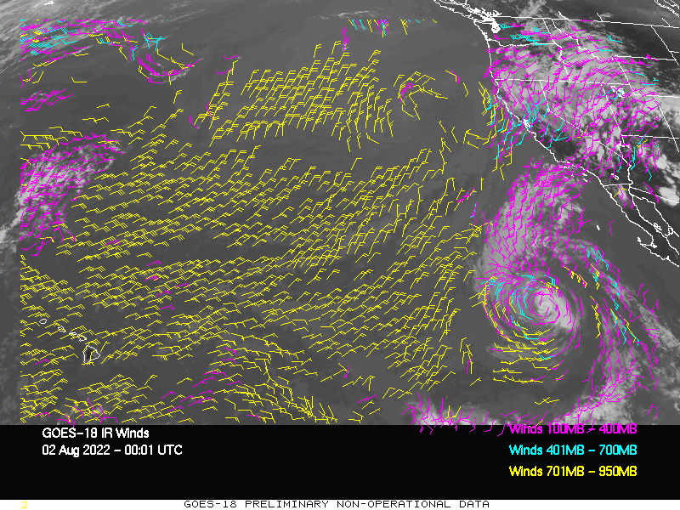
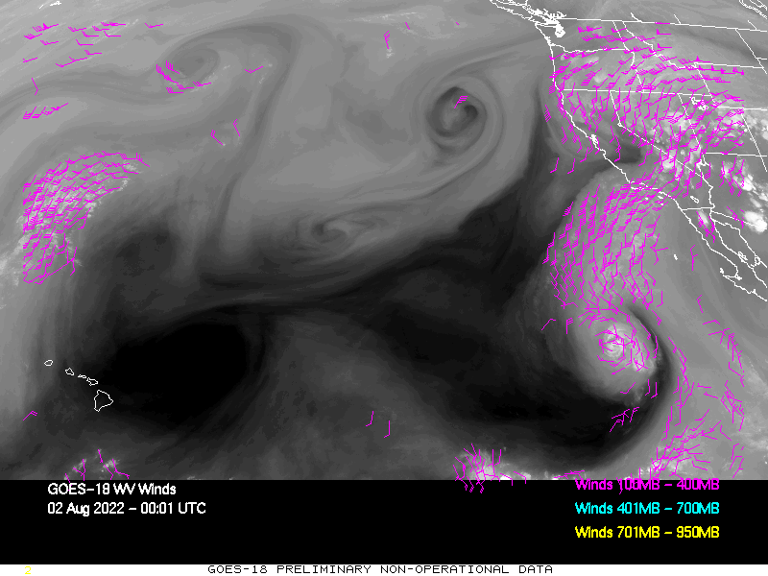
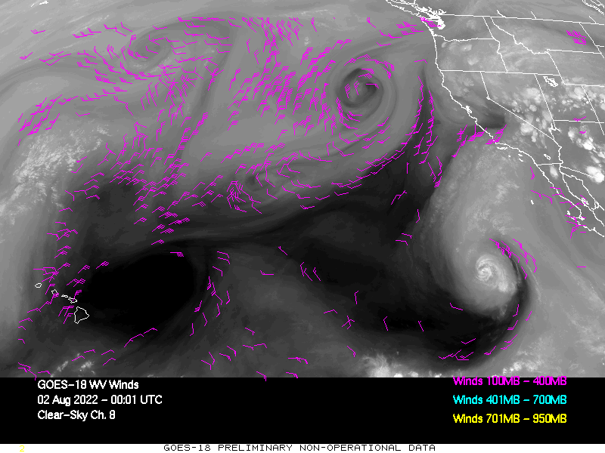
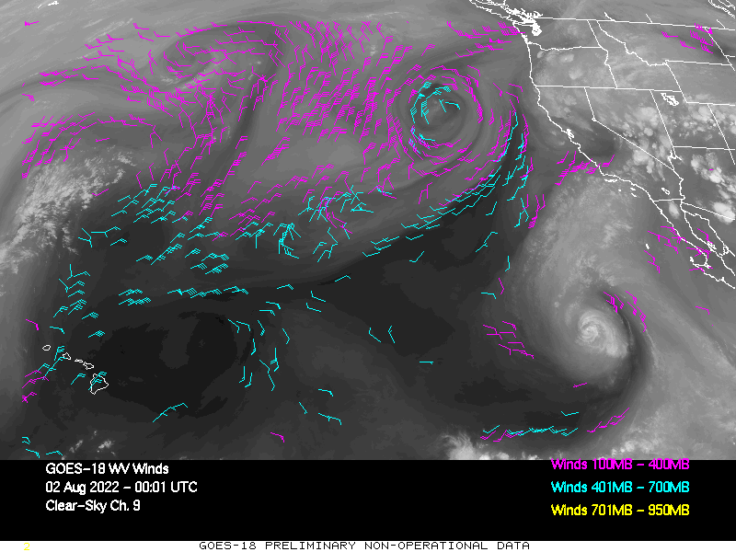
GOES-18 CONUS Winds
August 2, 2022; 00-23 UTC
LWIR Winds (band 14)
Cloud-top WV Winds (band 8)
ABI Band 8 weighting function peaks around 340 mb.
Clear-sky WV Winds (band 8)
Clear-sky WV Winds (band 9)
ABI Band 8 weighting function peaks around 340 mb.
ABI Band 9 weighting function peaks around 440 mb.

Slide 16
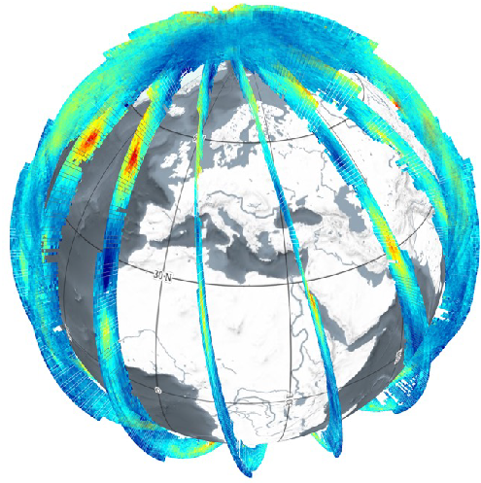
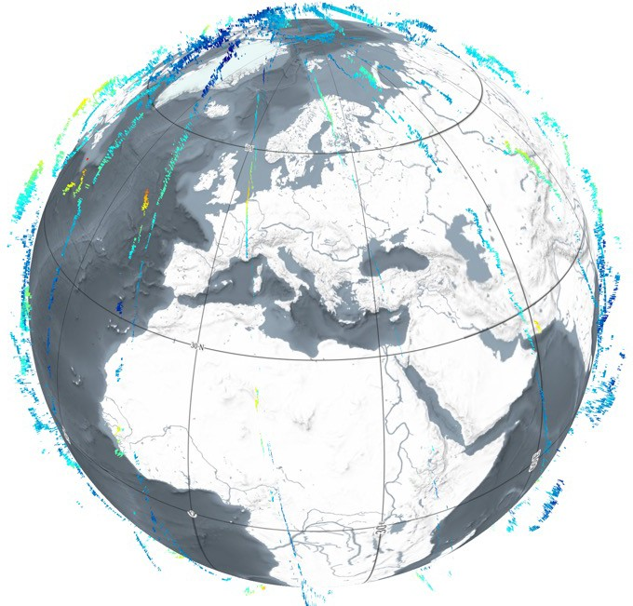
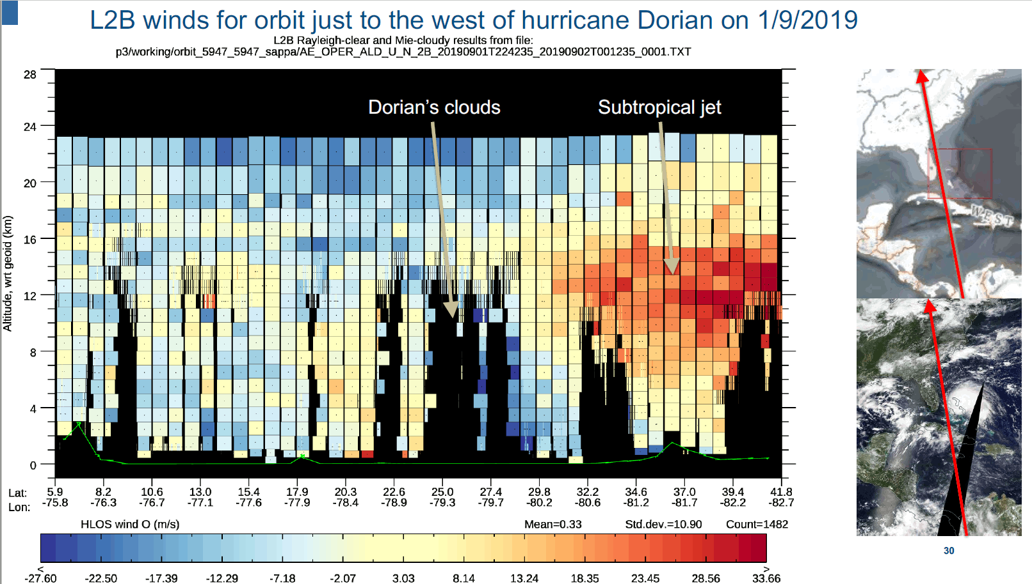
3D Winds – Filling a Critical Data Gap
There is a critical need to fill in data void regions (horiz & vertical) over oceanic, tropical, and polar regions of the globe.
“Tropospheric winds are the number-one unmet measurement objective for improving weather forecasts.” U.S. National Research Council (NRC) 2007 report.
National Acadamies 2018 Report: “Thriving on Our Changing Planet: A Decadal Strategy for Earth Observation from Space”:
  3D winds in troposphere/planetary boundary layer (PBL) for transport of pollutants/carbon/aerosol and water vapor, wind energy, cloud dynamics and convection, and large-scale circulation
  Candidate Measurement Approach: Active sensing (lidar, radar, scatterometer); or passive imagery or radiometry-based atmospheric motion vectors (AMVs) tracking; or lidar*
Spatial Distribution: Aeolus Winds
Rayleigh-clear
Mie-cloudy
From Michael Rennie, ECMWF)

Slide 17
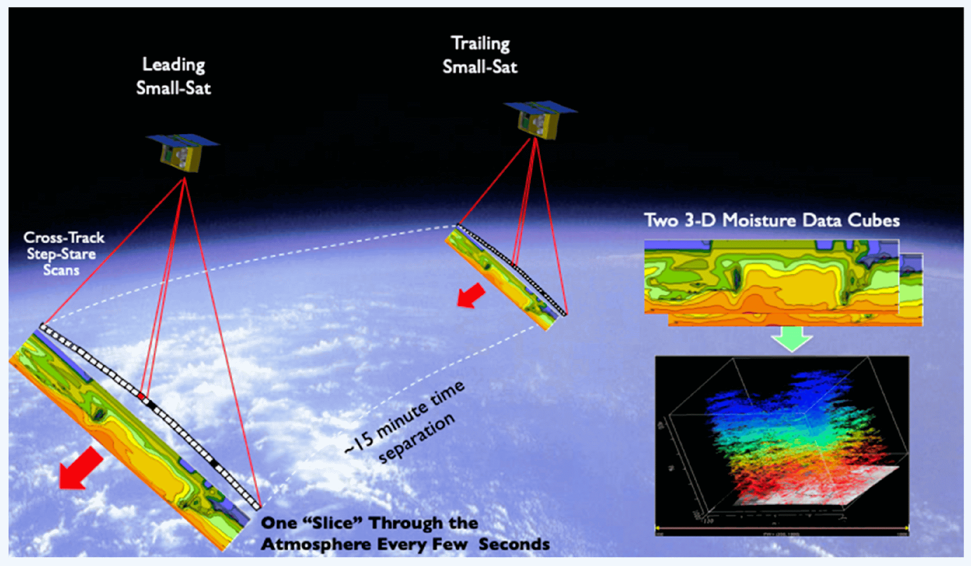
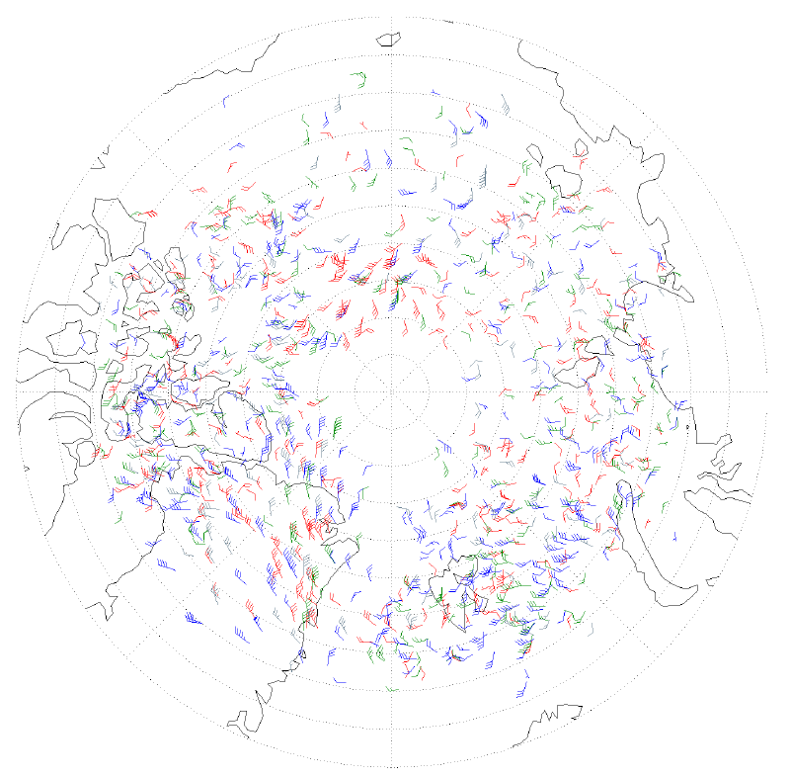
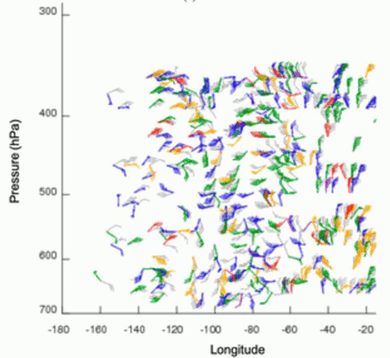
3D Winds – Filling a Critical Data Gap
There is a critical need to fill in data void regions (horiz & vertical) over oceanic, tropical, and polar regions of the globe.
“Tropospheric winds are the number-one unmet measurement objective for improving weather forecasts.” U.S. National Research Council (NRC) 2007 report.
National Acadamies 2018 Report: “Thriving on Our Changing Planet: A Decadal Strategy for Earth Observation from Space”:
  3D winds in troposphere/planetary boundary layer (PBL) for transport of pollutants/carbon/aerosol and water vapor, wind energy, cloud dynamics and convection, and large-scale circulation
  Candidate Measurement Approach: Active sensing (lidar, radar, scatterometer); or passive imagery or radiometry-based atmospheric motion vectors (AMVs) tracking; or lidar*
Spatial Distribution: Hyperspectral Sounder Winds
Aqua AIRs AMVs
From Dave Santek, U/W CIMSS
Notes:
Aqua AIRs AMVs derived from tracking moisture and ozone features (on pressure surfaces) observed in overlapping orbits.
Lower left figure shows the horizontal distribution of Aqua AIRS AMVs: All derived AIRS AMVs from 5 January 2011 color-coded by level: 700–600 hPa (red), 550–450 hPa (green),
400-300 hPa (blue), 150 hPa ozone (gray). Most of these retrieved winds are found in the mid-troposphere as indicated in lower right figure.
The combination of lidar winds and AMV winds might provide some advantages where one is used to calibrate the other.
AIRS instrument Horiz. Res: 13.5 km
Santek, D, S. Nebuda, and D. Stettner, 2019: Demonstration and Evaluation of 3D Winds Generated by Tracking Features in Moisture and Ozone Fields Derived from AIRS Sounding Retrievals. Remote Sens. 2019, 11(22), 2597; https://doi.org/10.3390/rs11222597
More significant NWP impact could be realized with a higher resolution hyperspectral sounder to retrieve more accurate AMVs. This could be done with a constellation of small polar-orbiting satellites flying in formation (in a similar orbit, but time separated) to track moisture features over time (as shown in top figure), or by placing a hyperspectral sounder on a geostationary satellite, which has been done recently by China with their Geostationary Interferometric Infrared Sounder (GIIRS) on FY4A and will be part of EUMETSAT’s Meteosat Third Generation (MTG) satellites.

Slide 18
Looking Ahead
NOAA BAA 3D winds studies plan to be completed this calendar year
  Assess study findings and make decisions on how to proceed
  A space deployment in the 2030-2050 timeframe is the target for an operational system
NOAA looks forward to acquiring and utilizing future data to develop/refine approaches for deriving tropospheric wind information
  Aeolus-2
    Aeolus wind profiles were not assimilated operationally in the NCEP GFS DA system because of the mission lifetime (3 years), however Aeolus’ longevity and work done at NOAA to ready NCEP’s Global Data Assimilation System has laid the foundation for operational use of Aeolus-2 wind data products.
  MTG and GeoXO Sounders
    Share/leverage development of clear-sky WV winds approaches
  New LEO satellite missions (ie., small sat concepts)
    Multiple LEO satellites, hyperspectral sounder, etc
Opportunities for continued NOAA/EUMETSAT collaboration

Slide 19
Questions?

