Slide 1
Cryogenic Ho:YLF Lasers for Advanced 2-Micron Transmitter
P. F. Moulton, A. Lobad, J. R. Ochoa, and T. Y. Fan
Workshop on Space-based Measurements of 3-Dimensional Winds
Feb. 19-20, 2025
DISTRIBUTION STATEMENT A. Approved for public release. Distribution is unlimited.
This material is based upon work supported by the Under Secretary of Defense for Research and Engineering under Air Force Contract No. FA8702-15-D-0001. Any opinions, findings, conclusions or recommendations expressed in this material are those of the author(s) and do not necessarily reflect the views of the Under Secretary of Defense for Research and Engineering.
© 2025 Massachusetts Institute of Technology.
Delivered to the U.S. Government with Unlimited Rights, as defined in DFARS Part 252.227-7013 or 7014 (Feb 2014). Notwithstanding any copyright notice, U.S. Government rights in this work are defined by DFARS 252.227-7013 or DFARS 252.227-7014 as detailed above. Use of this work other than as specifically authorized by the U.S. Government may violate any copyrights that exist in this work.
Notes:
1
1

Slide 2
Directly Pumped 2-µm Lasers for Doppler Wind Lidar
One transmitter approach is Tm-fiber-laser-pumped Ho³⁺:XXX (YLF, LLF, YAG)
There are key limitations for space-based lidar for 300 K Ho³⁺:XXX
  Average power
  Energy per pulse, particularly since at fixed average power, lower pulse repetition frequency (PRF), i. e., higher energy per pulse, is desired for coherent detection
  Efficiency
Cryogenic cooling (nominal 80 K) of Ho³⁺-doped crystals offers path forward
  Excellent average power scalability because of vastly improved thermo-optic properties of crystalline materials compared with 300 K
  Better energy-per-pulse performance because of lower saturation fluence for better extraction efficiency and lower risk of optical damage
  Excellent optical efficiency, near quantum-limited performance, by virtue of the transition becoming nearly ideal four-level laser and lower saturation flux/fluence at 80 K
  High electrical efficiency enabled by high optical efficiency and efficient, space-qualified Stirling coolers
Initial proof-of-principle demonstration of directly pumped, cryogenically cooled Ho:YLF shows the promise of this approach

Slide 3
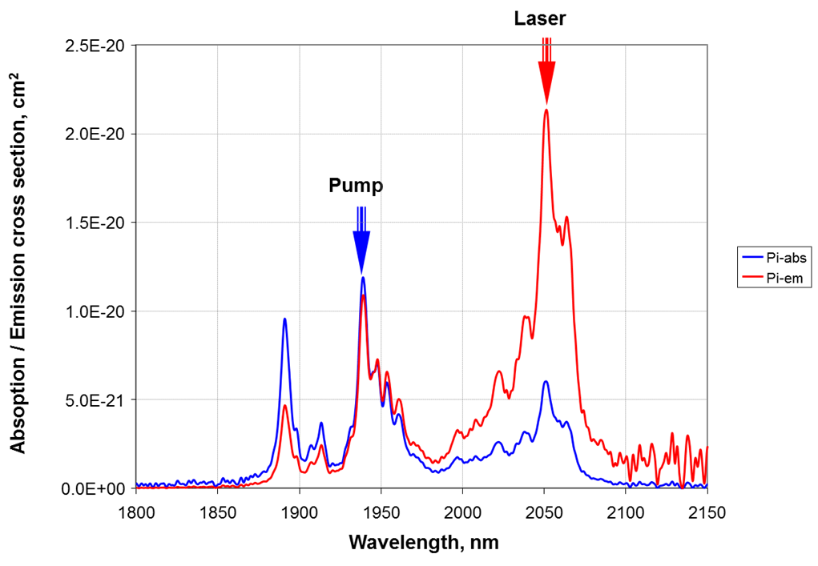
Overview of Technology:
Laser Pumping a Laser Pumping a Laser
  Diode pump lasers
  793 nm
  Tm:fiber laser
  1940 nm
  Ho:YLF crystal laser
  2050 nm
Efficient conversion of DC
to cw optical power
(35 → 53%)
Highly multimode
Output in fiber format
Efficient conversion of pump
to output( 55% → 75%)
Single mode
ns pulse energy limited by nonlinear effects to mJ levels
High energy storage
(15 ms lifetime)
Demonstrated ns-duration pulses > 150 mJ, > 100 W average powers
50% optical conversion, upside 90% with cryogenic cooling
“Eyesafer” wavelength
Laser
2.5E−20
Pi-abs
Pi-em
2.0E−20
Pump
1.5E−20
Absorption / Emission
Cross Section, cm²
1.0E−20
5.0E−21
0.0E+00
1800
1850
1900
1950
2000
2050
2100
2150
Wavelength, nm

Slide 4
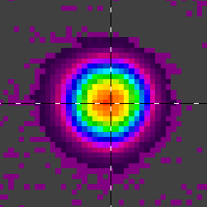
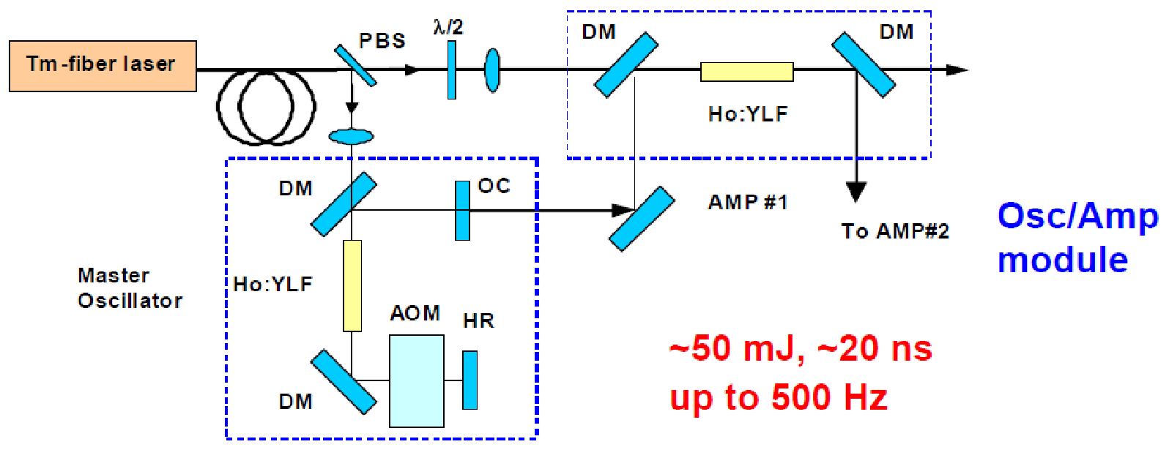
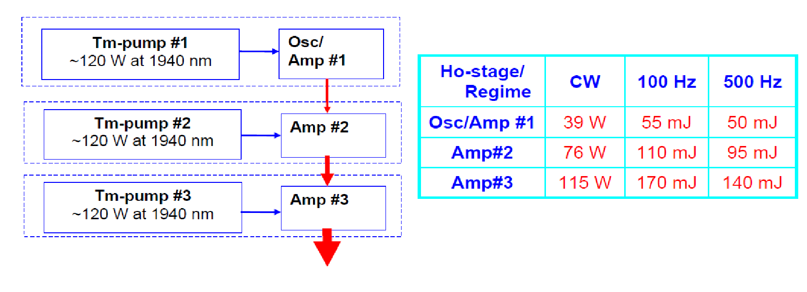
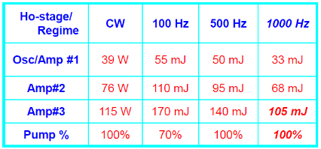
Prior Tm:Fiber-Pumped Ho:YLF Technology:
High-Energy, kHz-Rate, 20 nsec Pulses, >100 W Average, D.L. BQ
Courtesy Alex Dergachev,
formerly Q-Peak, Inc.
Pave:
17 W at 100 Hz
70 W at 500 Hz
105 W at kHz
CW 115 W
@360W of pump
8% wall-plug efficiency

Slide 5
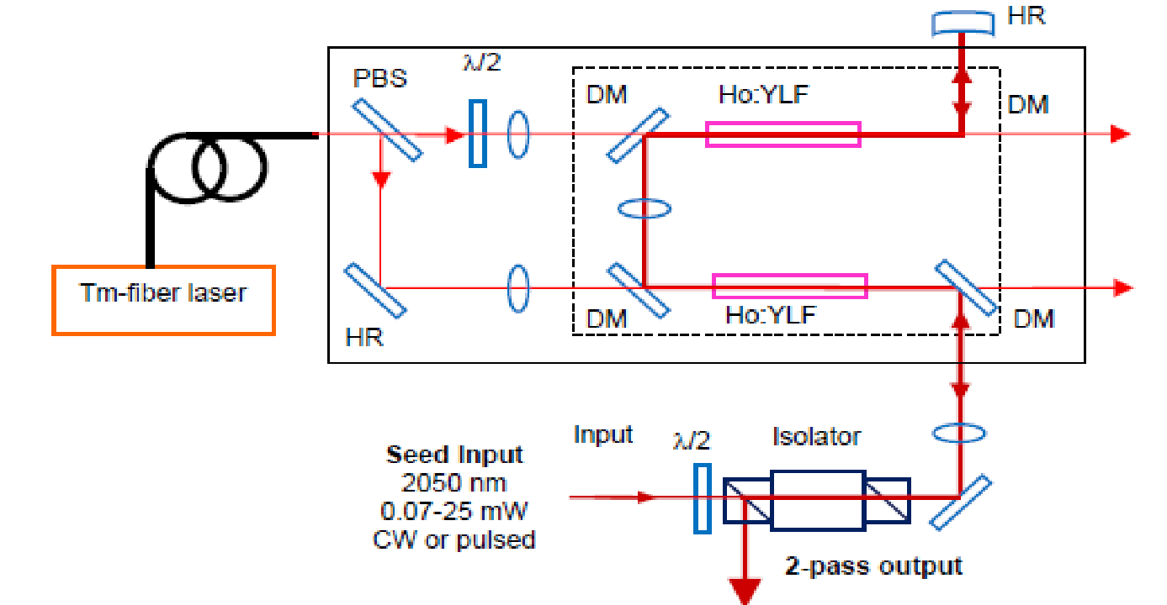



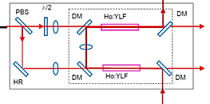
Complete System Design Provides Flexible Formats
High-gain Ho:YLF mid-stage amplifier
2050 nm modulated seeds
45-db gain
50 kW peak power out
seen in past work
More complex, but
narrow linewidth suited
for coherent systems
Tm:silica
fiber, 2-cm
HR
PR
High-gain,
long-wavelength
Tm:fiber
preamplifier
A. Dergachev, "45-dB, Compact, Single-Frequency, 2-µm Amplifier," in Lasers, Sources, and Related Photonic Devices, OSA Technical Digest (CD) (Optica Publishing Group, 2012), paper FTh4A.2.
Modulator
Distributed Bragg
gratings
Tm-fiber laser
Easy to implement,
poor linewidth control
Pulsed
diode
High-gain,
long-wavelength
Tm:fiber
preamplifier
Tm:fiber amplifier 200-600 W
1938 nm FBG seed laser
Ho:YLF power amplifier
Cryo cooling an option
with 90% efficiency
and efficient operation
at high pulse energies
Spiral in MIT LL fibers
for higher efficiency
2050 nm pulsed output

Slide 6
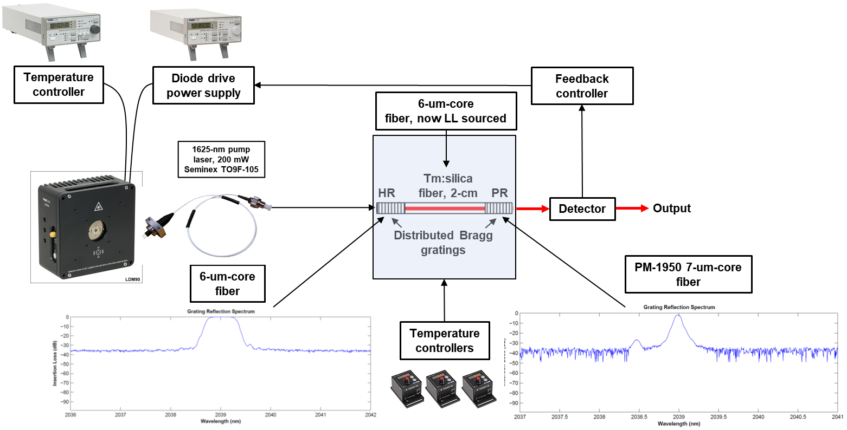
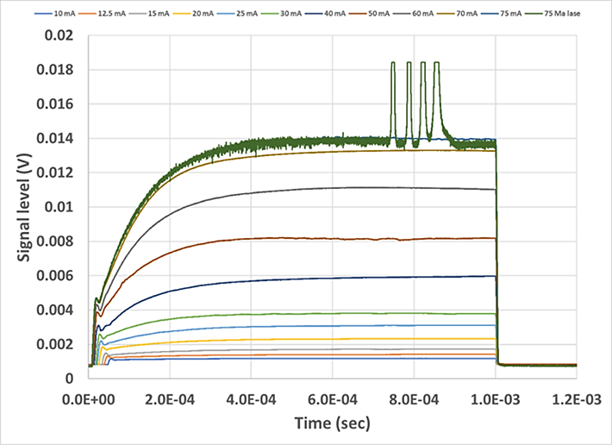
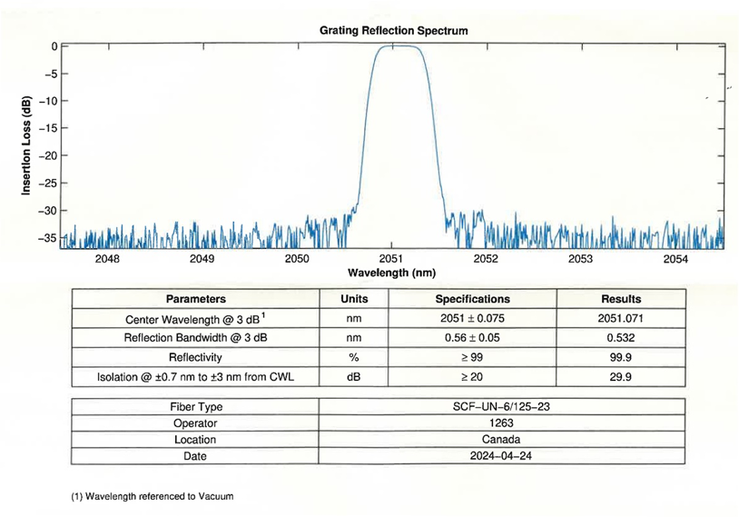
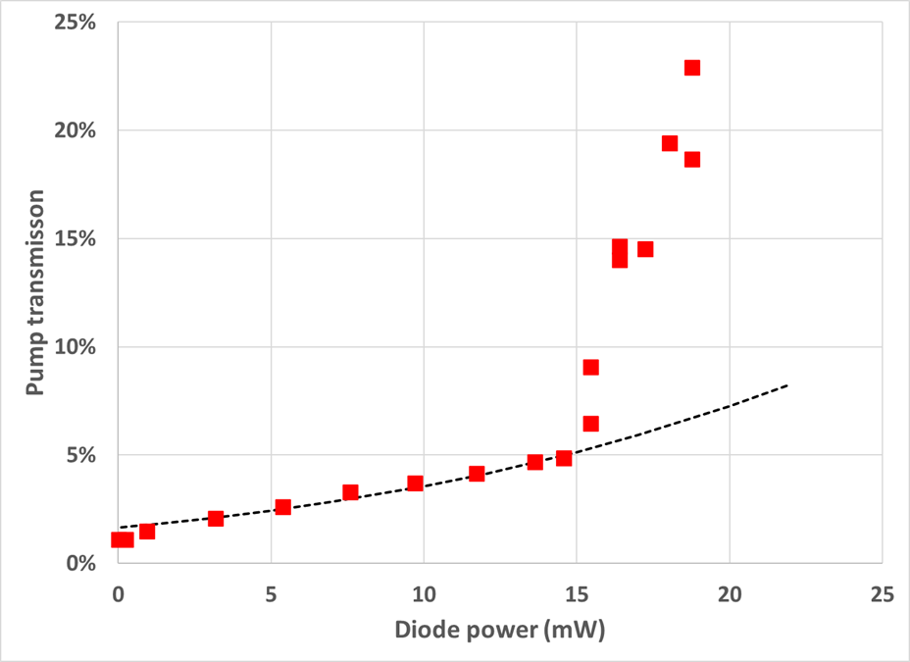
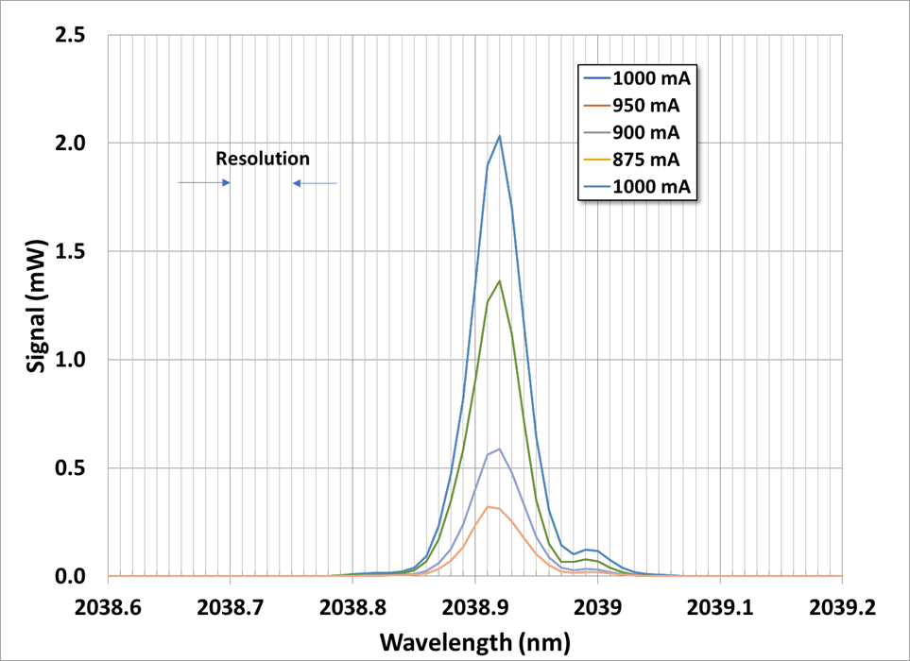
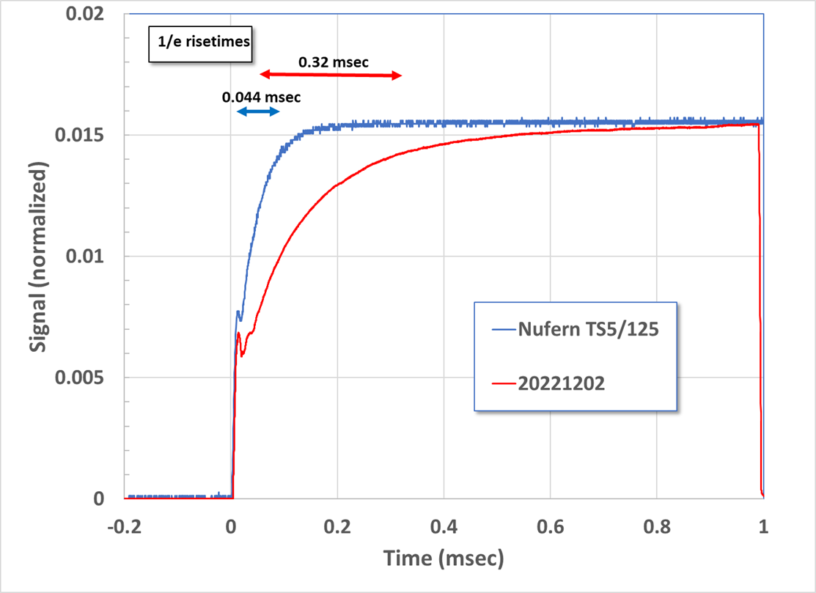
2039-nm DBR Design, Results and Future Work
0.02
10 mA
25 mA
New assembly with 2051-nm FBGs to be built
0.018
12.5 mA
30 mA
60 mA
15 mA
40 mA
70 mA
0.016
20 mA
50 mA
75 mA
75 Ma lase
0.014
0.012
Signal Level (V)
0
0.01
Grating
Reflection
Spectrum
0.008
-5
0.006
-10
-15
Insertion Loss (dB)
0.004
-20
0.002
-25
-30
0
-35
0.0E-04
2.0E-04
4.0E-04
6.0E-04
8.0E-04
1.0E-03
1.2E-03
2048
2049
2050
2051
2052
2053
2054
Time (sec)
Wavelength (nm)
25%
2.5
0.02
20%
2.0
0.015
15%
1.5
Pump Transmission
0.01
Signal (mW)
Signal (normalized)
0.01
10%
1.0
5%
0.5
0.005
0
0
5
10
15
20
25
0
0
Diode Power (mW)
2038.6
2038.7
2038.8
2038.9
2039
2039.1
2039.2
-0.2
0
0.2
0.4
0.6
0.8
1
Wavelength (nm)
Time (msec)

Slide 7
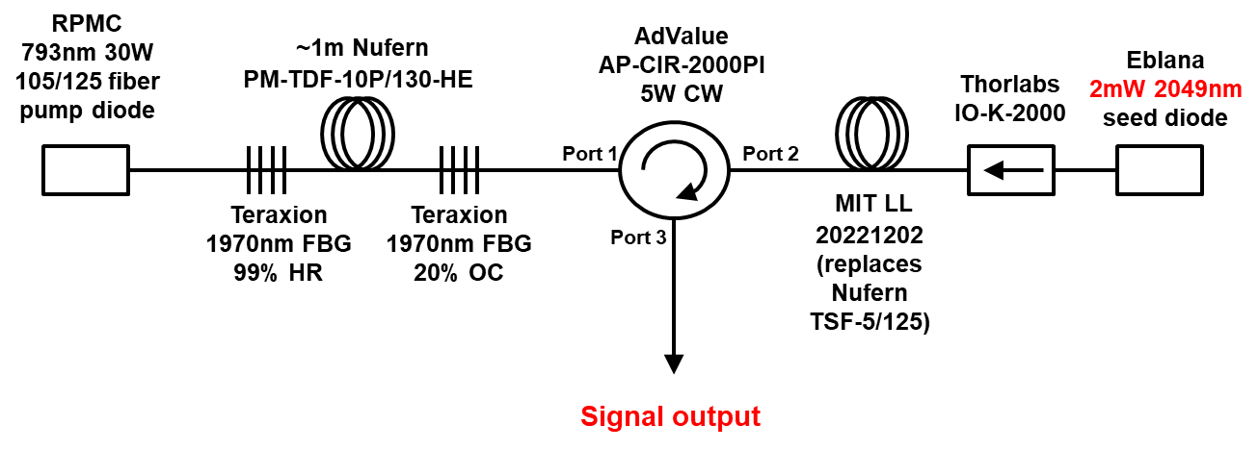
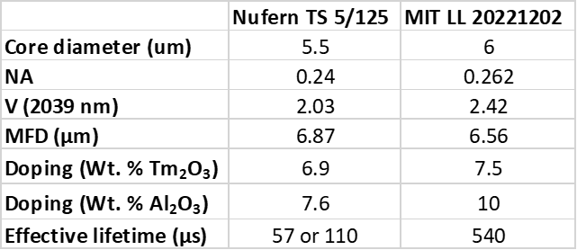
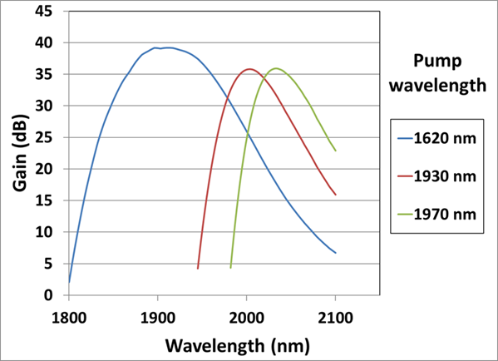
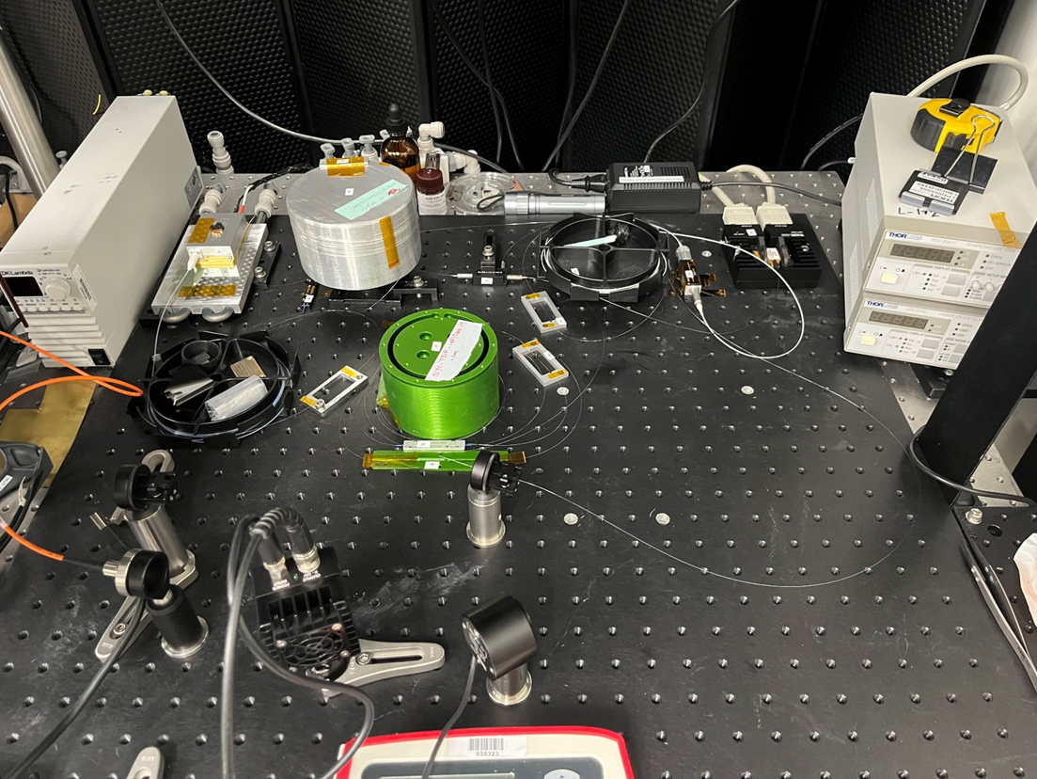
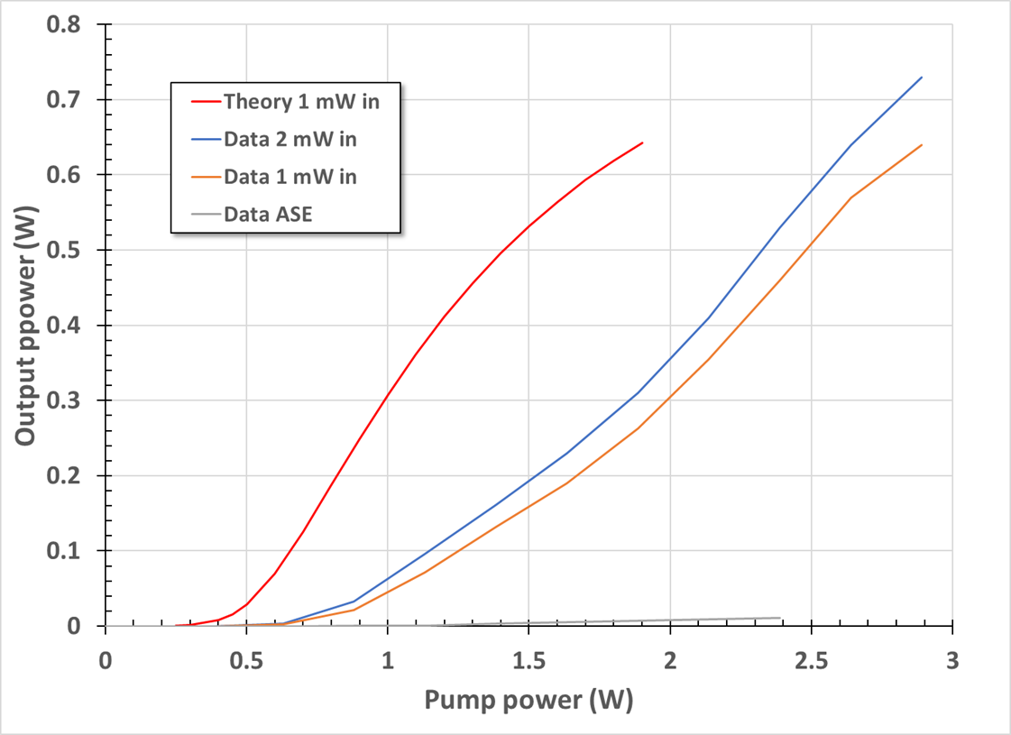
High-Gain, Long-Wavelength Preamplifier (HGLWP)
Maximum cw gain:
28 dB at 2049 nm
Pump
Wavelength
US Patent 9,4665,939 B2

Slide 8
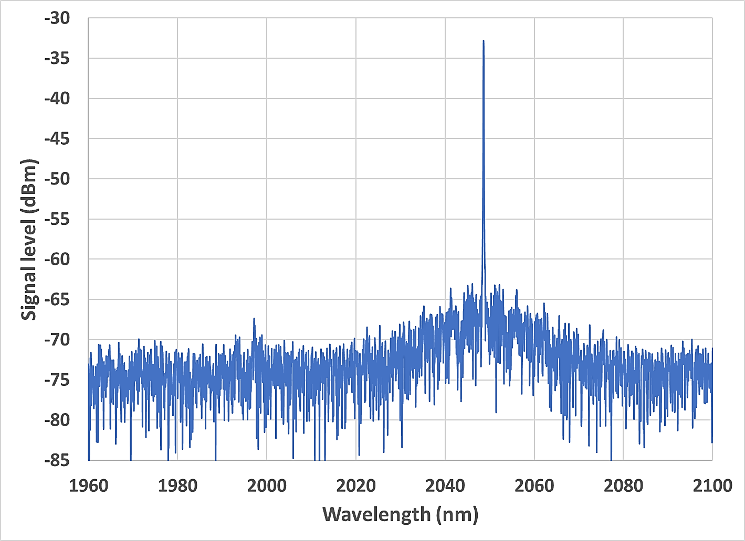
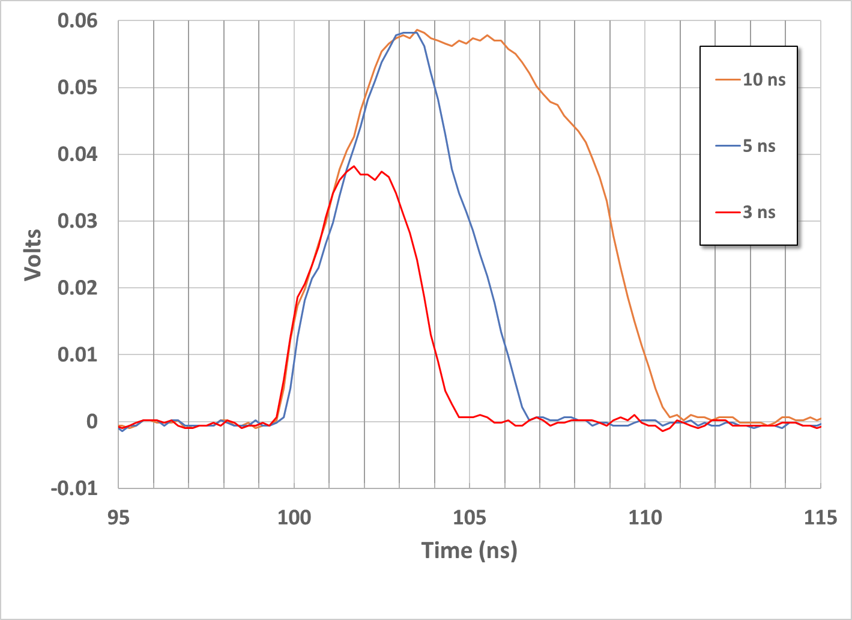
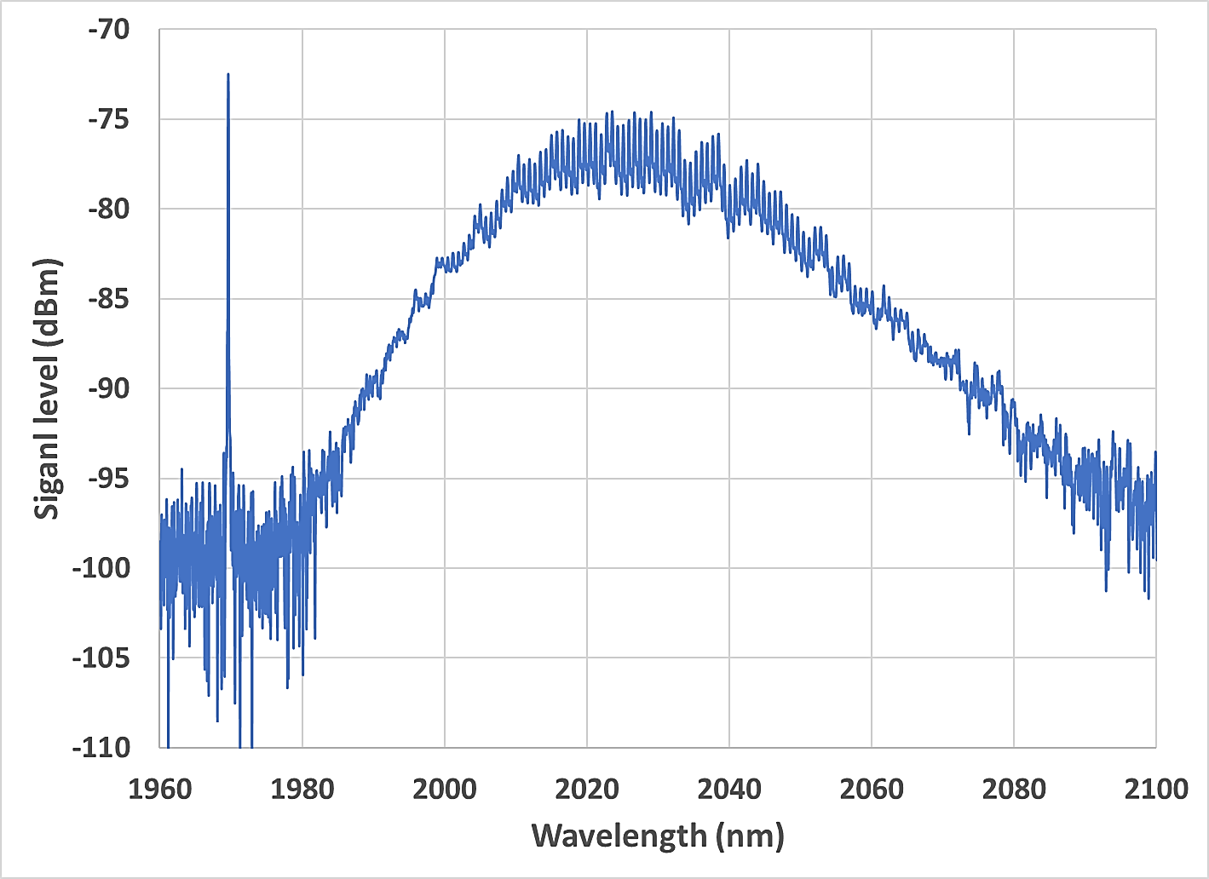
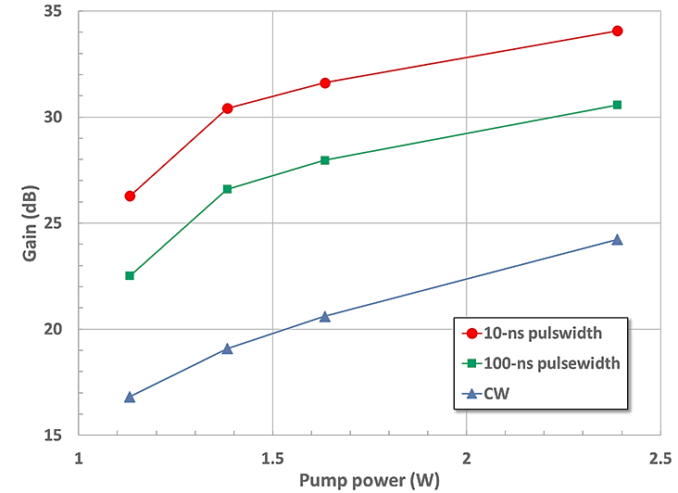
HGLWP Output at 2049 nm, ASE (no input)
Spectra and Pulsed Data
2 mW in
530 mW out
> 30 dB SNR
2.4 W pump
At 10 ns PW, 1 MHz PRR (1% D.C.)
51 mW average output power
5.1 W peak power
→ 34 dB gain @ 2 mW peak in
No input,
11 mW total out
2.4 W pump
Notes:
We plot the output spectra of the HGLWP at 530 mW of output power, showing (left) a > 30 dB ratio over the background ASE output. The plot on the right shows the spectra with no seed power. These curves confirm that the system provides very high gain at long wavelengths with minimal parasitic output.

Slide 9
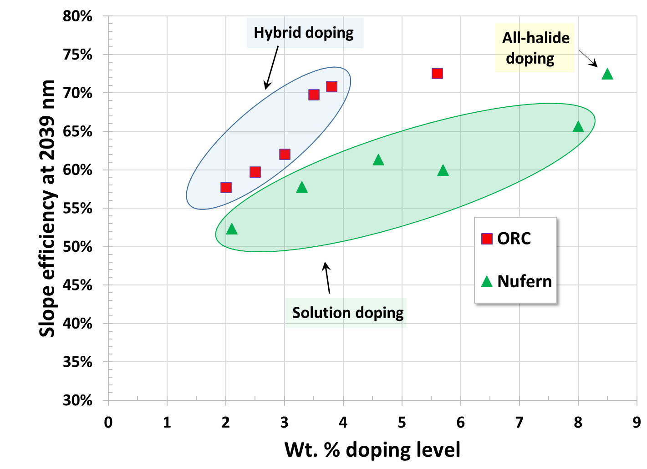
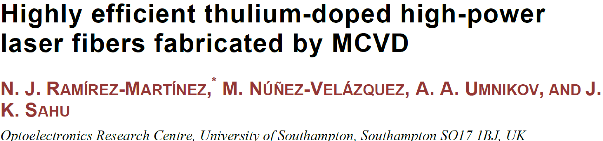
Tm:Fiber Laser Efficiencies:
Improved by Vapor-Phase Al (Tm) Doping
Results suggest that fiber fabrication technology as well as doping level have an impact on optical-optical efficiency
All efficiencies corrected for 2039-nm operation
Operation at 1938 nm 1.05x higher (76%)
1938 nm pump laser in this work uses 41% efficient pump diodes and commercial fiber with 45% slope
Notes:
Recent work has demonstrated that improved Tm:fiber fabrication processes can lead to improved Tm:fiber laser efficiencies. These are incorporated in the newly established fiber fabrication facility at MIT LL.

Slide 10
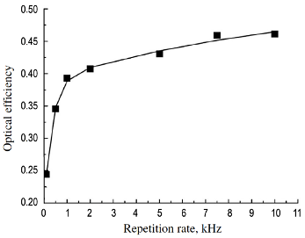
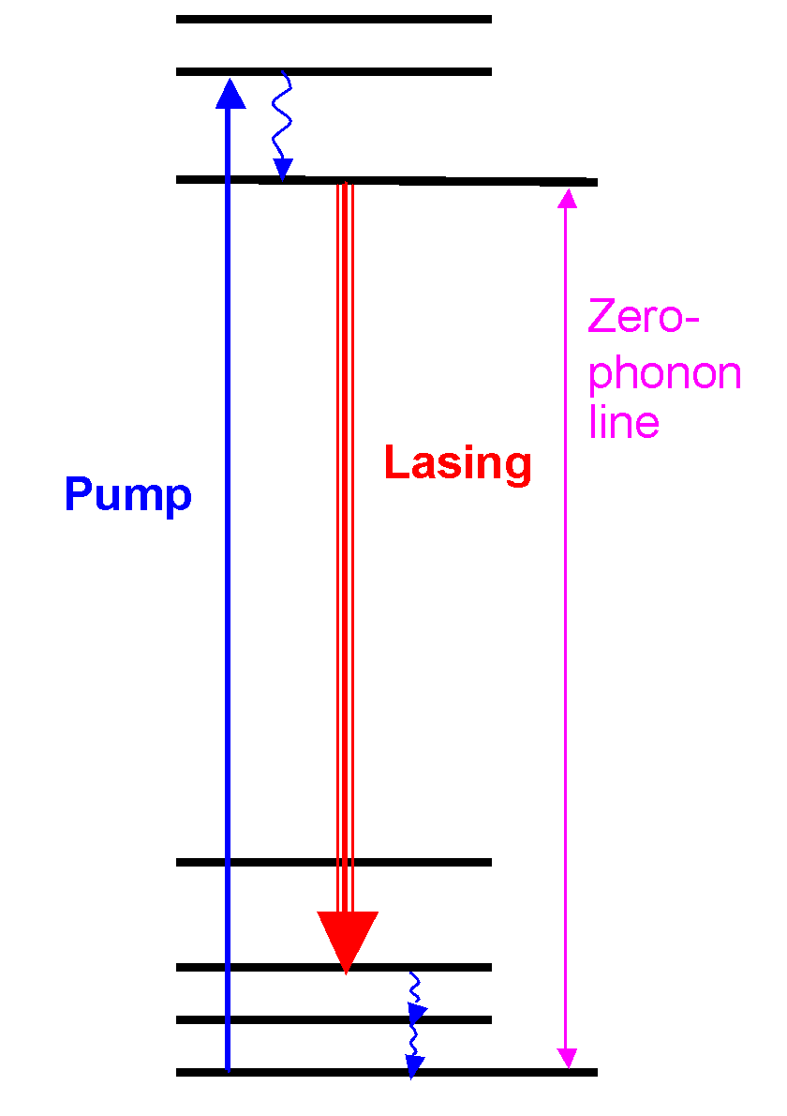
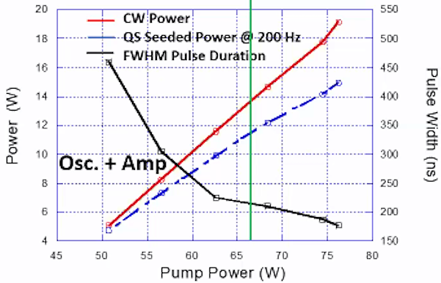
Limitations for 300 K Ho:YLF/LLF at Low Pulse Rates
Ho:YLF/LLF Energy Levels
Room temperature operation of Ho:YLF/LLF limits optical efficiency to ~50% using 1.9-µm pumping at high PRF (>2 kHz) and drops at low PRF (<1 kHz)
Limits on optical efficiency caused by quasi-three-level nature of transition and the need to bleach absorption to reach transparency
Saturation fluence of 4.4 J/cm² leads to damage risk and limits extraction efficiency
Optical Efficiency vs PRF
0.50
Upper-level (2) population
thermalizes rapidly
0.45
0.40
2
Optical Efficiency
0.35
3
0.30
Y. Bai et al.,
(2009)
0.25
0.20
0
1
2
3
4
5
6
7
8
9
10
11
Repetition Rate (kWz)
Ho:YLF Cross Sections (300 K)
Performance for CW and 200 Hz
Laser
20
550
2.5E−20
18
500
2.0E−20
16
450
4
Pump
Pi-abs
Pi-em
14
400
1.5E−20
Power (W)
Pulse Width (ns)
1
Absorption / Emission
Cross Section, cm²
12
350
1.0E−20
10
300
Lower-level (4) at around 315 cm⁻¹
~1.5kT at 300 K
5.0E−21
8
250
6
200
0.0E+00
1800
1850
1900
1950
2000
2050
2100
2150
4
45
50
55
60
65
70
75
80
150
Wavelength, nm
Pump Power (W)
S. Henderson et al.,
(2022)
Y. Bai et al, “High repetition rate and frequency stabilized Ho:YLF laser for CO₂ differential absorption lidar,” ASSP 2009, paper WB22.
S. Henderson et al, “Coherent lidar for airborne wind measurements with high-percentage tropospheric coverage,” Optica Advanced Photonics Congress, paper LsM6C.2

Slide 11
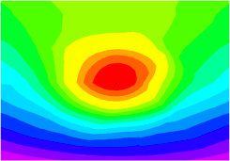
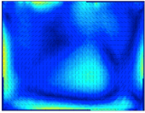
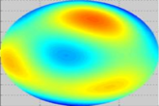
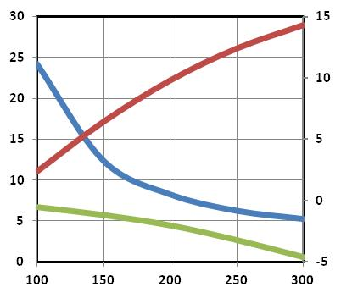
Why Use Cryogenic Temperatures?
Thermo-optic Properties
Thermal effects limit average power and beam quality
κ
dn/dT
CTE
Temperature
non-uniformity
Beam
distortion
Stress induced
birefringence
Key YLF Thermal Properties
Poor thermal conductivity κ inhibits heat removal, resulting in large temperature non-uniformity
This changes the index through dn/dT and results in beam distortion
Thermal expansion (CTE) creates stress which can cause depolarization and damage
All key thermo-optic properties scale favorably as temperature decreases by large amounts
Favorable
Thermal Conductivity
(W/m/K)
CTE (ppm/K),
dn/dT (ppm/K)
Favorable
Temperature (K)
Cryogenic cooling enables average-power scaling
Notes:
The thermo-optic properties of many Yb host systems improve as they are cooled to cryogenic temperatures. This graph shows the thermal conductivity, coefficient of thermal expansion, and temperature dependence of the refractive index for undoped YLF. All properties scale favorably as the temperature is decreased. These performance improvement trends hold for most other crystalline dielectrics as well.

Slide 12
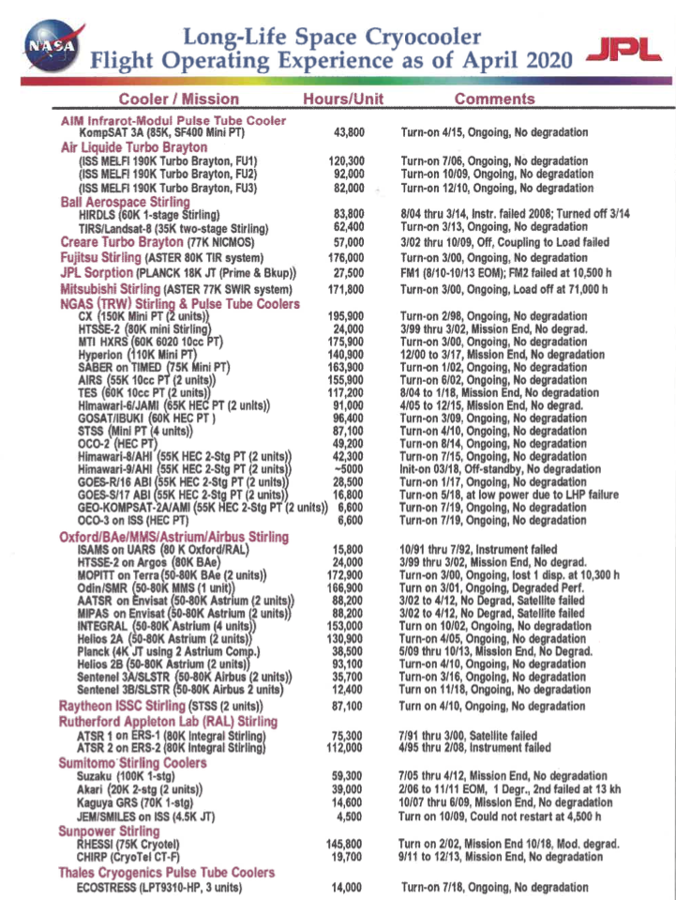
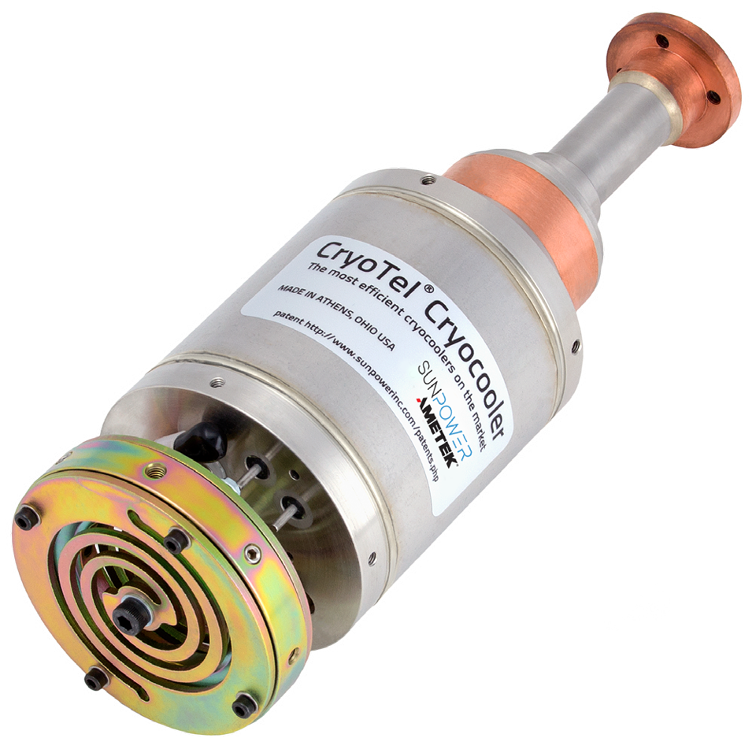
Stirling Coolers for Space Operation
Stirling coolers have been used in many space missions, primarily to cool infrared detectors and are considered mature for space
Application to cooling laser gain media for space-based applications appears to be new
Example Stirling Cooler – CryoTel CT
Key Specifications
Nominal lift at 77 K | 11 W
Nominal input | 160 W
Cooler mass | 3.1 kg
Length | 26.1 cm
MTTF | >200,000 hrs
M. Meyer and R. G. Ross, “NASA Cryogenics Technical Discipline Team Updates Long-Life Space Cryocooler Flight Operating Experience Survey,” Cold Facts 36 (5), 20 (2020).

Slide 13
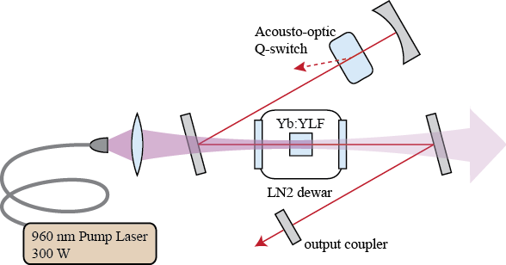
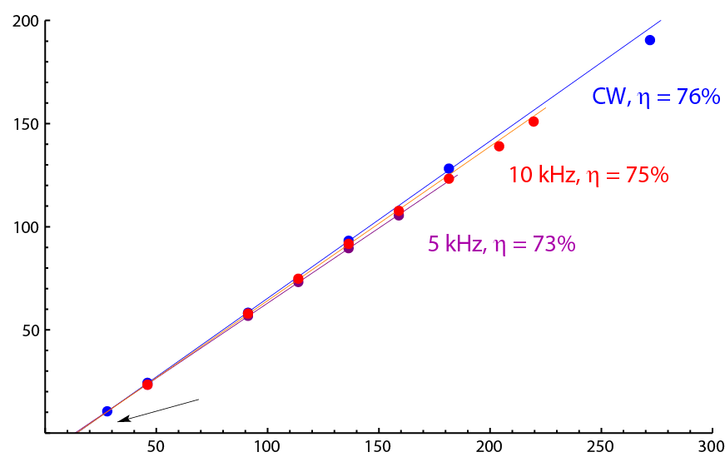
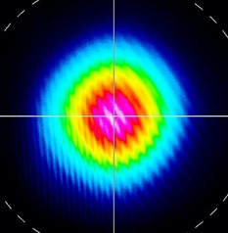
100-W-Class Q-Switched Yb:YLF (995 nm)
Proof-of-principle pulsed cryogenic Yb:YLF laser to demonstrate:
Power scaling to 100-W level
Diffraction limited beam quality
ns-class pulses with short coherence length
Efficient operation
Performance Data
149 W output at 10 kHz Q-switched PRF
M² beam quality of 1.04 (at 143 W)
64 ns pulse duration at 100 W, 10 kHz
  0.11 W heat deposited per 1 W output CW
Minimal thermo-optic effects
Output Power (W)
13 W Pump Threshold
Absorbed Pump Power (W)
Excellent performance and low thermal load sets stage for significant power scaling
D. E. Miller et al., Cryogenically cooled, 149-W, Q-switched, Yb:LiYF₄ Laser,” Opt. Lett. 38, 4260 (2013)
Notes:
Previously cleared under 109616

Slide 14
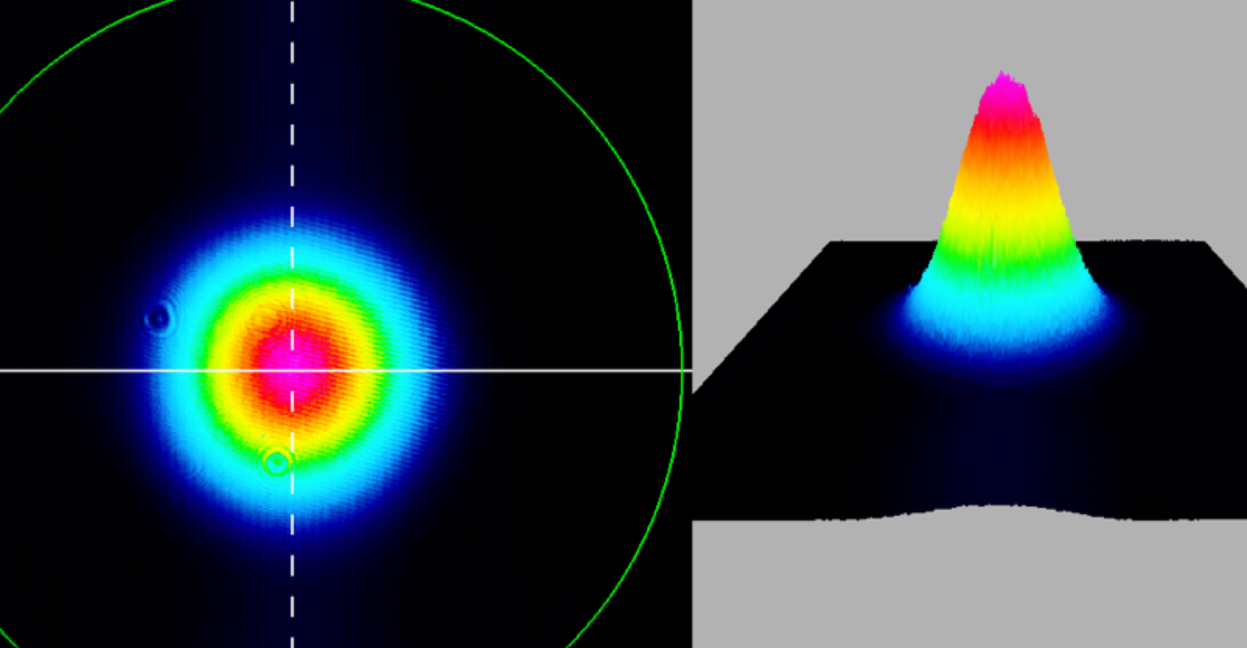
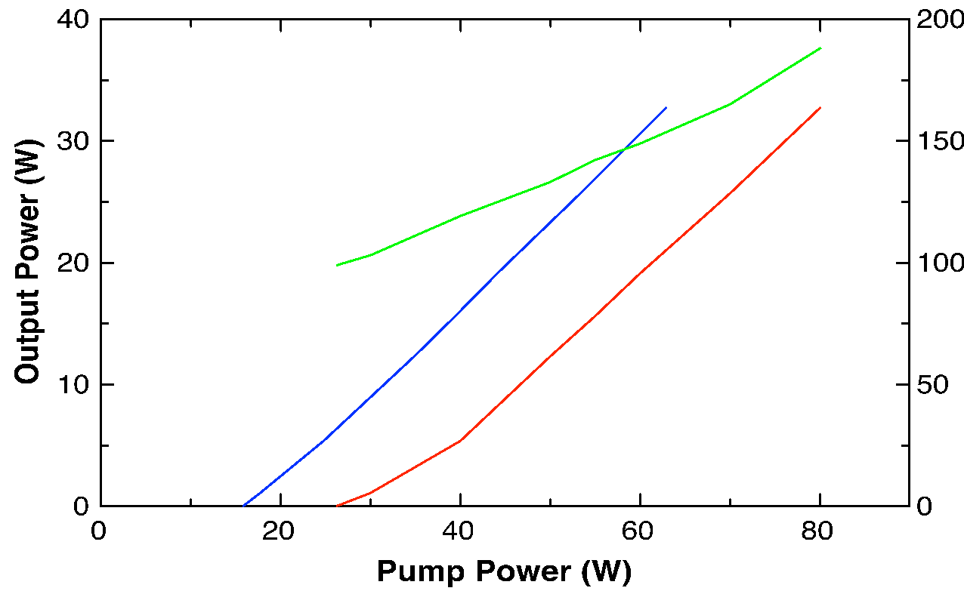
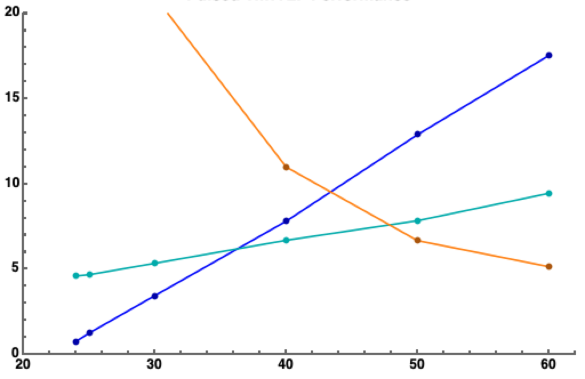
Stirling-Cooled Tm:YLF at 815 nm
791-nm pumped Tm:YLF with excellent performance, >30 W cw power at >35% optical efficiency
  TEM₀₀ output
  Electrical-to-optical efficiency at highest pump power including power to Stirling cooler is 8.4%
17.4 W Q-switched output power (pump-power limited) at 4 kHz pulse repetition frequency
  60-W incident pump power, 52-cm-long resonator, 90% R output coupler
Near-Field Beam at 19 W Output Power
CW Laser Performance
Q-Switched Performance (4 kHz)
79 K cold tip
90% R
Linear resonator
20
15
output power
Stirling Prime Power (W)
Power (W)
Pulse Width (x10, µs)
vs absorbed, 72% slope
10
transmitted pump
vs incident, 68% slope
5
pulse width
0
20
30
40
50
60
Incident Pump Power (W)
T. Y. Fan et al, "High-Power Tm:LiYF₄ Laser at 815 nm,” ASSL-23, paper AW4A.2
Notes:
1
1

Slide 15
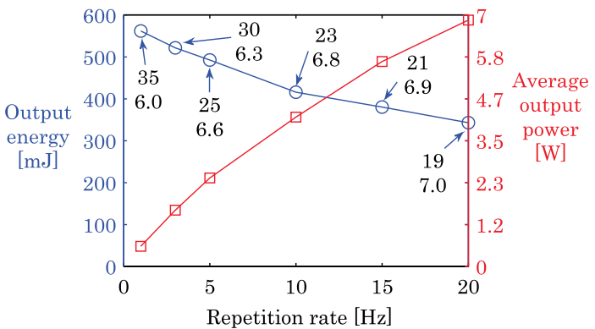
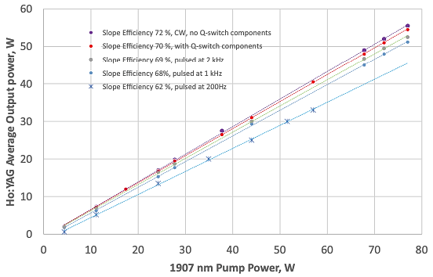
Direct-Pumped Cryogenic Ho³⁺ Lasers – Previous Work
Ho:YLF – Fonnum et al (2013)
Liquid nitrogen-cooled Ho:YAG and Ho:YLF lasers have been demonstrated
Ho:YLF pumped at 1940 nm and oscillates at 2051 nm – high energy per pulse at low PRF with relatively poor optical efficiency
Ho:YAG pumped at 1907 nm with laser output at 2098 nm – excellent optical efficiency down to 200 Hz PRF
YLF has two attractive properties relative to YAG for space lidar transmitter
  YLF has longer upper-state lifetime, 14 ms vs 7 ms, which helps maintain high efficiency to lower PRF
  YLF has smaller quantum defect, 5.4% vs 9.1%, for less thermal load, and therefore less electrical drive, to Stirling cooler
Ho:YAG – Ganija et al (2020)
Prior cryogenic laser work has demonstrated that basic principles should apply to Ho:YLF
M² < 1.15 at 27 W output
H. Fonnum et al., “550 mJ Q-switched cryogenic Ho:YLF oscillator pumped with a 100 W Tm:fiber laser, Opt. Lett. 38, 1884 (2013)
M. Ganija et al., “Cryogenically cooled, Ho:YAG, Q‑switched laser,” Appl. Phys. B 126, 72 (2020)

Slide 16
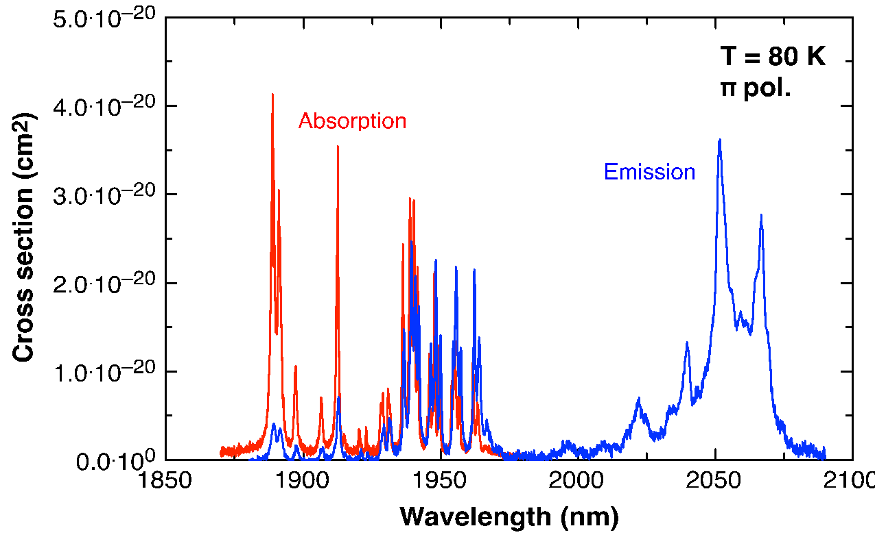
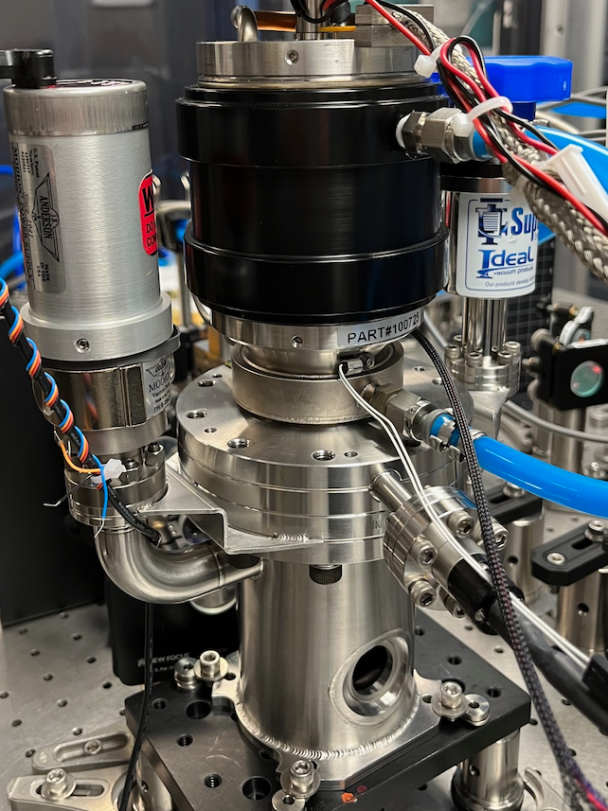
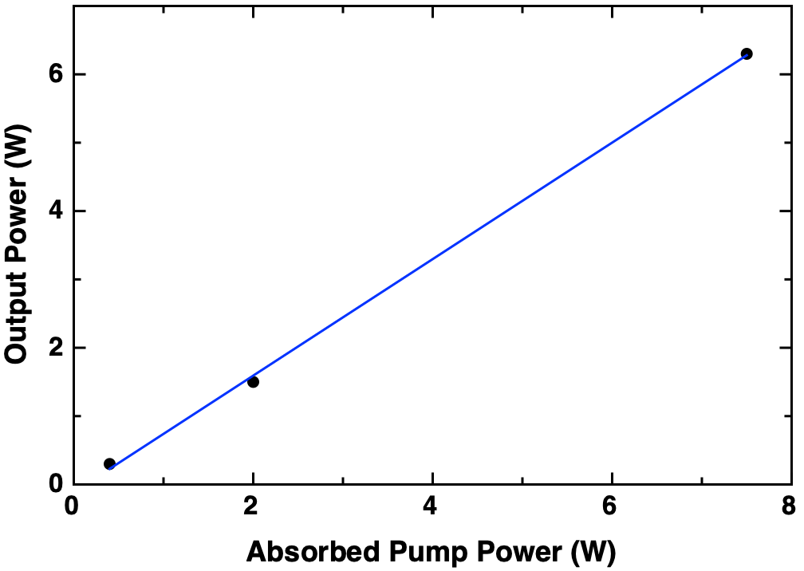
Proof-of-Principle Stirling-Cooled, Cryogenic Ho:YLF
Stirling-cooled Ho:YLF pumped by Tm-doped fiber amplifier
Gain cross section relative to 300 K is about doubled – saturation fluence/flux decreased by about half
0.3%-doped crystal, 25 mm long
CW operation at 85% slope efficiency and 83% optical efficiency relative to absorbed power – 77% of incident power is absorbed
Absorption and Emission Spectra
Stirling-cooled gain module
CW Laser Performance
T = 80 K
Dichroic HR
1940 nm
pump
Dichroic HR
DBR Tm Fiber Oscillator
Tm Fiber Amplifier
Ho:YLF
85% slope
HR
2050 nm
output
Output Coupler R = 80%
DBR: Distributed Bragg Reflector
HR: High reflector

Slide 17
Cryogenic Ho:YLF Efficiency Projection
Electrical-to-optical efficiency of 9.3% projected with 40 W output at 2.05 µm and electrical inputs to pump diodes and Stirling
  430 W electrical input
  20 W residual light (fluorescence + pump)
  10 W heat to cryogenic reservoir; 370 W to 300 K reservoir
Key assumptions
  Optical efficiency same as cryo Ho:YAG demo at
  200 Hz PRF
  CryoTel CT performance
  25% Tm-fiber amp efficiency
  0.25 W cryogenic thermal load per W of Ho:YLF output
Some of these assumptions are conservative with upside to >12% electrical efficiency
Block Diagram of Power Flow Accounting
150 W electrical
Cryocooler
160 W thermal (300 K reservoir)
10 W thermal (80 K reservoir)
280 W electrical
Pump Laser
Ho:YLF
40 W laser
output
70 W pump
20 W fluorescence and pump (300 K reservoir)
210 W thermal (300 K reservoir)
Cryogenic Ho:YLF offers path to >2X electrical efficiency compared with 300 K Ho:XXX
Notes:
1
1

Slide 18
Summary
Cryogenic Ho:YLF offers a large step change in transmitter performance relative to current 2-µm transmitter technology by virtue of fundamentally better materials properties and provides a path to space-based transmitter
  Better average power scalability (>10X), better energy per pulse capability (lower E_{sat}), higher electrical-to-optical efficiency (>2X, including power to the cryocooler)
  Leverages mature Stirling cooler technology
Demonstrations of cryocooled lasers (Yb:YLF, Tm:YLF, Ho:XXX) support this notion and validate the fundamental laser physics
Ongoing developments in Tm-doped fibers for pumps and other front-end technology offer further improvements to transmitter technology in push to space
Next step: implement Tm-fiber-pumped cryogenic Ho:YLF laser for coherent Doppler wind lidar transmitter

