Slide 1



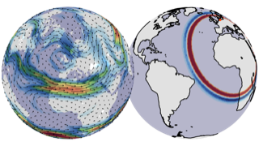
Scale-Dependent and Flow-Dependent Effects of Aeolus HLOS winds in the ECMWF system: Some Findings from the Aeolus+Processes Project
Nedjeljka Žagar, Robin Pilch Kedzierski¹, Chen Wang¹, Valentino Neduhal¹ and Frank Sielmann¹
Giovanna de Chiara², Sean Healy² and Michael Rennie²
¹University of Hamburg, Germany
²European Centre for Medium-Range Weather Forecasts

Slide 2
A bit of my history with the Atmospheric Dynamics Mission Aeolus
Some sketches from a 20-year-old PowerPoint file.
Wind field: V
GOS
GOS needs winds in the tropics and at subsynoptic scales
Mass field: M
but
while
https://doi.org/10.1175/1520-0469(2004)061<1877:AOEWBL>2.0.CO;2, J. Atmos. Sci., 2004

Slide 3
A bit of my history with the Atmospheric Dynamics Mission Aeolus
Some sketches from a 20-year-old PowerPoint file.
ADM Aeolus mission
Advanced NWP models and data assimilation, in particular 4D-Var
≈
Perfect-model OSSEs demonstrated effects of Aeolus HLOS winds on the large-scale equatorial waves in 3D-Var and 4D-Var OSSEs, in particular when used together with the mass-field data
https://doi.org/10.1175/1520-0469(2004)061<1877:AOEWBL>2.0.CO;2, J. Atmos. Sci., 2004

Slide 4


A bit of my history with the Atmospheric Dynamics Mission Aeolus
Some sketches from a 20-year-old PowerPoint file.
Advanced NWP models and data assimilation, in particular 4D-Var
Perfect-model OSSEs demonstrated effects of Aeolus HLOS winds on the large-scale equatorial waves in 3D-Var and 4D-Var OSSEs, in particular when used together with the mass-field data
WMO 2005 award for young scientists for J.Atmos.Sci. paper on the potential Aeolus impact on tropical wave flows
https://doi.org/10.1175/1520-0469(2004)061<1877:AOEWBL>2.0.CO;2, J. Atmos. Sci., 2004

Slide 5
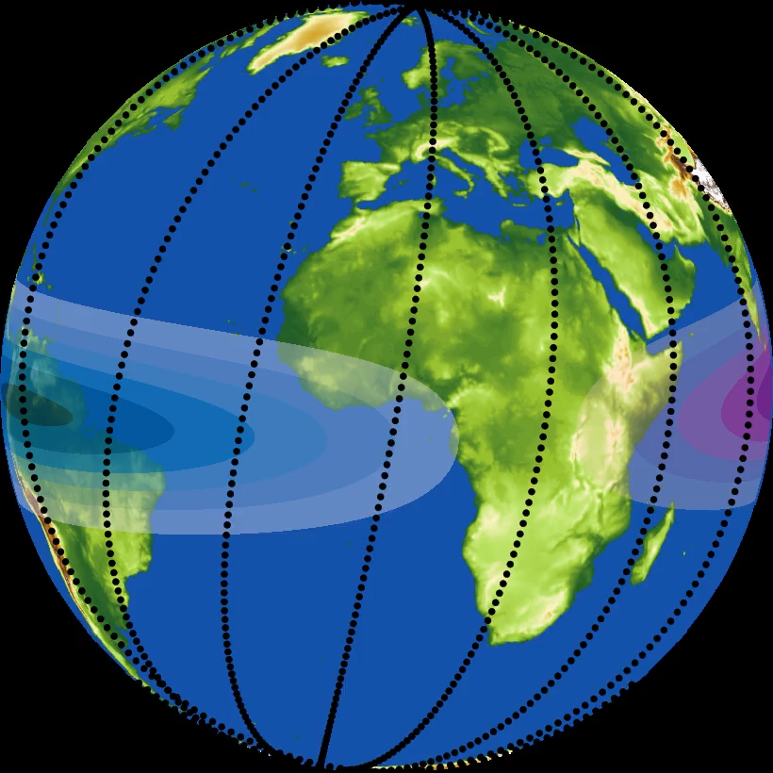
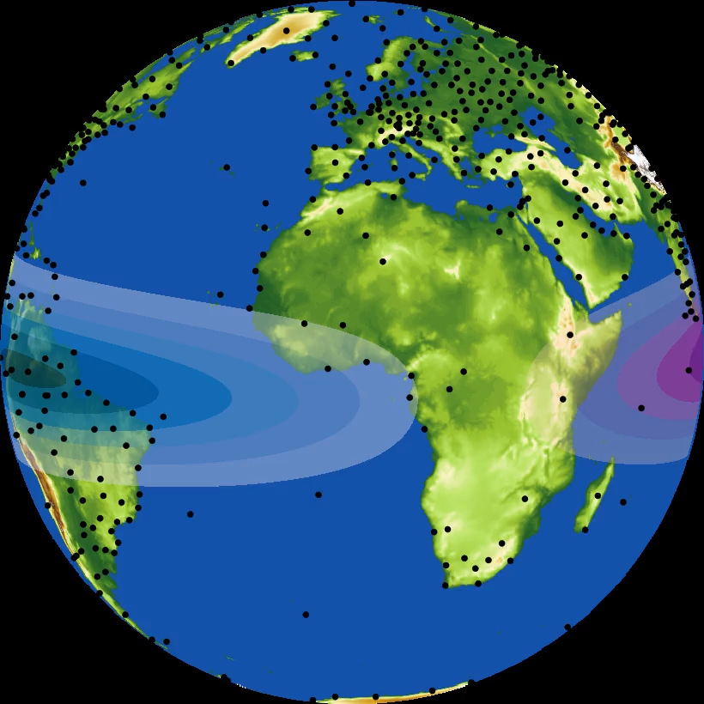
Atmospheric Dynamics Mission - Aeolus Doppler Wind Lidar mission
22 August 2018 - 28 July 2023
“Not all data are equal in their information-yielding capacity. Some are more equal than others.” J. Smagorinsky, 1969
ESA Aeolus+Processes project
Untangling process improvements in the ECMWF analyses and forecasts by the HLOS wind profiles.
1. What processes have been improved by Aeolus?
2. What is the role of 4D-Var for the analysis improvements by Aeolus?
3. How do Aeolus and COSMIC2 complement each other in 4D-Var?
4. How can we quantify scale-dependent predictability improvement due to Aeolus, compared to other observing systems, for example COSMIC2?
Aeolus 12-hour track
The project focuses on the tropical UTLS using the ECMWF OSEs
Sondes

Slide 6
Process improvements by Aeolus HLOS wind profiles
The effects of assimilating Aeolus wind profiles on equatorial waves are linked to the background shear.
The significant impact of Aeolus data on the meridional wind highlights analysis uncertainties in cross-equatorial flow (and power of the 4D-Var).
Overall, the effect of Aeolus in DA asserts uncertainties in tropical wind shear and wave-driven circulations
Submitted to GRL, DOI: 10.22541/essoar.173776264.46417622/v1

Slide 7
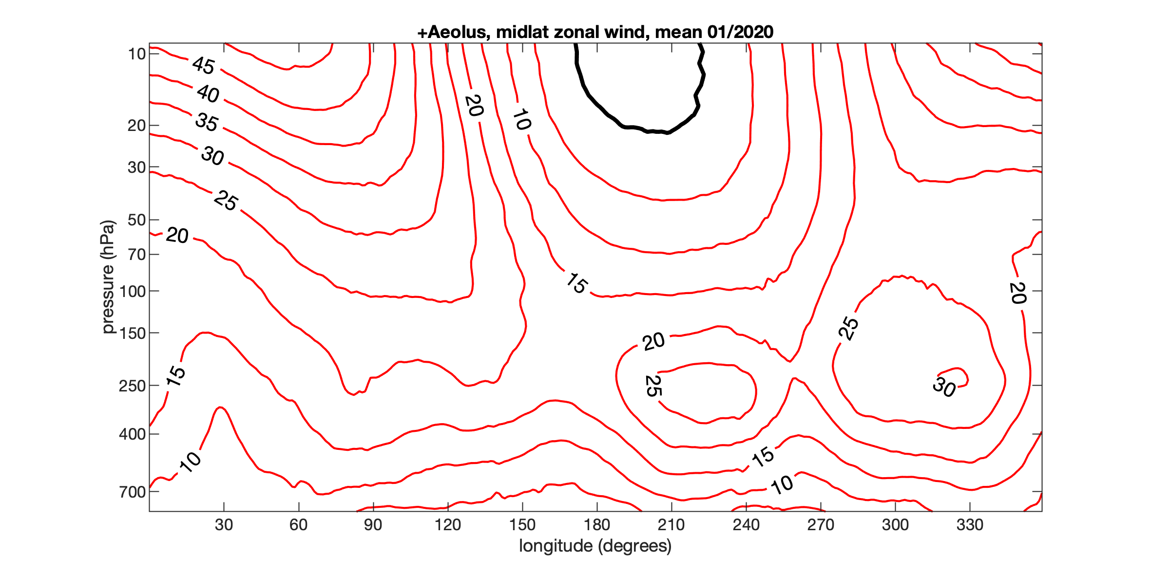
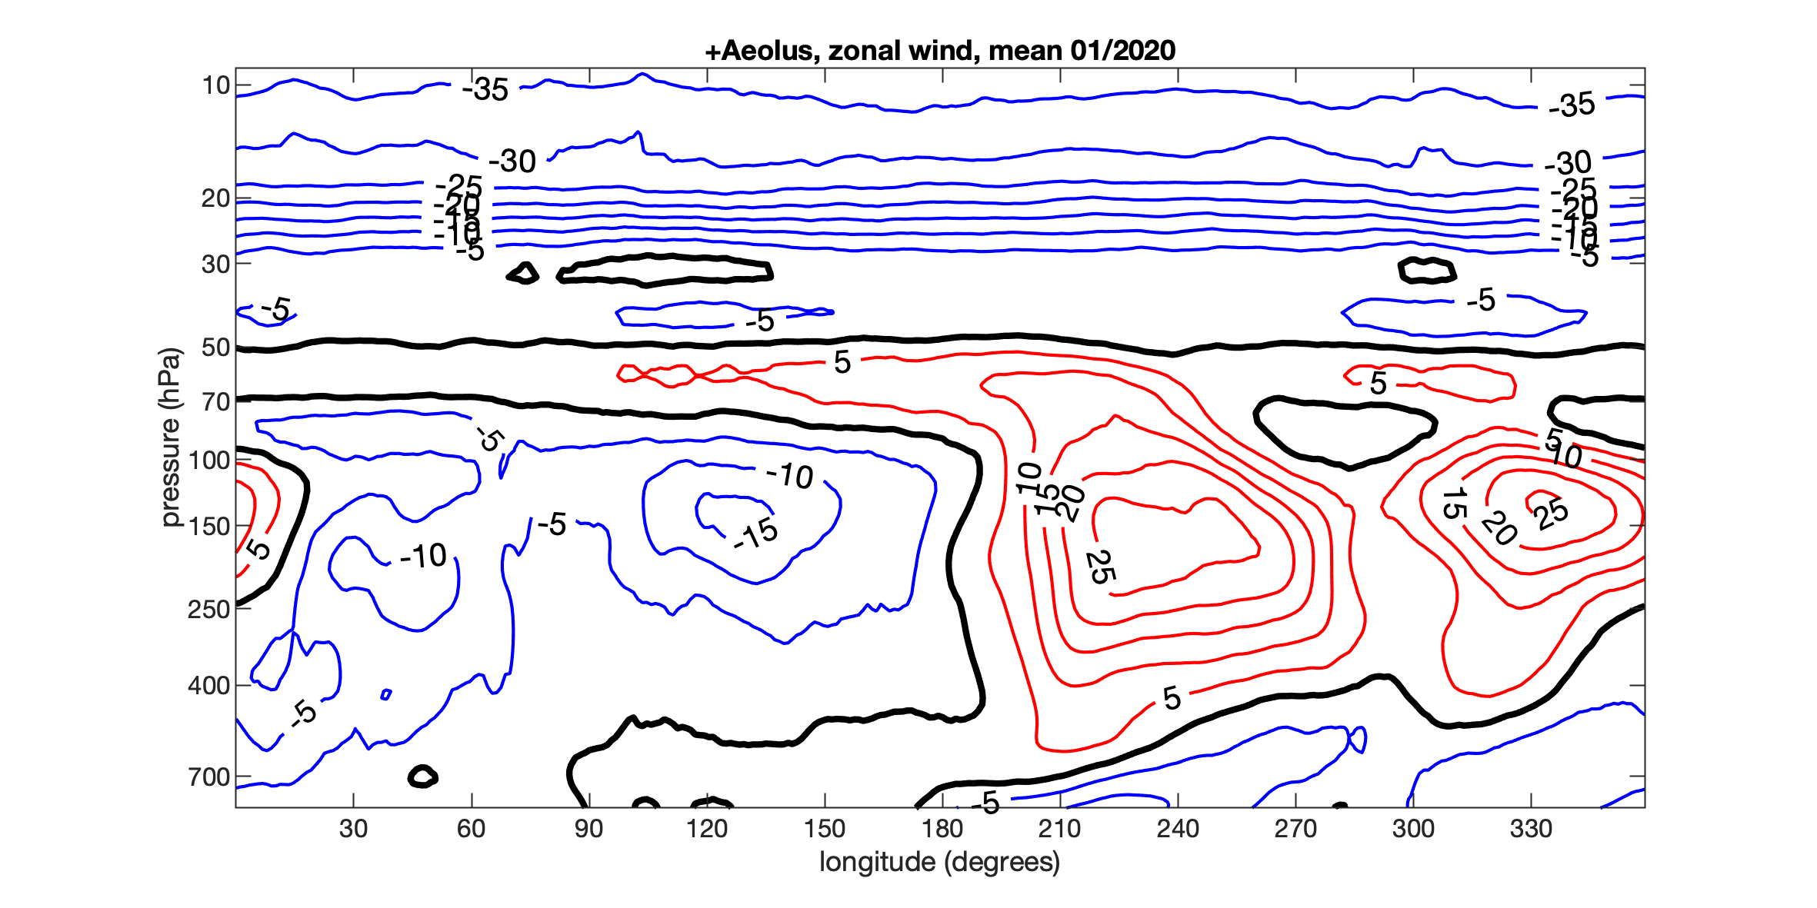
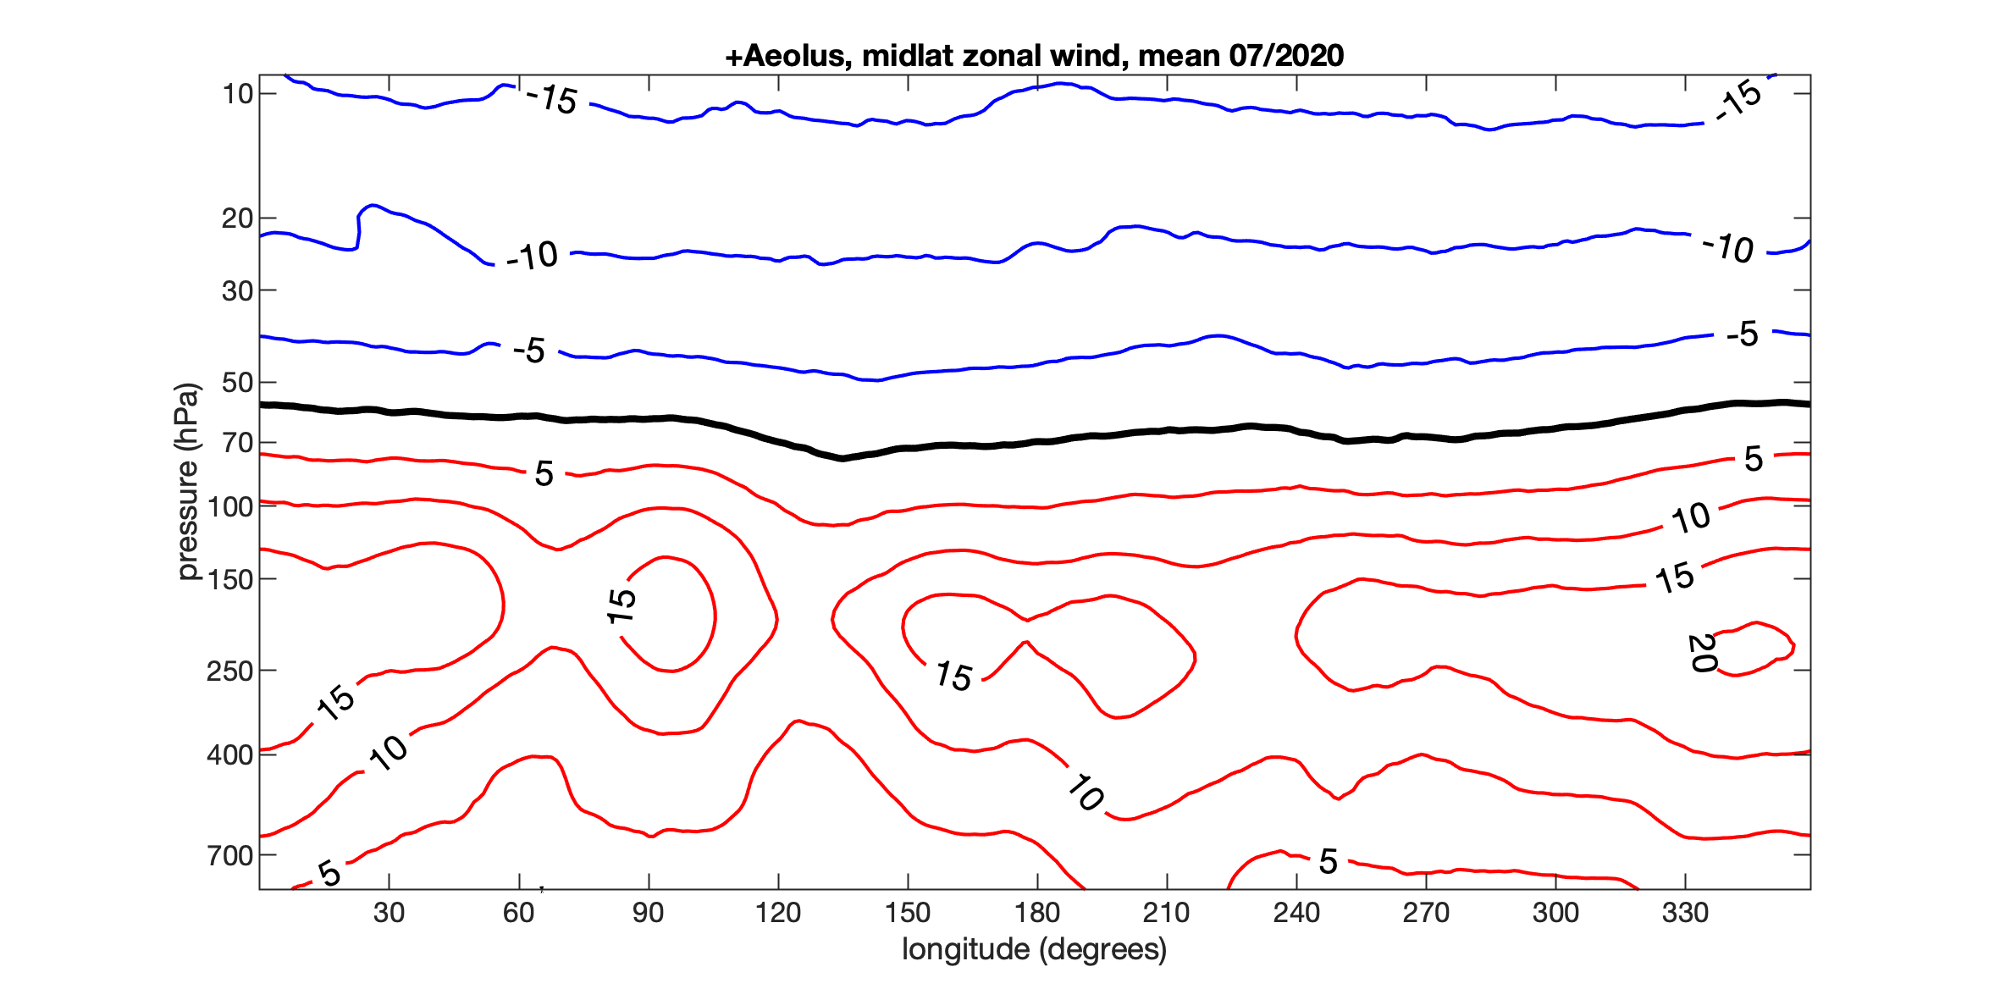
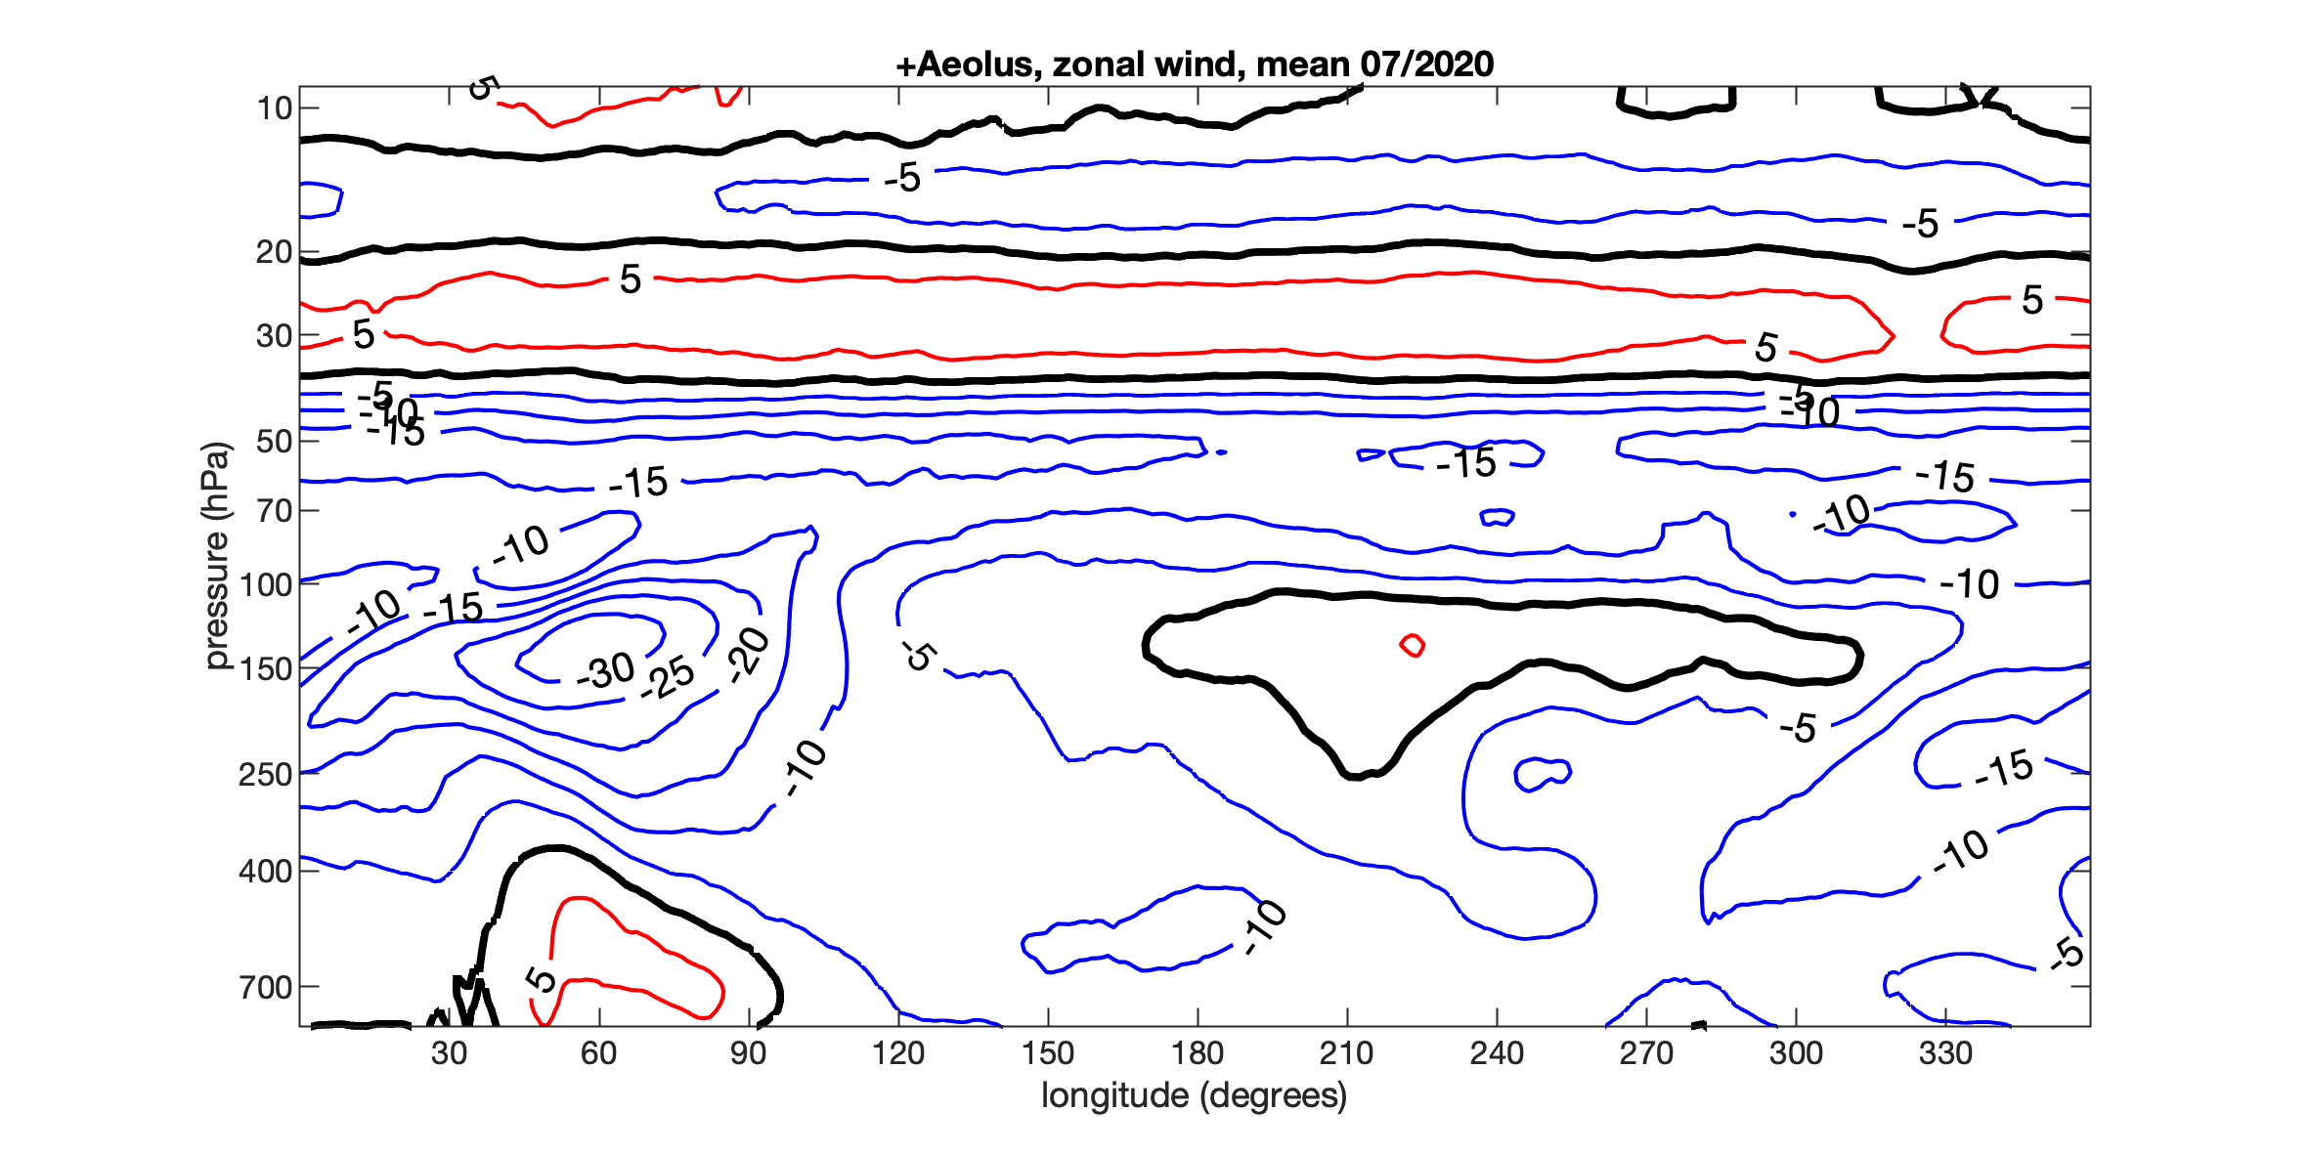
Linking effects of Aeolus winds with the background shear
Mean zonal wind, 40ºN-60ºN
Mean zonal wind, 10ºN-10ºS
Tropics vs. Midlatitudes
Large shear in the vertical and longitudinal direction
Flow complexity (3D wave propagation vs quasi-horizontal synoptic-scale dynamics)
How much the old dynamical arguments on the relative value of wind and mass-field observations matter in ECMWF 4D-Var?
01/2020
01/2020
07/2020
07/2020

Slide 8
Linking effects of Aeolus winds with the background shear
Monthly mean zonal wind and its shear (absolute value)
40º N - 50º N average
5º N - 5º S average
The largest wind shear is in the tropical UTLS: TEJ, core of Pacific westerlies, QBO shear lines.
On the other hand, tropical intra-monthly variability is 3-5 times smaller than in the middle latitudes.
Project results highlight that it is not the wind field itself, but its vertical shear wrt variability that defines the usefulness of the wind profiles in the NWP.

Slide 9
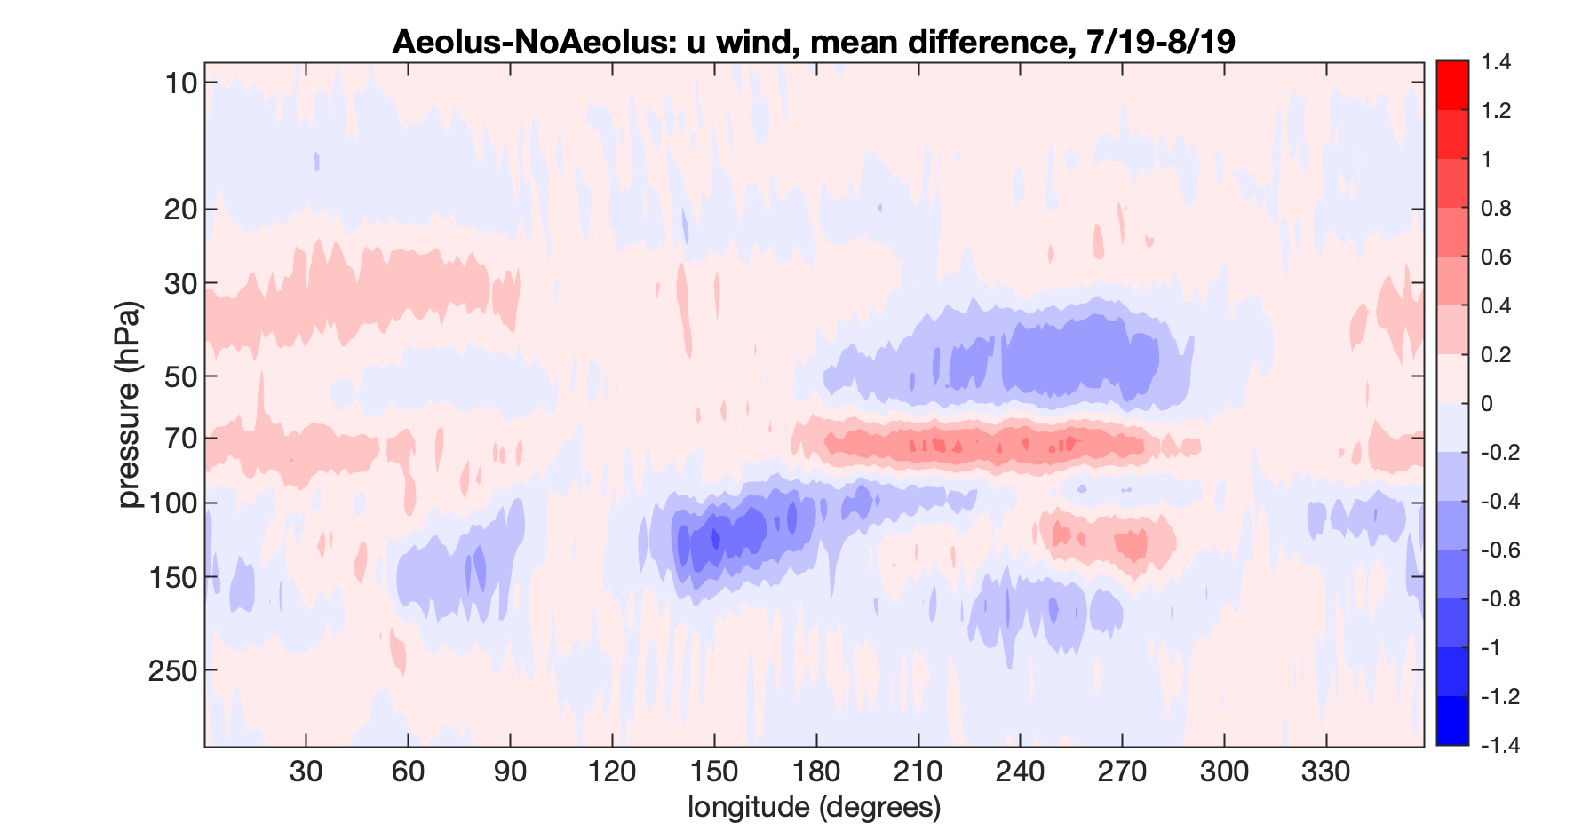
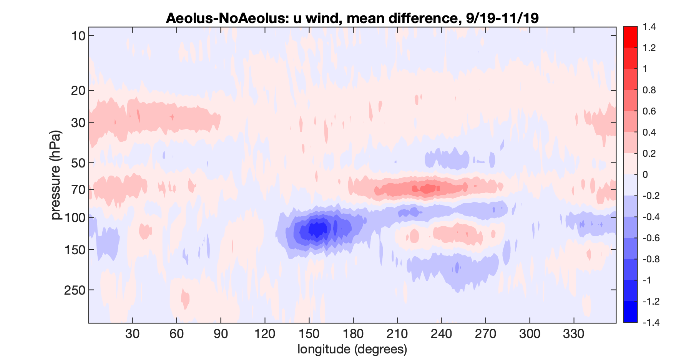
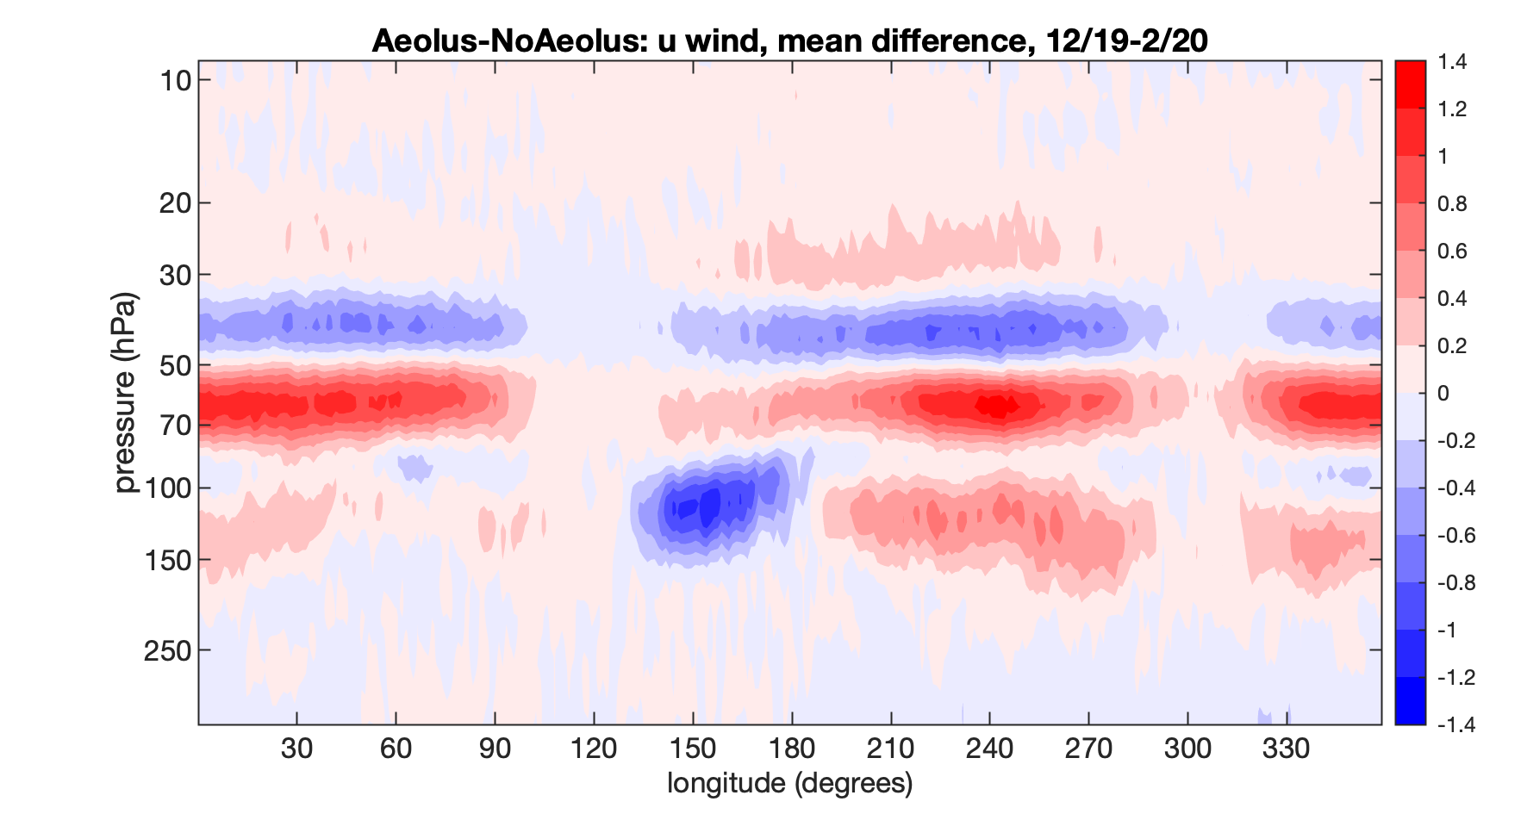
Linking effects of Aeolus winds with the background shear: systematic effects
Aeolus corrects systematic errors (model errors) in the UTLS
Jul-Aug 2019
Sep-Nov 2019
Dec 2019-Feb 2020
Pressure-Longitude cross sections for deep tropics
Averaging zonal wind difference for Aeolus-CTRL in 10ºN-10ºS
Systematic effects vary in time with the background flow,
especially the state of the QBO

Slide 10
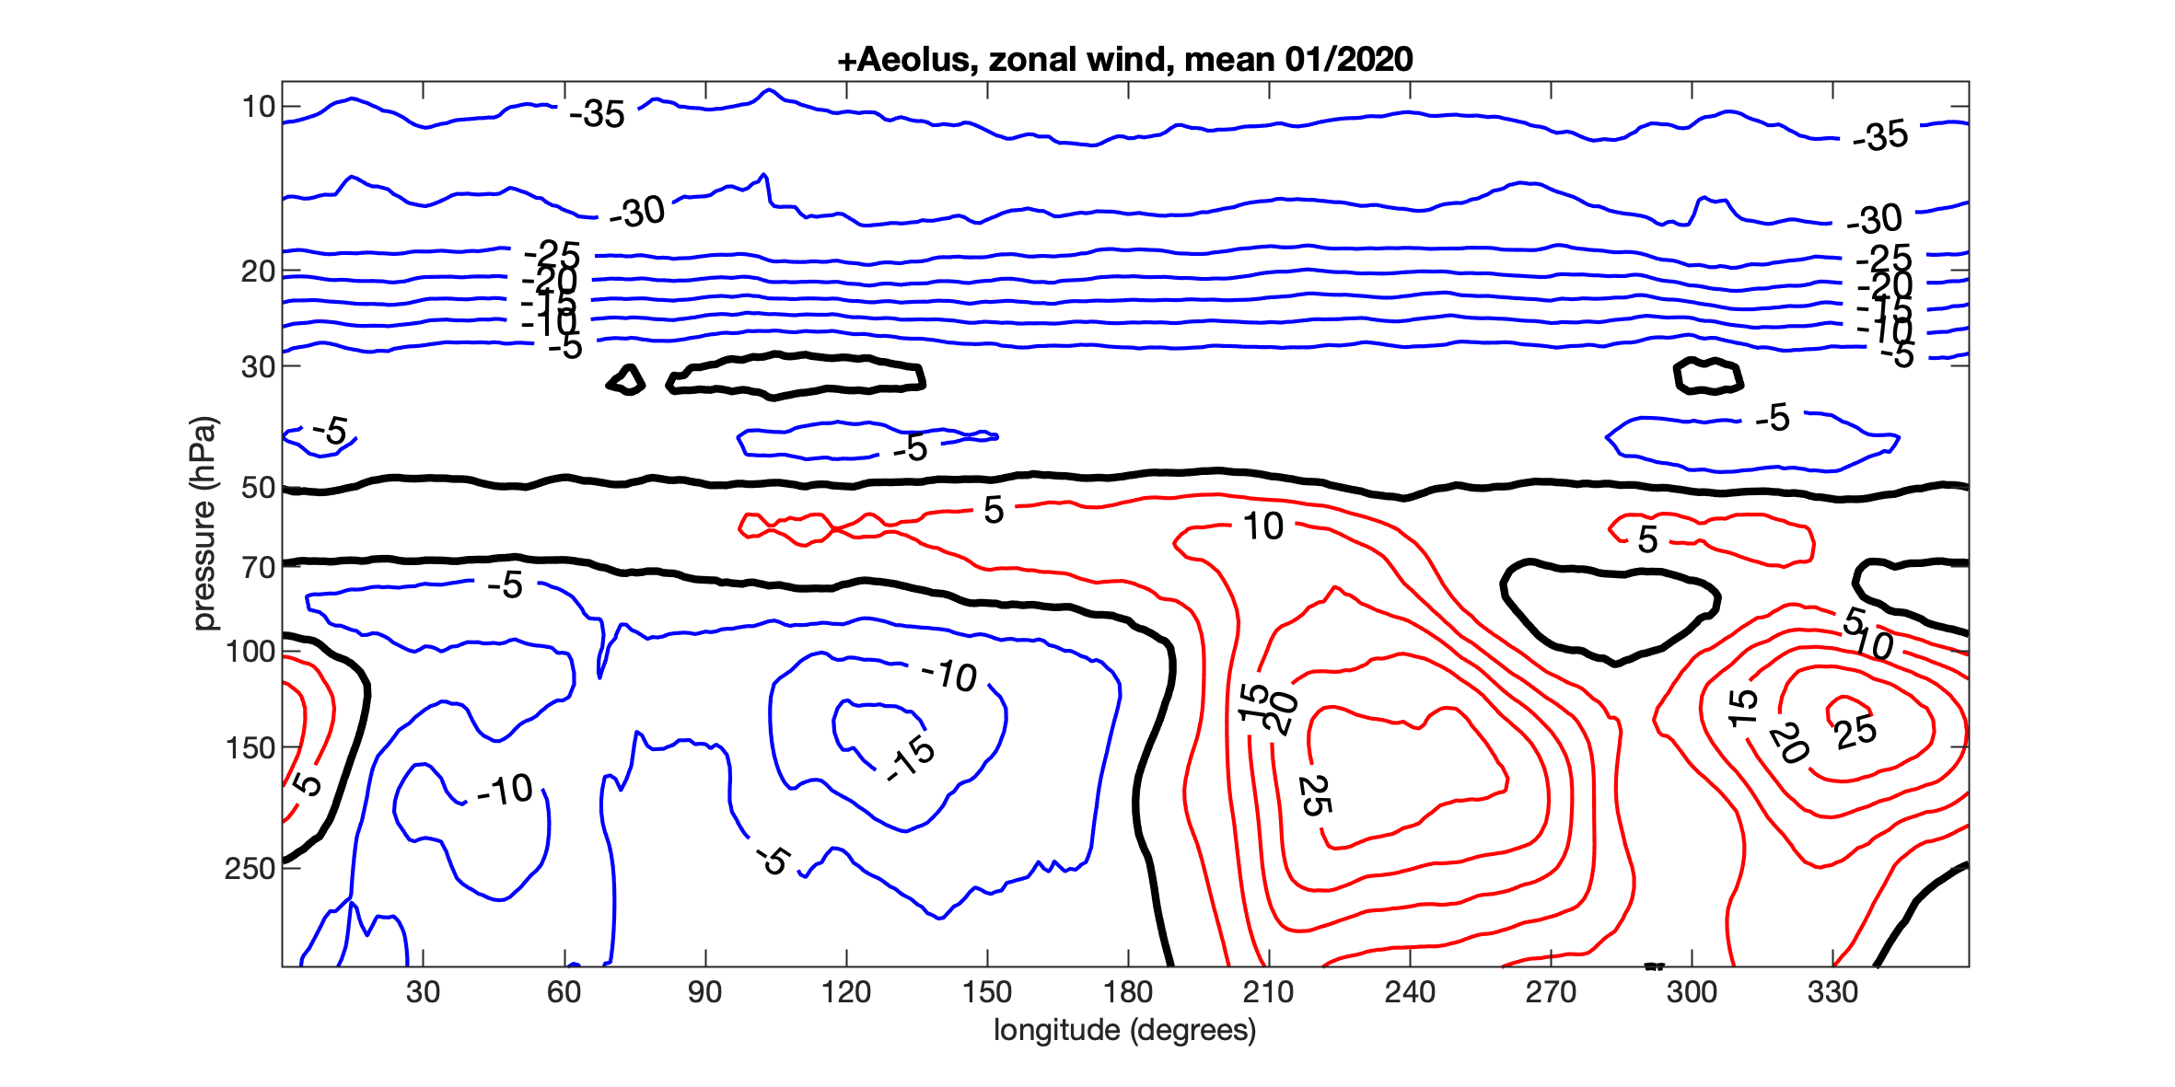
Linking effects of Aeolus winds with the background shear: systematic effects
Aeolus corrects zonal wind systematic errors (model errors) in the tropical UTLS
Jul-Aug 2019
Sep-Nov 2019
Dec 2019-Feb 2020
Pressure-Longitude cross sections for deep tropics
Averaging zonal wind difference for Aeolus-CTRL in 10ºN-10ºS
Systematic effects vary in time with
the background flow, especially the state of
the QBO.
Winter 2019/2020: the QBO disruption
Jan 2020

Slide 11
Linking effects of Aeolus winds with the background shear: stratospheric zonal mean state
Zonal-mean zonal wind difference Aeolus-CTRL
Largest effects of Aeolus winds on the zonal mean state occurred during the QBO disruption. They led to the largest effects on the forecasts in the OSE period.
This highlights importance of in-situ wind observations of the global-scale extreme events.
There is a limit of the wind information that can be extracted from the thermal wind balance, i.e. temperature data in 4D-Var
Pressure-Longitude cross-section, 5ºN-5ºS average
During the QBO disruption, the assimilation of Aeolus winds in the ECMWF system resulted in up to about 20% change in the stratospheric vertical momentum fluxes with respect to CTRL.

Slide 12
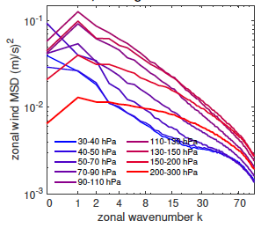
Linking effects of Aeolus winds with the background shear:
flow dependency of the effects
Scale, altitude and flow dependency
Mean square difference (MSD) of Aeolus – CTRL analyses.
Zonal wind MSD as a function of zonal wavenumber
Averaging over 07/2019-06/2020
Different layers of deep tropics (10⁰N - 10⁰S average)
Largest effect on k=0 in the 30-70 hPa layer
Effects spreads across many scales moving towards into the troposphere
Overall largest effect is within and just below the tropopause – a critical layer for the upward propagating waves from the troposphere

Slide 13
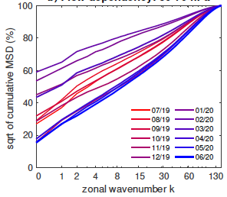
Linking effects of Aeolus winds with the background shear:
flow dependency of the effects
Scale, altitude and flow dependency
Square-root of the cumulative mean square difference (MSD) for the zonal wind for the first 150 zonal wavenumbers of Aeolus – CTRL
Averaging over 07/2019-06/2020 and 10⁰N - 10⁰S
Layer 50-70 hPa
Relative scale distribution of the effect within the UTLS greatly varies with the flow
Largest effect on the zonal mean state in summer 2019 and during the QBO disruption

Slide 14
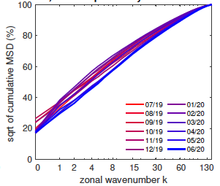
Linking effects of Aeolus winds with the background shear:
flow dependency of the effects
Scale, altitude and flow dependency
Square-root of the cumulative mean square difference (MSD) for the zonal wind for the first 100 zonal wavenumbers of Aeolus – CTRL
Averaging over 07/2019-06/2020 and 10⁰N - 10⁰S
Layer 90-110 hPa
Relative scale distribution of the effect within the tropopause layer varies little in time
60-70% of the effect in terms of MSDs is at k<15 (⬄ ~80% in terms of RMSDs)
Aeolus had largest effects on planetary scales flows in boreal summer 2019 (EQBO)

Slide 15
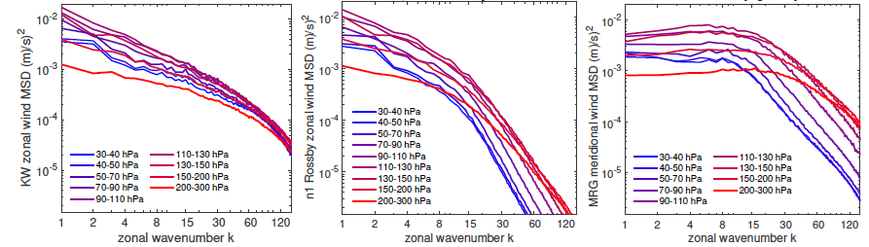
Effects of Aeolus wind assimilation on equatorial wave analyses
Kelvin wave
n=1 Rossby wave
MRG wave
Zonal wind
Zonal wind
Meridional wind
Aeolus – CTRL: average mean square difference (MSD) at different levels and zonal wavenumbers
The Aeolus effects maximize in the tropical tropopause layer.
The mixed Rossby-gravity (MRG) wave effect is an evidence of the strength of the ECMWF 4D-Var

Slide 16
Effects of Aeolus wind assimilation on equatorial wave analyses
KW k=1
Kelvin wave
n=1 Rossby wave
MRG wave
Zonal wind
Zonal wind
Meridional wind
Aeolus – CTRL: average mean square difference (MSD) at different levels and zonal wavenumbers
The Aeolus effects maximize in the lower stratosphere at the scales where the wave signals are strongest.
The mixed Rossby-gravity (MRG) wave effect is an evidence of the power of the ECMWF 4D-Var
But, model errors and DA assumptions are sources of significant analyses uncertainties in the tropics

Slide 17
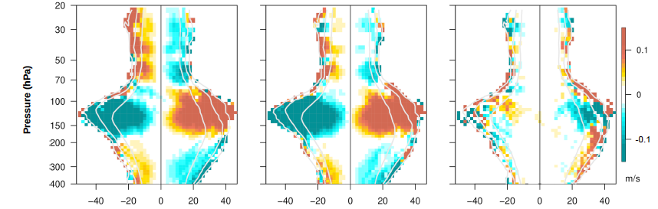
Flow-dependent effects of Aeolus wind assimilation on equatorial waves: systematic effects
Aeolus – CTRL analyses
Kelvin wave
n=1 Rossby wave
MRG wave
Zonal
wind
Meridional
wind
Zonal
wind
The assimilation of Aeolus winds aims at enhancing waves’ zonal winds in the TTL in both easterlies and westerlies
Equatorial wave filtering in the ECMWF data:
http://modes.cen.uni-hamburg.de

Slide 18
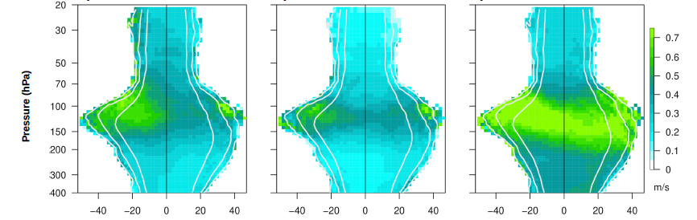
Flow-dependent effects of Aeolus wind assimilation on equatorial waves: total effects (MSDs)
<(Aeolus – CTRL analyses)^2>
Kelvin wave
n=1 Rossby wave
MRG wave
Zonal
wind
Meridional
wind
Zonal
wind
The equatorial KW and n=1 Rossby wave zonal winds are enahnced stronger in easterlies, which on avearge have a larger shear.

Slide 19
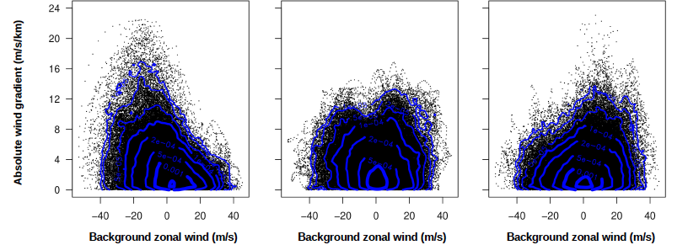
Flow-dependent effects of Aeolus wind assimilation on equatorial waves: total effects (MSDs)
MSDs
Kelvin wave
n=1 Rossby wave
MRG wave
Waves’ vertical shear near 120 hPa level

Slide 20
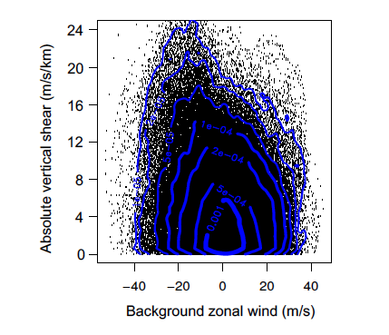
Flow-dependent effects of Aeolus wind assimilation on equatorial waves: total effects (MSDs)
MSDs
Kelvin wave
n=1 Rossby wave
MRG wave
Waves’ vertical shear near 120 hPa level
Zonal wind vertical shear

Slide 21
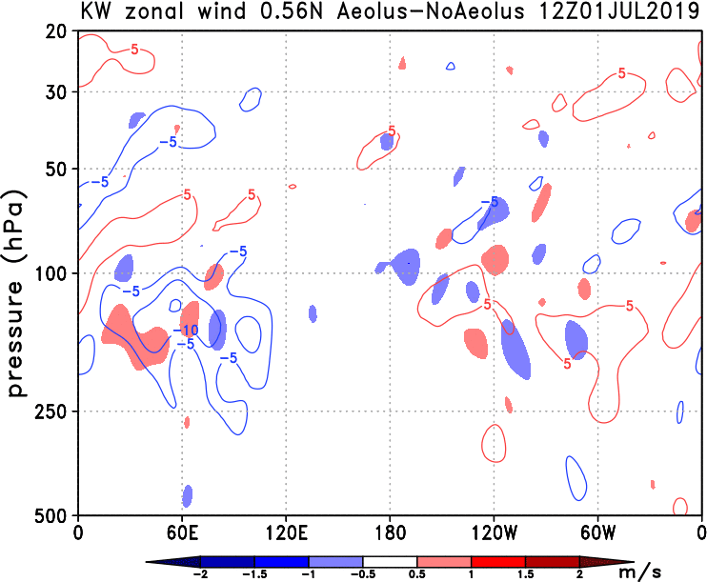
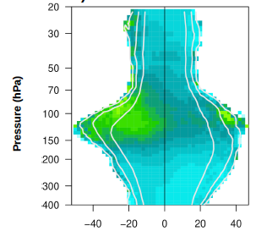
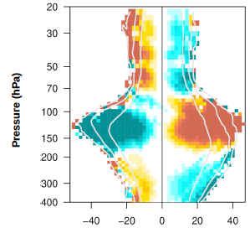
Effects of Aeolus wind assimilation on the equatorial Kelvin wave
Isolines: Kelvin wave zonal wind in CTRL
Shades: (Aeolus – CTRL) KW zonal wind
MSD>MD
MSD MD
See also https://doi.org/10.1029/2021GL094716, GRL, 2021

Slide 22

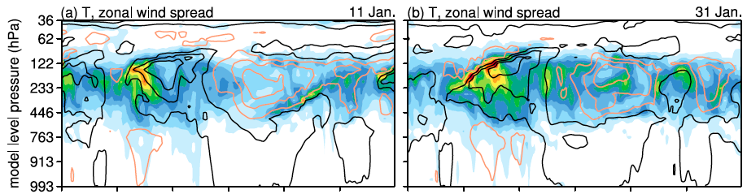
Relative value of wind and temperature observations in the tropics using a perfect-model in EnKF DA
Where do the forecast errors grow, if the forecast model were perfect?
m/s
Only T observations assimilated
Shades: 6-hour forecast errors (ensemble standard deviation)
Isolines: ensemble mean zonal wind (easterlies in black, westerlies orange)
Largest forecast errors are found in regions with the strong zonal wind shear, both vertical and longitudinal shear
https://doi.org/10.1002/qj.4511, Li et al., QJRMS 2023

Slide 23
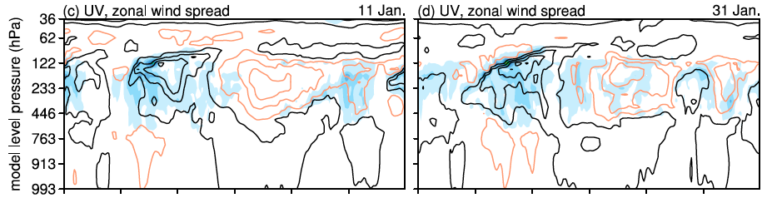
A perfect-model, EnKF study of the relative value of wind and temperature observations in the tropics
Where do the forecast errors grow, if the forecast model were perfect?
m/s
Only T observations assimilated
Only wind observations assimilated
https://doi.org/10.1002/qj.4511, Li et al., QJRMS 2023

Slide 24


Quantification of analysis uncertainties using Aeolus
Uncertainty = ratio between the RMSD between Aeolus and CTRL analyses, and variability on sub-monthly time scales
5º N and 5º S average
Without Aeolus, there would have been a greater uncertainty in stratospheric winds during the QBO disruption.
Aeolus winds will be assimilated in ERA6

Slide 25
Concluding remarks
A consistent positive effect of the Aeolus HLOS wind profiles across the range of operational NWP models suggests a significant gap in our current picture of the tropical UTLS flows. According to our results, the gap is associated with the underestimation of the vertical shear of the zonal wind in the mean state and wave amplitudes, in particular within TTL.
About 60% of Aeolus HLOS wind effect in the stratosphere turned into the correction of the zonal mean state during the 2019/2020 QBO disruption. Together with the major relative increase in the short-range forecast skill during this period, it demonstrates the importance of directly observing shear lines during extreme events. Implications also for air-traffic-threatening turbulence in a changing climate.
Aeolus2 will observe wind profiles with much larger accuracy. They may reveal new insights into how shear lines of the tropical zonal wind shape the troposphere-stratosphere coupling and its effects in the climate system.
The largest effects of Aeolus are at the largest scales. => Important implications for the high-resolution climate modelling in terms of the vertical model resolution and effects of small scales on large scales.

Slide 26
Thank you for your attention

