Slide 1
NASA Earth Science – a Headquarters Perspective
Presented to: Doppler Wind Lidar Working Group
May 1, 2012
George J. Komar
Associate Director/Program Manager
Earth Science Technology Office

Slide 2

Overview of the
President’s
FY 2013 Budget Request
Suomi NPP VIIRS
Visible Composite

Slide 3
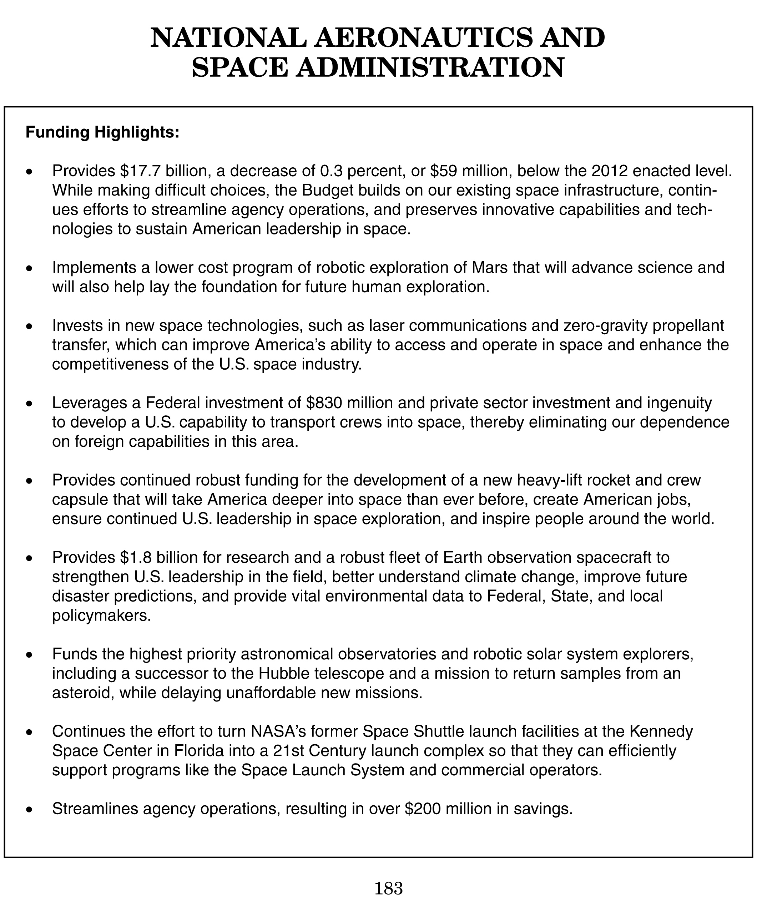
NASA “Highlights” Page from Budget Document

Slide 4
Earth Science Budget – FY13 Request
FY10 request
Prev Admin

Slide 5
Earth Science Budget Overview
The FY13 budget for Earth Science is consistent with the FY12 request – STABILITY!
Congressional appropriation for FY12 was also consistent with the President’s budget request
FY13 overall ESD funding level is ~$25M above FY12 appropriated level
Overall NASA agency FY13 level represents 0.3% decrease from FY12; SMD overall budget decreased by ~3.3% from FY12
The March 2011 Glory launch failure has resulted in delays for OCO-2 and SMAP launches, and significantly higher budgeted cost levels for mid-range launch vehicles
Solicitation for multiple launch services for OCO-2, SMAP (and JPSS-1) has been released – with higher evaluation emphasis on vehicle reliability
SMAP launch date: 23 Oct 2014
OCO-2 launch date: NET July 2014 (SMAP launch date has priority)
FY13-vs-FY12 decreases in R&A (1.5%), Applied Science (5%), and Technology (3.3%) lines; however, all non-flight lines increase throughout 2013-2017
All 3 strands of Venture Class are fully funded throughout, with all AOs released

Slide 6
Earth Science Program/Budget Strategy
Maintain a balanced program that:
advances Earth System Science
delivers societal benefit through Applications Development
provides essential global spaceborne measurements supporting science and operations
develops and demonstrates technologies for next-generation measurements, and
complements and is coordinated with activities of other agencies and international partners
Support Research, Applied Sciences, Technology Development, and E/PO programs
Continue to fund operations and routine data products for all on-orbit NASA research missions
Develop and launch remaining foundational missions: LDCM, GPM, OCO-2
Continue formulation and development of top-priority Decadal Survey and Continuity missions: SMAP (11/2014), ICESat-2 (1/2016), SAGE-III/ISS (2014) and GRACE-FO (2017).
Continue execution of the full Venture Class program
Continue working with NOAA and OSTP to address approaches for providing sustained, long-term spaceborne measurements.
Provide significant support to National Climate Assessment, USGCRP, and international (CEOS) coordination activities

Slide 7
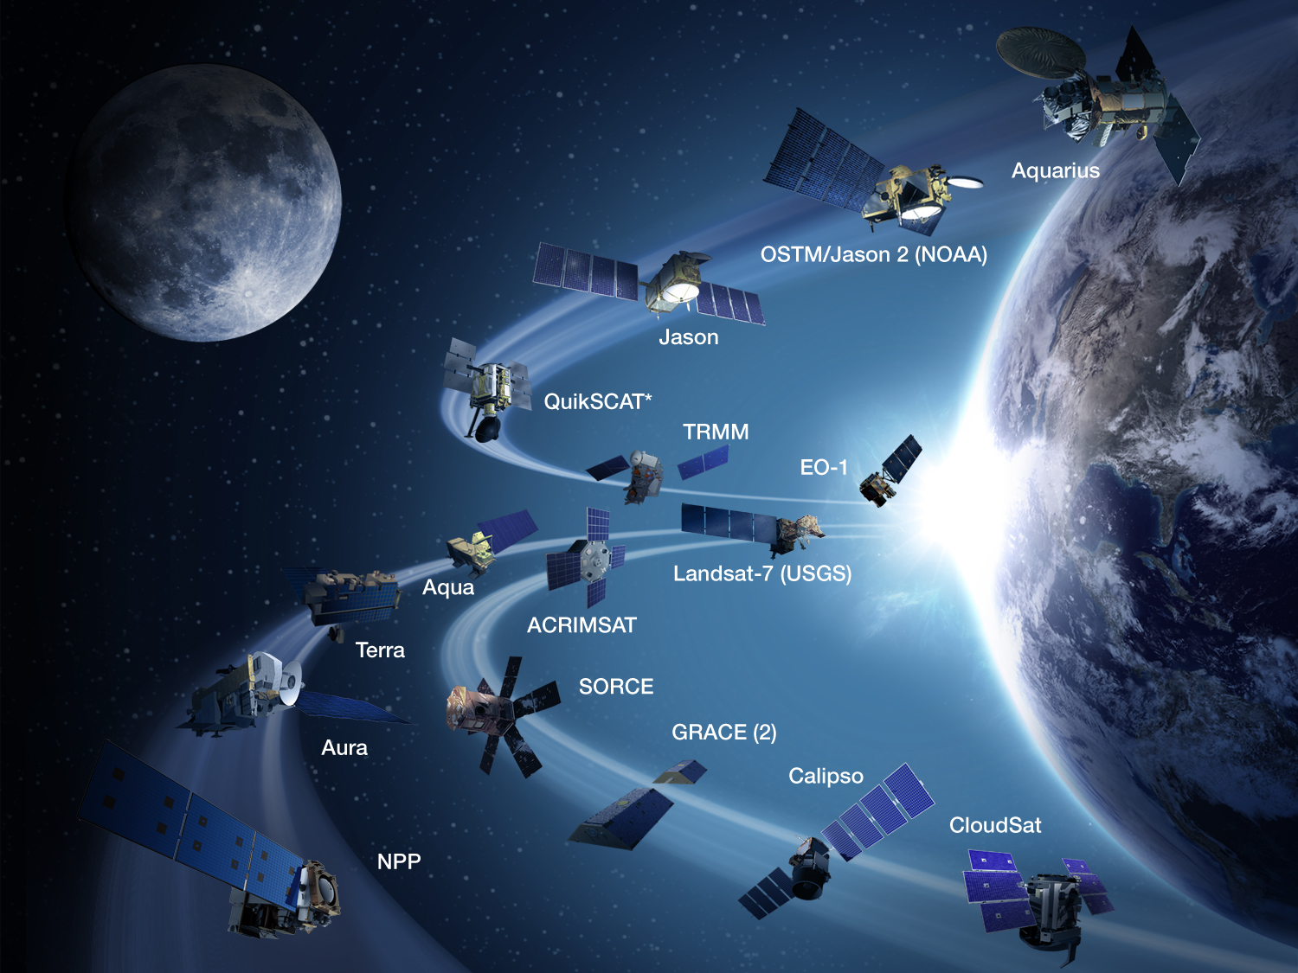
NASA Earth Science Major Operating Satellites

Slide 8
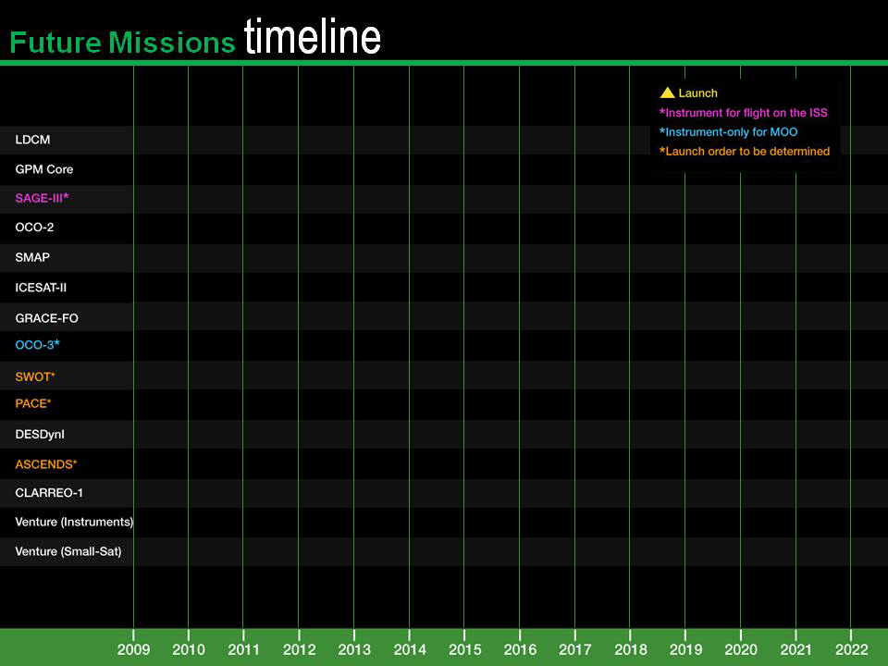
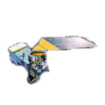
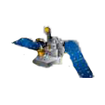
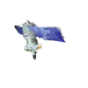
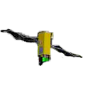
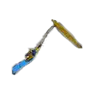
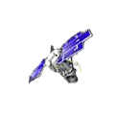
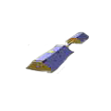
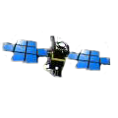
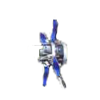
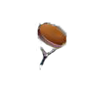
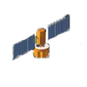
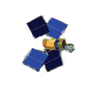

Slide 9
VENTURE-CLASS UPDATE/STATUS
Venture-Class is fully funded, with 3 “strands”
EV-1: suborbital/airborne investigations (5 years duration)
Solicited in FY09 (selections in FY10) and every 4 years
5 investigations selected; flights beginning in FY11
Next selection (EV-3) in FY14, and EV-5 in FY18
EV-2: small complete missions (5 years duration)
Solicited in FY11 (selections in FY12) and every 4 years
Small-sat or stand-alone payload for MoO; $150M total development cost
Selection imminent; EV-4 February 2016
EV-Instrument: Spaceborne instruments for flight on MoO (5 years dev.)
~$90M development costs, accommodation costs budgeted separately
Solicited in FY11 (selections in FY12) and 15-18 months thereafter
Notes:
9

Slide 10
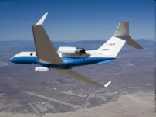
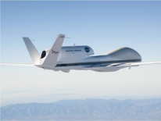
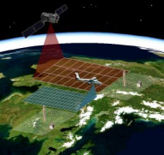
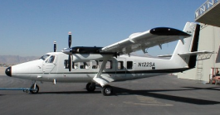
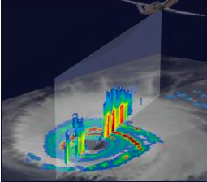

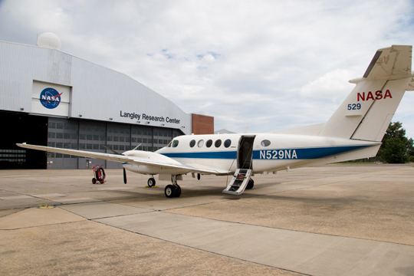
Earth Venture-1 Summaries
Airborne Microwave Observatory of Subcanopy and Subsurface (AirMOSS) - Univ Mich/JPL
North American ecosystems are critical components of the global exchange of the greenhouse gas carbon dioxide and other gases within the atmosphere. To better understand the size of this exchange on a continental scale, this investigation addresses the uncertainties in existing estimates by measuring soil moisture in the root zone of representative regions of major North American ecosystems. Investigators will use NASA's Gulfstream-III aircraft to fly synthetic aperture radar that can penetrate vegetation and soil to depths of several feet.
Airborne Tropical Tropopause Experiment (ATTREX) - ARC
Water vapor in the stratosphere has a large impact on Earth's climate, the ozone layer and how much solar energy the Earth retains. To improve our understanding of the processes that control the flow of atmospheric gases into this region, investigators will launch four airborne campaigns with NASA's Global Hawk remotely piloted aerial systems. The flights will study chemical and physical processes at different times of year from bases in California, Guam, Hawaii and Australia.
Carbon in Arctic Reservoirs Vulnerability Experiment (CARVE) - JPL
This investigation will collect an integrated set of data that will provide unprecedented experimental insights into Arctic carbon cycling, especially the release of the important greenhouse gases such as carbon dioxide and methane. Instruments will be flown on a Twin Otter aircraft to produce the first simultaneous measurements of surface characteristics that control carbon emissions and key atmospheric gases.
Deriving Information on Surface Conditions from COlumn and VERtically
Resolved Observations Relevant to Air Quality (DISCOVER-AQ) - LaRC
The overarching objective of the DISCOVER-AQ investigation is to improve the interpretation of satellite observations to diagnose near‐surface conditions relating to air quality. NASA's B-200 and P-3B research aircraft will fly together to sample a column of the atmosphere over instrumented ground stations.
Hurricane and Severe Storm Sentinel (HS3) – GSFC/ARC
The prediction of the intensity of hurricanes is not as reliable as predictions of the location of hurricane landfall, in large part because of our poor understanding of the processes involved in intensity change. This investigation focuses on studying hurricanes in the Atlantic Ocean basin using two NASA Global Hawks flying high above the storms for up to 30 hours. The Hawks will deploy from NASA's Wallops Flight Facility in Virginia during the 2012-14 Atlantic hurricane seasons.

Slide 11
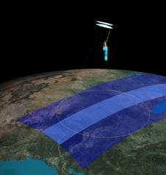
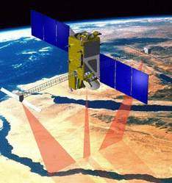
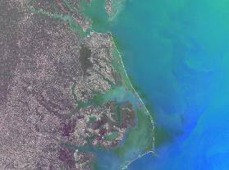
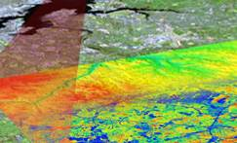
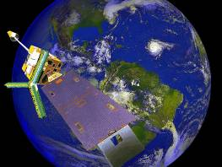
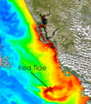
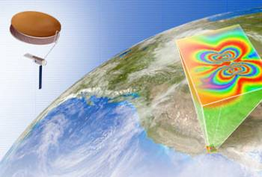
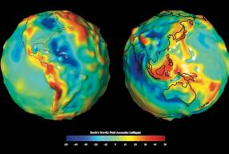
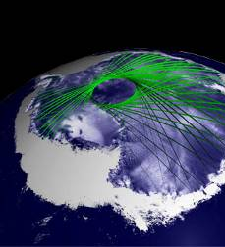
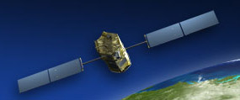
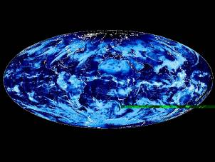
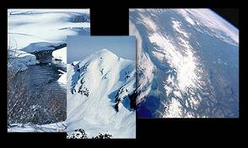
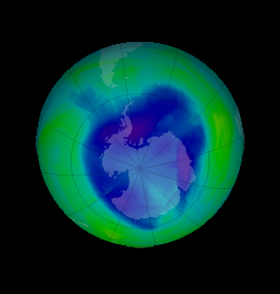
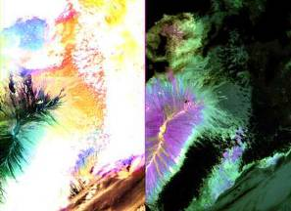
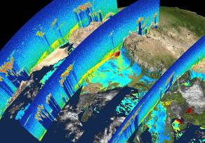
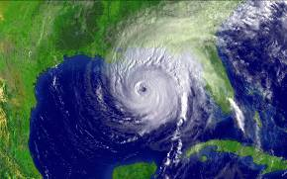
NASA Earth Science Decadal Survey Missions
Surface Water and Ocean Topography (SWOT)
Geostationary Coastal and Air Pollution Events (GEO-CAPE)
LIDAR Surface Topography (LIST)
Precipitation and All-Weather Temperature and Humidity (PATH)
Soil Moisture Active Passive (SMAP)
Pre-Aerosol - Cloud - Ecosystems (PACE)
Deformation, Ecosystem Structure and Dynamics of Ice (Radar) (DESDynI -R)
Gravity Recovery and Climate Experiment - II (GRACE - II)
Active Sensing of CO2 Emissions (ASCENDS)
Climate Absolute Radiance and Refractivity Observatory (CLARREO)
Snow and Cold Land Processes (SCLP)
Ice, Cloud,and land Elevation Satellite II (ICESat-II)
Global Atmospheric Composition Mission (GACM)
Hyperspectral Infrared Imager (HYSPIRI)
Aerosol - Cloud - Ecosystems (ACE)
Three-Dimensional Winds from Space Lidar (3D-Winds)
Near Term
Far Term
Notes:
11
PASSIVE OPTICS:
CLARREO
- UV to SWIR hyperspectral radiometric imager (Earth radiance)
- IR to Far IR spectral radiometer (Earth radiance)
HyspIRI
- Vis to SWIR hyperpectral imager (land surface)
- Multispectral thermal imager (land surface)
GEO-CAPE
- UV to Vis moderate resolution hyperspectral imager (atmospheric
chemistry)
- High resolution coastal event imager (ecosystems)
- IR CO radiometer (atmospheric chemistry)
ACE
- Multispectral, multiangle, polarimetric imager (aerosols)
- UV to NIR spectrometer (ocean color)
GACM
- UV to IR spectrometers (atmospheric chemistry)
PASSIVE MICROWAVE:
SMAP
- L-band radiometer
PATH
- 50 to 183 GHZ thinned array radiometer (T and humidity)
SCLP
- K and Ka-band radiometers (snow-water equivalent)
GACM
- Microwave limb sounder (atmospheric chemistry)

Slide 12
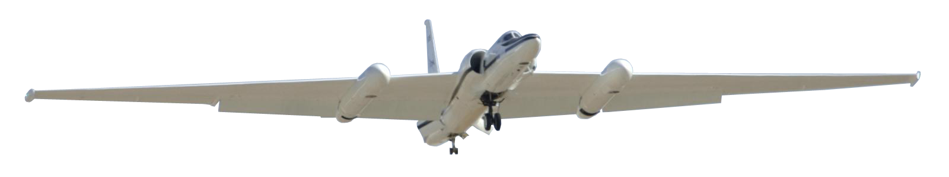
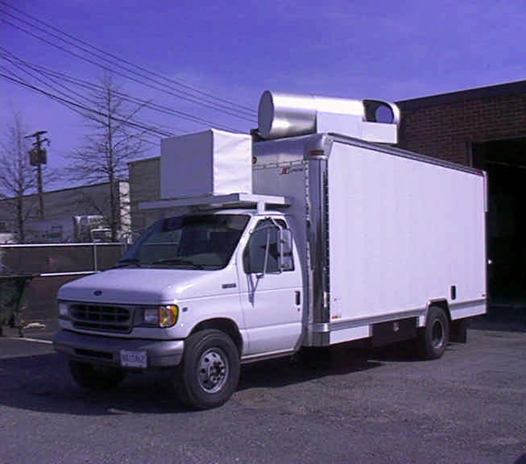
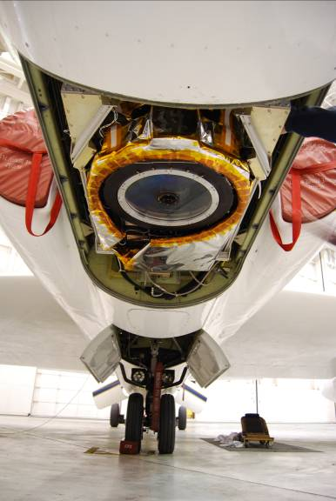
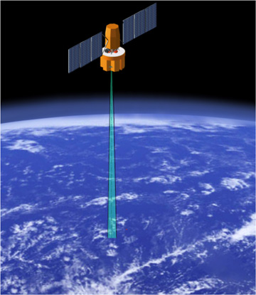
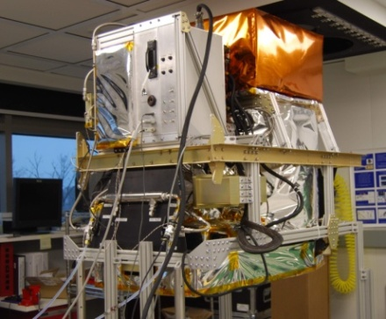
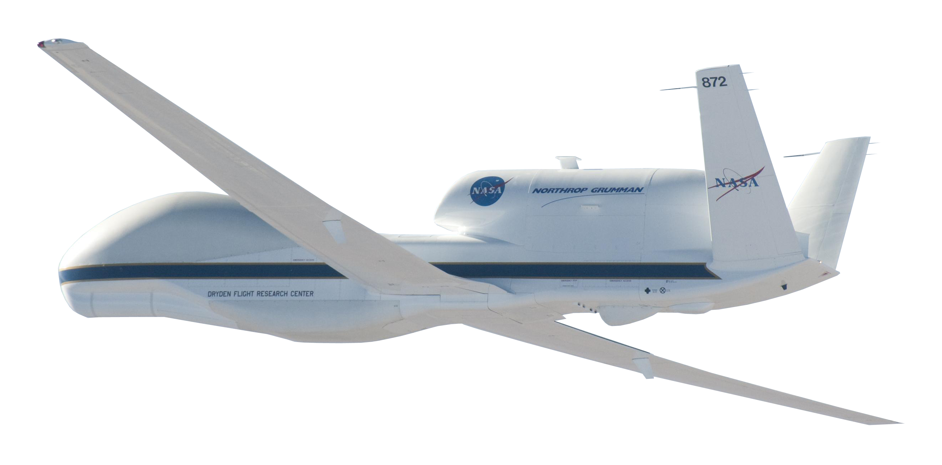
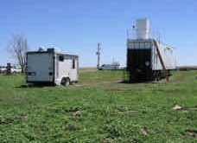
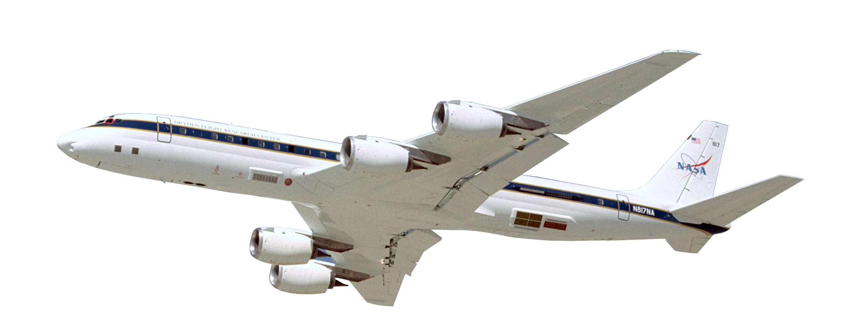
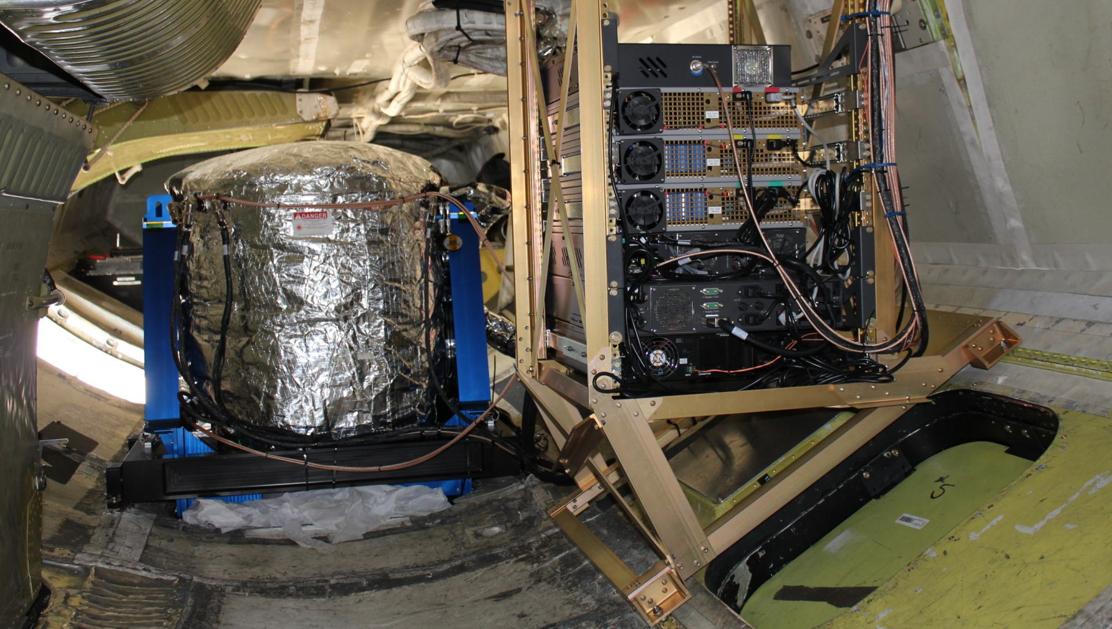
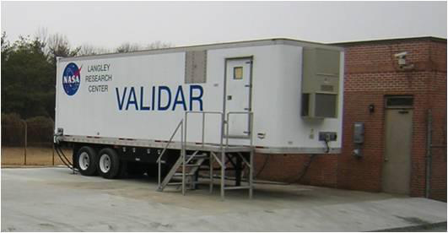
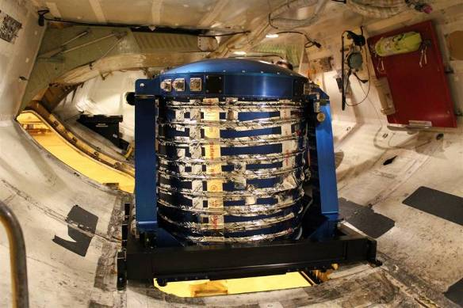
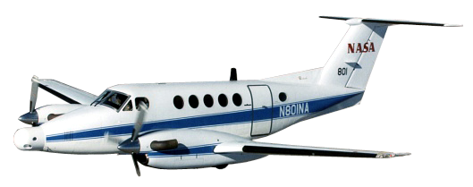
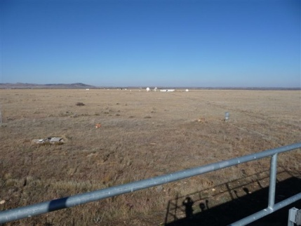





Toward 3D-Winds: Active Optical Investments
Tropospheric Wind Lidar Technology Experiment (TWiLiTE)
Flew on the ER-2 in 2009 & 2011 and is being configured to fly on the Global Hawk for the Hurricane and Severe Storm Sentinel (HS3) EV-1 Mission in 2012.
3D-Winds Decadal Survey Mission
UV Direct Detection
Molecular Winds
(Gentry, NASA GSFC)
Doppler Aerosol Wind Lidar
(DAWN)
2008 Ground Comparison
Flew 112 hours over 15 flights on the DC-8 in 2010 in support of the NASA GRIP campaign. Additional flights are planned on the B200.
2.0 um Coherent Doppler
Aerosol Winds
(Kavaya, NASA LaRC)
Optical Autocovariance Wind Lidar (OAWL)
2011 Ground Comparison with NOAA mini-MOPA
UV Direct Detection
Aerosol & Molecular Winds
(Grund, Ball Aerospace)
Test flights conducted on the WB-57 in 2011.
IDL / MDL testing, and an Observing System Simulation Experiment (OSSE) are planned for 2012.
Technology Development
Demonstrations / Campaigns
Science Measurements

Slide 13

Technology Enables our Future
Visit us at esto.nasa.gov

