Slide 1

Update and Plans for a Joint OSSE System
Michiko Masutani
NOAA/NWS/NCEP/EMC
JCSDA
Wyle IS

Slide 2
Observing Systems Simulation Experiments
(OSSEs)
Data Assimilation Systems (DAS)
Process initial conditions from observed data.
OSSE
Evaluate observing systems and data assimilation systems using simulation experiments.
A Nature Run (NR, proxy true atmosphere) is produced from a free forecast run using the highest resolution operational model which is significantly different from the NWP model used in DAS.

Slide 3
Data from
Current observing system
Nature Run
Existing data +
Proposed data
DWL, CrIS, ATMS, UAS, etc
DATA
PRESENTATION
OSSE
DATA
PRESENTATION
Real
TOVS
AIRS
etc.
Quality Control
(Real conventional
data)
OSSE
Quality Control
(Simulated conventional
data)
Simulated
TOVS
AIRS
etc.
OSE
(Data denial experiments for Real NWP)
OSSE
DA
OSSE
DA
NWP forecast
NWP forecast

Slide 4
International Collaborative Joint OSSE
- Toward reliable and timely assessment of future observing systems -
http://www.emc.ncep.noaa.gov/research/JointOSSEs
Participating Institutes
JCSDA, NCEP, NASA/GSFC
SWA, NOAA/ NESDIS/STAR,
Environment of Canada (EC), ECMWF,
NOAA/OAR/AOML,
Royal Dutch Meteorological Institute (KNMI)
Mississippi State University/GRI (MSU)
Univ. of Maryland, University of Utah
Indian Institute of Tropical Meteorology (IITM)
SUNYAA, NCAR (DATA distribution)
Other institutes expressing interest
NCAR, NASA/JPL, NASA/GSFC/SIVO,
National Space Organization (NSPO,Taiwan), Central Weather Bureau(Taiwan),
JMA(Japan), University of Tokyo, JAXA, JAMSTEC,
Norsk Institutt for Luftforskning (NILU,Norway), CMA(China), and more

Slide 5
OSSEs in Progress (partial list)
DWSS and JPSS JCSDA,EMC,NESDIS,AOML,DOD
Simulation of DWL planned from NASA (GWOS, ISS)
Simpson Weather Assicuates G. David Emmitt, Steve Greco, Sid A. Wood,(SWA)
Evaluation of Wind Lidar (GWOS, ISS) impact and configuration experiments for NASA JCSDA, NCEP/EMC
Simulation of radiance data for control experiments and made available to Joint OSSE, NCEP/EMC, NESDIS, NASA/NCCS
Evaluation of results, IITM
PREMIER InfraRed and MicroWave Limb Sounder measurements by ESA/ESTEC Environment of Canada
Polar Communications and Weather mission (PCW)Environment of Canada
ADM-Aeolus and follow up mission
KNMI, NASA/GSFC/GMAO
Evaluation of Unmanned Aircraft System
NOAA/ESRL
Evaluation of Hybrid Data assimilation system
NCEP, UMD

Slide 6
DWSS OSSE at JCSDA
Sean P.F. Casey, (JCSDA), Lars Peter Riishojgaard, (JCSDA), Michiko Masutani (EMC,JCSDA)
Jack Woollen(EMC)
Planned Experiments
A control run in which all relevant observations from systems other than DWSS are assimilated
Same as 1., but without early morning orbit coverage (no NOAA-16/DMSP-F17)
Same as 2., but with JPSS (i.e. CrIS and ATMS) added in the early morning orbit
Same as 2., but with VIIRS in the early morning orbit (i.e., polar winds)
Same as 2., but with VIIRS and ATMS in the early morning orbit
OSSE System
Moving from Vapor(IBM) to JIBB(Linux cluster)
Period of experiments proposed (distribution of existing observation)
(July2011-August2011, January2012-February2012)

Slide 7
Joint OSSE Nature Run Data
Joint OSSE Nature Run by ECMWF
Spectral resolution : T511, Vertical levels: L91, 3 hourly dump
13 month long. Starting at 12Z May 1, 2005
Daily SST and ICE: provided by NCEP
Andersson, Erik and Michiko Masutani 2010: Collaboration on Observing System Simulation Experiments (Joint OSSE), ECMWF News Letter No. 123, Spring 2010, 14-16.
Copies are available to designated users for research purposes & to users known to ECMWF
User list is maintained by Michiko Masutani (NOAA/NCEP)
contact: michiko.masutani@noaa.gov
Complete Nature Run data set is posted at NASA/NCCS portal
http://portal.nccs.nasa.gov/osse/index.pl
Password protected. Accounts are arranged by Ellen Salmon (Ellen.M.Salmon@NASA.gov)
Limited data set is available from NCAR
http://dss.ucar.edu/datasets/ds621.0/matrix.html
Contact: Chi-Fan Shih chifan@ucar.edu and Steven Worley worley@ucar.edu

Slide 8
Simulated observation for Control experiments
- Entire Nature run Period -
Michiko Masutani and Jack Woollen (NOAA/NCEP/EMC)
Simulated radiance data,
Only Clear Sky radiance are posted
(Cloudy radiance are also simulated. Radiance with mask based on GSI usage is also simulated. But these data are not posted.)
BUFR format for entire Nature run period
Type of radiance data and location used for reanalysis from May 2005-May2006
Simulated using CRTM1.2.2
No observational error added
Conventional data
Entire Nature run Period
Restricted data removed
Cloud track wind is based on real observation location
No observational error added

Slide 9
Data Distribution
NASA/NCCS
http://portal.nccs.nasa.gov/josse/index.pl
Contact:
Ellen Salmon Ellen.M.Salmon@NASA.gov
Bill McHale wmchale@nccs.nasa.gov
NCAR
Currently saved in HPSS Data ID: ds621.0
http://dss.ucar.edu/datasets/ds621.0/matrix.html
Contact: Chi-Fan Shih chifan@ucar.edu and Steven Worley worley@ucar.edu

Slide 10
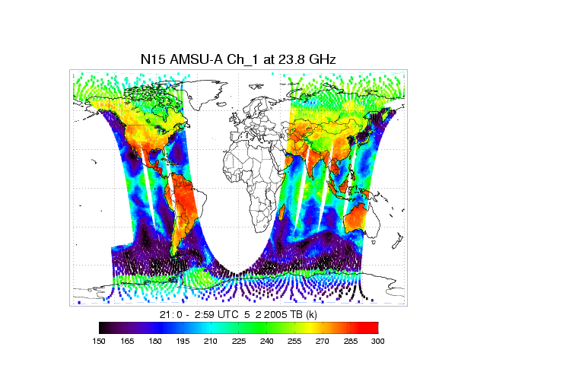
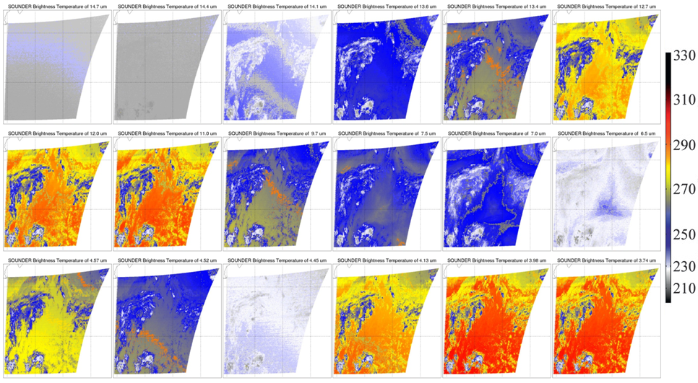
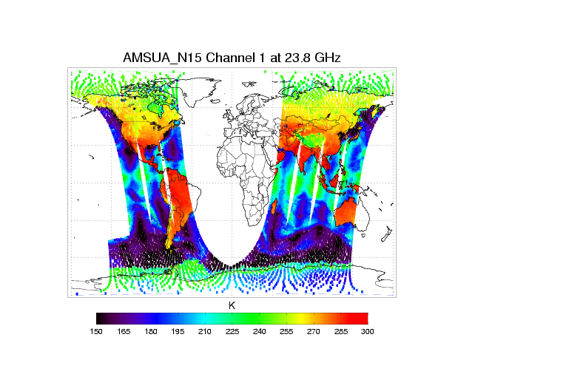
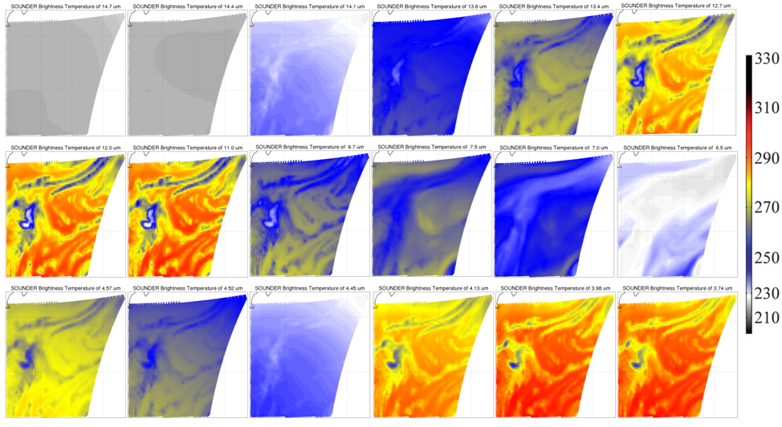
Th
Observation and simulation of GOES-12 Sounder 18 IR channels at over North Atlantic region at 1200 UTC October 1, 2005.
Tong Zhu (NESDIS)
Evaluation of simulated GOES and AMSUA at the 1st step (12hr fcst) of the Nature Run
simulated with 2005 template
Tong Zhu (NESDIS)
Observed
Observed
These figures do not have to be same as weathers are different , but similarities are observed.
These figures are expected to be very similar.
Simulated
Simulated
Fig. 1 NOAA -15 AMSU-A Channel 1 brightness temperature at GSI analysis time 0000 UTC May 2, 2005, time window 6 hours from (left) observation, (right)) CRTM simulation with NR atmospheric profiles.

Slide 11
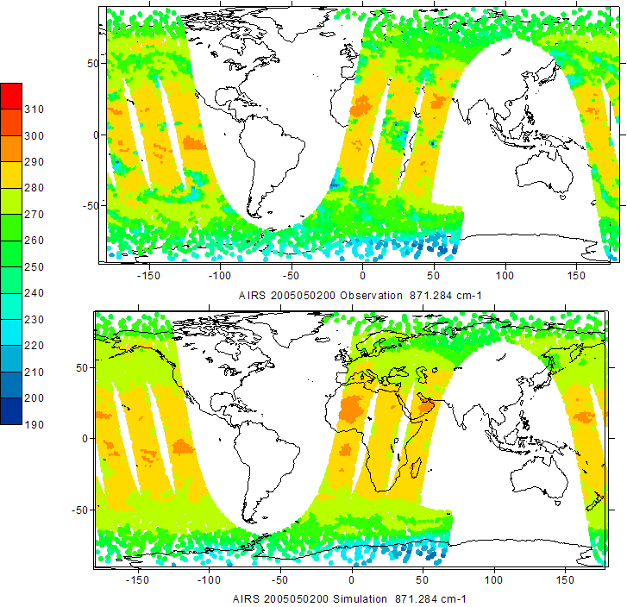
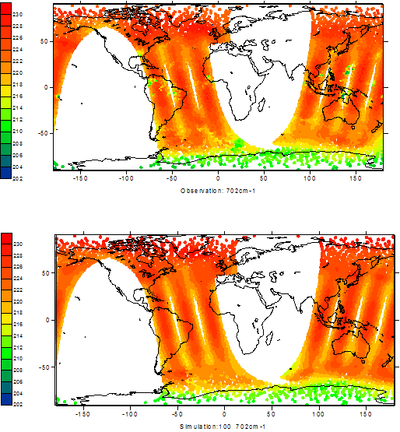
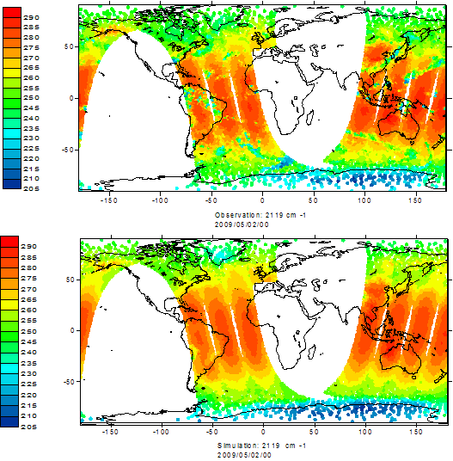
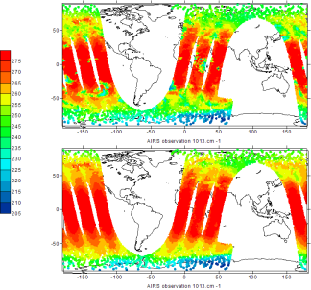
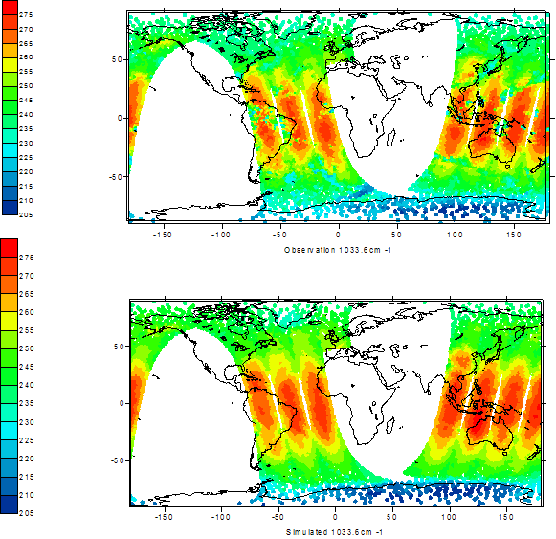
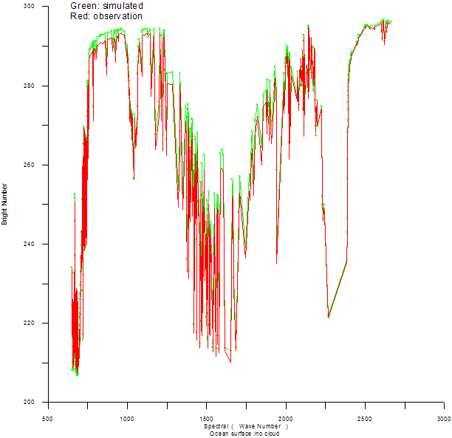
Evaluation of simulated AIRS and IASI at the 12hr fcst of the Nature Run
simulated with 2009 template
Haibing Sun (NESDIS)
AIRS
IASI
IASI simulation Evaluation at C0₂ Absorption Band
IASI simulation Evaluation at Windows channel
Observed
Observed
Simulated
Simulated
IASI simulation Evaluation at O₃ Absorb band
IASI Simulation over ocean
( Clear atmosphere)
The Nature run start at May 1st 12z. At 00z May 2nd (12hr forecast), the Nature Run fields are still very close to real atmosphere and simulated radiance can be compared with real observations.

Slide 12
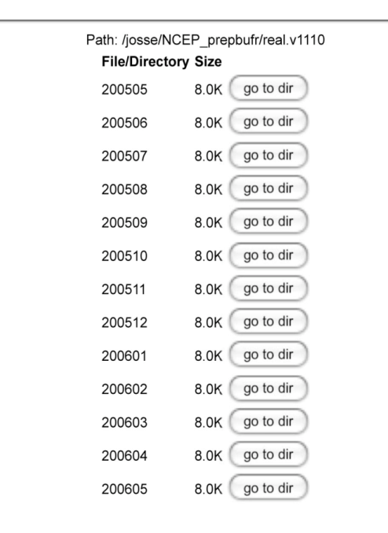
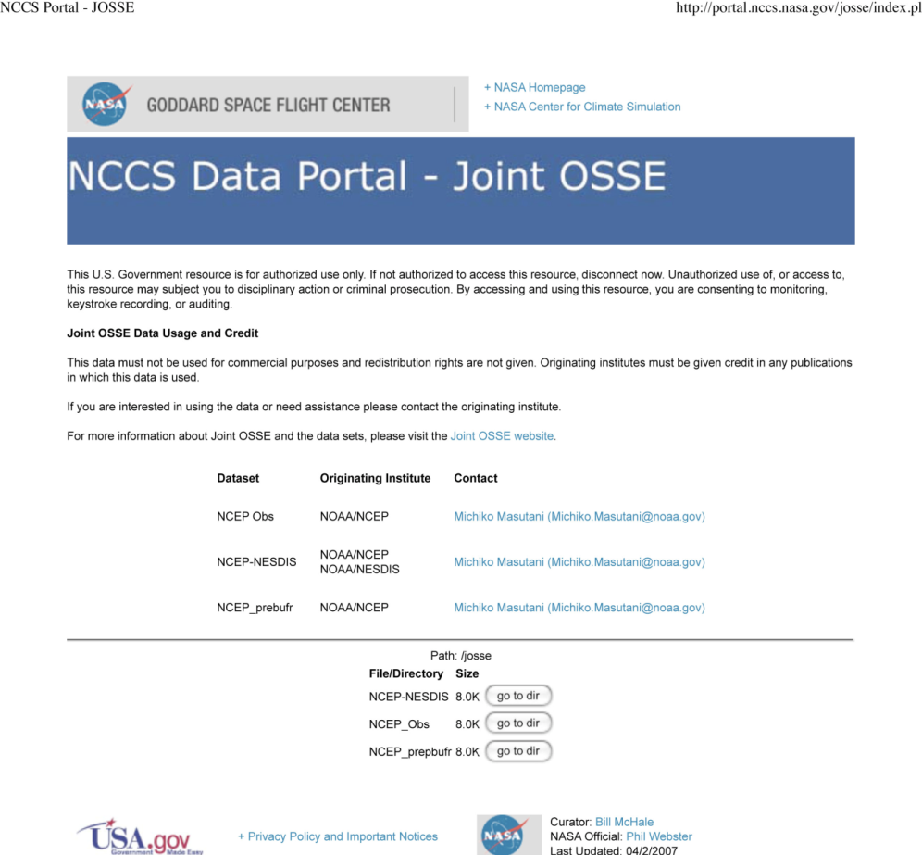
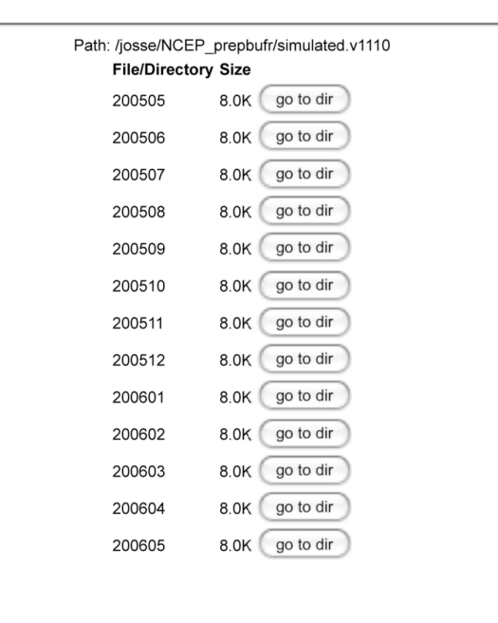

Conventional data posted at NASA/NCCS
Restricted data removed
Real
Simulated

Slide 13
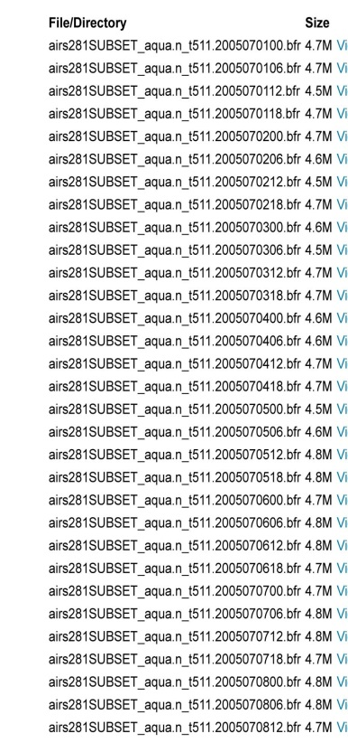
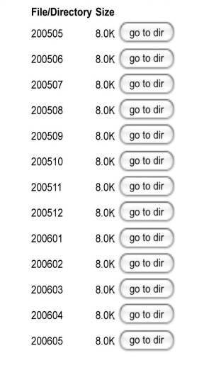
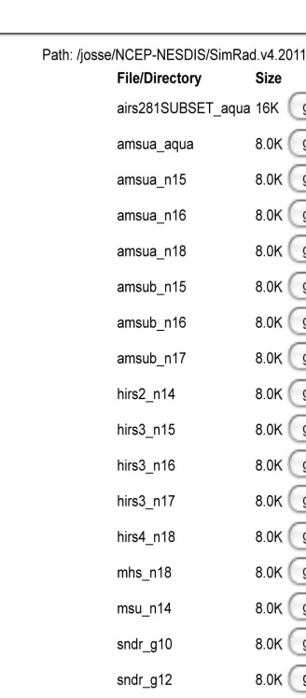
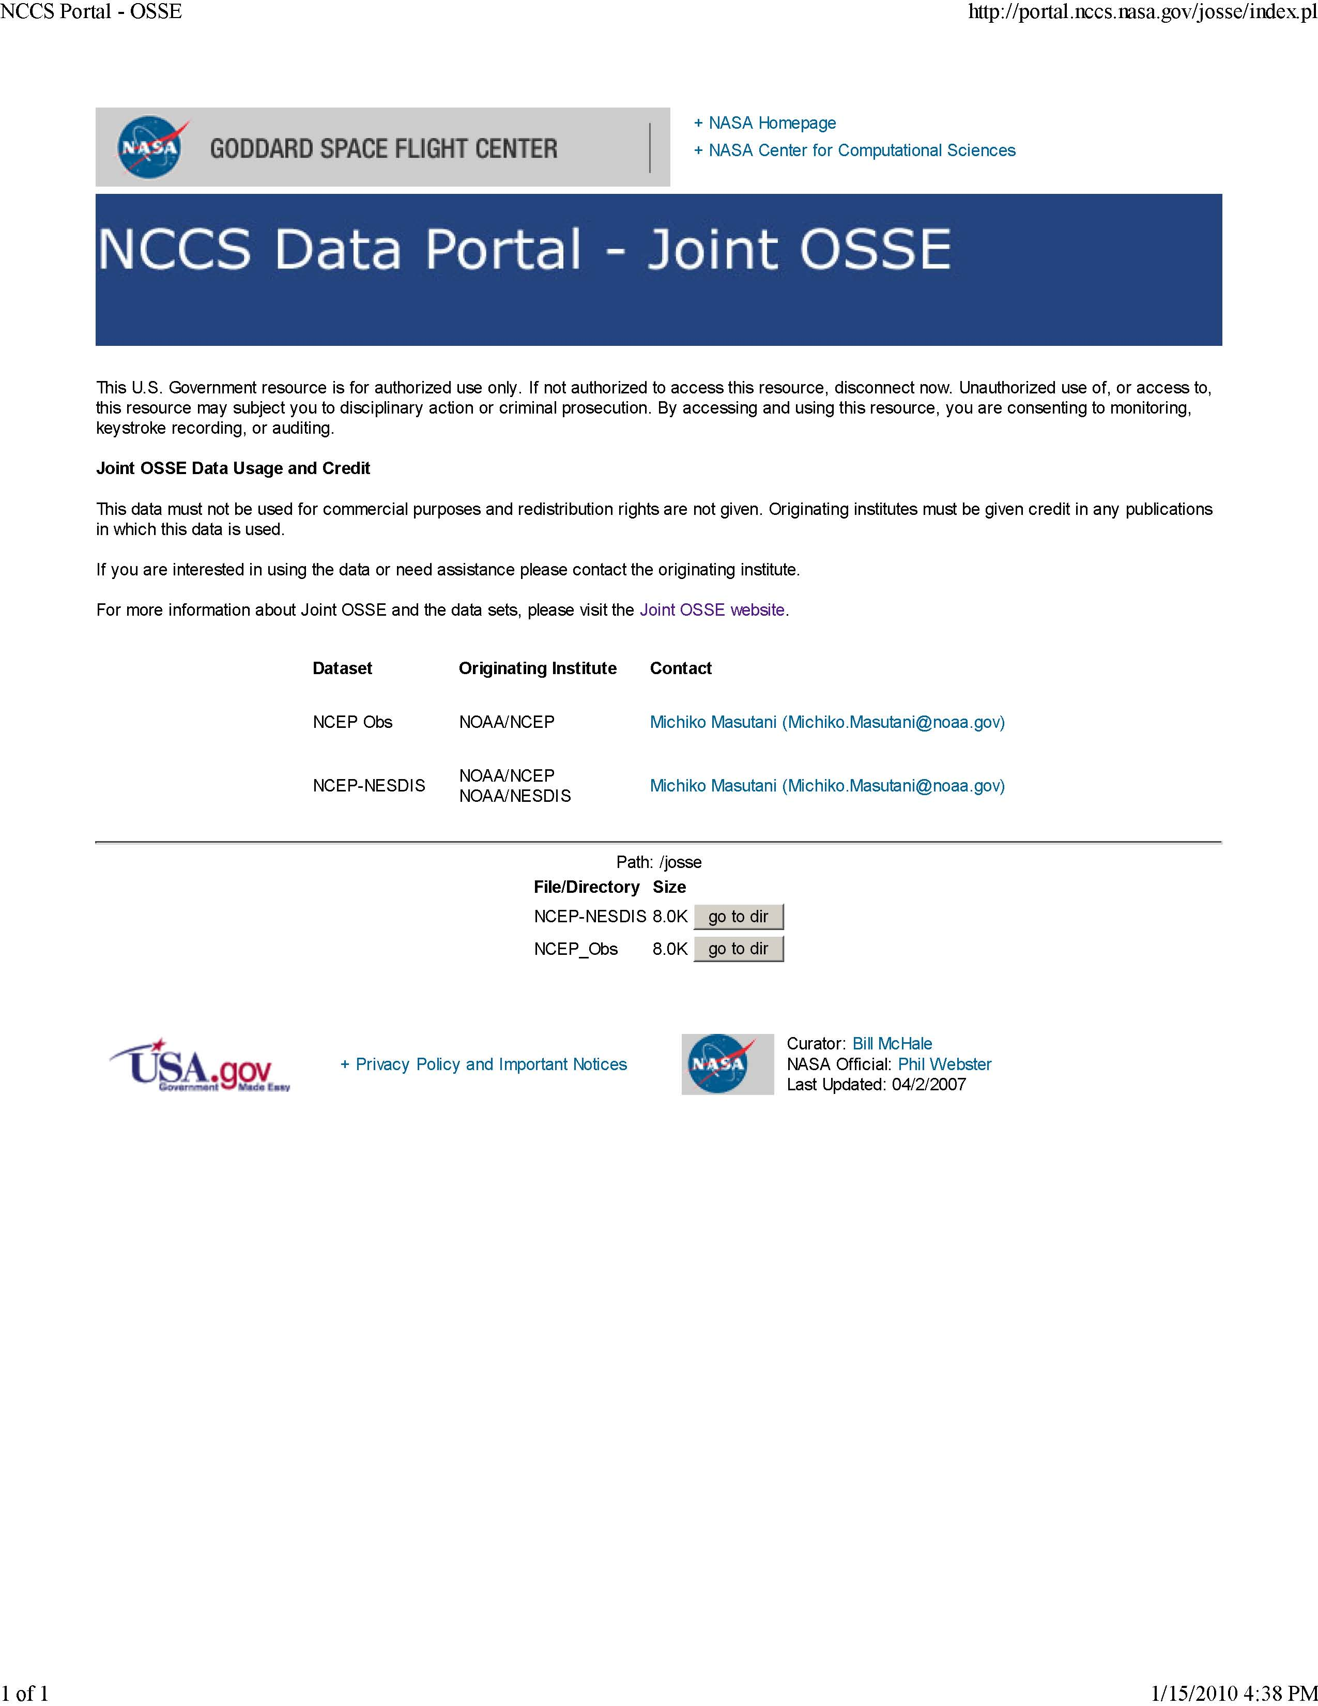

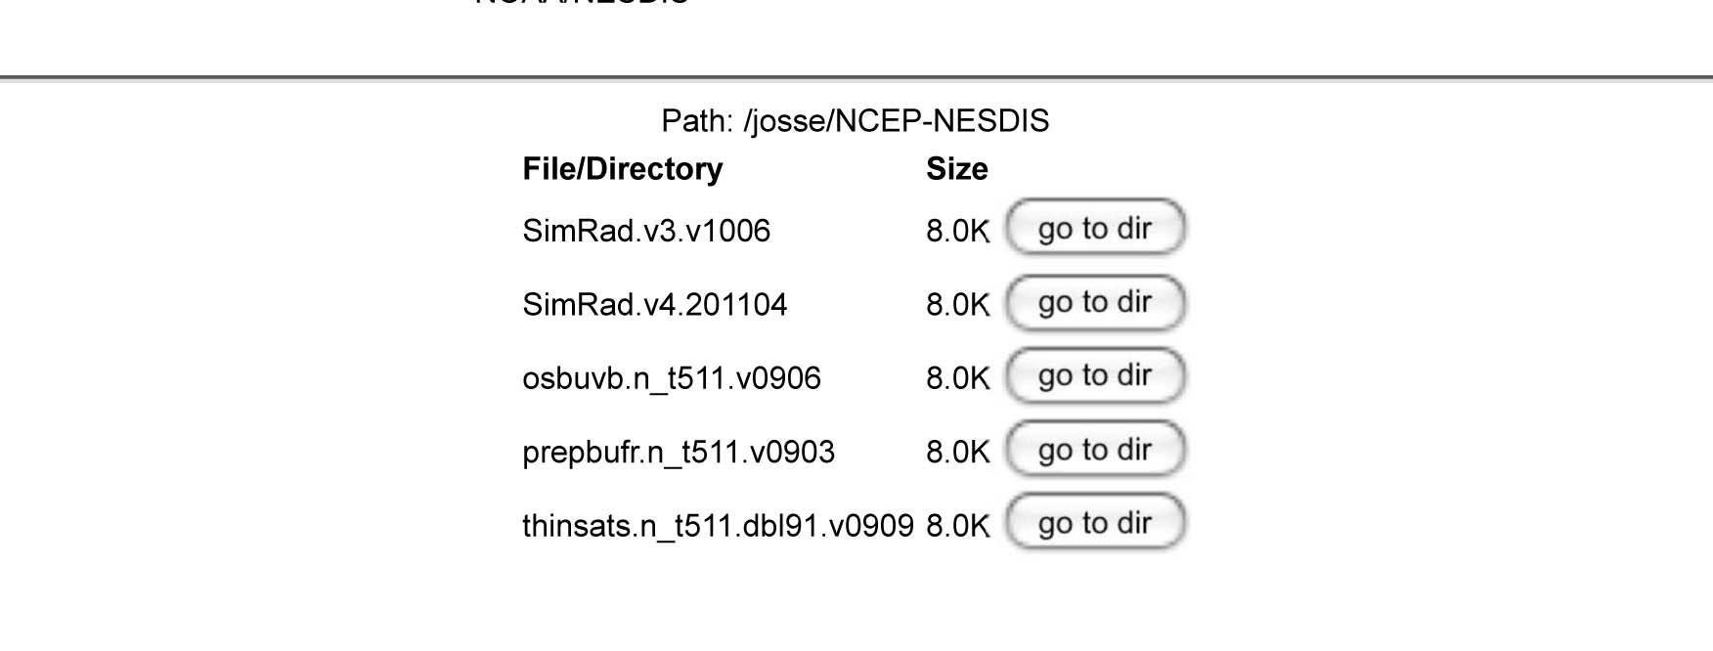
Radiance data at NASA/NCCS
Simulated radiance data, with and without MASK in BUFR format for entire Nature run period
Type of radiance data used for reanalysis from May 2005-May2006
Simulated using CRTM1.2.2

Slide 14
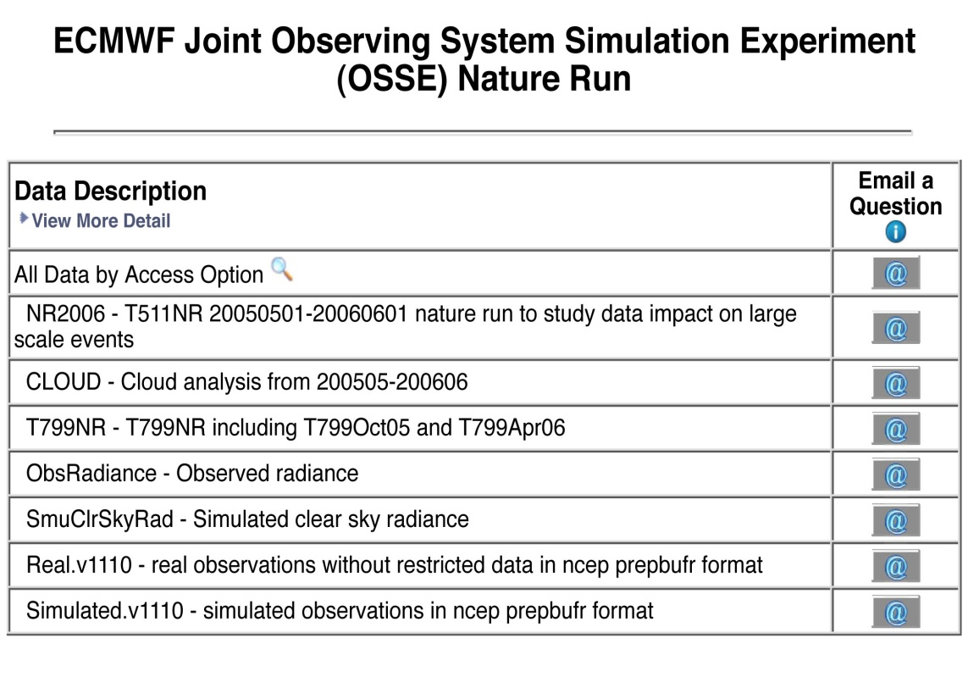
Joint OSSE Data set at NCAR
Currently saved in HPSS , Data ID: ds621.0
http://dss.ucar.edu/datasets/ds621.0/matrix.html
NCAR Contact:
Chi-Fan Shih chifan@ucar.edu Steven Worley worley@ucar.edu

Slide 15
Additional Data Available
http://www.emc.ncep.noaa.gov/research/JointOSSEs/
Simulation of TC vital
TC vital was simulated for entire NR periodusing software originally written by Tim Marchock and currently developed by Guan Ping Lou of NCEP.
Initial condition
The data were assimilated for entire Nature run period with T126 resolution model.
This analysis provide initial condition for OSSE experiments.
Software used for simulations are all posted.
CRTM used for simulation. CRTM1.2.2 (Different from the version posted at JCSDA website)

Slide 16
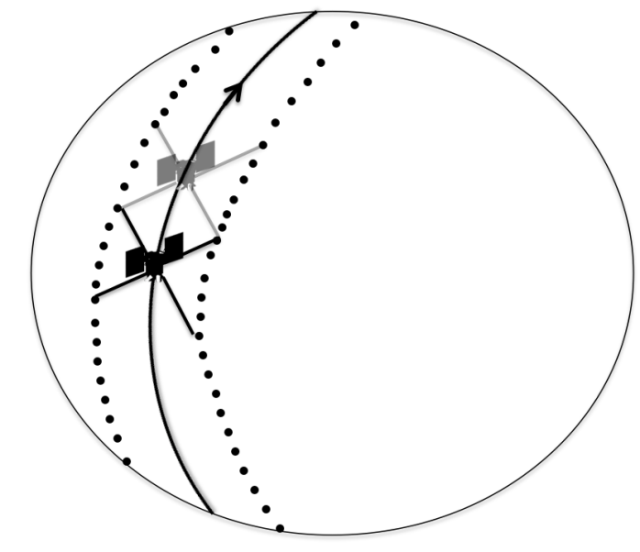
Some subtle results which require OSSEs
Testing advantage of producing vector wind.
315°
GWOS Lidar Wind obs
135°
45°
225°
315°
Diagram by Zaizhong Ma

Slide 17
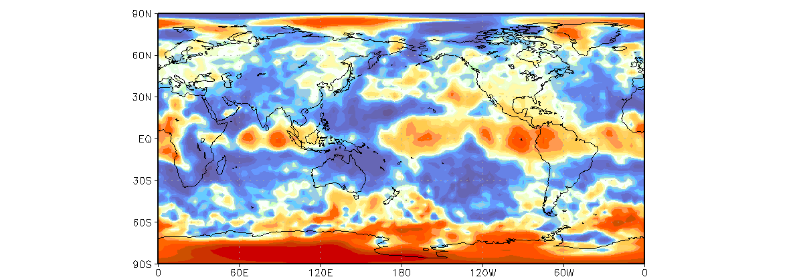
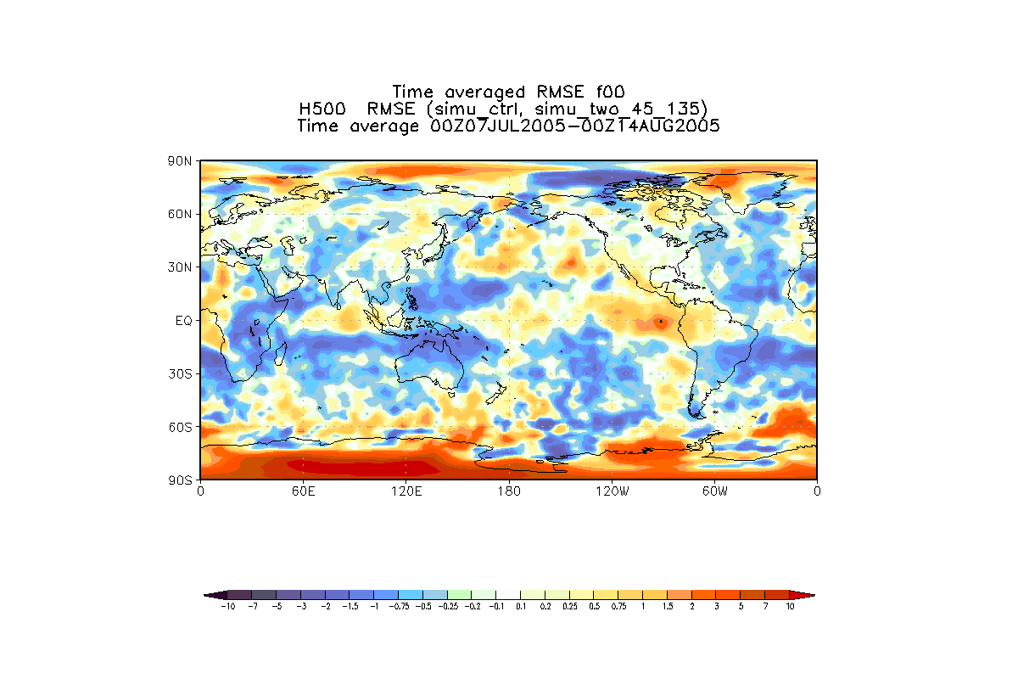
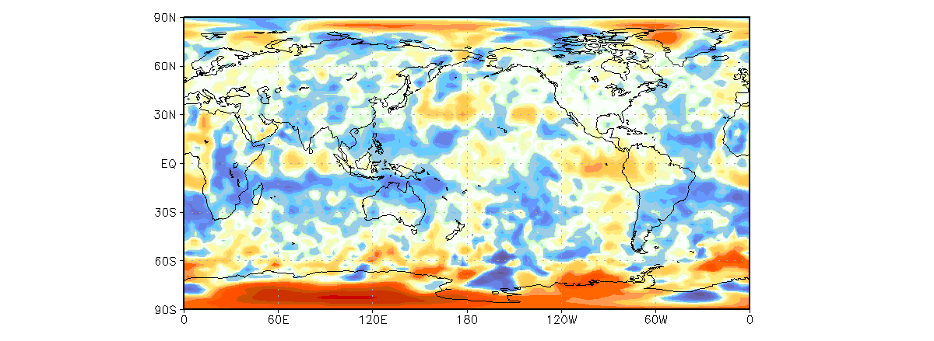
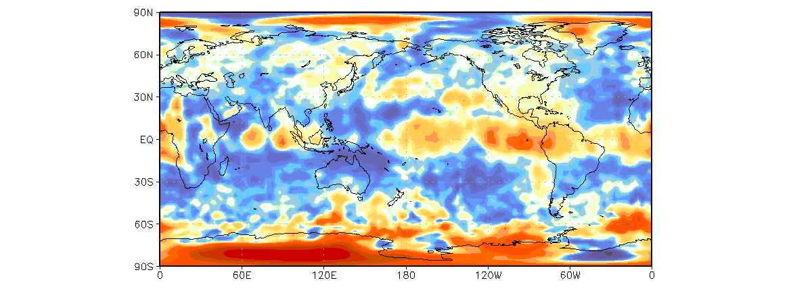
Reduction of RMSE from NR in H500 Analysis (Averaged between July 7-August 15)
Four Looks
Two front looks (45deg and 135 deg)
Same number of observation
Four time more observation
One Look (45 deg only)
Two one side looks (45deg and 315 deg)
To produce vector wind
Two synchronized one side looks (45deg and 315 deg) ) which provide vector winds show advantage in tropics compare with Two front looks (45deg and 135 deg)

Slide 18
Hurricane Case study Michiko Masutani
Investigate design for OSSE experiments.
Experiments comparison between model resolution and GWOS data to find out the best resolution for the WLS OSSE
Effect of observational error in data impact

Slide 19
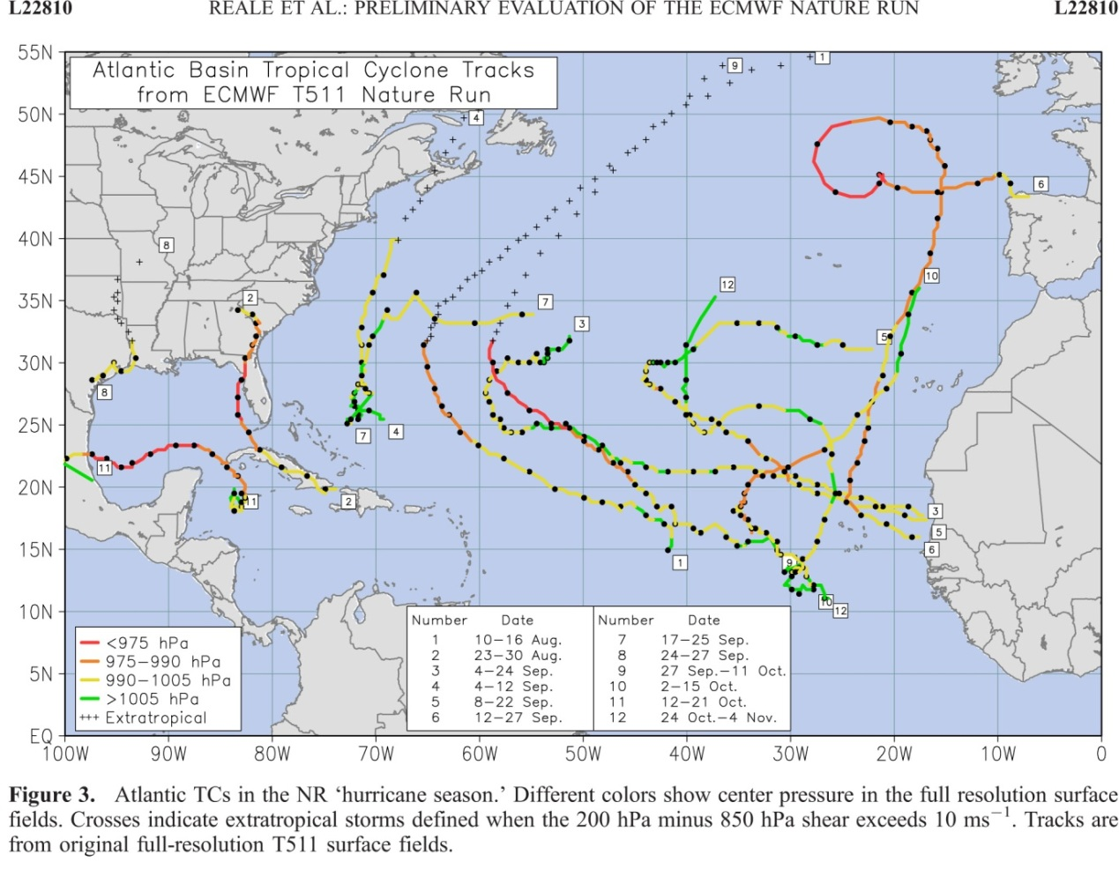
Atlantic Hurricane in the nature run for the analysis period of 9/25-10/10
Simulated observation
Control data: Observation type and distribution used by reanalysis for 2005.
Observational error is not added to the control data but calibration was performed to demonstrate the impact of observational error in control data.
DWL data: GWOS concept DWL simulated by Simpson weather associates.
The figure produced by Joe Terry

Slide 20
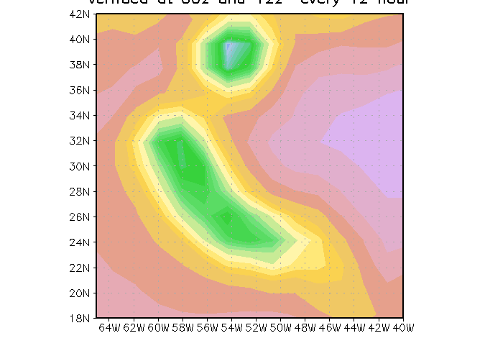
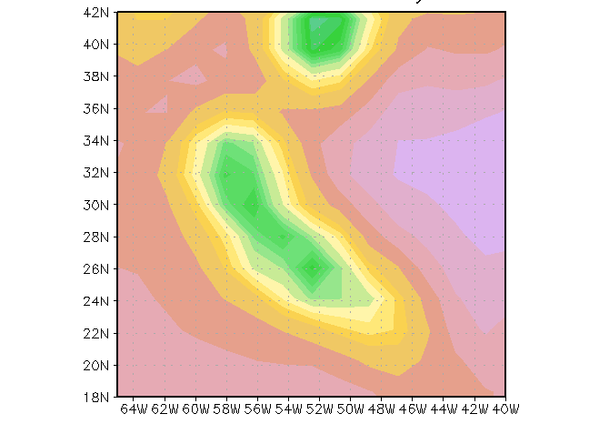
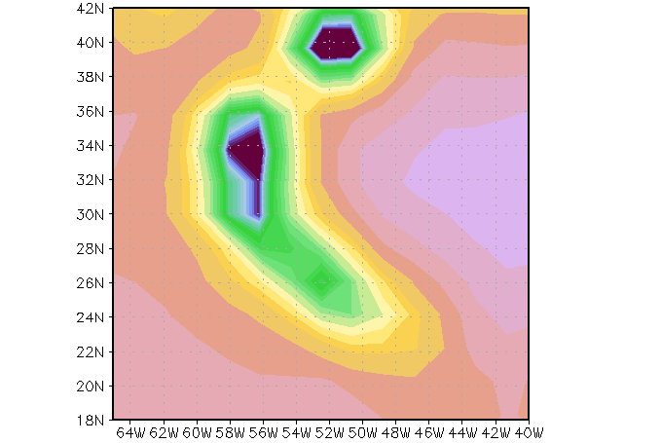
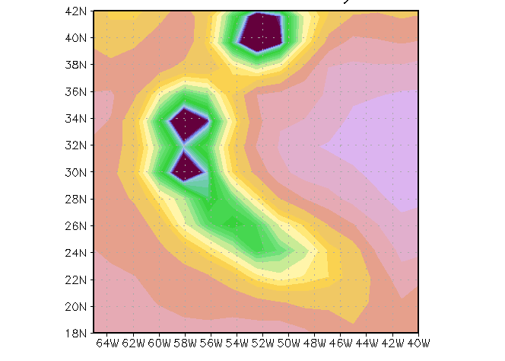
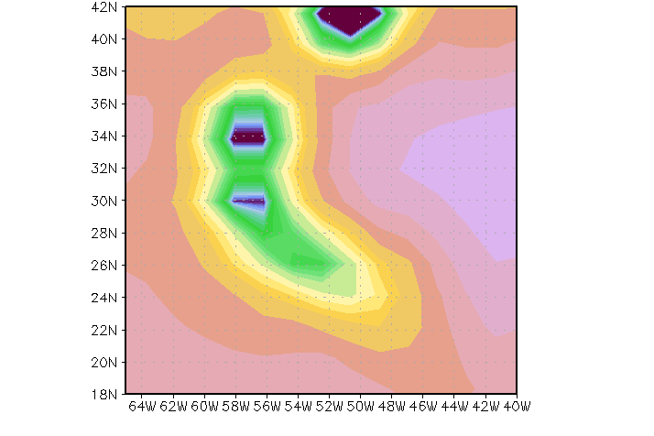
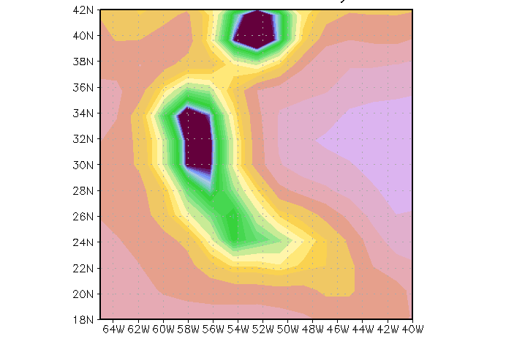
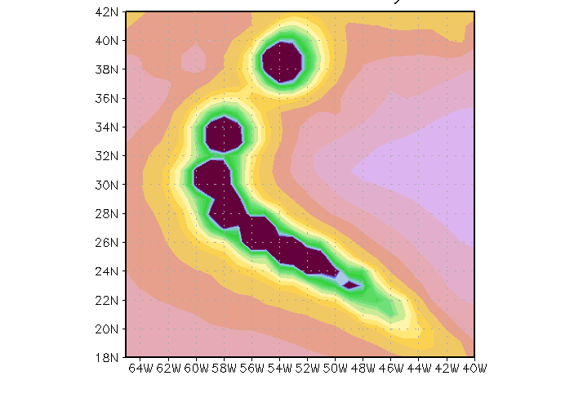
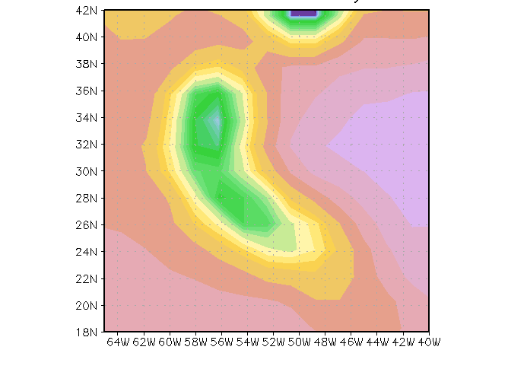
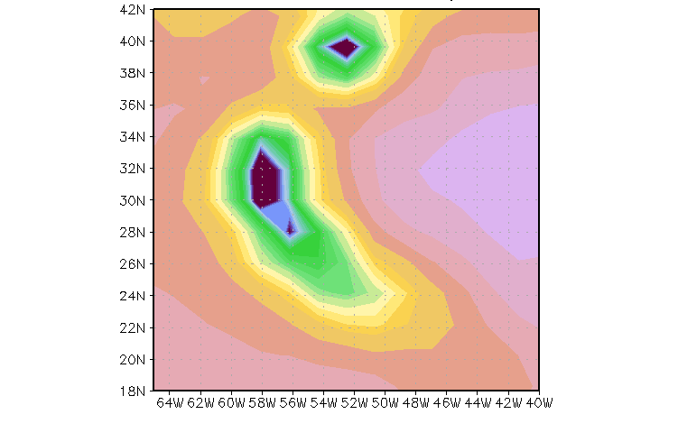
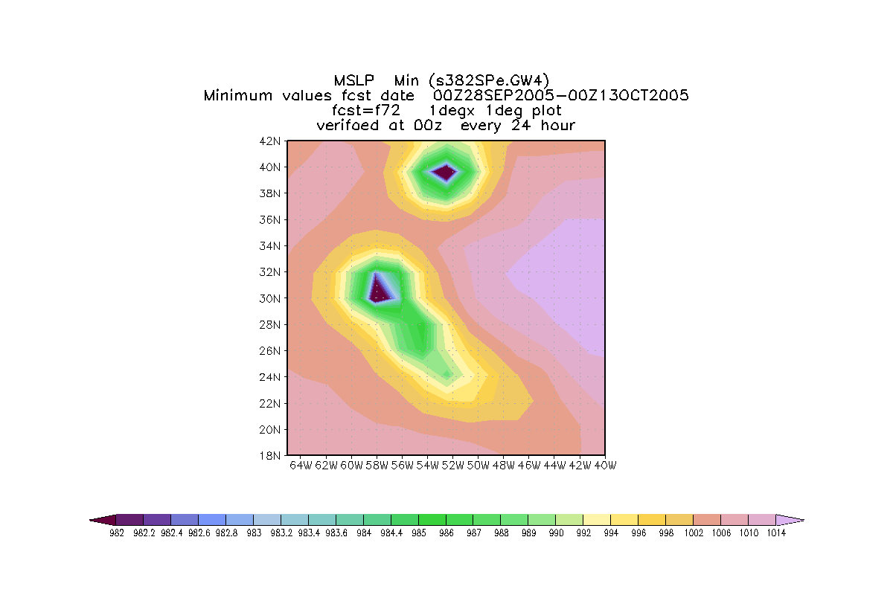
Minimum Mean Sea level Pressure
The verification period:
Sep28-Oct13, 2005
in 72 hour forecast
Evaluated at 00Z and 12Z
This display indicates the hurricane track and intensity
T126
With DWL
T126
T170
With DWL
T170
T254
Nature run
Truth
T254
WithDWL
T382
T382
With DWL

Slide 21
Initial Summary of Hurricane OSSE
At least T170 resolution is required to utilize DWL data for hurricane forecast . Impact of DWL is larger in T254 than in T170 model forecast. T382 model for OSSE with T511 Nature run may not be the best.
A Nature Run with higher resolution is required to evaluate data impact with T382 model.
◆ OSSE with control observation without observational error is useful to provide initial outlook of data impact a new type of observation.
Random error do not have significant impact in large scale, but more impact in smaller scale.

Slide 22
Further work on Hurricane Case study
Add various observational errors to control observations and study data sensitivity to the data impact. This by itself is a major important project.
Produce standard EMC skill package to compare anomaly correlations
Make use of Hurricane diagnostics package at EMC to show track and intensity in more detail
Seek for possible high resolution Nature run

Slide 23
T799 Nature run provided by ECMWF in 2006
Need for Nature run in Higher resolution
AEJ is 40% weaker than climatology
Atlantic TC activity contains some highly suspicious tracks
Eastern Pacific seems to present excessive proliferation of weak TCs
The intensity of the strongest ATL systems is not superior to T511
Different behavior in different basins
Structure of some intense system not very satisfactory in terms of scale and size of eye-like feature

Slide 24
Some requirements for the Nature run
Performance
♦The NWP model must have good forecast skill
Great visualization does not guarantee good forecast skill.
♦ Realistic spectrum of turbulence
♦ Realistic 30-60 day oscillation (MJO) in tropics
♦ Stable (no drift) to run for long period
Architectures
♦ At least 3 month lower resolution run with same model is required to provide a period for spin up for bias correction.
♦Must have a good TC or a severe storm in the nature run period.
♦Sufficient number of vertical levels. Minimum 91 levels.
♦Some degree of coupling with ocean and land surface
♦ Include some aerosol for realistic simulation
♦ Need NR to be shared within Joint OSSE
♦ User friendly archive
♦ Cloud resolving model

Slide 25
Current status of high resolution models
(limited my personal awareness)
There are many high resolution models under development
No model satisfying the requirement
GMAO is ready to produce high resolution NR for morethan one year
ECMWF promised to produce replacement of T799 nature run with better hurricane in T1279 or T2047.
They wants US commitment toward OSSEs

Slide 26
Need for Joint OSSE

Slide 27
Real data OSE
Data Denial Experiments
Simulated data (OSSE)
Observing System Simulation Experiment
Typically aimed at assessing the impact of a hypothetical data type on a forecast system
Simulate atmosphere (“Nature Run”)
Simulate reference observations (corresponding to existing observations)
Simulate perturbation observations (object of study)
Verify simulated observation
Simulate observational error
Control run (all operationally used observations)
Evaluate simulated data impact (Calibration)
Perturbation run (control plus candidate data)
Compare!
Costly in terms of computing and manpower
Observing System Experiment
Typically aimed at assessing the impact of a given existing data type on a system
Using existing observational data and operational analyses, the candidate data are either added to withheld from the forecast system and the impact is assessed
Control run (all operationally used observations)
Perturbation run (control plus candidate data)
Compare!
A lot of work

Slide 28
Need
Nature Run
(grib1 reduced Gaussian)
91 level 3-D data (12 Variables)
2-D data (71 Variables)
Climatological data
Observation template
Geometry
Location
Mask
Need Experts from
various fields
Need complete NR (3.5TB)
Random access to grib1 data
Need Data Experts
Decoding grib1
Horizontal Interpolation
DBL91
Need lots of cpu’s
Need Radiation Experts
Need Data Experts but this will be a small program
Running Simulation program (RTM)
Post Processing (Add mask for channel, Packing to BUFR)
Simulated Radiance Data

Slide 29
International Joint OSSE capability
Full OSSEs are expensive
Sharing one Nature Run and simulated observations saves on cost
Allow sharing diverse resources
OSSE-based decisions have international stakeholders
Decisions on major space systems have important scientific, technical, financial and political ramifications
Community ownership and oversight of OSSE capability is important for maintaining credibility
Independent but related data assimilation systems allow us to test robustness of answers

Slide 30
References
Summary and concept of OSSEs
Masutani, M., T. W. Schlatter, R. M. Errico, A. Stoffelen, E. Andersson, W. Lahoz, J. S.. Woollen, G. D. Emmitt,L.-P. Riishøjgaard, S. J. Lord, 2010a: Observing System Simulation Experiments. Data Assimilation: Making sense of observations, Lahoz, W., B. Khattatov, R. Menard, Eds., Springer, 647-679. Hardcover ISBN: 978-3-540-74702-4
Description about the Joint OSSE Nature Run
Andersson, Erik and Michiko Masutani 2010: Collaboration on Observing System Simulation Experiments (Joint OSSE), ECMWF News Letter No. 123, Spring 2010, 14-16.
Recent OSSEs
Masutani, M, J. S. Woollen, S. J. Lord, G. D. Emmitt, T. J. Kleespies, S. A. Wood, S. Greco, H. Sun, J. Terry, V.Kapoor, R. Treadon, K. A. Campana (2010), Observing system simulation experiments at the National Centers for Environmental Prediction, J. Geophys. Res., 115, D07101, doi:10.1029/2009JD012528.

Slide 31

Recently published Hand book for Data assimilation
Data Assimilation
Making Sense of Observations
Springer
Lahoz, William; Khattatov, Boris; Menard, Richard (Eds.)
1st Edition., 2010, XIV, 732 p.
Hardcover, ISBN 978-3-540-74702-4
Data assimilation methods were largely developed for operational weather forecasting, but in recent years have been applied to an increasing range of earth science disciplines. This book will set out the theoretical basis of data assimilation with contributions by top international experts in the field. Various aspects of data assimilation are discussed including: theory; observations; models; numerical weather prediction; evaluation of observations and models; assessment of future satellite missions; application to components of the Earth System. References are made to recent developments in data assimilation theory (e.g., Ensemble Kalman filter), and to novel applications of the data assimilation method (e.g., ionosphere, Mars data assimilation).

