Slide 1
DATA ASSIMILATION FOR HURRICANE PREDICTION Update on data assimilation developments and improvements with particular reference to ability to test Lidar impacts in OSSEs -
Tomislava Vukicevic¹ ,
Altuğ Aksoy^{1,2}, Kathryn Sellwood^{1,2} , Sim Aberson¹, Sylvie Lorsolo^{1,2}, Xuejin Zhang^{1,2} and Frank Marks¹
¹NOAA/AOML Hurricane Research Division
²U. Miami/RSMAS Cooperative Institute for Marine & Atmospheric Studies
³Science Applications International Corporation

Slide 2
HWRF Hurricane Ensemble Data Assimilation System (HEDAS)
Forecast model:
HWRF
2 nested domains (9/3 km horizontal resolution, 42 vert. levels)
Static inner nest to accommodate covariance computations
➔ Inner nest size: ~10x10 degrees
Data assimilation:
Square-root ensemble Kalman filter
Assimilates inner-core aircraft data on the inner nest
➔ NOAA P-3, NOAA G-IV, USAF, PREDICT G-V
Ensemble system:
Initialized from semi-operational GFS-EnKF (NOAA/ESRL) ensemble
30 ensemble members
Aksoy et al., 2012

Slide 3

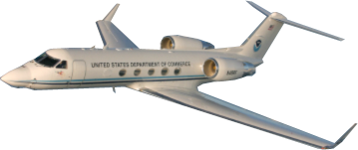
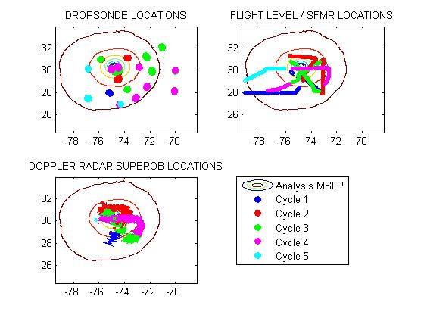
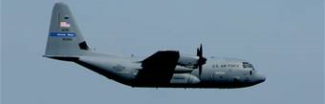
Observations
2 NOAA Orion P-3
Dropsonde + Flight level
+ Tail Doppler Radar
1 NOAA Gulfstream G-IV
Dropsonde
Data types
flight level: wind temperature and humidity + SFMR surface wind
GPS dropwindsonde: wind, temperature, humidity and pressure
Tail Doppler Radar: radial winds.
Approximate vertical location
Orion P3: ~ 3 km
G-IV : 13 - 14 km and
U.S. A.F. C-130’s: 10km maximum with a minimum 2000ft. vertical separation from the P3’s
Observation distribution
(9/02/2010 02Z analysis)
U.S.A.F WC-130J
Flight level + Dropsonde

Slide 4
HEDAS Performance
Retrospective 2008-2011
Altuğ Aksoy

Slide 5
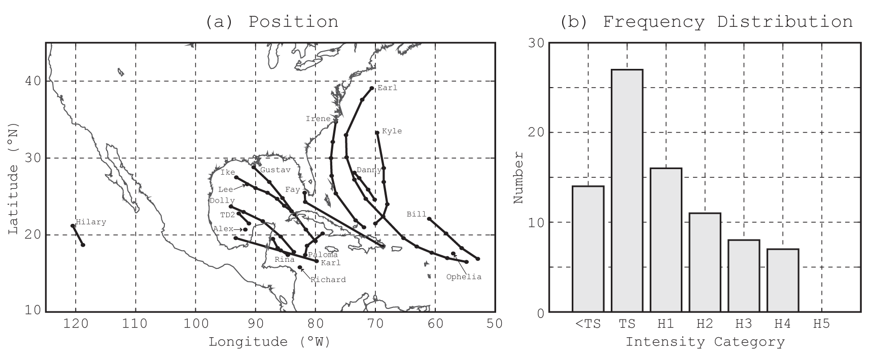
Distribution of Cases

Slide 6
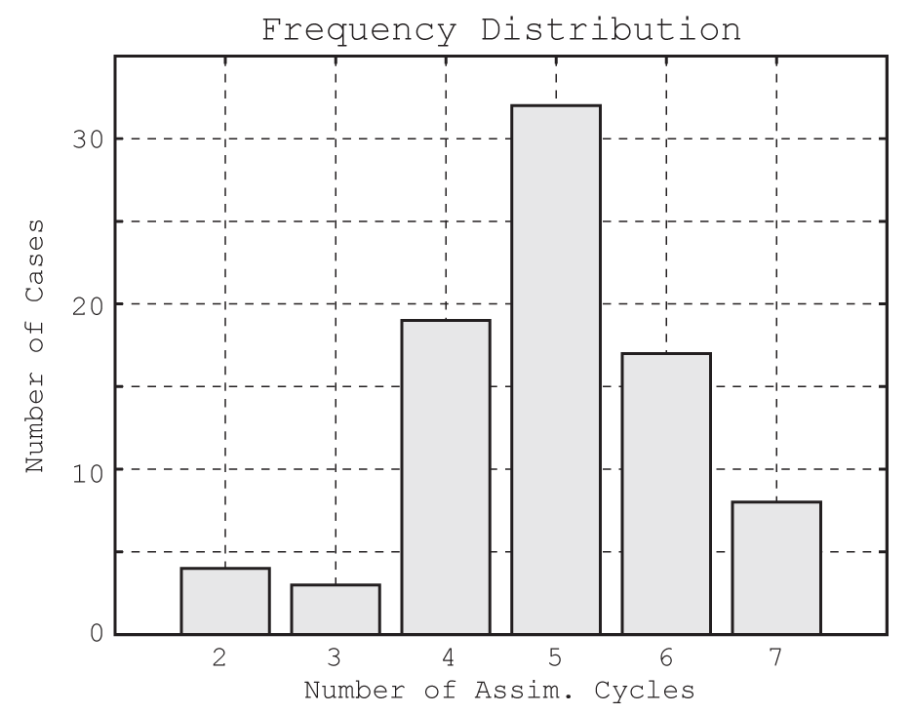
Number of Assimilation Cycles

Slide 7
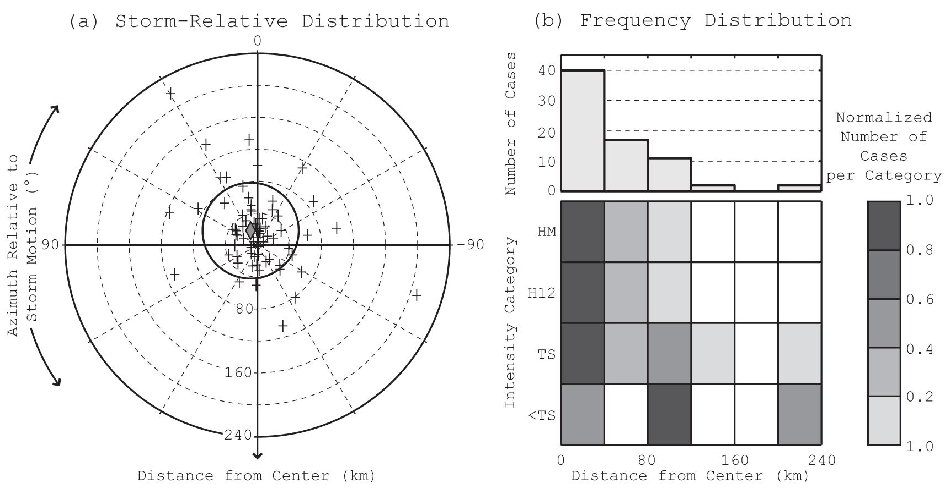
Analysis Position Error

Slide 8
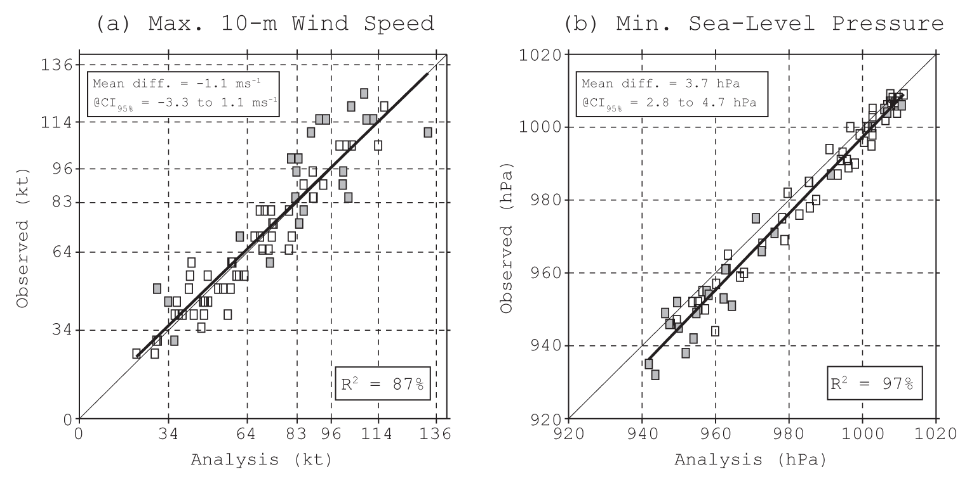
Analysis Intensity Error

Slide 9
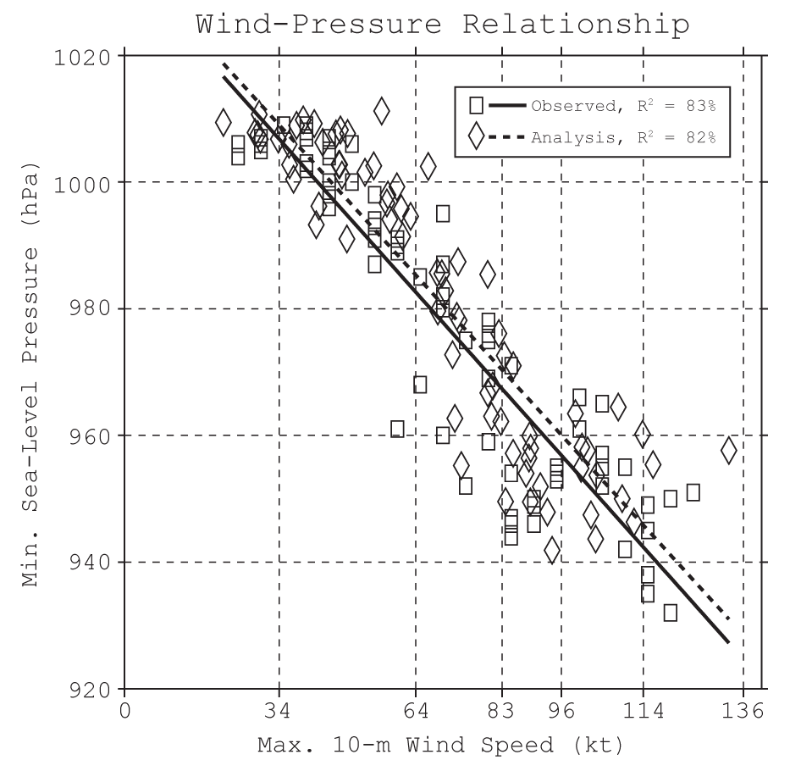
Analysis Wind-Pressure Relationship

Slide 10
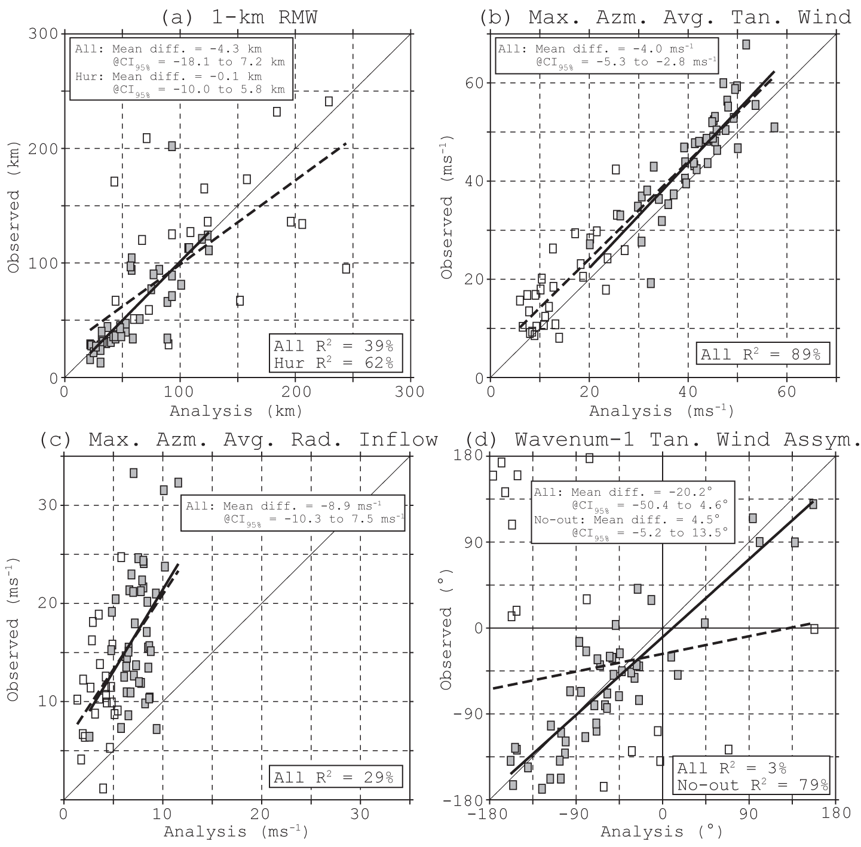
Analysis Doppler-Derived Structure
2008 Fay (1)
2008 Gustav (2)
2008 Ike (1)
2008 Kyle (4)
2008 Paloma (1)
2009 Danny (1)
2010 Earl (1)
2010 Karl (2)
2010 Tomas (1)
2011 Irene (2)

Slide 11
Summary of analysis properties
Very good estimate of 3D primary circulation
Small amplitude but statistically significant negative intensity bias for hurricane intensity cases
Very good estimate of storm location
The observed storm center location was not assimilated
Low skill of the estimate of secondary circulation
Underestimate of both the vertical and radial components
POTENTIAL FOR IMPACT OF LIDAR OBSERVATIONS
Good estimate of axisymmetric structure of temperature and humidity with a bias in mean amplitude

Slide 12
OSSE capability
HEDAS is an off line system with respect to HWRF
Adaptable to any resolution and location
Requires significant computational resource
Observation operators are modular
New operators could be easily added
Required collaboration with the observation experts

