Slide 1
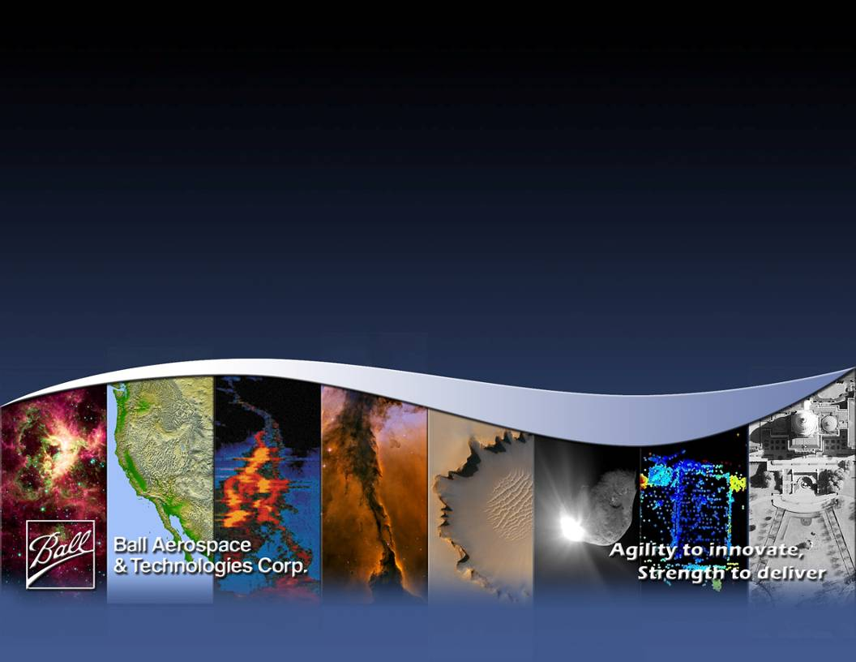
Successes of the OAWL IIP and next steps (with a FIDDL):
Sara C. Tucker, Thomas Delker, & Carl Weimer Ball Aerospace & Technologies Corp.
Working Group on Space-based Wind Lidar
1-2 May 2012 - Miami, FL

Slide 2
What is OAWL?
The Optical Autocovariance Wind Lidar (OAWL) is a Doppler Wind lidar designed to measure winds from aerosol backscatter at 355 nm (and 532 nm) wavelength(s).
The OAWL IIP was a multi-year Ball Aerospace & NASA Earth Science Technology Office development effort to grow the Optical Autocovariance technology, raise the OAWL TRL from TRL-3 to Space TRL-5 (Aircraft TRL6), and demonstrate the potential of OAWL to reduce cost and risk for future Earth Science Lidar missions.
One system, one laser, global winds.

Slide 3
‘Hooo’ is OAWL?
The Ball OAWL Development Team
Mike Adkins – Electrical engineering
Tom Delker – Optical engineering
Scott Edfors – FPGA code
Dave Gleeson – Software engineering
Bill Good – Airborne test lead
Chris Grund – System architecture,
science, systems engineering
Teri Hanson – Business analyst
Paul Kaptchen – Opto-mechanical technician
Mike Lieber – Integrated system modeling
Miro Ostaszewski – Mechanical engineering
Jennifer Sheehan - Contracts
Sara Tucker – PI, science, signal processing, algorithm development
Carl Weimer – Space lidar consultant
OAWL Test Support
NASA WB-57 Program office: aircraft maintenance, engineering, and flight crew
NOAA Chemical Sciences Division Atmospheric Remote sensing group
The OAWL Lidar system development, ground validation, and flight demo is supported by NASA ESTO IIP grant: IIP-07-0054
FIDDL supported by NASA ESTO ACT grant: ACT-10-0078
Any opinions, findings, and conclusions or recommendations expressed in this material are those of the author(s) and do not necessarily reflect the views of the National Aeronautics and Space Administration.
Notes:
No data or proprietary info

Slide 4
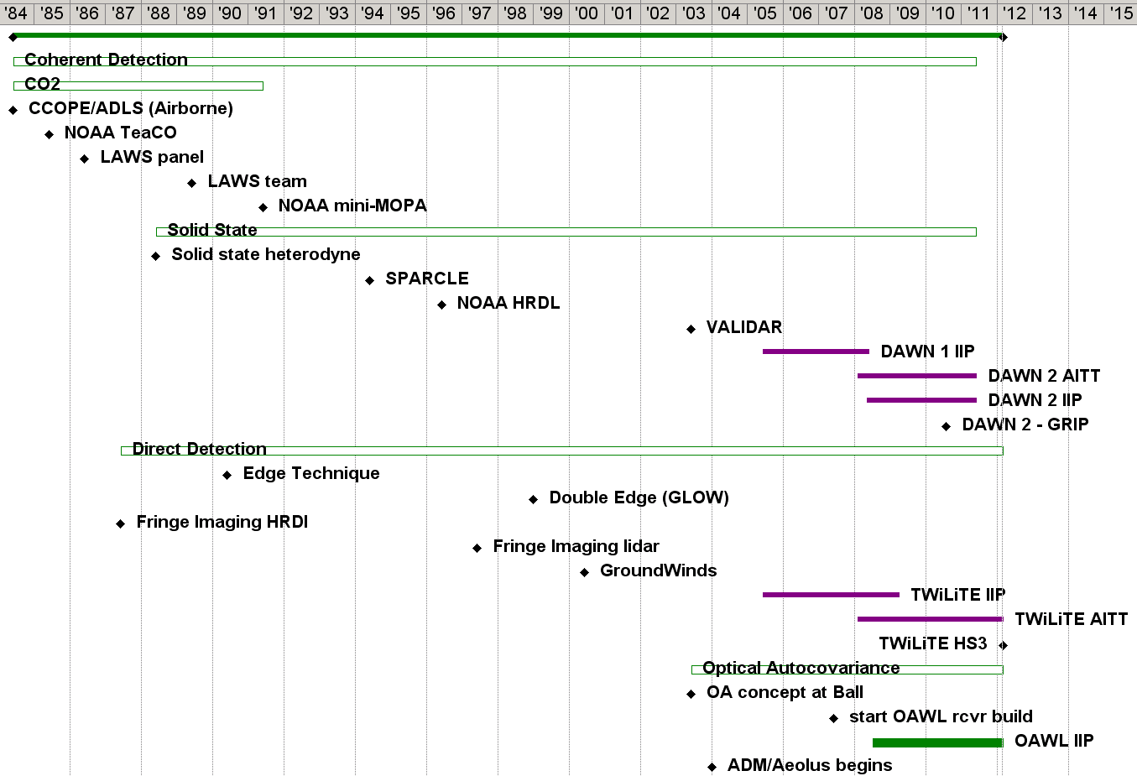
A wind lidar timeline (corrections & additions are welcome)
Back to 1973

Slide 5
Optical Autocovariance Wind Lidar
OAWL Transceiver
Single Frequency Laser Transmitter,
Telescope, & Data System
Optical Autocovariance Receiver @ 355/532 nm
Aerosol wind speed and direction estimates on 10 m to 10’s km, scales (platform dependent)
Additions: HOAWL
for HSRL & FIDDL for molecular wind channels
Line of sight wind speed
Aerosol & molecular wind + aerosol characteristics → opens the gate for combined global wind & aerosol mission: one system, one laser.
Horizontal wind speed
Ball Aerospace patents pending

Slide 6
Coherence & bandwidth of atmospheric lidar return
Aerosol return has a narrow bandwidth, longer temporal coherence length
Molecular return has a wide (Doppler broadened) bandwidth, shorter temporal coherence length.
OAWL uses the aerosol portion of the return, the molecular portion adds background/offset, reducing the system contrast.
Using the molecular return in a double-edge lidar first makes use of the molecular and improves the OAWL contrast.
FIDDL ACT will demonstrate this (more on this later).
2.5
Doppler Shift
Due to wind
2
outgoing laser pulse frequency
f_{o} = c/λ₀
1.5
Return spectrum from a
Monochromatic source
Backscatter (W)
1
A+M+BG
A
0.5
M
BG
0
160
80
40
20
10
0
10
20
40
80
160
Wavelength Shift (m/s)

Slide 7
OAWL: Optical Autocovariance Wind Lidar
OAWL Development Effort
Ball internal investments
develop the OAWL theory
develop flight-path architecture and processes
develop the performance model
perform OA proof of concept experiments
design and construct a flight path IFO-receiver prototype
perform upgrades on the OAWL interferometer components
develop an integrated direct detection (IDD) concept to measure winds from aerosol and molecular returns at 355 nm
NASA IIP: input OAWL IFO-receiver at TRL3
perform vibration testing on the IFO-receiver
build the IFO-receiver into a robust lidar system (laser, telescope, data system, T0 path, etc.)
Ready the system for flight on the WB-57 (pallet frame, vibration isolation, pallet windows, heating/cooling system, etc.)
Validate performance of the OAWL system design from ground and in the WB-57
Bring OA technology to TRL-5
Notes:
No data or proprietary info

Slide 8
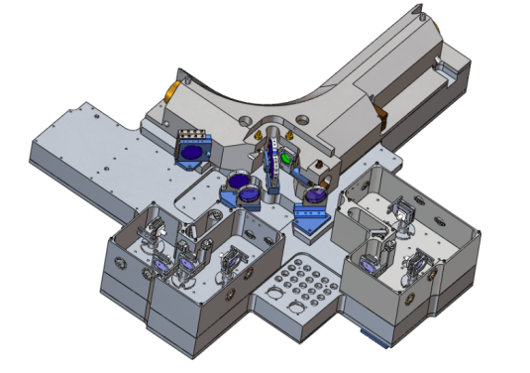
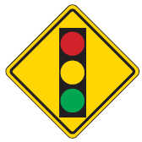

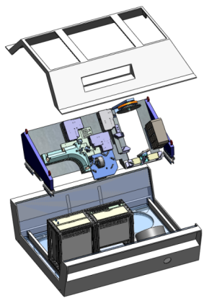
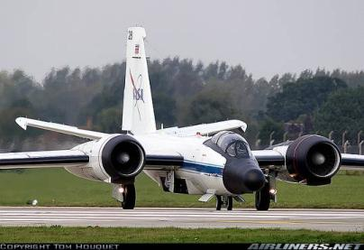

Overview: OAWL IIP Development Process
ENTER TRL 2.5
Integrate the OAWL IFO-receiver into a wind lidar system
(add laser, telescope, data system, acquisition software, and processing algorithms)
Vibe & Thermal tests of OAWL IFO-receiver ( Ball IRAD, delivered Oct. 2009)
Validate OA system design
TEST
Perform Ground Validations: TRL4
Demonstrate concept, design, autonomous operation, and performance from the NASA WB-57 aircraft:
Design, build, and qualify components for aircraft flight
(frame, vibration isolation, optical window assembly, thermal controls, and autonomous control software → all in the WB-57 pallet)
BUILD
EXIT TRL 6
TEST

Slide 9
OAWL IIP Executive Summary
The Ball OAWL team has successfully completed the OAWL ESTO IIP Grant
The OAWL system is complete and its design meets all stated objectives
Measured winds from the ground with < 1m/s precision (1-2s)
Measured winds from the aircraft (2-6 m/s precision 30s, first ever set of flight tests)
The OAWL IFO-receiver was vibration tested and demonstrated performance in-line with that needed for aircraft operation.
The OAWL laser, telescope, heaters, and data-system were designed, built, integrated with the OAWL IFO-receiver, and the system was aligned and tested.
The successful ground comparison/validation test put the system at TRL4. The measurement results were presented at the August 2011 winds working group.
The aircraft hardware preparation was completed, including the building and installation of the WB-57 pallet frame, optical window assembly, cooling system, cabling (> 400 conductors) etc..
Aircraft payload data package was completed and signed off, and the in-pallet technical readiness review (TRR) was passed at JSC.
Software and sensors for fully autonomous operation on the WB-57 were completed, integrated, and tested.
Flight tests are complete, putting the system at Aircraft-TRL6 (Space-TRL5). The system measured Doppler shifts from ground (validated by aircraft speed), clouds, and aerosols (winds).
Data processing algorithms were developed for ground and aircraft profile data. Analysis & validation of flight data complete.

Slide 10

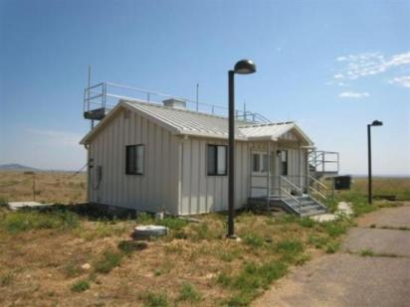
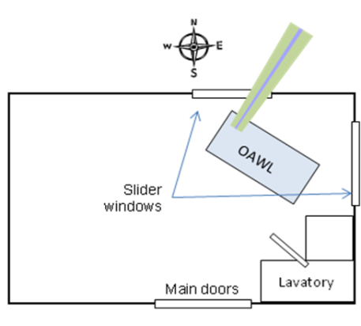
OAWL Ground Validation with NOAA’s mini-MOPA
OAWL Ground Validation
Line-of-sight (LOS) comparisons between
OAWL (355 nm)
NOAA’s mini-MOPA (10 µm) Coherent Detection Doppler lidar – established “truth” system
~15 hrs of data, 11-21 July, 2011
Pointing out over Table Mountain Test Facility (north of Boulder, CO): 17° (NNE) azimuth at 0.3° elevation.
Mini-MOPA
OAWL (inside)

Slide 11
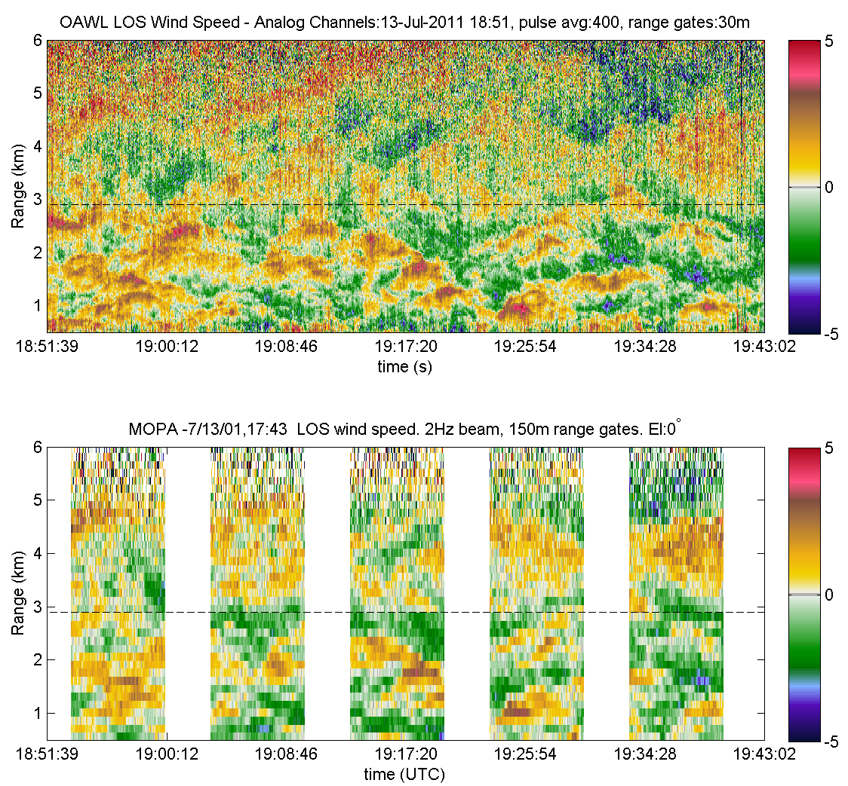
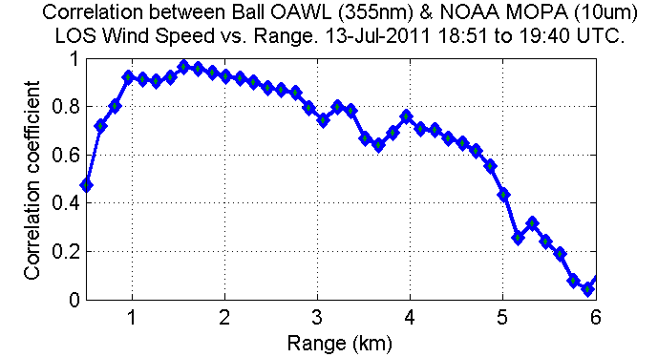
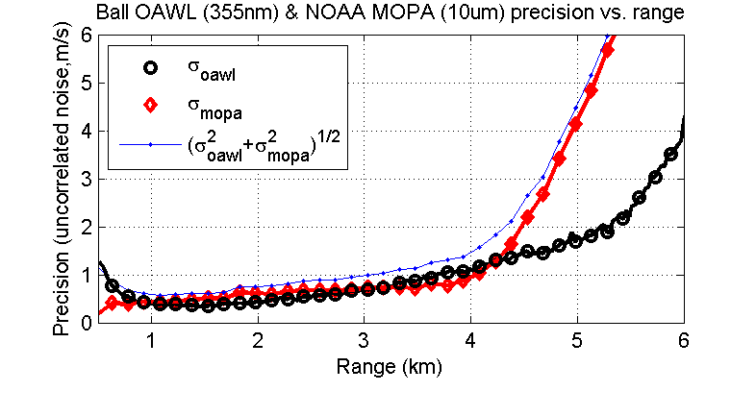
OAWL Validation: Correlation with mini-MOPA
OAWL & MOPA LOS Wind Data: “Average” (decimate with low-pass filtering) MOPA in time, and OAWL in range to put both systems on the same grid.
max correlation > 95%.
50 minutes

Slide 12
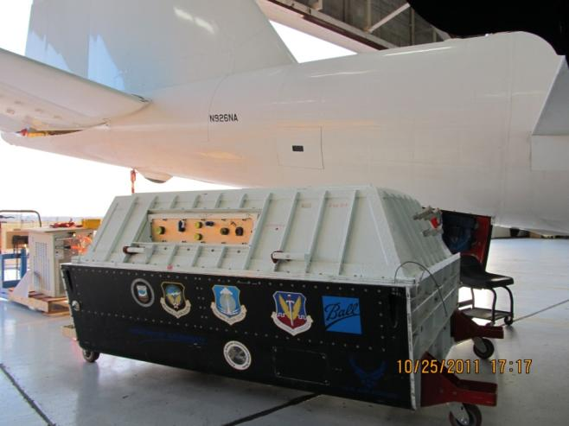
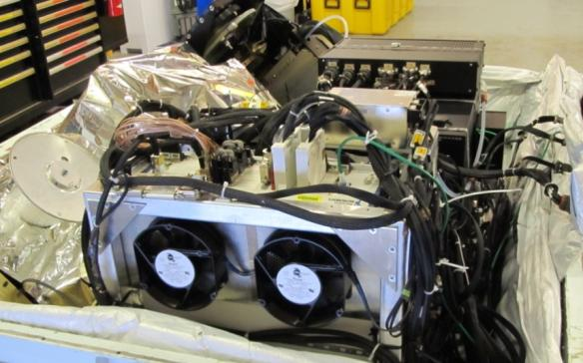
Airborne Test Planning & Preparation
Pressurized pallet component design & fabrication
System frame (with vibration isolation)
Electronics rack & cabling (> 400 conductors)
Thermal and air flow systems
Chiller fluid circulation system.
Optical and safety pressure test on pallet windows
Hardware integration - many layers, cables, etc.
Payload Data Package (200+pgs) was signed off by Johnson Space Center mid-September.
In-pallet Technical Readiness Review (at JSC) passed with no action items.
The OAWL system, in the pressurized pallet, with the tail of the NASA WB-57 jet in the background.
Automated system operational software:
Data acquisition and storage
Laser control (warmup, monitoring)
Auxiliary/housekeeping data acquisition and storage
Automated control algorithm development and testing: boot/reboot sequence, system monitoring, pilot interface (on-off control only), etc.

Slide 13
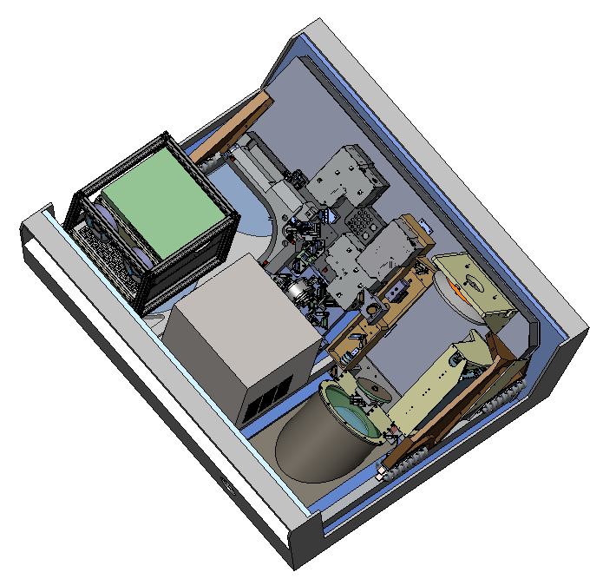
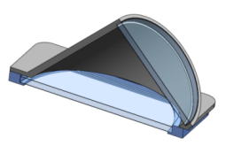
OAWL System in the WB-57 Pallet
Optic Bench
Insulation
IFO-receiver optical system mounted 45 deg to the base of the pallet.
Electronics Rack (not vibration isolated)
Laser Power Supply
Data Acquisition Unit (+ extra fans)
DC power supplies
Telescope Primary Mirror
Pallet Frame
Telescope Secondary Mirror
Chiller
Double Window provides symmetric wave-front distortion
Wire Rope Vibration Isolators
Laser
Double Window Section

Slide 14
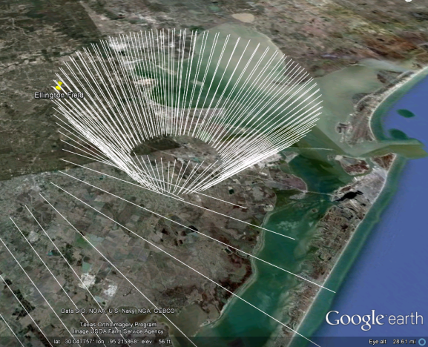
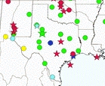
OAWL WB-57 Flight Objectives
Demonstrate ability to operate autonomously in a low-pressure, high-vibration, cold (to -65° C), and noisy environment
Demonstrate ability to measure Doppler shifts from ground & atmosphere
Validate the measurements using aircraft NAV data (for ground) and radar wind profilers (for atmosphere)
Clockwise orbit the RWP, with the OAWL LOS pointing toward the center at 45° off nadir plus aircraft roll
Required to keep < 10° roll/bank→ 20-40 km radius orbit →10-20 km radius on the ground.
Storm patterns prevented comparison with Doppler wind lidar at DOE ARM site.
Multi-agency profiler (MAP) network

Slide 15
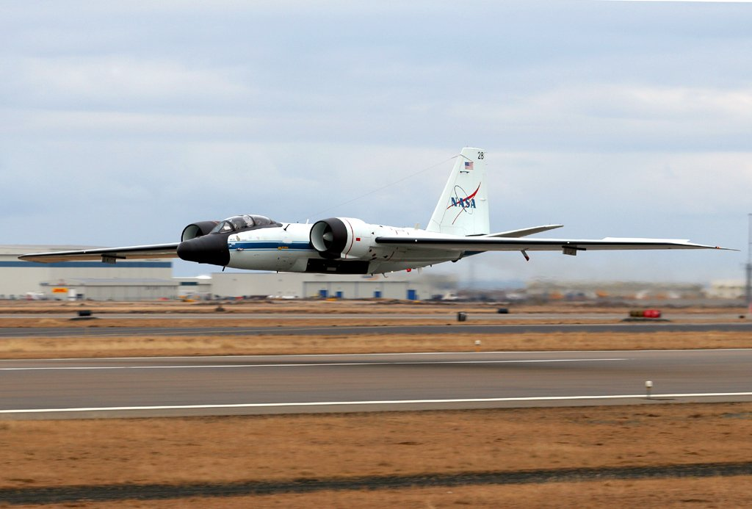

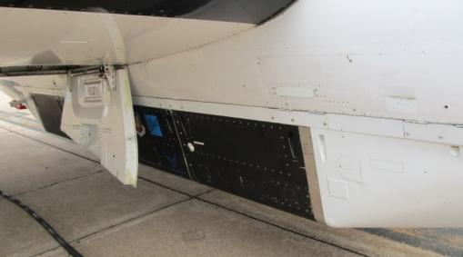
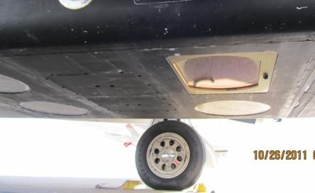
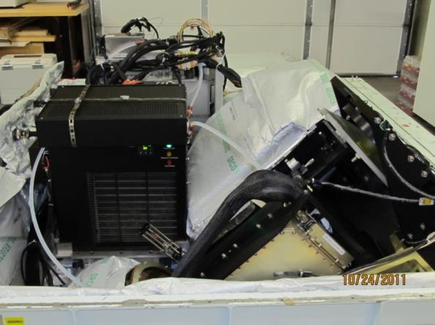
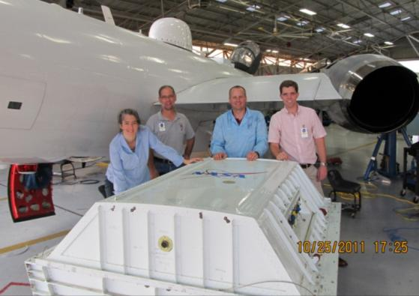
OAWL on the NASA WB-57 Jet
Pallet installed in the aircraft
View of optical port on bottom of pallet
Photo courtesy of Don Hanselman, WB-57 Program Office.
Aircraft interface tests complete, & pallet lid on
Everything fits!

Slide 16
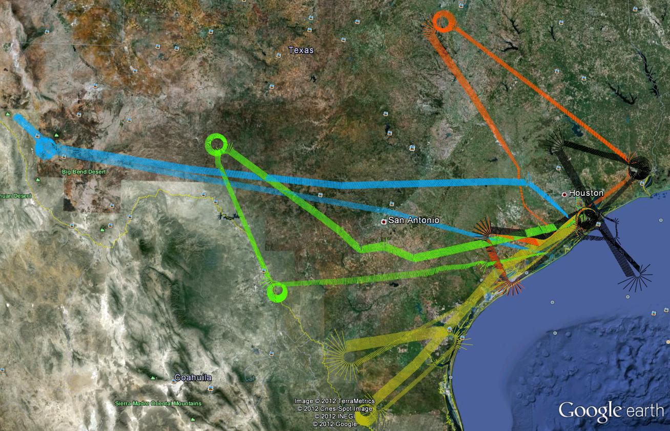
5 Flight Tests: 26 October - 8 November 2011
OAWL Flights on the WB-57
Flight # | Flight Date
1 | 26 Oct 2011
2 | 02 Nov 2011
3 | 04 Nov 2011
4 | 07 Nov 2011
5 | 08 Nov 2011

Slide 17
OAWL WB-57 Flight Summary
The 2011 NASA WB-57 flight tests successfully demonstrated autonomous operation of the OAWL instrument on each of five (5) flights, gathering over 14 hours of lidar data, and measuring Doppler shifts from the ground, clouds and aerosols.
OAWL Flights on the NASA WB-57
Flight # | Date | Mission Length | OAWL Lasing Time*
1 | 26 Oct 2011 | 4.0 hrs | 1.8 hrs
2 | 02 Nov 2011 | 4.4 hrs | 3 hrs
3 | 04 Nov 2011 | 4.5 hrs | 3 hrs
4 | 07 Nov 2011 | 5.6 hrs | 3.8 hrs
5 | 08 Nov 2011 | 4.1 hrs | 2.5 hrs
 |  | 22.6 hrs | 14.1 hours Total
*Lasing time = lidar data acquisition time, only at flight levels > 33,000 feet.
OAWL took auxiliary data during the entire mission/flight time.

Slide 18
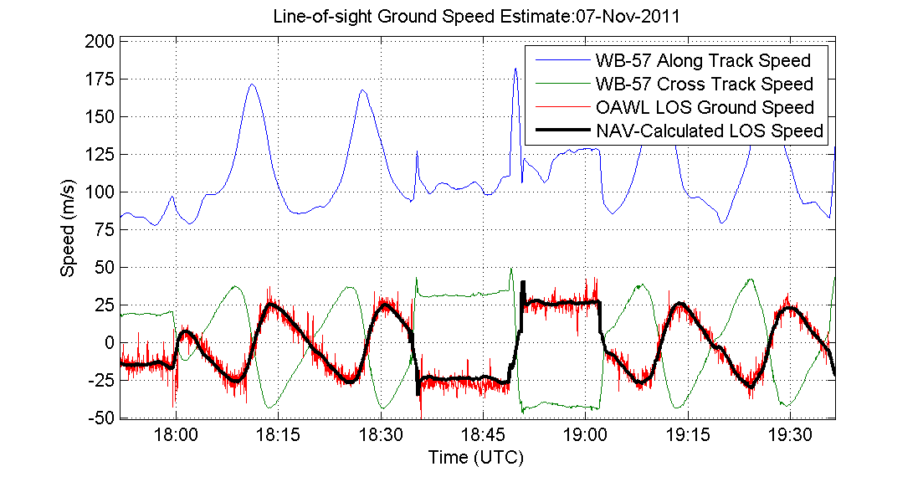
First Validation: OAWL Ground Returns
Calculate T0-relative Doppler shift of ground return (Ground return L_{c} ~= laser L_{c})
Calculate expected ground speed as observed along OAWL-LOS using WB-57 NAV data
Comparison of the two signals shows > 97% correlation when the right pointing angle (between aircraft IMU axis and OAWL LOS) is known.
Pointing angle can vary throughout the flight due to fuel consumption changing the aircraft shape (and thus relationship between OAWL and aircraft IMU)
With optimized angle for the section of data analyzed, the error variance between the speeds is ~2 m/s for 2 second estimates (on the order of the OAWL estimate precision at this low SNR)
IMU precision/accuracy unknown.
relative ground speed as measured by OAWL along the OAWL LOS.
NAV-data calculation of WB-57 ground speeds along the OAWL LOS
Aircraft along-track speed
Aircraft cross track speed

Slide 19
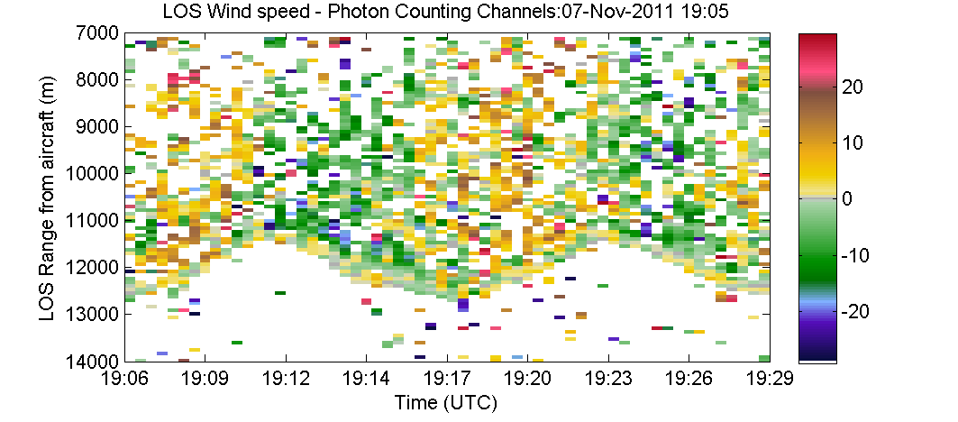
OAWL LOS wind speed vs. range from aircraft
Image shows LOS wind speed estimates measured from aerosol return
Cool colors: winds toward lidar
Warm colors: winds away from lidar
Noisy estimates appear, depending on where the noise threshold is set.
30-seconds and 225 m range used for each LOS fit.
“Wavy” ground (at 13-14 km from the aircraft, after which no returns are observed) is due to
different roll angles of the aircraft as it orbited the profiler
Variations in altitude in the terrain around the profiler
Ground return shows “0” velocity

Slide 20
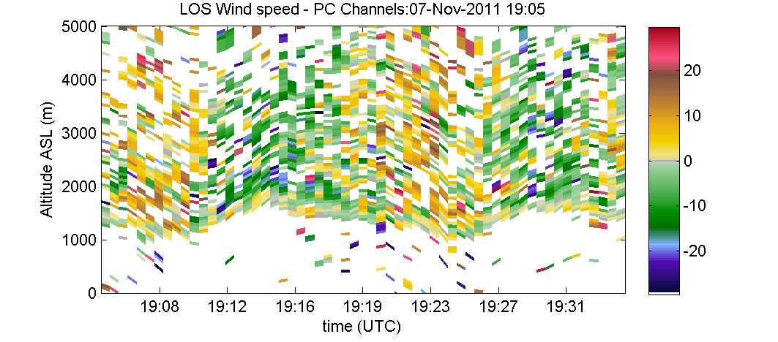
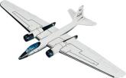

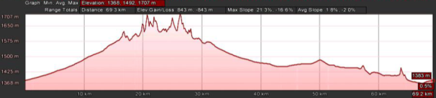
OAWL LOS wind speed vs. altitude
Use the aircraft GPS altitude and orientation (yaw/pitch/roll) to find the altitude of each LOS wind estimate in meters above mean sea level (MSL).
Residual “wave” motion of the ground is real - due to the variations in terrain (see below)
Ground returns show 0 speed (speeds have been processed to be ground relative)
Wind direction

Slide 21
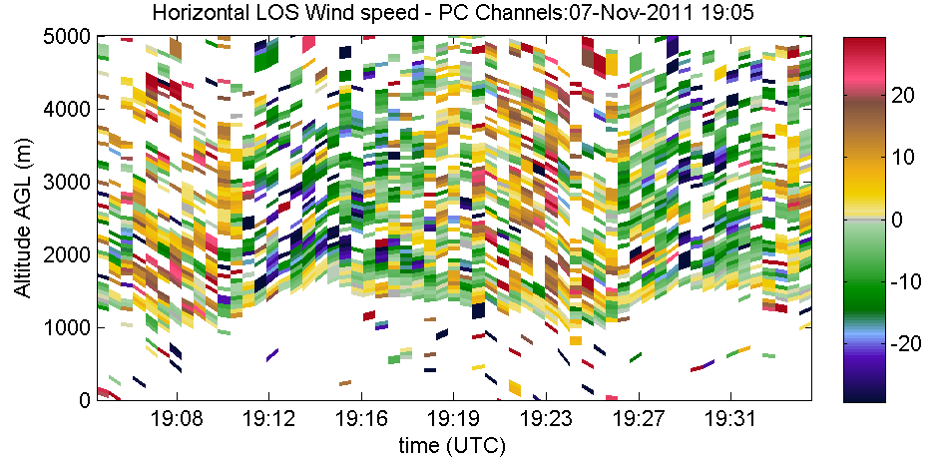
OAWL LOS speed vs. altitude → wind profile
Use pointing angle to estimate horizontal wind speed for each LOS wind estimate.
LOS pointing angle determines earth elevation angle
cos(elevation)⁻¹ scales from LOS to horizontal wind
Bin estimates by altitude
Organize binned estimates by the earth-relative azimuth of the LOS pointing angle
Fit sinusoid to the estimates
Fit phase = wind direction (in earth coordinates)
Fit amplitude = wind speed (relative to ground)
20
10
Speed (m/s)
0
-10
-20
-150
-100
-50
0
50
100
150
Earth Azimuth (deg)

Slide 22
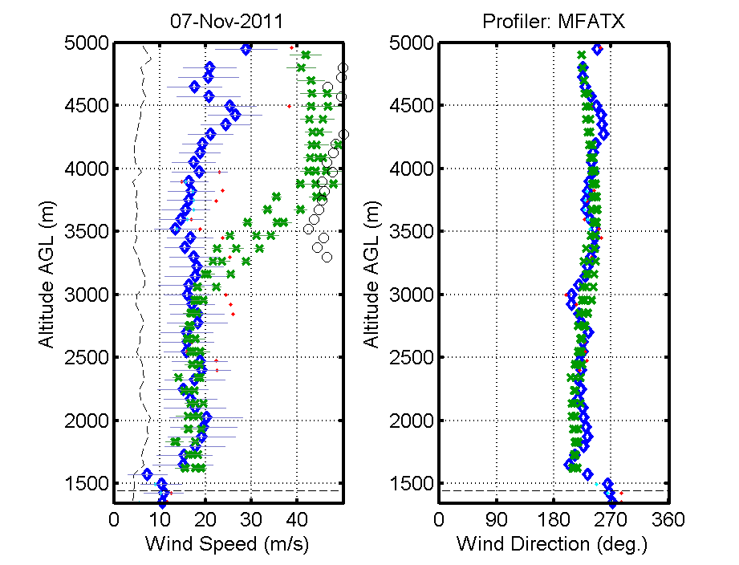
Profile Results: Flight 4, 07 Nov 2011
Circling 449MHz profiler near Marfa, TX (Aerostat installation)
Disambiguous range for OAWL
Currently ±29.6 m/s range
Increase to ± 59 m/s if OPD were 0.45 m.
Believe range ambiguity to be the cause of the large error at z>3km in this profile
If we had good SNR (i.e. 2 or greater) & contrast, it would have been possible to track this jump in speed.
x RWP
OAWL
- - σ (OAWL)

Slide 23
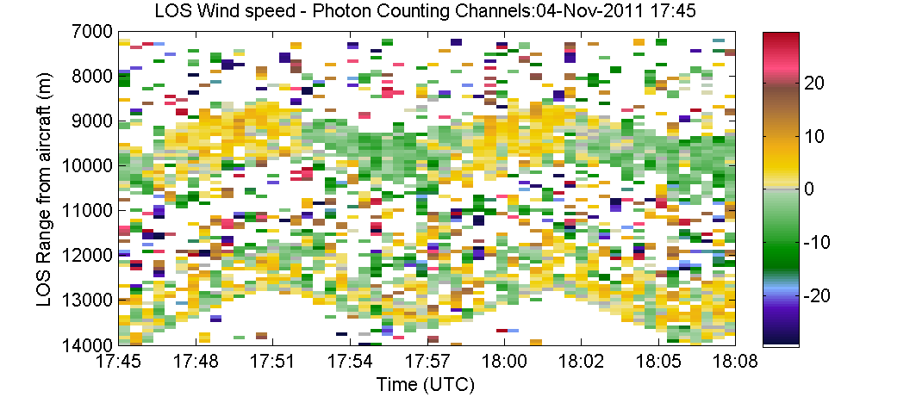
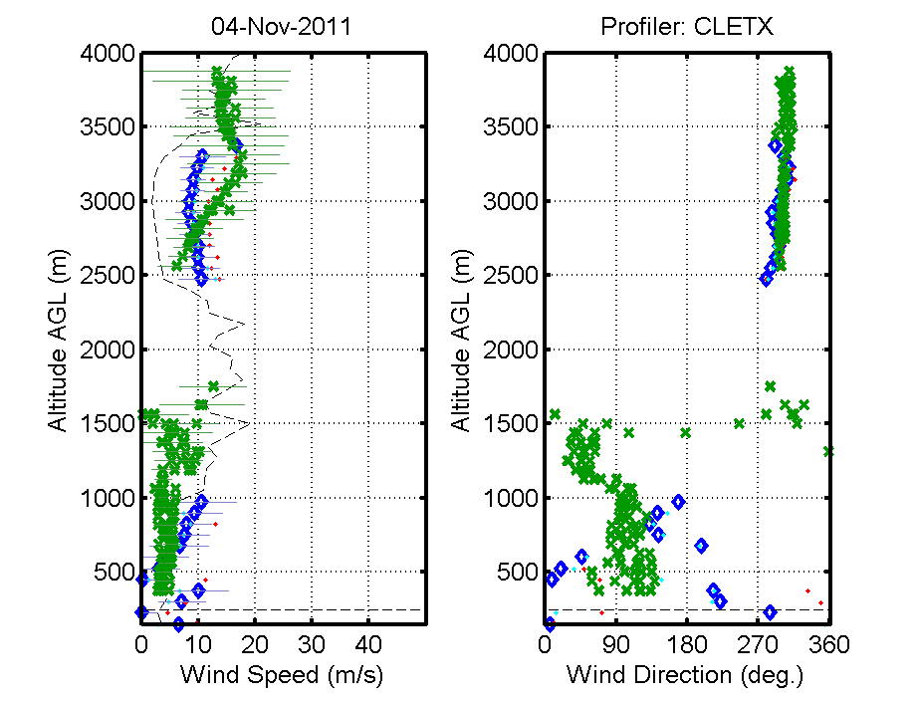
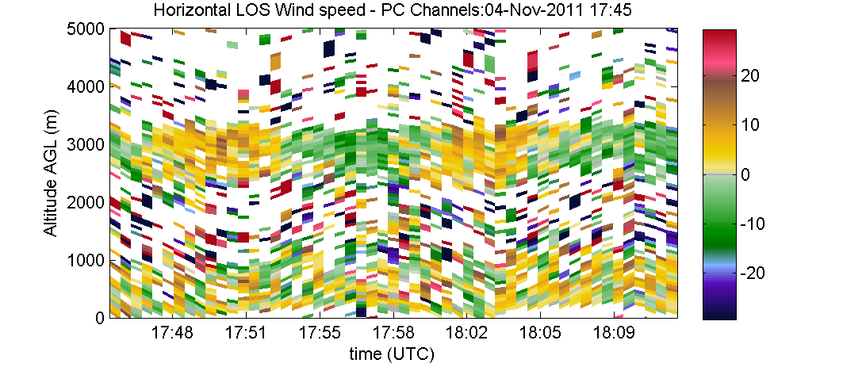
Profile Results: Flight 3, 04 Nov 2011
Boundary layer (up to 1km), clean layer, and another aerosol layer aloft.
Low wind speeds increase variability in direction estimate
Large “error” bars on RWP data above 3km indicate RWP likely wrong up there.
x RWP
OAWL
- - σ (OAWL)

Slide 24
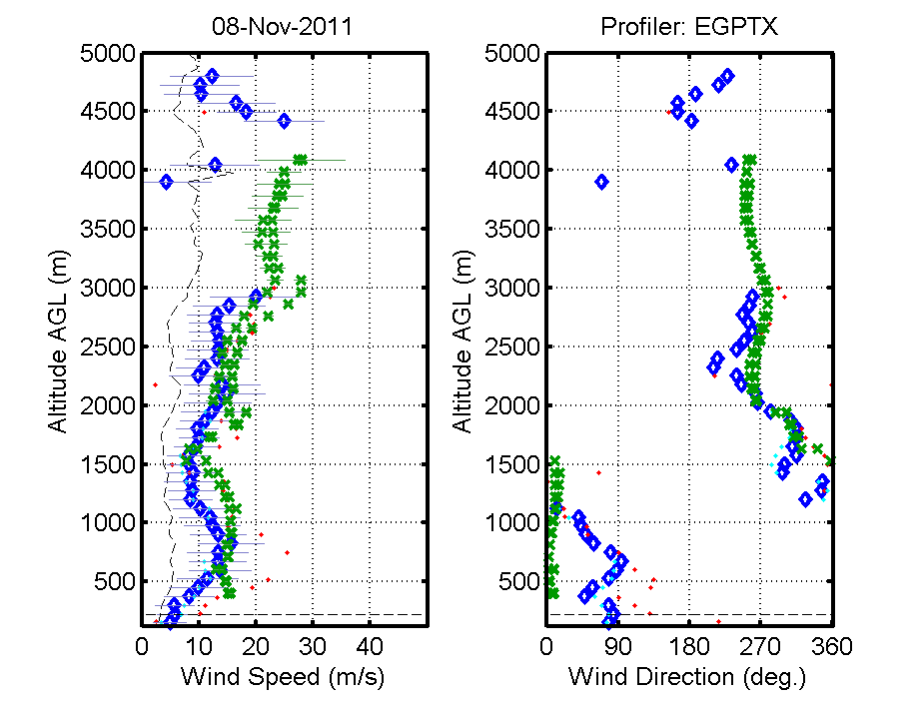
Profile Results: Flight 5, 08 Nov 2011
Weaker signals on 08Nov2011 (aerosols? Overlap?) but still enough return to use for a profile estimate
Again, low speeds (and low precision) affect the direction estimate near the surface.
Ongoing analysis
Analog (linear) channels have better near-surface estimates (not shown).
Combining analog and photon-counting data to improve profile precision.
x RWP
OAWL
- - σ (OAWL)

Slide 25
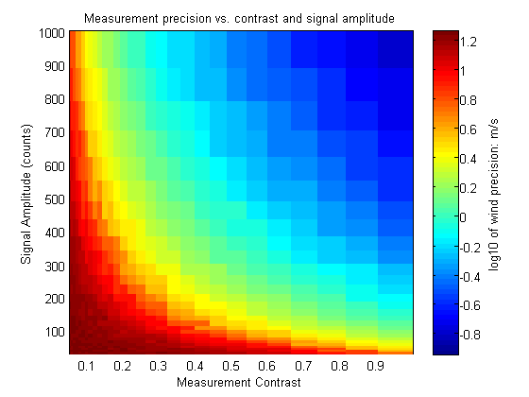
OAWL Wind Precision
OAWL wind precision is a function of
System contrast (interferometer + laser)
Aerosol-to-molecular scattering ratio (a/m)
Lidar SNR (how many photons collected – a function of 1/R², overlap, laser power, telescope size, etc.)
a) & b) affect the measurement contrast
Possible to get strong lidar SNR, but weak target contrast (i.e. low a/m)…
…or weak lidar SNR, but good contrast (high a/m).
Both examples could have the same wind precision.
OAWL flight precision affected by combined effects of 1/R², and system contrast.
Preliminary model results below show dependence of precision (color) on signal contrast (x-axis) and amplitude (y-axis).

Slide 26
Root Causes of reduced performance on WB-57
Issue | Effect | Planned Improvement
70% vs. >85% window transmission | Reduced lidar SNR | Better coatings for future aircraft windows
20 mJ vs. 30 mJ modeled laser output | Reduced lidar SNR | Planned mods to next gen OAWL laser (will also improve laser bandwidth)
Residual Aircraft Torsional stresses change overlap as fuel is consumed | Reduced lidar SNR | Unlikely to fly WB-57 again, but will use 3-pt kinematic mounts wherever needed for any future aircraft operations.
Extreme temperature gradients may have affected beamsplitter alignment | Reduced contrast | New interferometer design will be more robust to thermal gradients (and vibe).
Actual aircraft vibe higher than vibe-test: May have affected alignment and laser seeding | Reduced contrast | Future flights will test all vibration isolators to ensure they perform as modeled – and match to vibe tests.
Laser pulse length shortened (prior to and during flights) | Reduced contrast | Planned mods to next gen OAWL laser to improve pulse energy and length.

Slide 27
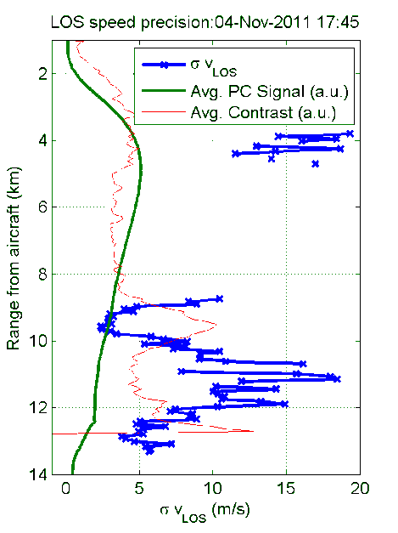
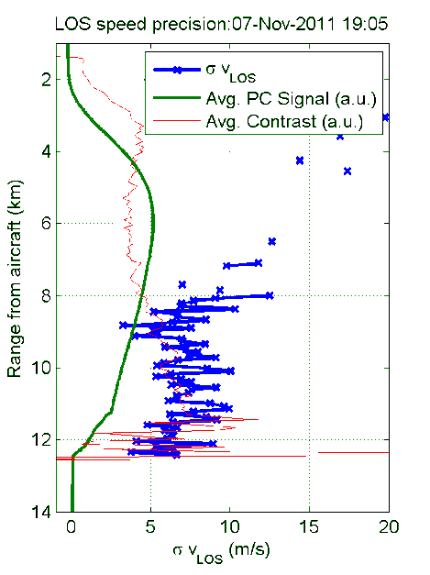
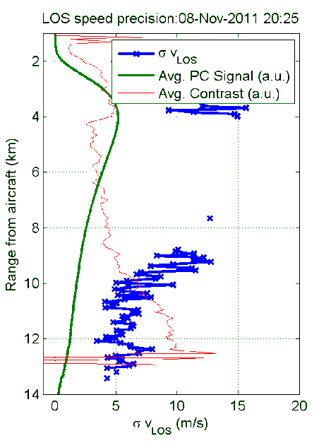
OAWL LOS wind speed precision-in Flight
Variance of LOS wind speeds (i.e. precision of wind estimate) versus range from the aircraft depends on
Signal strength (function of aerosol backscatter, SNR(R), overlap, etc.)
System contrast (i.e. best contrast of T0 signal)
Aerosol/molecular scattering ratio (feeds into measurement contrast)

Slide 28
OAWL Technical Readiness Level (TRL)
The first OAWL IFO-receiver came in to the IIP at <TRL3.
Ground validation of the basic lidar system (built and assembled under the IIP) brought OAWL to TRL4.
Within 3 years, the flight tests on the NASA WB-57 brought the OAWL system to Space-TRL5, and Aircraft-TRL6.
Aircraft-TRL7 is not yet attained due to loss of contrast prior to and during flights inconsistent with predictions from vibe testing.
TRL 5 - System/ subsystem/ component validation in relevant environment: Thorough testing of prototyping in representative environment. Basic technology elements integrated with reasonably realistic supporting elements. Prototyping implementations conform to target environment and interfaces)
TRL 6 - System/subsystem model or prototyping demonstration in a relevant end-to-end environment (ground or space): Prototyping implementations on full-scale realistic problems. Partially integrated with existing systems. Limited documentation available. Engineering feasibility fully demonstrated in actual system application.
TRL 7 System prototyping demonstration in an operational environment (ground or space): System prototyping demonstration in operational environment. System is at
or near scale of the operational system, with most functions available for demonstration and test. Well integrated with collateral and ancillary systems. Limited documentation available.

Slide 29
Next Steps for OAWL
Re-design the OAWL interferometer layout based on lessons learned → preliminary design for an Engineering Design Unit (EDU)
Improvements to the OAWL optical, electrical, and radiometric models
Run OAWL through an Instrument Design Lab at GSFC
Perform Pre-OSSE studies, with potential for full-up OSSE to follow
Progress on the FIDDL ESTO-funded ACT (see following slides) and demonstrate the Integrated Direct Detection wind lidar concept.
Develop, build & test the EDU and demonstrate performance on future aircraft flights (with objective to reach TRL 7)

Slide 30
Coherence & bandwidth of atmospheric lidar return
Aerosol return has a narrow bandwidth, longer temporal coherence length
Molecular return has a wide (Doppler broadened) bandwidth, shorter temporal coherence length.
OAWL uses the aerosol portion of the return. The molecular portion adds background/offset, reducing the system contrast.
Using the molecular return in a double-edge lidar first makes use of the molecular and improves the OAWL contrast.
FIDDL ACT will demonstrate this.
2.5
Doppler Shift
Due to wind
2
outgoing laser pulse frequency
f_{o} = c/λ₀
1.5
Return spectrum from a
Monochromatic source
Backscatter (W)
1
A+M+BG
A
0.5
M
BG
0
160
80
40
20
10
0
10
20
40
80
160
Wavelength Shift (m/s)

Slide 31
FIDDL Basics: 2nd pass (model only)
Fabry-perot for the Integrated Direct Detection Lidar (FIDDL):
Green line shows the molecular return spectrum (includes broadening from the1.2 mrad FOV incident on the F-P.)
Dashed red shows the etalon transfer function @ original incidence.
Solid red shows the light transmitted through the etalon.
Dashed blue shows the etalon transfer function at angle offset.
Solid blue shows the light transmitted through the etalon after both passes (note the notch).
Solid green line shows the center portion which is reflected and passed to OAWL.
Currently working on trade studies using the models
1
0 m/s Return and both edge transmissions
0.8
0.6
Transmission
0.4
0.2
0
-5
0
5
Offset center frequency (GHz)

Slide 32
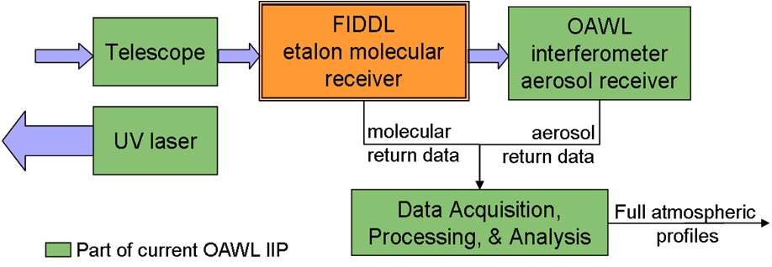
Addressing the Decadal Survey 3D-Winds Mission with An Efficient Single-laser All Direct Detection Solution
Integrated Direct Detection (IDD) wind lidar approach:
Fabry-Perot Etalon for the IDD (FIDDL – a double-edge) would use the molecular component to measure winds, but largely reflect the aerosol.
OAWL measures the aerosol Doppler shift to measure winds with high precision …
…while the FIDDL removes molecular backscatter (reducing shot noise)
OAWL HSRL retrieval determines residual aerosol/molecular mixing ratio in etalon receiver, improving molecular precision
Ball Aerospace patents pending
Result
single-laser transmitter, single-wavelength system, telescope driven by DD requirements not coherent detection
single simple, low power and low mass signal processor
full atmospheric profile using aerosol and molecular backscatter signals – with less cost/risk.
Notes:
Previously approved
Top level description of a possible wind lidar architecture

Slide 33
Summary & Conclusions - 1
The OA approach has been demonstrated in a working Doppler Wind Lidar with field widening and 355 nm.
Ground-validation demonstrated predicted performance of OAWL as a 355 nm aerosol lidar with < 1 m/s precision and greater than 90% correlation with the 10µm mini-MOPA data.
Three months later, OAWL was integrated into the WB-57 Pallet, approved for flight (TRR) on the NASA WB-57, and flew 5 flights between 25 Oct. and 8 Nov. 2011, producing 1-6 m/s precision (aerosol dependent) Doppler estimates from ground returns, and from clouds & aerosol returns (winds!).
OAWL showed that a single detector (multi-pixel-photon-counting) has the dynamic range to acquire both T0/ground/cloud (linear) and atmospheric photon counting data.

Slide 34
Summary & Conclusions - 2
The autonomous flight data (acquired within 3 years of the OA interferometer build), combined with known improvements to be gained from system design modifications, demonstrate the system’s promise to provide a single (355 nm) laser approach to space-based wind sensing using OAWL for the aerosol wind measurements.
OAWL ground and aircraft performance analysis and design improvements are ongoing, with focus on improving the instrument for future aircraft and space flight.
Under separate ESTO ACTs, OAWL will undergo contrast improvement efforts (for HSRL = HOAWL) and we will develop the FIDDL system. OAWL will then become part of an Integrated Direct Detection Wind Lidar system to measure Doppler shifts from both aerosol and molecular returns (full atmospheric profile) using a single wavelength 355 nm laser.
One system, one laser, global winds

Slide 35
Benefits of an OAWL System
OAWL is a potential enabler for reducing mission cost and schedule
Aerosol wind precision similar to that of coherent Doppler, but achieved at 355nm
Accuracy is not sensitive to aerosol/molecular backscatter mixing ratio
Tolerance to wavefront error allows simpler (and heritage) telescope and optics
Compatible with single wavelength (i.e. holographic) scanner allowing adaptive targeting
Wide potential field of view allows relaxed tolerance alignments (similar to CALIPSO) while supporting 10⁹ spectral resolution (without active control)
Minimal laser frequency stability requirements
LOS spacecraft velocity correction without a need for active laser tuning or a variable local oscillator.
High optical efficiency
OAWL Opens up multiple mission possibilities including multi-λ HSRL & DIAL compatibility
Notes:
No data or proprietary info

Slide 36
Extras

Slide 37
Ball OAWL Receiver Design Uses Polarization Multiplexing to Create 4 Perfectly Tracking Interferometers
Mach-Zehnder-like interferometer allows 100% light detection on 4 detectors
Cat’s-eyes field-widen and preserve interference parity allowing wide alignment tolerance, practical simple telescope optics, and high spectral resolution
Receiver is achromatic, facilitating simultaneous multi-λ operations (multi-mission capable: Winds + HSRL(aerosols) + DIAL(chemistry))
Very forgiving of telescope wavefront distortion saving cost, mass, enabling HOE optics for scanning and aerosol measurement
2 input ports facilitating 0-calibration
patents pending
Notes:
Shown publicly (6/08) at the ILRC and wind lidar WG (2/08). Identical to previously ITAR and IP approved.

Slide 38
OAWL Doppler Shift Measurement
Modified Mach-Zehnder Interferometer with ~1m OPD
The interferometer fringe phase is measured at the outgoing pulse: T₀
OAWL subsequently measures the phase of lidar return at t > T₀
The phase difference Δϕ is related to the line-of-sight wind speed, V_{LOS}
Detector
Detector
Δϕ
Laser at T₀
Doppler shifted
Atmospheric Return at t> T₀

