Slide 1
NASA Earth Science Update
Presented to: Doppler Wind Lidar Working Group
October 15, 2012
George J. Komar
Associate Director/Program Manager
Earth Science Technology Office

Slide 2
Topics
  Earth Science Division Overview
  Planned Future Activities
  Earth Science Technology
  Future Directions

Slide 3
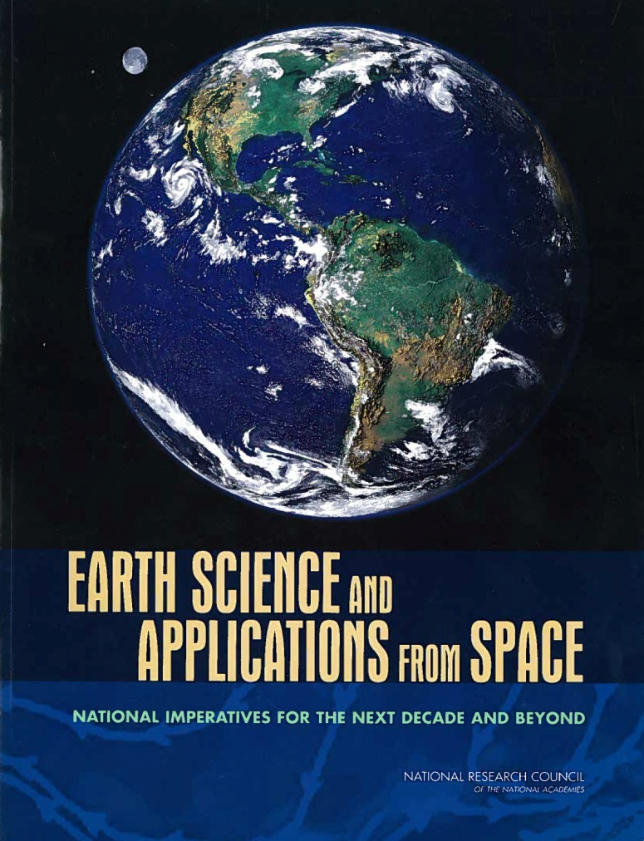

Guiding Recommendation Documents
Administration priorities
and constraints
Decadal survey,
OCO-2,
climate continuity
missions,
balanced program
Integrated Program
2007 Decadal Survey
2010 NASA Response to
Climate Plan
Research and Applications communities priorities
No realistic budget constraint (calls for $2B funding [FY06 constant $$ beginning in FY10)
Decadal Survey +
Administration priorities
Executable for FY11 Pres. Bud.
OSTP, USGCRP, OMB approval

Slide 4
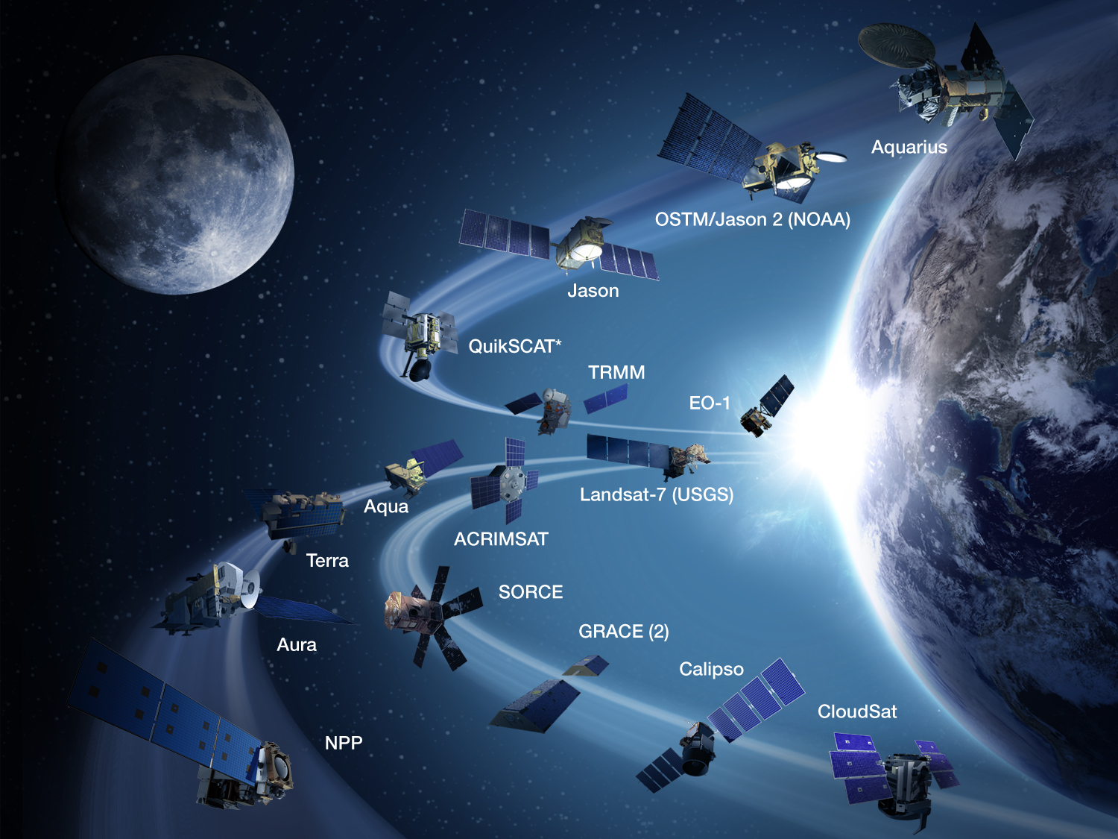
NASA Earth Science
Major Operating Satellites

Slide 5

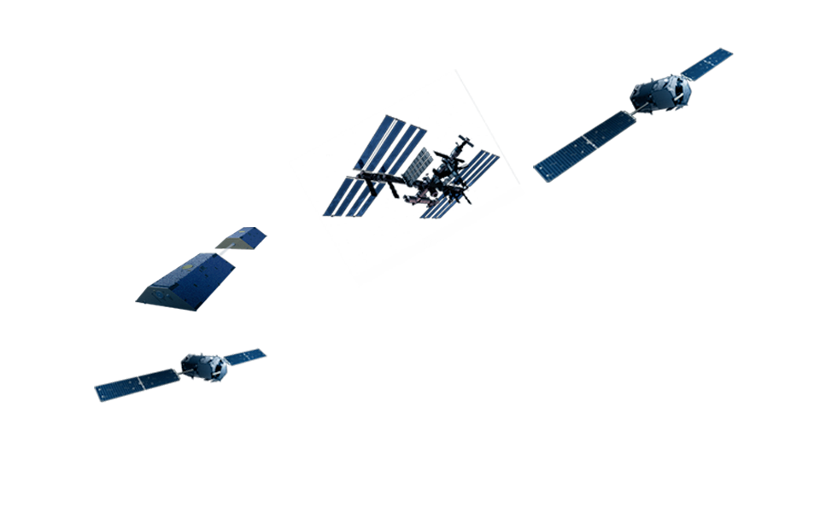

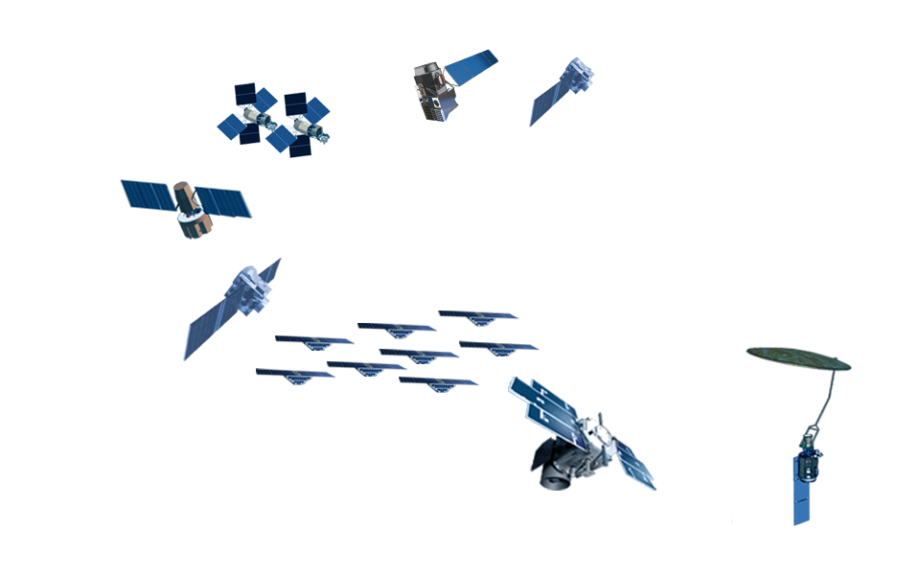
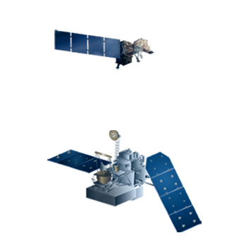
NASA Earth Science
Planned Missions (2013-2023)
Climate
Earth Venture
Foundational
Decadal Survey

Slide 6
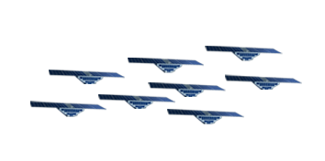
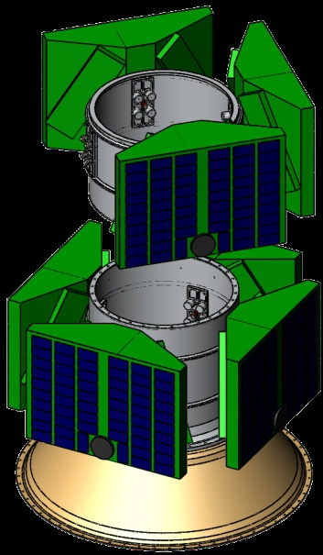
CYGNSS
(CYclone Global Navigation Satellite System)
CYGNSS is a constellation of eight satellites that will collect
measurements of ocean surface winds through variations in
the direct vs reflected Global Positioning System signals.
CYGNSS measurements will yield a critical data set that will enable science and applications users to understand processes that link the ocean surface properties, moist atmospheric thermodynamics, radiation and convective dynamics in terrestrial water, energy and carbon cycles
Each observatory in the the constellation (to be built by Southwest Research Institute (SwRI)) will contain a Delay Doppler Mapping Instrument (DDMI). The DDMI is a Global Navigation Satellite System (GNSS) Receiver-Remote sensing Instrument.
Mission Life: 2 years
Launch Date: 2016-2017
Cost Cap: $100.0M + NASA provided LV
PI: Chris Ruf, University of Michigan

Slide 7
Earth Venture Mission Schedule
Earth Venture - 1 (EV-1): Sustained Sub-Orbital Investigations
Earth Venture - 2 (EV-2): Complete, self-contained, small missions
Earth Venture - Instrument (EV-I): Full function, facility-class instruments Missions of Opportunity (MoO)
EV Schedule | Type | Solicitation | Selection | Launch/Delivery
EV-1 | Suborbital | 2009 | 2010
EV-2 | Full Orbital | 2011 | 2012 | LRD ~2016
EV-I1 | Instrument Only | 2012 | 2012 | Del ~2016
EV-I2 | Instrument Only | 2013 | 2014 | Del ~2018
EV-3 | Suborbital | 2013 | 2014
EV-I3 | Instrument Only | 2014 | 2015 | Del ~2019
EV-I4 | Instrument Only | 2015 | 2016 | Del ~2020
EV-4 | Full Orbital | 2015 | 2016 | LRD ~2021
EV-I5 | Instrument Only | 2016 | 2017 | Del ~2021
EV-I6 | Instrument Only | 2017 | 2018 | Del ~2022

Slide 8
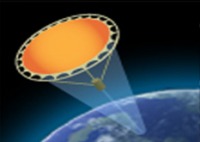
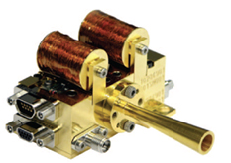
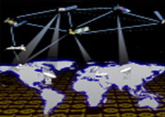
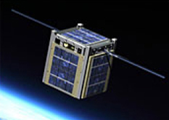
Technology Program Overview
The Earth Science Technology Office (ESTO) is a targeted, science-driven, competed, actively managed, and dynamically communicated technology program and serves as a model for technology development.
Competitive, peer-reviewed proposals enable selection of best-of-class technology investments that retire risk before major dollars are invested: a cost-effective approach to technology development and validation.
ESTO investment elements include:
Instrument Incubator Program (IIP)
provides robust new instruments and measurement techniques
16 new projects added in FY11 (total funding approximately $67M over 3 years)
Observation
Advanced Component Technologies (ACT)
provides development of critical components and subsystems for instruments and platforms
15 new projects added in FY11 (total funding approximately $16M over 3 years)
Advanced Information Systems Technology (AIST)
provides innovative on-orbit and ground capabilities for communication, processing, and management of remotely sensed data and the efficient generation of data products
18 new projects added in FY12 (total funding approximately $23M over 3-4 years)
Information
In-Space Validation of Earth Science Technologies (InVEST)
provides in-space, orbital technology validation and risk reduction for small instruments and instrument systems that could not otherwise be fully tested on the ground or in airborne systems First Solicitation released 9/13/12
Validation
Notes:
86 proposals reviewed

Slide 9
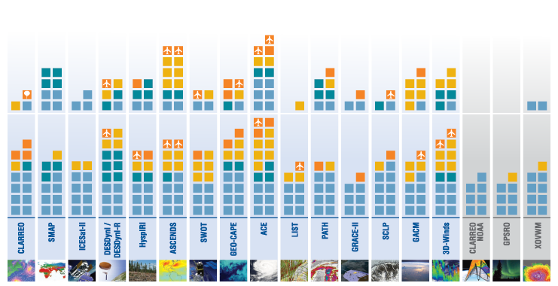
Science Driven:
Enabling the Earth Science Decadal Survey
Upon publication of the Earth Science Decadal Survey in 2007, ESTO investments already supported all
18 of the recommended mission concepts. Since then, ESTO has awarded 107 additional technology projects representing an investment of over $211M directly related to the Earth Science priorities outlined by the Decadal Survey.
2010 - 2012
2007 - 2009
Tier I
Tier II
Tier III
Instrument Technology Investments
Information Systems Investments – Direct Applicability
planned aircraft testing
planned balloon testing
Component Technology Investments
Information Systems Investments – Secondary Applicability
(note: component and information systems investments may apply to more than one mission)

Slide 10


ES Decadal Survey: Midterm Report
NASA responded favorably and aggressively to the 2007 decadal survey, embracing its overall recommendations for Earth observations, missions, technology investments, and priorities for the un- derlying science.
ESTO has organized its proposal solicitations around the 2007 decadal survey and is investing to advance technological readiness across the survey mission queue.
The report acknowledged that NASA’s budget did not match projections, but “NASA should consider increasing the frequency of Earth Venture stand-alone/space-based missions.”
A Midterm Assessment of NASA’s Implementation of the Decadal Survey

Slide 11
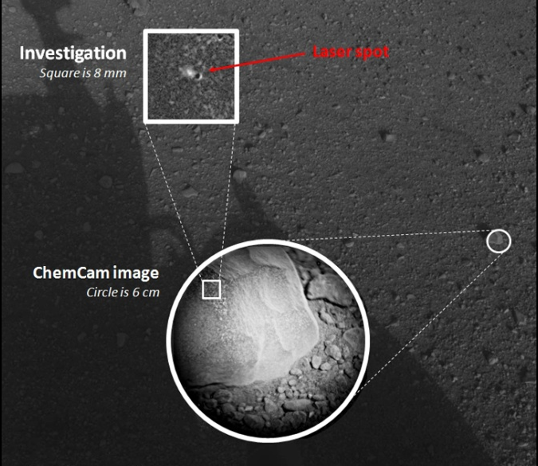
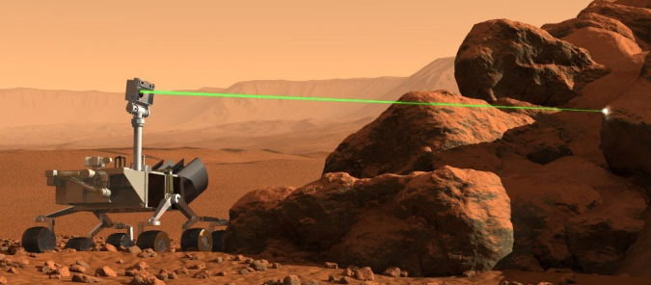
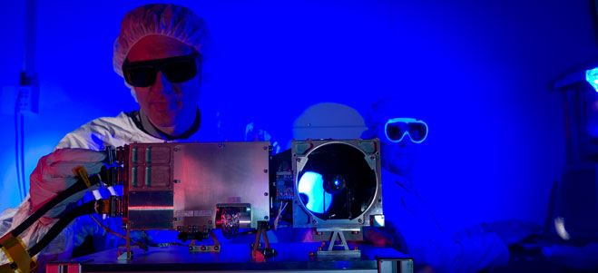
Technology Highlight:
Research on Mars Enabled
by Memory Module
The Radiation Tolerant Intelligent Memory Stack (RTIMS) is an integral component of Curiosity’s Chemistry and Camera (ChemCam) instrument which successfully fired its laser on Mars for the first time on August 19 to study a small rock named Coronation.
RTIMS was developed to support Earth observing missions at geostationary and low-Earth orbit through radiation-tolerant on-board data processing that could handle the growing demand for increasing resolution, quality, and quantity of data.
As part of ChemCam, RTIMS is controlling the firing of the laser, data acquisition, data buffering, and communication with the Rover Computer Element.
Features of RTIMS
Radiation shielding at the component level
Patented Self-scrubbing and radiation event detection system
Triple-redundant digital memory
In-flight reconfigurability
Weighs less than two ounces
Stacking technique saves 80% in volume
(single RTIMS module is 42.7 x 42.7 x 13.0mm)
Top: Composite image of the first laser firing by ChemCam; Middle: Artist’s depiction of ChemCam; Bottom: ChemCam mast unit being prepared for laser tests.
PI: Jeffrey Herath, LaRC AIST-02

Slide 12

Technology Empowers our Future
Visit us at esto.nasa.gov

