Slide 1



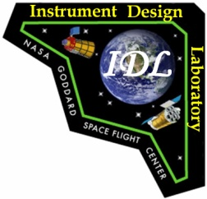
Optical Autocovariance Wind Lidar (OAWL) Instrument Design Lab (IDL) Study: 25-29 June 2012
Final Output Presentation
Sara Tucker, Carl Weimer, Tom Delker,
Chris Seckar, Mike Adkins – Ball Aerospace & Technologies Corp.
Funding provided by the NASA Earth Science Technology Office (ESTO)
ESTO Representatives at the IDL: Michael Pasciuto & Keith Murray

Slide 2
Summary
This presentation contains information about the 2012 run of the Ball-Aerospace Optical Autocovariance Wind Lidar (OAWL) Instrument design concept through the Goddard Instrument Design Lab (IDL)
The OAWL IDL run, funded by ESTO, was performed as part of the effort to demonstrate that the OAWL Instrument can meet the requirements of the aerosol component of a wind lidar mission – using the same 355 nm wavelength proposed for molecular systems.
The IDL concluded that the baseline OAWL system design is feasible with many components at high TRL, and that the system can fit within the volume, mass, power, and thermal budgets of a JEM-EF module on the ISS with >80% reliability for a 1-year requirement, 2-year goal.

Slide 3
OAWL Instrument Design Lab (IDL)
The Optical Autocovariance Wind Lidar (OAWL) is a Doppler Wind lidar designed to measure winds from aerosol backscatter at 355 nm wavelength.*
*Adding 532 nm is an option for High Spectral Resolution Lidar + 532 nm winds, but not used in this IDL
IDL Objective
The Optical Autocovariance Wind Lidar (OAWL) IDL study objective is to generate a GSFC-IDL-vetted blueprint and cost scope (within an Earth-Venture- cost cap) for an OAWL mission on the ISS thereby maturing the optical, electrical, structural, thermal, and software designs for a space-based OAWL.
IDL Funding
The OAWL IDL was funded by the NASA Earth Science Technology Office (ESTO). Ball Aerospace internal investments were used to develop the JEM-EF lidar concepts (previous investment) and to develop the OAWL radiometric model used for trade studies.
IDL Timeline
The OAWL IDL (at Goddard) took place 25-29 June 2012.

Slide 4
OAWL IDL 2012 Study Participants
Study week: 25-29 June 2012
Funded by NASA Earth Science Technology Office (ESTO)
  Ball team at the IDL:
    Sara Tucker (PI)
    Tom Delker
    Carl Weimer
  ESTO
    Mike Pasciuto
    Keith Murray
    ESTO visitors
  IDL Team
    Team Lead: Jennifer Bracken
    Attitude Determination: Kong Ha
    Contamination: Tom Riley
    Costing: Sharon Seipel, Sanjay Verma
    Detectors: Carl Kotecki
    Electrical: Paul Earle
    Flight Software: Kequan Luu
    Lasers: Barry Coyle
    Mechanical Designer: Dave Palace
    Mechanical Systems: John Crow
    Mechanisms: Dick McBirney
    Optics: Peter Hill, Bert Pasquale
    Reliability: Aron Brall
    Structural (TBD): Jeff Bolognese
    Systems: Ed Aguayo & Martha Chu

Slide 5
OAWL IDL Study Summary
  Ball Aerospace went into the study with a fairly mature design concept for the OAWL system in a JEM-EF module.
  The IDL engineering experts performed thorough reviews of this design (in their individual areas of expertise, and as a team) and vetted all of the components. They found no tall poles in the component technology or design.
  The IDL then performed some repackaging of the Ball design, recommended alternatives for some minor components, and added an initial design concept for thermal control.
  Based on the IDL experts’ conclusions for component TRLs, the IDL then performed a parametric costing analysis using Price-H for hardware and SEER-SEM for software

Slide 6
Systems Overview & Science Requirements

Slide 7
Performance Requirements
The OAWL Science Requirements were designed to meet or exceed the aerosol portion of the 3D-Winds mission concept requirements (which are subject to change) – The OAWL 2012 IDL did not include a molecular channel.
Latest 3D-Winds requirements
Attribute | Goal
Vertical depth of regard (km) | 25
Vertical resolution Tropopause to 25 km Top of BL to tropopause Surface to top of BL | 4 2 1 (.25)
Horizontal resolution (km) | 350 (35)
# of tracks | 1
# of perspectives within target volume | 2
Horizontal component error (m/s) Above BL to 10 km Within BL (includes sampling RMSE) | < 3 2 (1)
NOTE: OAWL maximum horizontal speed detection is based on etalon filter bandwidth constraints & pointing/station-speed knowledge and NOT on detection bandwidth as seen in coherent systems.

Slide 8
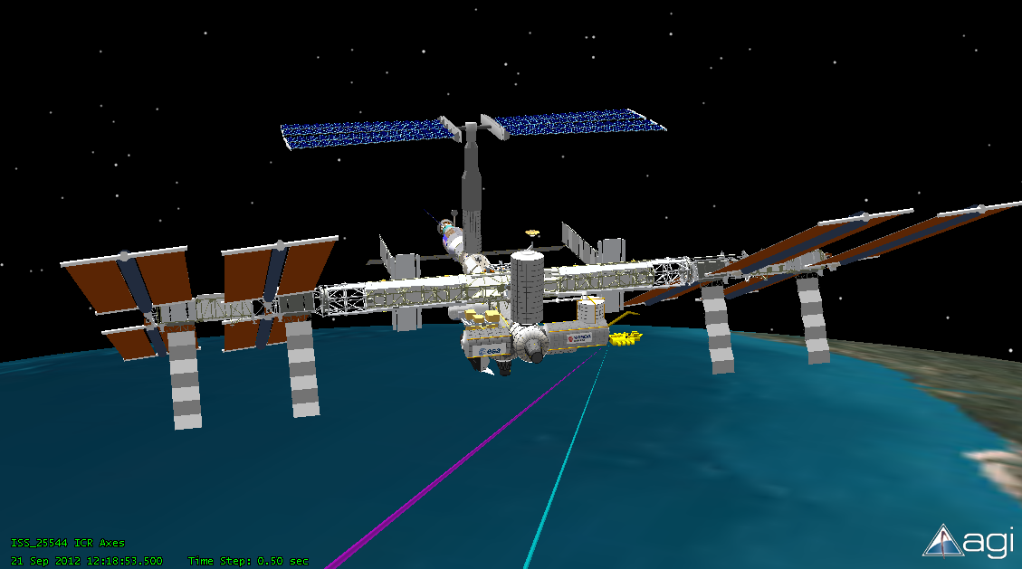
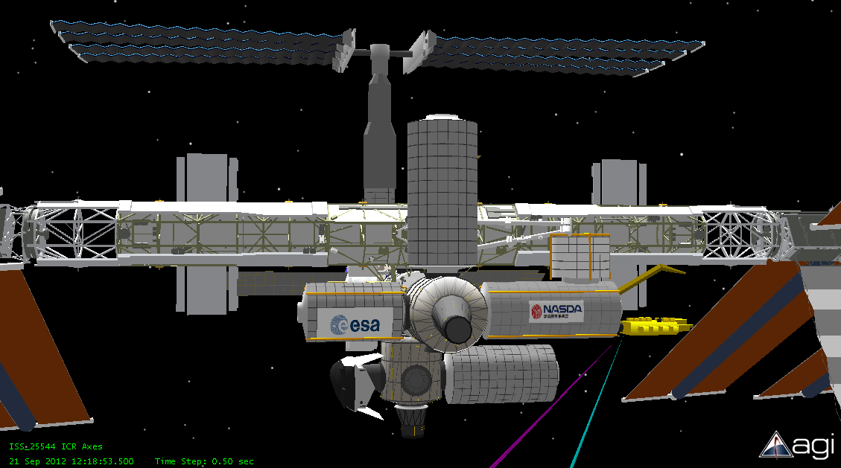
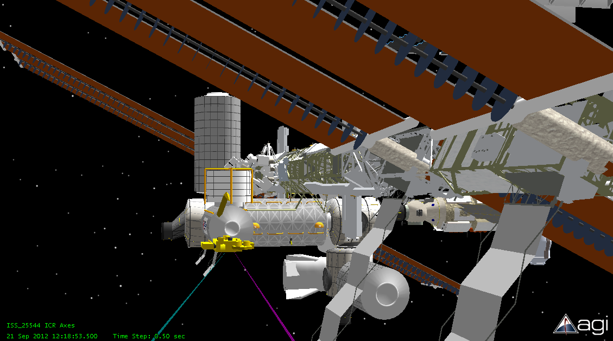
Pointing Angles for OAWL on JEM-EF
JEM-EF chosen for mass/power, cooling availability
Beams point off-nadir 40º inboard
Forward + Aft views separated by 90º (±45º from cross-track)

Slide 9
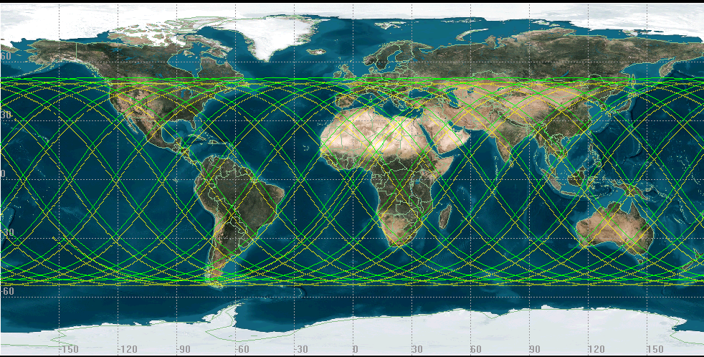
OAWL ISS Coverage (24 hours)
Green = ground track
Yellow = coverage (observation) swath

Slide 10
OAWL IDL: Fundamental Instrument limits(JEM-EF)
- and requirements for SNR
Item | Requirement
Mission Duration | 1 year requirement, 2 year goal
Orbit* | ISS: ~350 to 400 km at 51.6° inclination
Instrument Mass* | NTE 500 kg
Power* | NTE 3kW
Volume* | Envelope 1850x800x1000 mm
Thermal Control* | Interface to JEM-EF Cooling Loops; 3 kWt minimum, negotiable up to 6 kWt
Lasers | 355 nm; 550mJ/pulse; 50 Hz rep rate – each laser (interleaved)
Detector | PMTS (with space qualified heritage)
Mechanisms | 2 – occasional-use, low-speed boresight mechanisms
Pointing Knowledge | ~10 urad (30 cm/s rms error)
Telescope | 2x; 0.7m primary (Secondary obstruction OK).
Look Angle | 40°off nadir; 45° inboard from Ram and Wake
*limits set by JEM-EF module

Slide 11
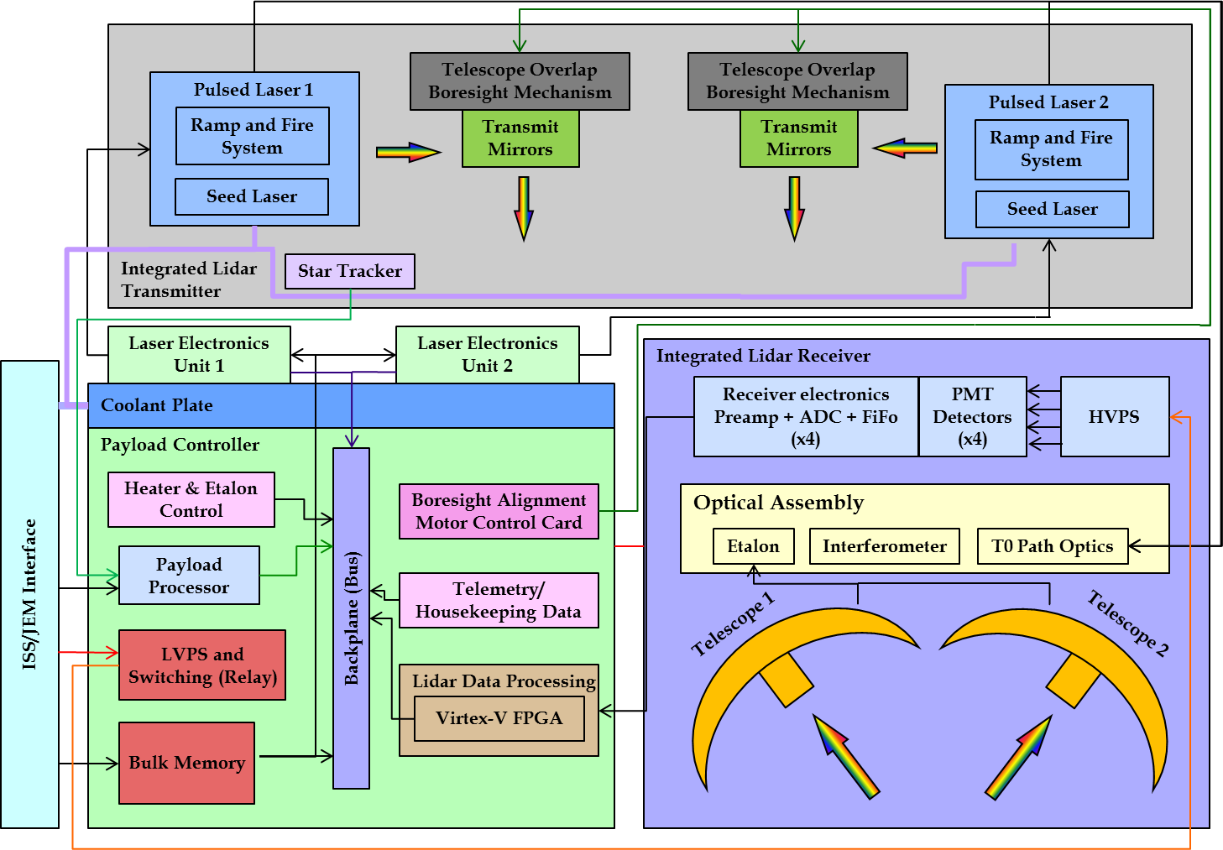
OAWL IDL Block Diagram
Valve Actuator (x2)

Slide 12
Top Level Summary of Conceptual System (IDL Output)
OAWL | Total Mass | Total Operating Power (Effective average) | Total Data Rate
OAWL Laser Assembly Laser Components Laser Optical / Drive Subassembly Laser Structure Subassembly Laser Control Electronics Box Transmitter Assembly Boresight Mechanism Assembly TO Turning Mirror Assembly Telescope Assembly Laser Channel Receiver Assembly Optical Assembly Etalon + Oven Interferometer Detector Assembly HVPS Structure Assembly Main Electronics Box Contamination System Harness uASC Assembly Thermal Subsystem 5% misc Hardware | 344.3Kg Approximate Overall Dimensions 1855mm X 800 mm X 1000mm tall [JEM-EF Module] | 2403 W | Average Data Rates: 6.3 Gbits/24hrs
These parameters are for a conceptual ISS design only and do not reflect an optimized system for free-flyer or other platforms.

Slide 13
OAWL ISS - Design Decisions
Two lasers in the system- both operational, each pointing along a different line of sight.
  Eliminates high-speed high-use mechanisms (required to switch a single laser from one view to another) that are subject to poor overlap and/or misalignment and wear and tear.
  Mission requirement of 1 year (2 year goal) reduces the risk in this approach → both lasers could run full time.
Loss of one laser on the OAWL design would result in the loss of one view – whereas loss of a high-speed mechanism (used on other designs, not OAWL) could result in the loss of at least one view (possibly both).
  Pulses from the 50 Hz PRF lasers are interleaved, so system data acquisition repetition rate is 100 Hz.
  No gaps in forward-aft beam overlap → can optmize profile calculations (i.e. in cloud free regions).
  Two low-speed, low-use mechanisms are added (one per laser) to perform occasional overlap alignment optimization (as done on CALIPSO once every ~6 months).

Slide 14
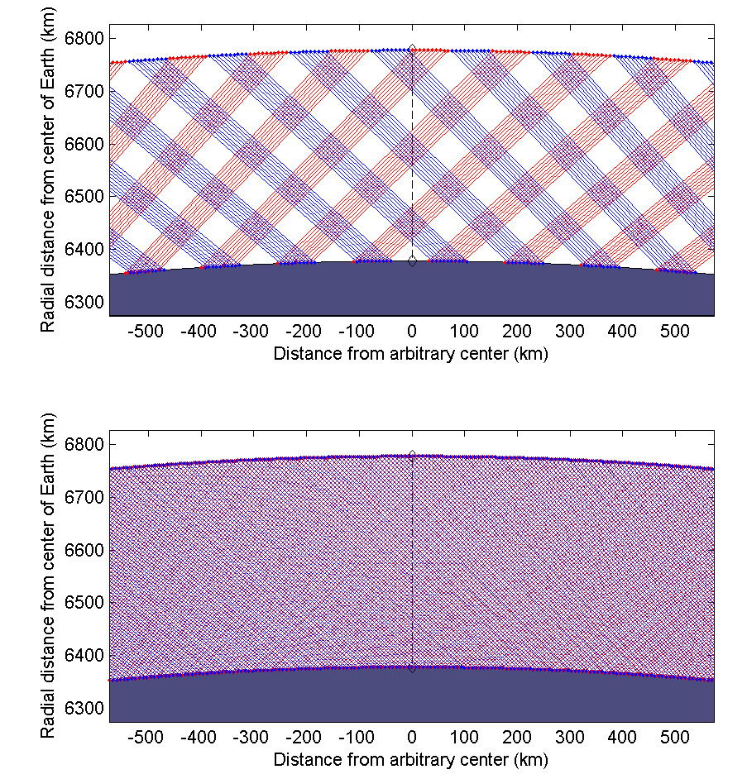
Lidar beam geometry from 400 km orbit
Hybrid
±45º (forward and aft) beams (40º off nadir). 1 beam per second per laser drawn here.
Hybrid design: Mechanism switches beams between forward & aft telescopes (10 s period). Resulting overlap is periodic, with 72 km maximum overlap width at base.
OAWL: two lasers, one per telescope, each at 50 Hz PRF (interleaved for effective 100 Hz). Overlap is constant allowing for variable horizontal averaging.
OAWL

Slide 15
OAWL IDL Subsystems
Integrated Lidar Transmitter
Integrated Lidar Receiver
Payload Controller
Payload (incl. JEM-EF Interface)

Slide 16
OAWL Laser Requirements-IDL
Output power | 555 [500] mJ @ 355 nm
Pulse width | ≥ 20 ns (FWHM)
Pulse Repetition Freq. | 50 Hz
ΔTemp range (Operating) | 35ºC +/- 1ºC (likely can go broader range)
ΔTemp range (Survival) | -20ºC to 50ºC
Divergence | ~100 uR ( 400 km altitude)
Mass (Optical head without Beam Exp) | ~20 kg
Size (Optical head without Beam Exp) | ~30 cm x 35 cm x 25 cm
Lifetime per Laser | Goal of 100% for 2 yrs: 3.16 Billion Shots 1 yr (1.6 B shots) requirement
Overall Electrical Optical Efficiency | >6% (BOL) and 5% (EOL)

Slide 17
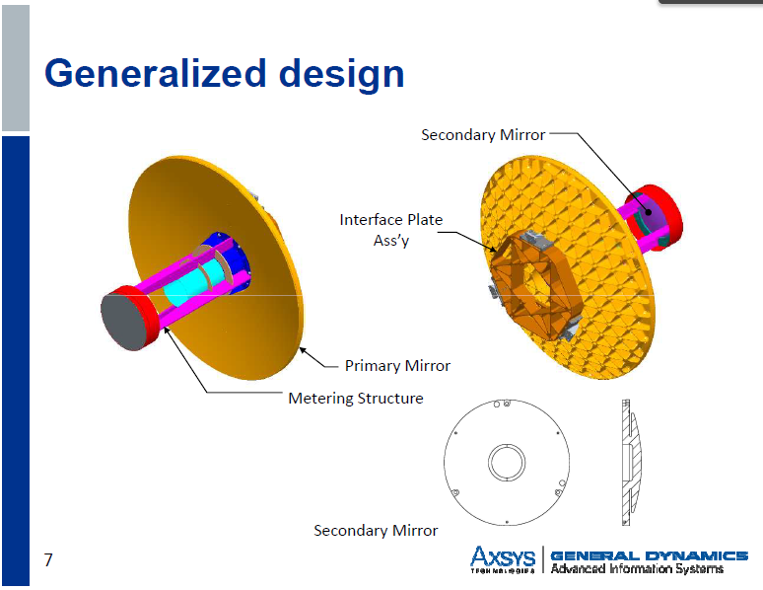
Telescope for OAWL ISS Mission
Two look angles (two telescopes)
  Elevation of 40 degrees off nadir
  Azimuth angles of 45 degrees from the Ram and Wake directions
70 cm diameter
  Secondary mirror optic and structure obscurations are acceptable since this is not coherent detection.
Wavefront quality requirement: ~1-lambda at 632.
Telescope mirrors have 98% reflectivity at 355 nm (per IDL)
Weight < 11kg each.
Use scaled down version of the light-weighted Axsys telescopes in use on CALIPSO and MOLA (also GLAS, CATS-ISS, ATLAS).

Slide 18
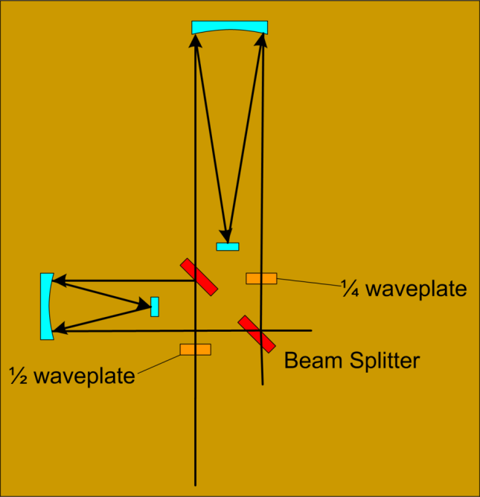
OAWL baseline interferometer design
Smaller OPD version of the OAWL IIP system (TRL5)
OAWL Patents: US7929215(B1) and US8077294(B1).

Slide 19
Detectors & Data acquisition
    Hamamatsu R7600U-200 PMTs (TRL5) – Quantity 4
      43% Quantum Efficiency with Ultra-Bialkali
      Low dark count & dark current, operate in analog mode
      Will have heritage in the ATLAS PMTS R7600U-300.
    Thermal cycling and radiation effects are not an issue (IDL statement).
    Detection bandwidth: ~2 MHz
      OAWL velocity range is NOT limited by detection bandwidth. Reducing detection bandwidth improves SNR – but decreases sample range resolution.
    Processing & Control: Single Board Computer and FPGA (data acquisition & real-time processing)
    Processed and averaged raw data transmitted and/or stored if needed.
    All data rates verified to be feasible by IDL

Slide 20
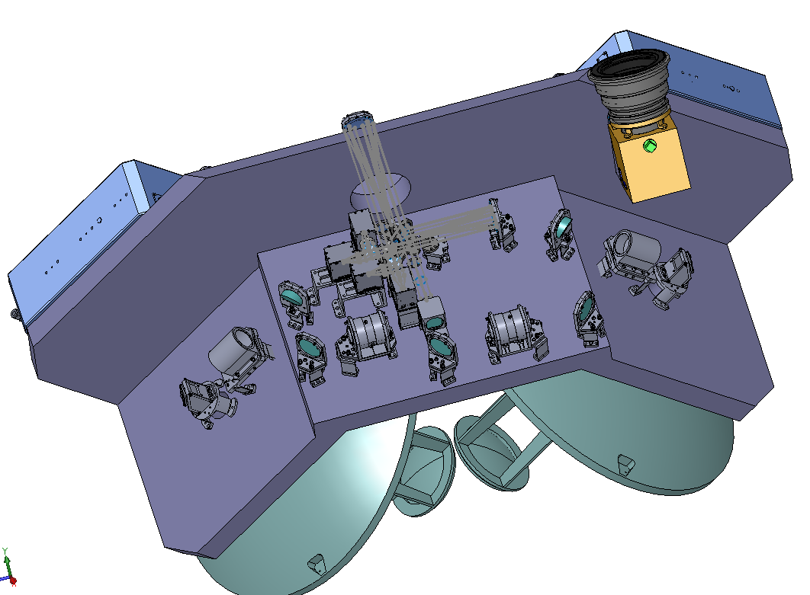
Input to IDL: Ball OAWL JEM-EF design
Various components reused from CALIPSO (including PMT box designs, etalons, telescope, optical mounts, etc).
Input a baseline design concept shown at right (and next slide)
Pointing is 35° off nadir, allowing the system to be put in any
JEM-EF module. 40° achieved with IDL version.
(restricts to modules 1 and 2)
Uses two 0.7m diameter Axsys
telescopes (from CALIPSO
and previous proposal
models)

Slide 21
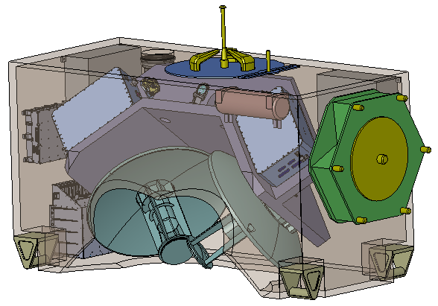
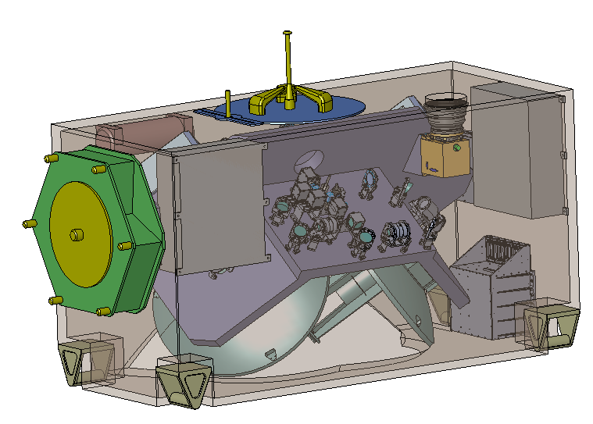
Ball OAWL concept design
There is actually a connector in the JEM-EF module here so a re-design was required – using the baseline concept as a starting point
IDL Mechanical engineers re-arranged the layout/components and redesigned the bench to come up with the design described on the following slides.

Slide 22
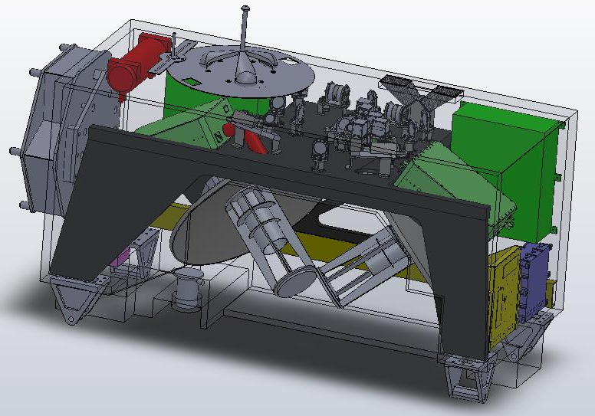
Overall View and Dimensions
1855
800
1000
Dims in mm are for the JEM-EF module

Slide 23
Conclusions, Cost Analysis, & Next Steps

Slide 24
OAWL IDL Study - Output Summaries
Laser: “TRL5 can be reached quickly by simply building a final form, fit, and function unit at Fibertek. Then pursuit of TRL6 can begin with Flight Qual.”
Electrical: “No electrical tall poles or low TRL concerns.” “The OAWL Raw Data rate is well below the 100Mbps bandwidth of the ISS HRDL and poses no concern.”
Flight Software: “Line Of Code estimation shows 79% code reuse for MEB. High heritage based on Ball/GSFC approach. …No technical show-stoppers”
Mechanical: “It fits! Re-packaged the optics and telescopes to fit within the JEM attached payload envelope.”
Optical: “Beryllium telescopes have a lot of flight heritage for this spaceflight application and should be considered high TRL. 355 nm operating wavelength poses minimal risk to design due to proven Ni plating technology and HR coatings.
Detectors: “PMTs have flown on many space flight missions including the Compton gamma ray telescope…Thermal cycling and radiation effects are not an issue…TRL of these PMTs is TRL-5”
Reliability: “Instrument exceeds 80% Reliability at 1 year operation with lower confidence limit in excess of 70%. Degraded Science (one laser) Reliability exceeds 95% at 1 year operation.”
Conclusion: The OAWL IDL Baseline design is feasible and fits within the power, volume, mass, and thermal budgets of the ISS JEM-EF module.

Slide 25
Cost Summary & Analysis
Costing done based on 5-year mission (EV-4 type schedule)
Costed as an unmanned mission, Class B Electronics.
Total IDL Cost Estimate for OAWL on the ISS: < $100M.
This includes
  Instrument (PRICE-H costed) including 5% misc. hardware and Integration & Test
  software (SEER-SEM costed) & software simulator
  extras (testing, flight spares, GSE etc.)
This is in-scope with Ball Cost Estimates for similar systems.
Cost Variations
  IDL Laser costs were high (>2X) compared to Fibertek ROM
  IDL telescope costs were ~2X higher than Axsys ROM.
  Some “manned mission” type requirements may add cost, but it was not specified where/how they would apply.
  No adjustments were made for a Class D mission or for ISS capabilities (i.e. to handle large masses, etc. - these are not “knobs” in their Price-H model)

Slide 26
IDL Lessons
The IDL is an important step/gate for any instrument concept and the extra “eyes” on the system designs, and suggestions for alternative components are quite valuable.
The IDL may be best suited for systems in the earlier stages of design: Some of the extra Ball effort to help OAWL “catch-up” to the hybrid system IDL concept(s) was offset by the IDL process for an instruments’ “first time in.”
Difficult to balance Ball Proprietary issues with need to share Ball designs with the Goddard IDL employees who may also work on competitive instruments.
Costing information provided to Ball was incomplete due to “Goddard proprietary” algorithms.
Uncertainties (in subsystem designs and/or gaps in the knowledge base of the IDL team) lead to higher costs. Less experience on the IDL team with lidars, ISS system designs, and ISS costing likely lead to an overestimation of cost.
Coming in with a mature design and experienced team help lead to a more realistic cost for OAWL. The Ball OAWL team has a great deal of combined experience that includes building and flying CALIPSO, building & demonstrating OAWL hardware, designing and performing trades for other lidars on the ISS, lidar radiometric modeling, space-flight hardware, etc.

Slide 27
Next Steps
Where to focus the TRL development to reduce cost?
  Lifetime laser at 355 nm (to raise laser TRL to 6, according to Goddard laser-TRL definitions): Would benefit OAWL, TWiLiTE, FIDDL, and others
  PMT Detector space-qualification
  Space-qualified FPGA board design and data processing algorithm development
  Space-qualified thermal management systems for ISS-based laser systems
  OAWL EDU build and aircraft flight testing
Adding the Molecular Channel - Double Edge Etalon
  FIDDL (Fabry-perot for the Integrated Direct Detection Lidar) is currently under development at Ball to show the full atmospheric winds at 355 nm approach.
  Laser, telescope, power, data acquisition, cooling, etc. – all apply. Need to add the Molecular Receiver: etalon and controller, detectors, entrance/exit optics, etc.
  Goal: One system, one laser, global winds & aerosols.

Slide 28
OAWL Presentations & Publications
Publications
2009 - SPIE Defense and Security Sensors Symposium, paper and talk: “Optical Autocovariance Direct Detection Lidar for Simultaneous Wind, Aerosol, and Chemistry Profiling from Ground, Air, and Space Platforms”, Grund, Howell, Pierce, and Stephens
Jan 2011 - “Optical Autocovariance Wind Lidar (OAWL): A New Approach to Direct-Detection Doppler Wind Profiling “,Christian J. Grund, and Sara C. Tucker , talk and extended abstract: 5th Symposium on Lidar Atmospheric Applications, AMS Annual Meeting, Seattle, WA.
Presentations & Posters
2008 - AGU fall meeting in December. Poster: “Enabling Characteristics of Optical Autocovariance Lidar for Global Wind and Aerosol Profiling”, Grund, Stephens, Lieber, and Weimer
2009 - SPIE Defense and Security Sensors Symposium, paper and talk: “Optical Autocovariance Direct Detection Lidar for Simultaneous Wind, Aerosol, and Chemistry Profiling from Ground, Air, and Space Platforms”, Grund, Howell, Pierce, and Stephens
Jan 2011 - “Optical Autocovariance Wind Lidar (OAWL): A New Approach to Direct-Detection Doppler Wind Profiling “,Christian J. Grund, and Sara C. Tucker , talk and extended abstract: 5th Symposium on Lidar Atmospheric Applications, AMS Annual Meeting, Seattle, WA.
Jan 2012 – “Wind Profiling with the Optical Autocovariance Wind Lidar: Results of Validation Testing,” AND “Optical Autocovariance Wind Lidar for Atmospheric Research,” S. Tucker, C. Grund, T. Delker, M. Adkins, B. Good, P. Kaptchen, and D. Gleeson, 2012 AMS Annual Meeting, New Orleans, LA.
Wind Lidar Working Group Presentations
Jan 2009 (Destin, FL)- OAWL Progress and Plans: Grund, Pierce, Howell, Ostaszewski
Jun 2009 (Wintergreen, VA) - OAWL System Development Status : Grund, Pierce, Howell, Ostaszewski
Feb 2010 (Destin, FL) - OAWL IIP Development Status: Year 1.5: Grund, Howell, Ostaszewski, Pierce, Tucker
Aug 2010 (Bar Harbor, ME) – OAWL IIP Development Status: Year 2.0: Grund, Tucker, Howell, Ostaszewski, Pierce.
Feb 2011 (Coconut Grove, FL)- First Optical Autocovariance Wind Lidar Measurements and Status of the OAWL IIP: Grund and Tucker.
Aug 2011 (Boulder, CO) – Results from the OAWL IIP Ground Validation: Tucker, T. Delker, and C. Grund.
May 2012 (Miami, FL) - Successes of the OAWL IIP and next steps (with a FIDDL): S. Tucker, T. Delker, C. Weimer.
ESTO ESTF:
6/2010 Development and Demonstration of an Optical Autocovariance Direct Detection Wind Lidar: Grund, Tucker, Pierce, Ostasziewski, Kanizay, Demara, Howell, ESTF2010
6/2011 - First Demonstration of an Optical Autocovariance Direct Detection Doppler Wind Lidar (OAWL): Grund, Tucker, and Delker, ESTF2011.

