Slide 1
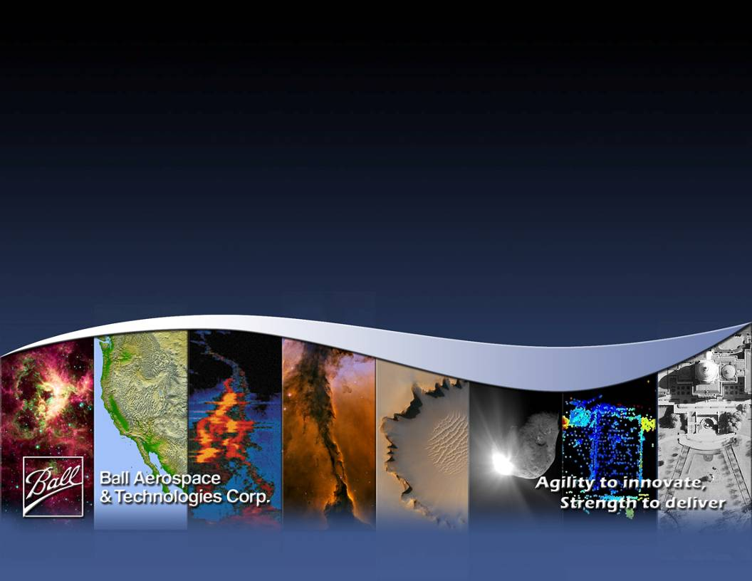
Introduction to The Fabry-perot for the Integrated Direct Detection Lidar: FIDDL
S. Tucker, Ball Aerospace & Technologies Corp.
Working Group on Space-Based Wind Lidar
17 October 2012

Slide 2
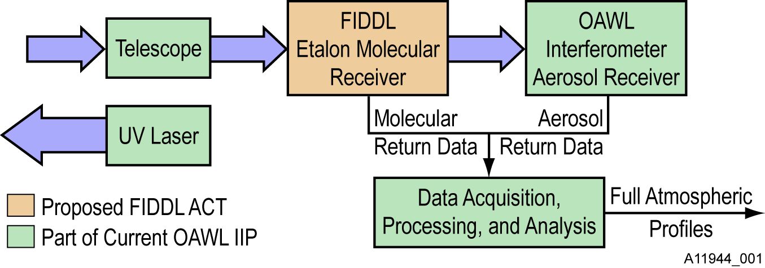
Introduction: FIDDL & OAWL
The Fabry-perot for the Integrated Direct Detection Lidar (FIDDL) is funded under the NASA ESTO Advanced Component Technologies (ACT) program
FIDDL fits in the MIDDL: between the OAWL (Optical Autocovariance Wind Lidar) telescope and the OAWL receiver interferometer
FIDDL is designed to provide wind estimates from molecular return at 355 nm,
and then reflect the aerosol portion of the spectrum (center) on to OAWL
FIDDL ACT
OAWL IIP
One system, one laser, global winds & aerosols.

Slide 3
The FIDDL team (more to come…)
Electrical…………………….... Mike Adkins
Co-I, Optical…………………. Tom Delker
Optical……………………….. Bob Pierce
Models & Control Systems…… Mike Lieber
PI, PM, Modeling/Algorithms… Sara Tucker
Management Support…………Carl Weimer
Ray Demara

Slide 4
FIDDL Primer: bandwidth of atmospheric lidar return
Aerosol return has approximately the same narrow bandwidth as the outgoing laser pulse.
Molecular return has a wide bandwidth due to all the Doppler shifts from the molecular vibrations (Doppler broadening).
The center of both returns is Doppler shifted by the line-of-sight wind speed V, according to:
Where
  f_{o} is the outgoing laser pulse
  frequency = c/λ₀
  c is the speed of light
2.5
Doppler Shift
Due to wind
2
1.5
Return spectrum from a
Monochromatic source
Backscatter (W)
1
A+M+BG
A
0.5
M
BG
0
160
80
40
20
10
0
10
20
40
80
160
Wavelength Shift (m/s)

Slide 5
FIDDL Requirements
Overall Science Goals:
  Pushing for <1 m/s precision in the wind estimate (ground tests)
    For low aerosol loading conditions.
    1-2 second time span (TBR based on laser PRF, SNR, etc.)
  <1 m/s accuracy in the wind estimate
    Will aim to verify with OAWL in the overlap (low aerosol)
    Eventual “synergy” with HOAWL (separate signal processing task) may be used to lessen the impact of aerosol signals through knowledge of the R_{a/m}
Design approach - without risking the technology demonstration
  Best effort to build the system for aircraft
  Best effort to make use of components with path-to-space
  Best effort to design the physical system to fit with current AND future OAWL systems.

Slide 6
FIDDL Tasks
FIDDL is a new receiver component to be added to OAWL.
Thus the build requires:
  Etalon optical design & build
  Etalon gap control design & build (biggest part!)
  Input/output optics – to receive light from the telescope, and pass reflected light off to OAWL – design and build.
  Polarization multiplexing and detector installation
  Data analysis algorithms and calibration techniques
As a lidar, most components already exist as part of OAWL
  Telescope
  Laser
  Data acquisition system
  Detector design

Slide 7
FIDDL Block Diagram
Detection Electronics
Edge 2 detector assembly
Polarization Multiplexing
FIDDL optical bench
From telescope
To OAWL
PBS
Upstream optics
Edge 1 detector assembly
incident
PBS
reflected
QWP
QWP
Downstream optics
etalon
Data acquisition (shared with OAWL)
Etalon Control Electronics
Plant: Etalon piston/tip/tilt
Observers: Capacitive sensing & detectors
Actuators: PZTs (3x)
Thermal control and pressure monitoring

Slide 8
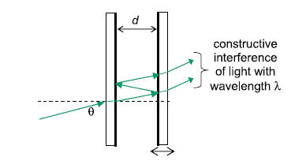
FIDDL: Fabry-Perot Basics
mλ = 2d cosθ
For real lidar systems, we have:
  lots of frequnencies (input with finite frequency bandwidth > 40 Mhz)
  Lots of incident angles (θ) due to the receiver field of view & system geometry
  For FIDDL, both of the above are from the same laser and telescope receiver used for OAWL.
Control over the gap spacing d is one of the main objectives for FIDDL.
But we’ll use θ too…
2.5
Doppler Shift
Due to wind
2
1.5
Backscatter (W)
Return spectrum from a
Monochromatic source
1
A+M+BG
0.5
A
M
0
BG
160
80
40
20
10
0
10
20
40
80
160
Wavelength Shift (m/s)

Slide 9
FIDDL Primer: General Double Edge Technique
Split the atmospheric return light and send the return light through two Fabry-Perot etalons – symmetrically centered on the edges of an ideal unshifted molecular return.
  Transmission curves shown as Red and Blue dashed-line curves at right.
  Dashed green line shows Doppler shifted atmospheric return.
The light through each filter (solid lines) is incident on a separate detector.
When the center frequency of the return light is Doppler shifted by wind, the relative intensities on the two detectors changes.
The intensity changes map to the wind speed.
Molecular+Aerosol return and 2 edge transmissions
1
0.9
0.8
0.7
0.6
Transmission
0.5
0.4
0.3
0.2
0.1
-6
-4
-2
0
2
4
6
Offset center frequency (GHz)

Slide 10
FIDDL Primer: Fabry-Perot 1st pass
NOTE: The plots in this and following slides are outputs from the updated
FIDDL Etalon Model
Molecular Return and 2 edge transmissions
Designed the FP to pass-through a portion of the Doppler broadened molecular return.
OAWL receiver passes ~2.4 mrad (full) of field on to the FP – this field effectively broadens the transmission spectrum
Green line shows the molecular return spectrum
Dashed red shows the etalon transfer function
Solid red shows the light transmitted through the etalon.
1
0.9
0.8
0.7
0.6
Transmission
0.5
0.4
0.3
0.2
0.1
-6
-4
-2
0
2
4
6
Offset center frequency (GHz)

Slide 11
FIDDL Primer: Fabry-Perot 2nd pass
The rejected light (that doesn’t pass through) is transformed (via a QWP and reflection) to the opposite polarization
For the 2nd pass through, add a tilt to shift the center of the FOV.
Still have a 1.2 mrad total FOV incident on the FP, but it starts off axis.
Green line again shows the molecular return spectrum
Dashed blue shows the etalon transfer function at the new angle
Solid blue shows the light transmitted through the etalon after both passes (note the notch where edge 1 was).
Molecular Return and 2 edge transmissions
1
0.9
0.8
0.7
0.6
Transmission
0.5
0.4
0.3
0.2
0.1
-6
-4
-2
0
2
4
6
Offset center frequency (GHz)

Slide 12
Unique characteristics of the FIDDL approach…
Transmission through both edges: solid green line shows the center portion which is reflected and passed to OAWL.
  Transmission functions are tuned to balance sensitivity to change in frequency and total throughput.
The same beam passes through BOTH filters (T1 & T2) sequentially.
  No splitting into two channels so 2X the power can get through on each channel without using polarization recycling.
  Etalon diameter can be smaller (~1”) reducing risk of thermal effects.
Wind speed is related to the ratio of the intensity on detectors (i.e. the total light passed through the separate edge filters).
The center frequencies are reflected toward OAWL for aerosol return wind measurement.
Molecular Return and 2 edge transmissions
1
0.9
0.8
0.7
0.6
Transmission
0.5
0.4
0.3
0.2
0.1
-6
-4
-2
0
2
4
6
Offset center frequency (GHz)

Slide 13
FIDDL Requirements: Etalon Gap Control
Etalon Gap Control
  Three gap observers & three actuators (PZTs) for tip, tilt, and piston (TTP) control of the etalon plate spacing.
  Gap is measured via measuring capacitance with a capacitance to digital conversion (CDC).
  Gap shift/error dx relates to a wind speed error dV by
  We are aiming to measure the three gaps with ~16 pm precision or 0.025% of the ~12 GHz FSR*
  This translates into ~96dB of dynamic range (about 16 bit precision) measurement requirement on the CDC.
  New Ball Aerospace CDC approach has been demonstrated with test board showing >96 dB of dynamic range.
etalon area
  *All listed values TBR

Slide 14
FIDDL Modeling & Analysis
Upgraded and added-to the Ball etalon model(s)
  Matlab etalon model (originally built on Ball funds) updated and geared to model FIDDL
  Paired with the OAWL radiometric model (RMM) which
    includes laser transmitter, atmosphere, telescope, photo-detectors, etc.
    allows for SNR modeling at different altitudes, with varying aerosol/molecular scattering ratios and molecular bandwidths.
    may be easily updated to integrate new atmospheres
  All input angles in the FIDDL approach are represented (one dimensional tilt tuning plus two-dimensional input field of view)
Developed preliminary wind retrieval algorithms for the unique FIDDL system
  Modeled output sensitivity to wind speeds → revealing the optimal placement for the lower-finesse filter transmission.
Using the models (with the CDC test results) to finalize etalon specifications (trades/balancing of requirements).

Slide 15
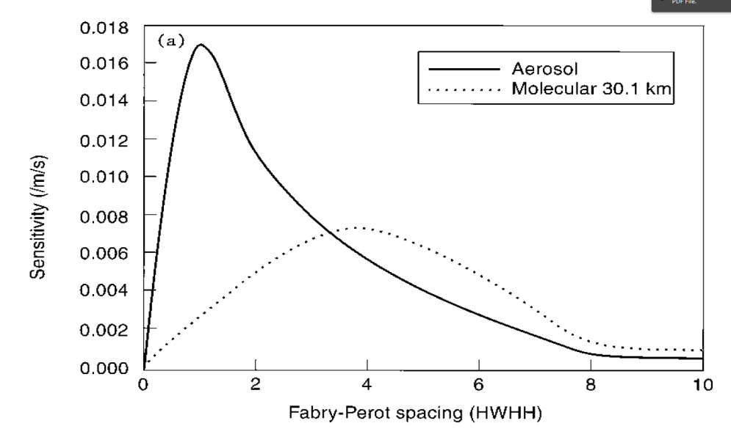
Model Results: optimum edge filter placement
Want to maximize the sensitivity to wind speed changes in the molecular channel, with minimal impact on the aerosol channel (passing through to OAWL)
Tilt-tuning means that the optimum (most sensitive) Edge 2 and Edge 1 filter centers are asymmetric about 0.
Compare results to Flesia and Korb (1999) paper describing optimal placement of symmetric etalons (for 30.1 km alt.)
  Both models peak at ~4X the half width half height at 0.8%.
  The large difference in the aerosol curve is due to the double pass approach for FIDDL.
  Flesia & Korb suggest cross-over approach to balance aerosol & molecular…
  But OAWL provides lidar ratio so we can optimize to reduce impact on the aerosol channel.
2.5
New: asymmetric Etalon FIDDL Models
2
1.5
Sensitivity (%) /m/s
1
0.5
1
2
3
4
5
Edge 1 Center, (in HWHH units)
From Flesia & Korb, 1999

Slide 16
In conclusion…
The FIDDL ACT is underway with
  system models with field and angle tuning
  radiometric models to understand SNR
  new CDC designs for etalon gap sensing and control
Next major step: specifying the etalon and finding allowed vendor.
Expect to have a FIDDL PDR in November
Plan to start electronics and optical hardware builds early Spring 2013.

