Slide 1
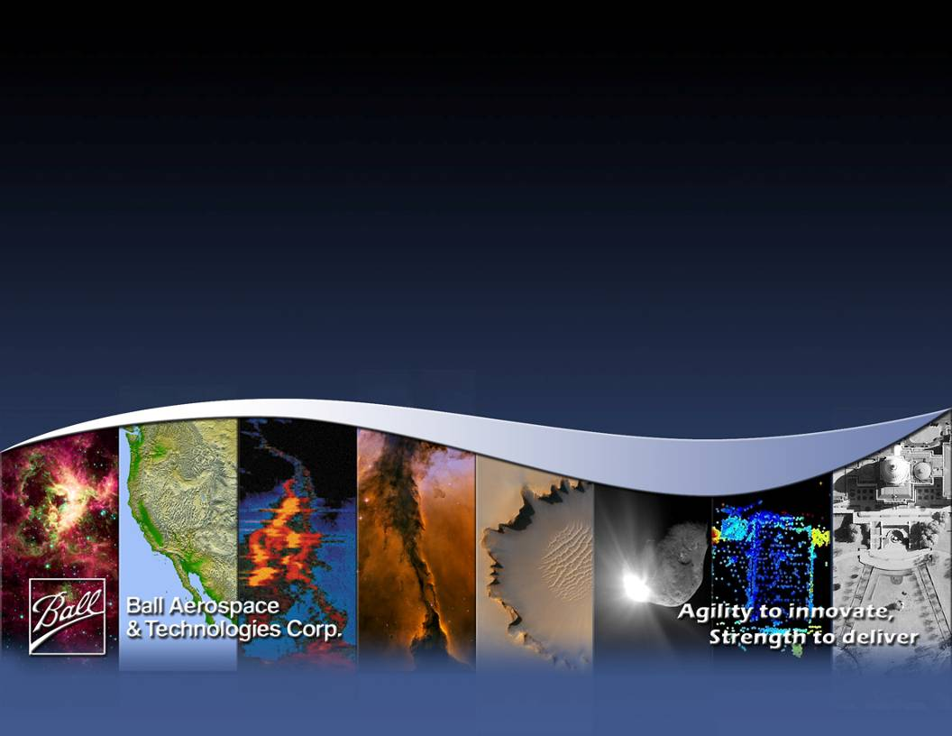
Introduction to Combined HSRL and Optical Autocovariance Wind Lidar (HOAWL)
T. Delker, Ball Aerospace & Technologies Corp.
Working Group on Space-Based Wind Lidar
17 October 2012

Slide 2
HOAWL relevance to Working Group
Openings meeting goals by Mike Hardesty
“Can we combine a wind mission with another decadal survey mission to move up the priority list?”
Action Item List
“5. Continue to explore design modifications to a DWL mission for additional earth science measurement capabilities”
HOAWL combines Winds and HSRL in same instrument
Opportunity: Combine lidar portion of ACE mission with 3D-Winds mission

Slide 3
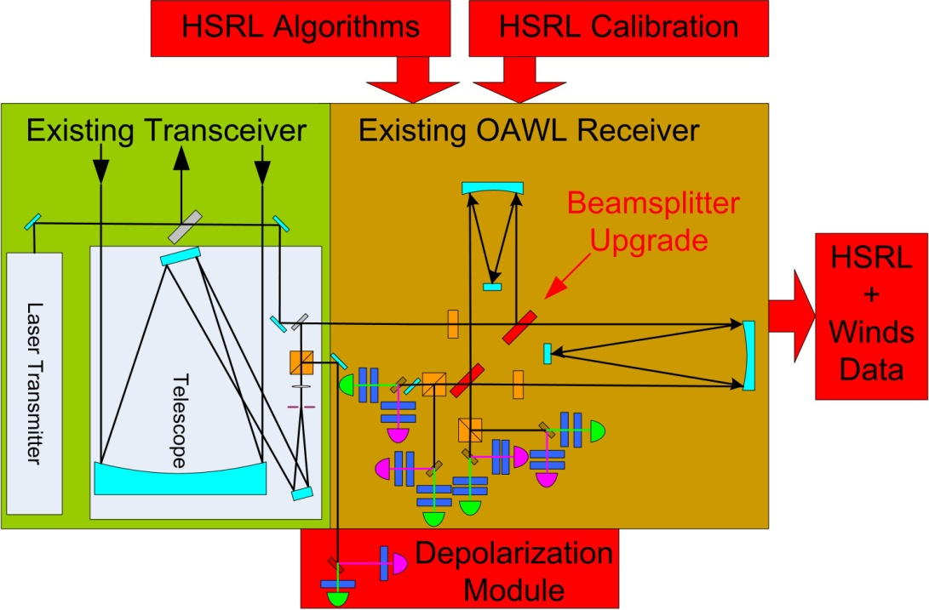
HOAWL Executive Summary
HOAWL funded under NASA’s ESTO 2011 ACT Program
Will result in measurements of both HSRL and wind in one instrument
Reuses much of OAWL Hardware
Upgrades hardware to allow two wavelength measurements
Much of initial engineering and hardware already in place from IIP
Develop and measure HOAWL calibration factors for HSRL products
Develop algorithms
No impact on winds measurement
Wind measurement achieved through measuring phase of fitted sine
HSRL backscatter achieved by measuring amplitude and offset of fitted sine
Calibration need to turn amplitude and offset in to HSRL
Any improvements to the instrument that increase SNR of HSRL will also increase wind measurement SNR
Allows off-nadir HSRL measurements
Doppler-shift does not effect HOAWL-HSRL retrievals

Slide 4
The HOAWL team
Electrical……………………… Mike Adkins
Optical……………………….. Shaun Ashby
Harlan Kortmeyer
PI, PM, Optical……………….. Tom Delker
Software……………………… Dave Gleeson
CO-I …………………………. Christian Grund
Mechanical…………………… Miro Ostaszewski
CO-I/Modeling/Algorithms…... Sara Tucker
Management Support…………Carl Weimer Ray Demara

Slide 5
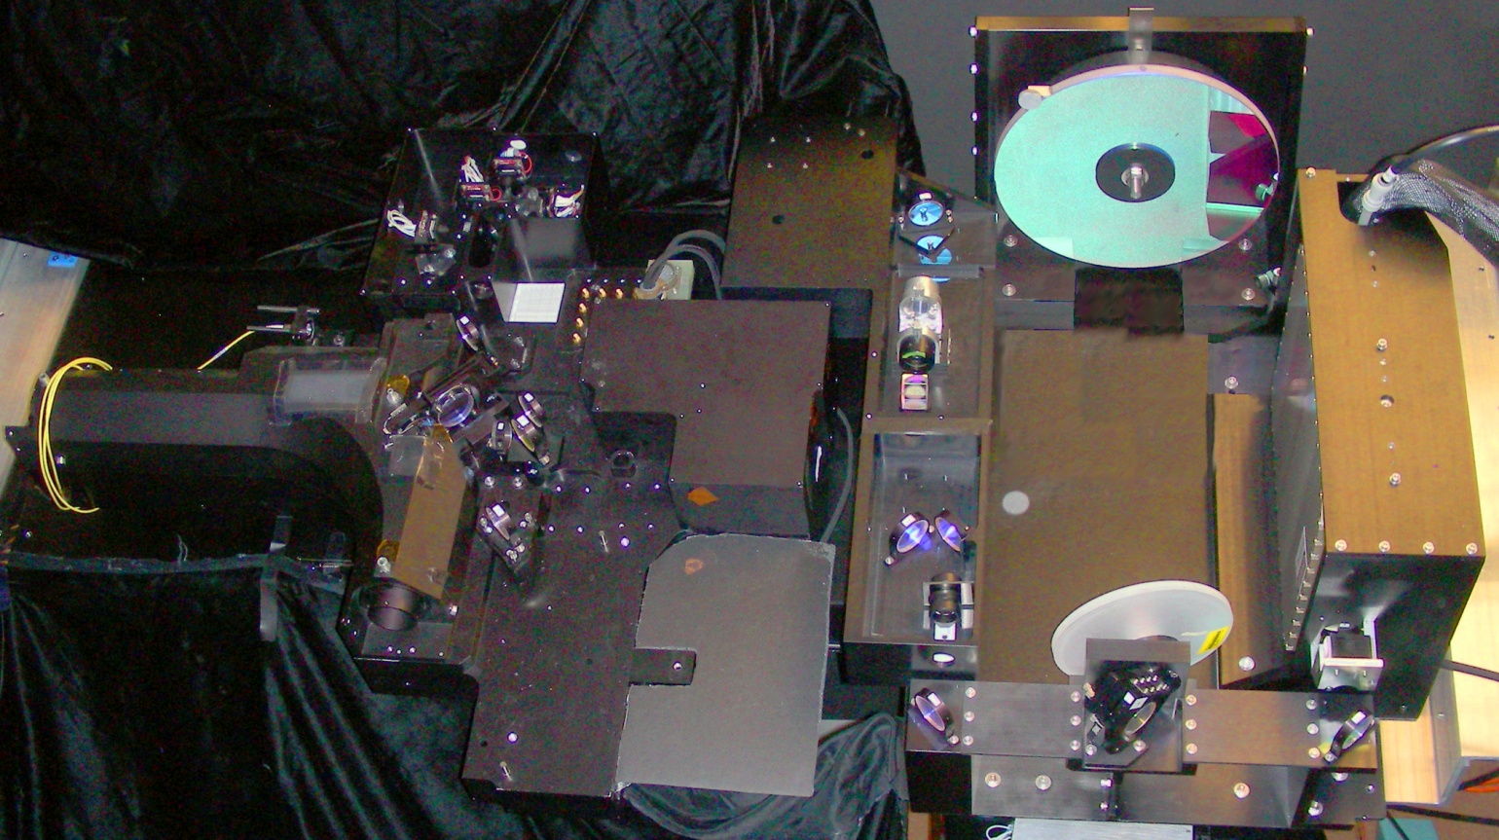
HOAWL Introduction
ACT will add HSRL retrievals to OAWL
Delivers both winds from aerosols and atmospheric composition measurements
OAWL works as a system
Successfully showed wind retrievals from ground with collocated coherent doppler wind lidar¹
Successfully showed wind retrievals and Doppler-shifted ground returns from air platform (WB-57)²
HSRL hardware upgrades
Current OAWL only working for 355 nm
Add 2nd wavelength channel (532 nm)
New collimator
New waveplates
Add signal acquisition card to data system
Rework detectors
New Depolarization channel
Optical system realignment
System characterization
1) Tucker et al, (2012): Wind Profiling with the Optical Autocovariance Wind Lidar: Results of Validation Testing, AMS 92nd Annual Meeting, 22-26 January, 2012 – New Orleans, LA
2) Tucker et al, (2012): Successes of the OAWL IIP and next steps (with a FIDDL), Working Group on Space-based Wind Lidar, 1-2 May 2012 - Miami, FL

Slide 6
Why HSRL
Goal
Measure atmospheric aerosol scattering and extinction profiles
Supports ACE, GACM and GEO-CAPE missions
High Spectral Resolution Lidar
Lidar = range resolved measurements
Something passive instruments can’t do and need
High spectral resolution
=> Can see effect of line broadening of laser light caused by molecular backscatter
Allows separating aerosol from molecular backscatter
Single wavelength insufficient to provide needed information for aerosol characterization
HRSL retrievals
Backscatter (β)
Three wavelengths preferred
OAWL currently configured for 2 wavelengths, could support three (355nm, 532, 1064 nm)
Extinction (α – for attenuation)
Two wavelengths (355 nm, 532 nm)
Depolarization (δ)
Two wavelengths (355 nm, 532 nm)

Slide 7
Aerosol vs. Molecular Coherence
As a result….
Aerosol return has approximately the same narrow bandwidth & temporal coherence length as the outgoing laser pulse.
Molecular return has a wide bandwidth due to all the Doppler shifts from the molecular vibrations (Doppler broadening) → shorter temporal coherence length.
The center of both returns is Doppler shifted by the line-of-sight wind speed V, according to:
Where
f_{o} is the outgoing laser pulse frequency = c/λ₀
c is the speed of light
2.5
Doppler Shift
Due to wind
2
1.5
Return spectrum from a
Monochromatic source
Backscatter (W)
1
A+M+BG
A
0.5
M
BG
0
160
80
40
20
10
0
10
20
40
80
160
Wavelength Shift (m/s)

Slide 8
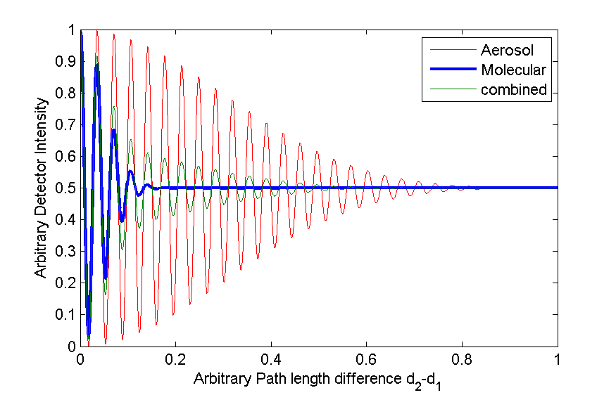
Separate Molecular vs. Aerosol
Aerosol return (narrower BW) exhibits good fringe contrast over a range of OPDs
Molecular return (broader BW) fringe visibility is negligible (~10⁻¹²) at HOAWL’s 0.9 meter OPD
The atmospheric return is the combination of the two.
The HSRL retrieval is in the separation of these two plus noise.
Fringe contrast or interferometer visibility (V = (I_{max}-I_{min})/(I_{max}+I_{min})) depends on:
Maximum system contrast, V_{max}
Optical Path Difference, OPD
Temporal Coherence length of the laser backscatter from atmosphere, Lc

Slide 9
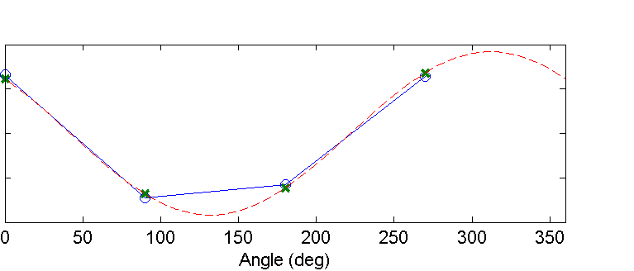
Phase(wind), Amplitude (Aerosol), and Offset (Molecular)
Four channels: Ideally, these are aligned to detect the 0, 90, 180, and 270 phases of the interferometric signal.
[0, 90, 180, 270] could be [135, 225, 315, 45] or any set of values separated by 90.
The T0 detector phase definitions are arbitary – but used to define the current state of the interferometer.
For each time stamp, perform a sinusoidal fit to the detector amplitudes at these phases → phase, amplitude, and constant (‘dc”) offset of the fit are returned.
Phase provides the wind
Amplitude provides polarization-preserved Aerosol content
Aerosols return has ~same contrast as outgoing laser pulse
Calibrated with To signal shot to shot (ideally)
Offset provides polarization-preserved molecular content
Widened spectrum of molecular backscatter is incoherent for chosen optical path different
Results in offset in sine fit
D
D
O

Slide 10
HSRL Data Products
Measurement or retrieval | Description (all a function of range)
P_{m} =P_{m} ^{ǁ} | Return from molecular backscatter in the co-polarized OAWL receiver
P_{a} =P_{a} ^{ǁ} | Return from aerosol backscatter in the co-polarized OAWL receiver
δ_{a} | Aerosol depolarization ratio: P_{a}⊥/P_{a}^{ǁ}
α_{a+m} | Total extinction
α_{a} | Aerosol extinction coefficient
t_{a} | Aerosol optical depth
β_{a} | Aerosol backscatter
R_{a} | Aerosol lidar ratio: α_{a} /β_{a}
R_{am} | Aerosol to molecular backscatter ratio: β_{a}/β_{m}

Slide 11
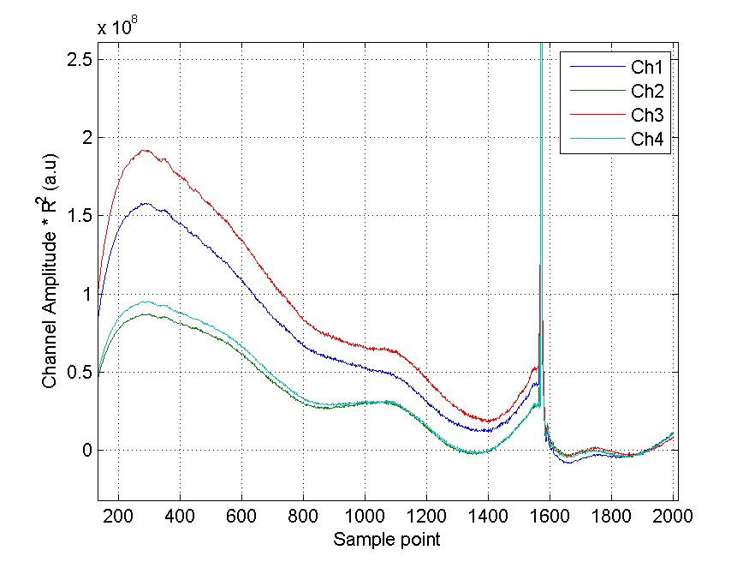
HSRL from Previous OAWL Data
Previous OAWL data used to test algorithm development
Ground validation data
Single Channel (355 nm)
Caveats
Overlap affects extinction estimate at the near ranges (common problem for all HSRL systems).
Horizontal view at low altitude → lots of extinction → SNR drops at farther ranges.
“ringing” in noise floor (believed to be from Q-switch electronics) falsely affects extinction estimate.
To was not optimized (equal To and telescope path contrast not ensured).
Don’t have actual depolarization measurements → aerosol backscatter may be too high/low
No calibration has been performed.
Don’t have actual depolarization measurements → aerosol backscatter may be too high/low
Very difficult to validate with Denver data.

Slide 12
Successes
Output values are “reasonable” (i.e. within normal ranges) where SNR is strong and overlap issues are lessened.
Average of output (i.e. for aerosol backscatter, or aerosol extinction/AOD) is not affected by number of points used in the average (other than more points leads to smaller variance).
Data “generally” follow Denver air quality data (too many variables for good comparison)

Slide 13
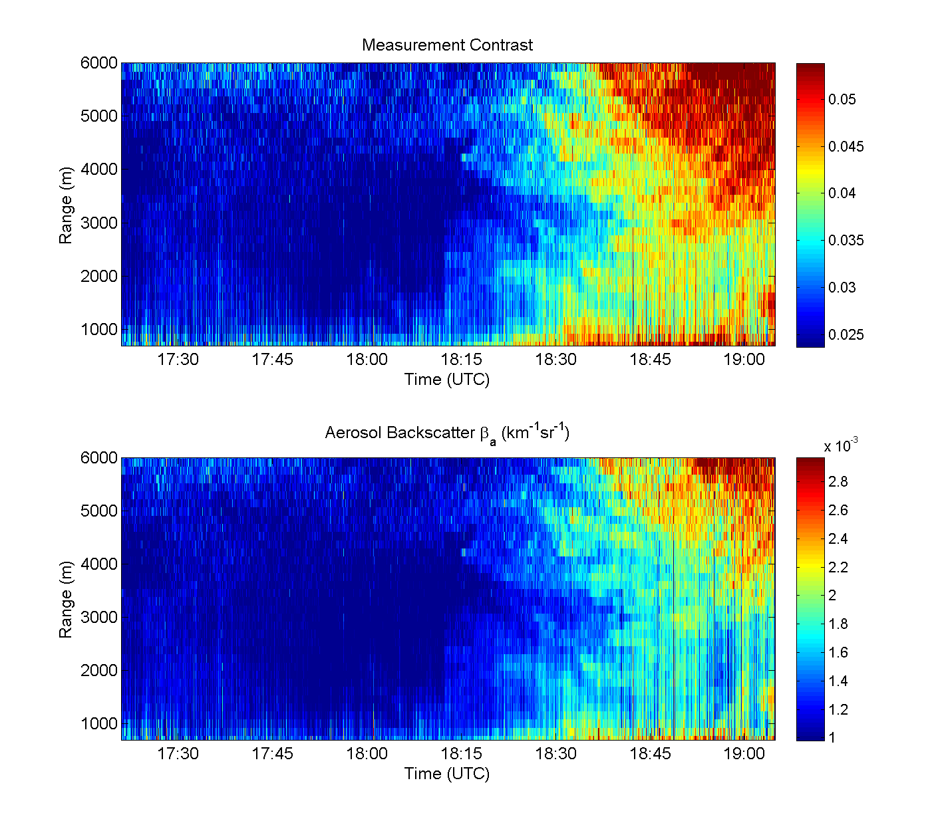
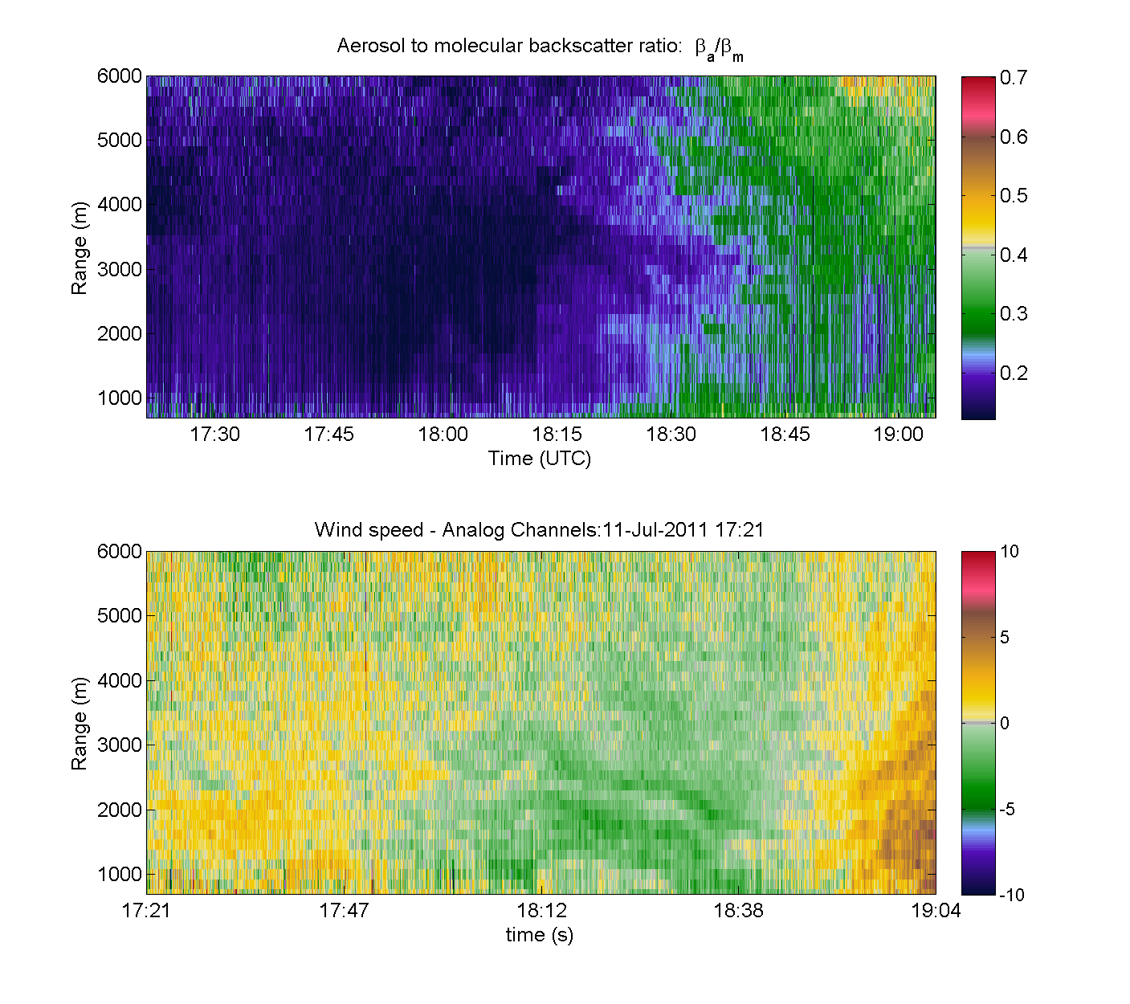
Preliminary Results: 11 July 2011
150 m range gates, 4 second averages

Slide 14
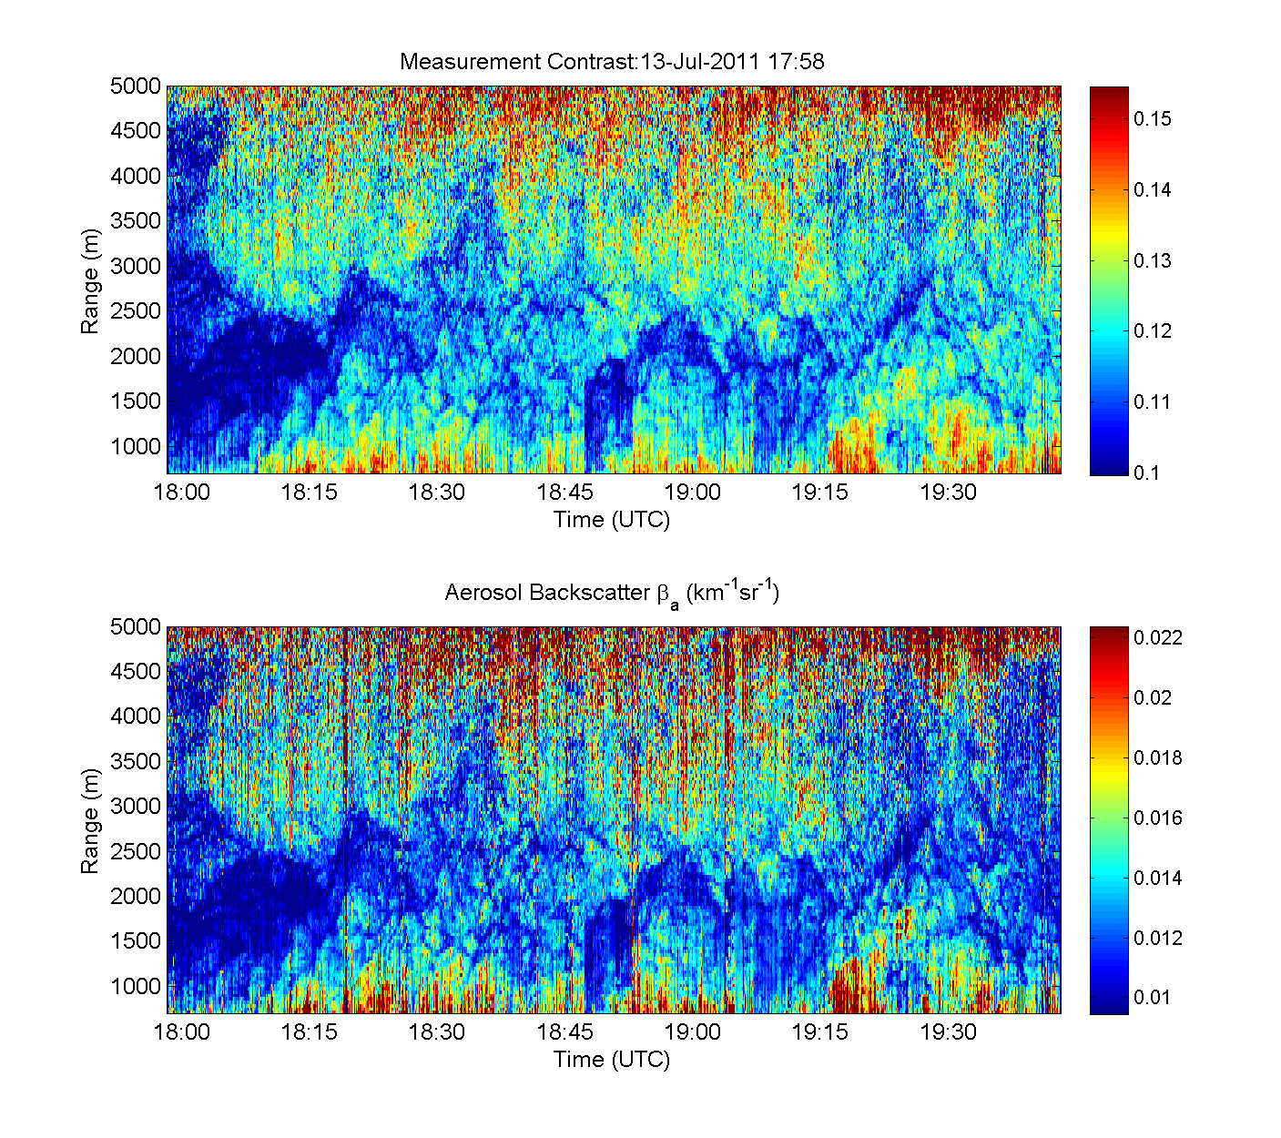
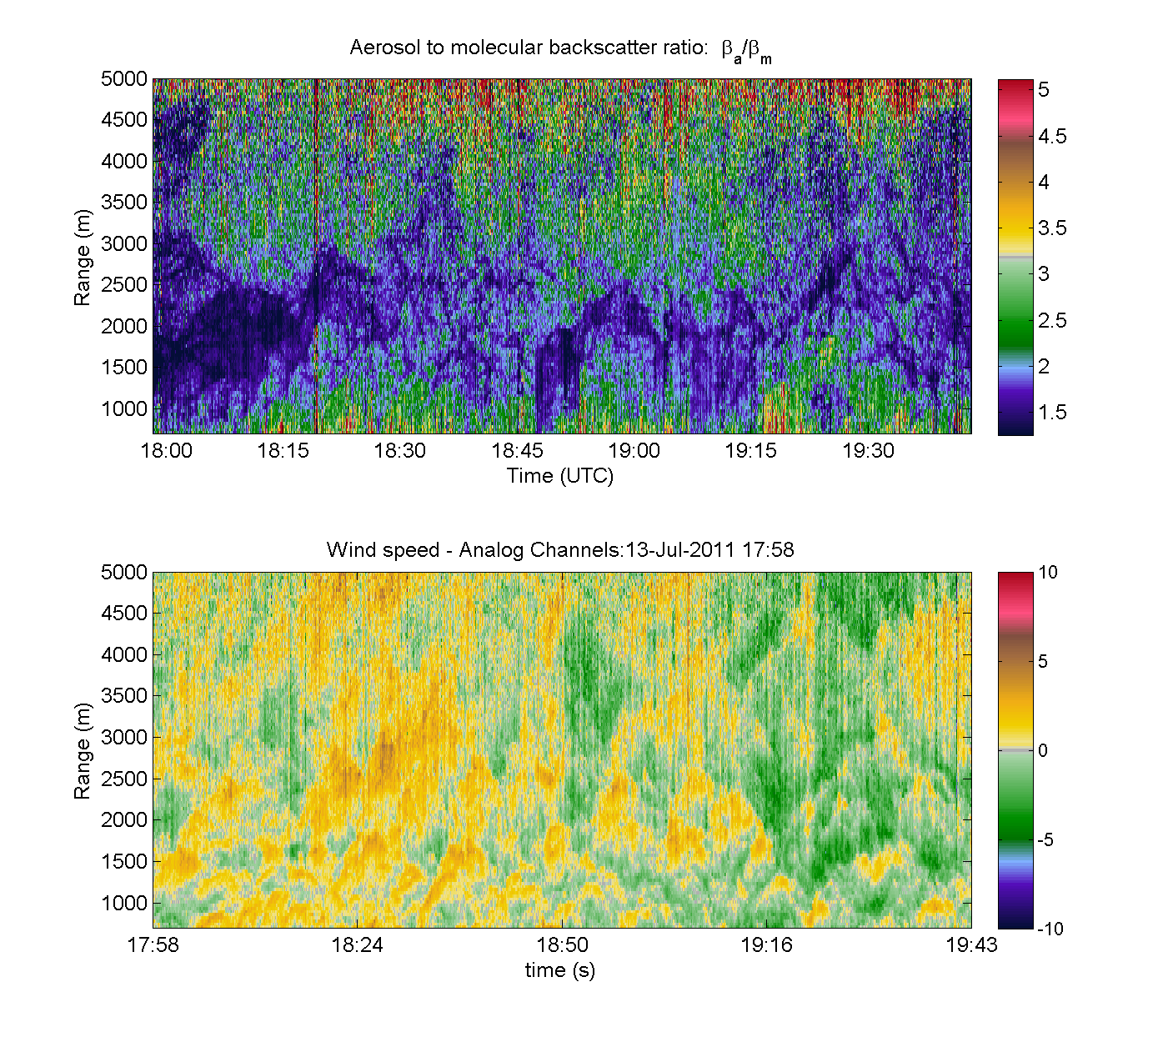
Preliminary Results: 13 July 2011
37.5 m range gates, 1 sec. averaging
High aerosol backscatter & extinction day

Slide 15
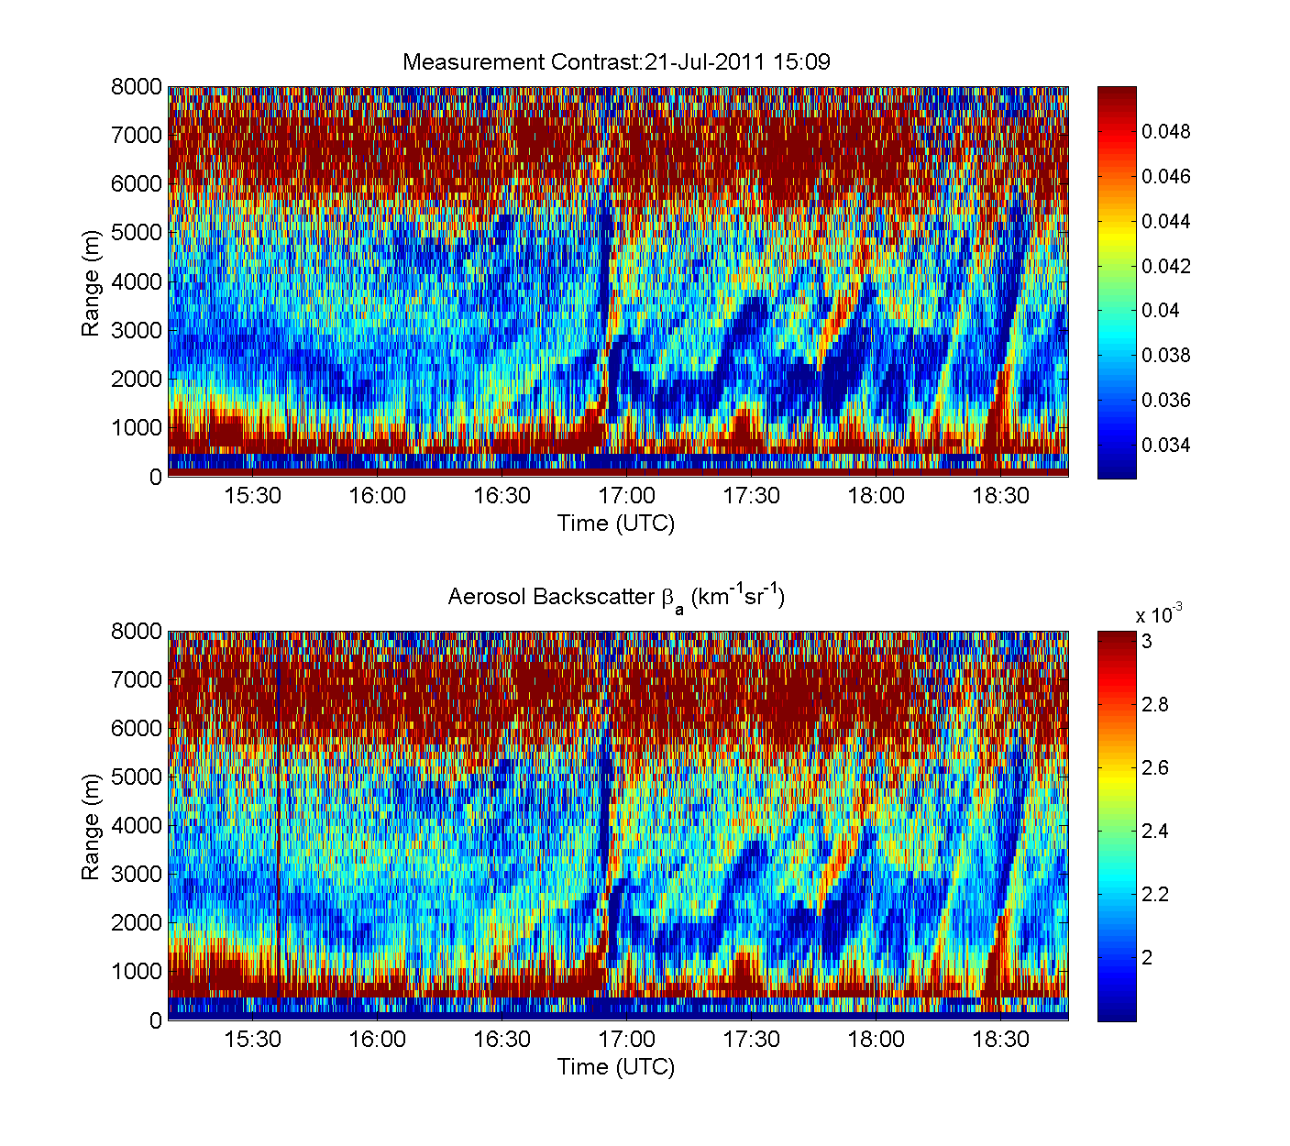
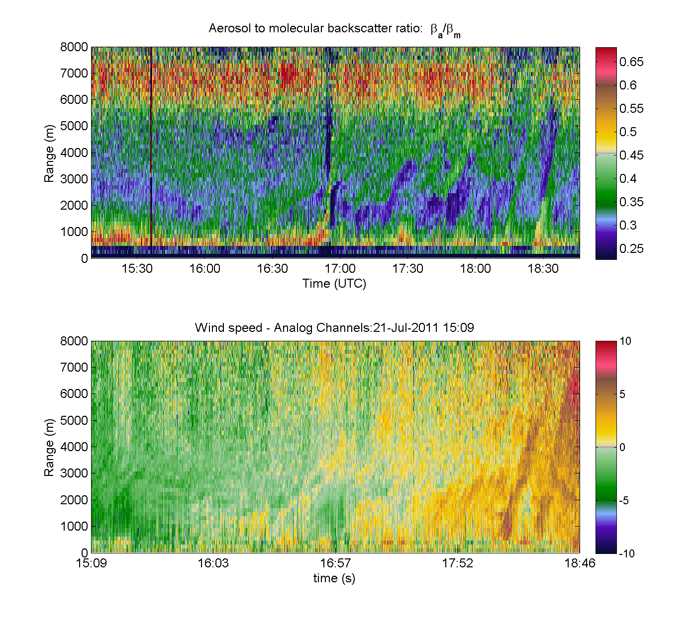
Preliminary Results: 21 July 2011
150 m range gates, 4 sec. averaging
Medium to low aerosol backscatter & extinction – overlap effects are also present
Note different color scales

Slide 16
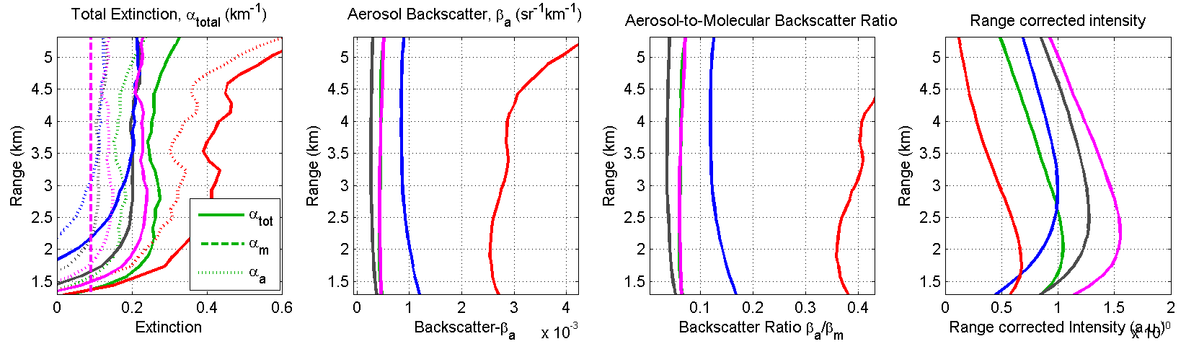
Average output results
Averages for full data set (2+ hrs)
150 m range gate on inputs
Not verified, but all within reasonable limits.
Biases (intensity & extinction) likely present due to range-dependent offsets (from Q-switch noise) and …
…from possible changes in system setup (experiment was intended for winds, not HSRL – some mods were made)
11 July 2011
13 July 2011
14 July 2011
19 July 2011
21 July 2011

Slide 17
HOAWL ACT Summary
HOAWL ACT will demonstrate:
Two wavelength HSRL measurement
Two wavelength Aerosol wind measurement
Hardware upgrades underway
Initial hardware upgrades happening now
Rooftop demonstration by end of this year
Additional hardware upgrades following first dual wavelength retrievals
Final data sets and wrap up ACT in early 2014
For FIDDL hardware integration
Algorithms under development
Some preliminary HSRL results from existing wind data

Slide 18
HOAWL for LIDAR potion of ACE mission
HOAWL can deliver data for lidar portion of ACE baseline concept
HSRL 3β + 2α + 2δ
Backscatter at 355 nm, 532 nm, 1064 nm
Extinction at 355 nm and 532 nm
Depolarization at 355 nm and 532 nm
In addition - Aerosol wind at 355 nm and 532 nm
Add FIDDL for molecular if desired and fits in cost
Minor hardware changes add HSRL to OAWL
Photons already there
Emit existing 1064 nm and 532 nm light generated by laser
Byproduct of 355 nm light currently used by OAWL
Multiwavelength optical components
Add backscatter channel at 1064 nm
Dichroic with detector
Add depolarization channel
355 nm and 532 nm
Add 4 detectors at output interferometer
Already exist in current OAWL
It’s not free, but it’s not expensive
Could descope some parts
1β + 1α + 1δ comes at the cost of just a single extra detector

Slide 19
3D Winds plus LIDAR potion of ACE mission
Makes mission more relevant to NASA
Decadal survey already ranks 3-D winds mission low
Especially when/if ADM-Aeolus flies
BUT, make sure cost increase is minor
Maximize science/cost ratio
CLARREO lesson – Don’t try to do too much
It’s too expensive
GEO-CAPE is taking the clue
Separating Ocean Color from Aerosol Mission
Is this an ACE Mission with 3-D winds for free?
Use ACE for higher decadal survey position
Get winds from lidar portion of ACE via HOAWL for free
It costs to add HSRL to 3-D winds
Need to verify
Do ACE mission and 3-D winds mission orbits overlap?
Do viewing and pointing requirements overlap?
Does HOAWL meet ACE HSRL measurement accuracy and precision?
Need to engage ACE mission scientists
Goal: One system, one laser, global winds & aerosols.

