Slide 1
OSSEs to assess the impact of early morning orbit coverage
Sean P.F. Casey^{1,2,3,4}, Michiko Masutani^{3,5}, Jack Woollen^{3,5},
Lars Peter Riishojgaard^{2,3}, Tong Zhu^{3,4} and Zaizhong Ma^{2,3,4}
¹Cooperative Institute for Climate and Satellites (CICS)
²Earth System Science Interdisciplinary Center (ESSIC)
³Joint Center for Satellite Data Assimilation (JCSDA)
⁴NOAA/NESDIS/STAR
⁵NOAA/NWS/NCEP/EMC

Slide 2
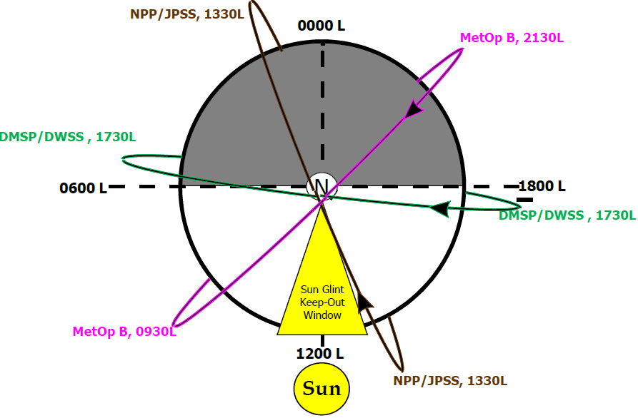
Three polar orbits? Or two?
Recently, plans for a meteorological satellite in the “early morning orbit” (~0530/1730 equatorial crossing time) were scrapped for budget reasons. How will this effect medium-range weather forecasts? Which of three suggested replacement satellites would have the greatest forecast impact?
Image Courtesy F. Weng

Slide 3
Planned Early-Morning-Orbit Experiments
A control run, using all available instruments as of May 1st, 2012
Same as 1., but without current early morning orbit coverage [(no Special Sensor Microwave Imager/Sounder (SSMI-S)]
Same as 2., but with Cross-track Infrared Sounder (CrIS) and Advanced Technology Microwave Sounder (ATMS) added in the early morning orbit
Same as 2., but with Visible Infrared Imaging Radiometer Suite (VIIRS) in the early morning orbit (i.e. polar winds)
Same as 2., but with VIIRS and ATMS in the early morning orbit

Slide 4
Simulating new instruments

Slide 5
Model Specifications
Experimental Setup:
NCEP GDAS system based on May 2011 GFS, May 2012 GSI
Horizontal resolution of T-382 (previously used for operations) constrained by
Computational resources
Nature Run resolution (T-511)
Experimental periods:
July/August: 2005 Nature Run, using instruments from 2011 (+ ATMS & CrIS/NPP)
January/February: 2006 Nature Run, using instruments from 2012
2-week spin-up for each time period & experiment, 45 days for forecast impact analysis

Slide 6
Two checks for simulated data:
Values must be “reasonable”
“Current Boulder temperature:”
Values must be “accurate”
“Current Boulder temperature:”
800°C
8°C

Slide 7
Check for accurate simulated values
Assimilate simulated observations from new instrument ONLY
Compare to nature run (“truth”)
Compare previous 6-hour forecast (valid for analysis time) to nature run—new analysis should be closer to “truth”
True
State
Forecast
State
Observations
New Analysis

Slide 8
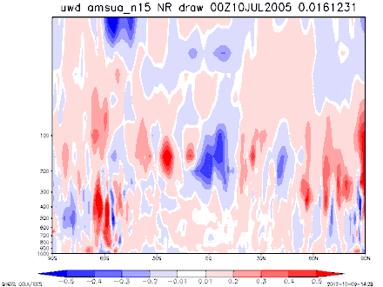
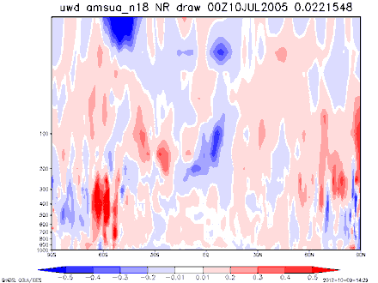
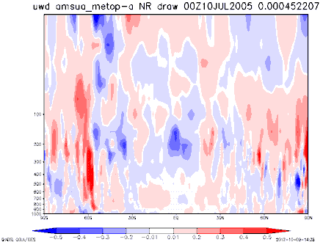
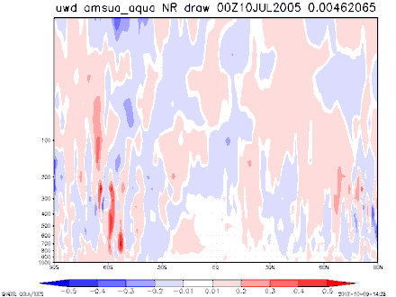
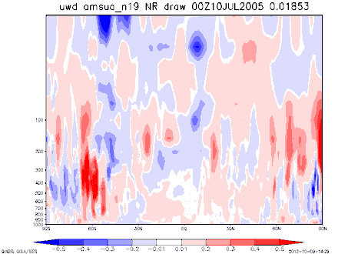
Check for accurate simulated values
Latitude by Height charts of Forecast Impact:
Blue = analysis worse than previous forecast
Red = analysis closer to nature run than previous forecast
NOAA-15
NOAA-18
METOP-A
AMSU-A
AQUA
NOAA-19

Slide 9
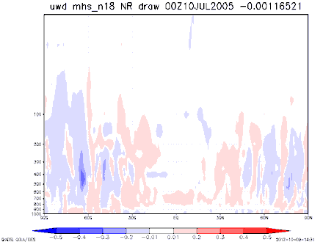
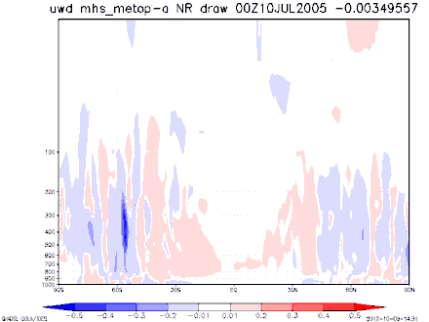
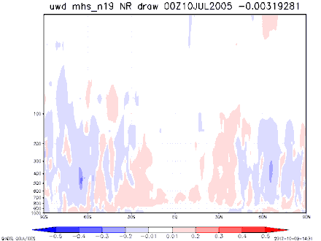
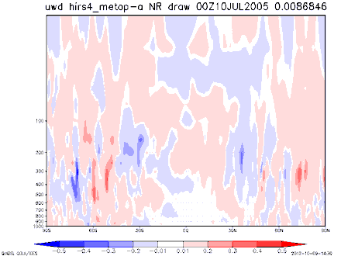
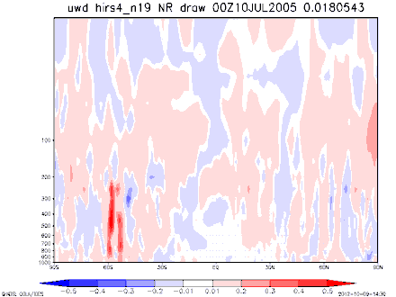
Check for accurate simulated values
Latitude by Height charts of Forecast Impact:
Blue = analysis worse than previous forecast
Red = analysis closer to nature run than previous forecast
MHS
NOAA-18
METOP-A
NOAA-19
HIRS-4
METOP-A
NOAA-19

Slide 10
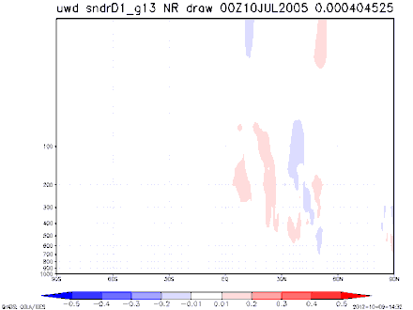
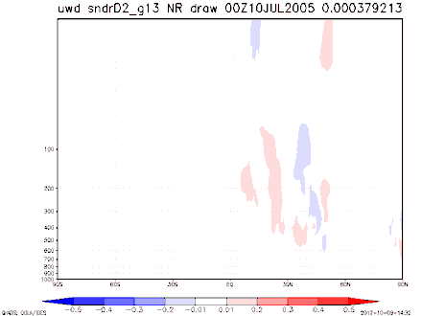
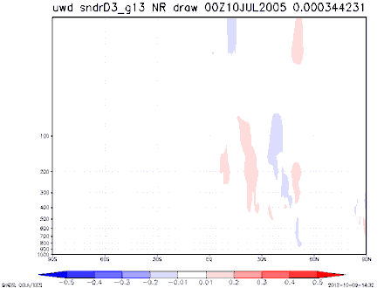

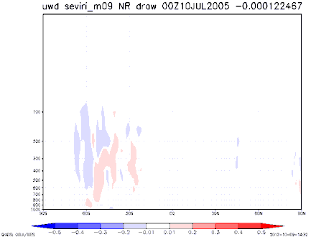
Check for accurate simulated values
Latitude by Height charts of Forecast Impact:
Blue = analysis worse than previous forecast
Red = analysis closer to nature run than previous forecast
SNDR-D1
SNDR-D2
SNDR-D3
GOES-13
(4 Sounders)
SNDR-D4
SEVIRI-M09

Slide 11
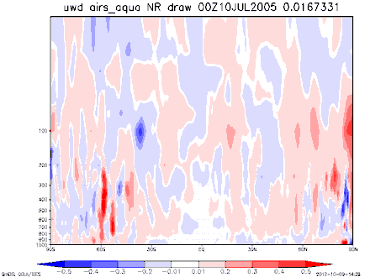
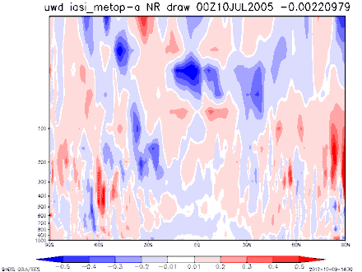
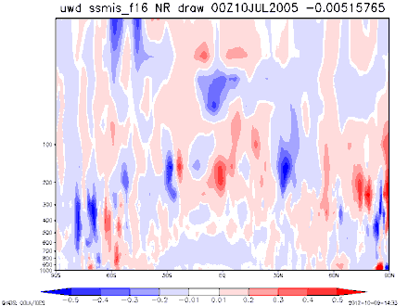
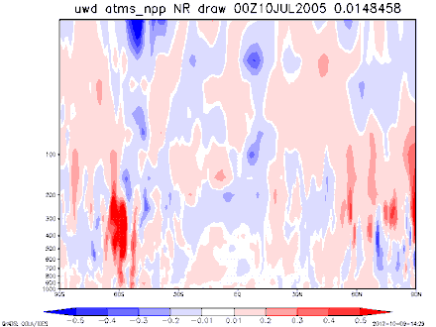
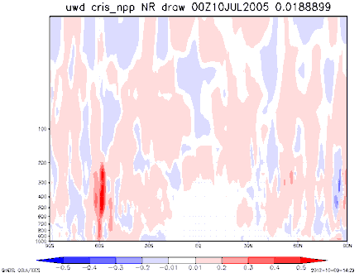
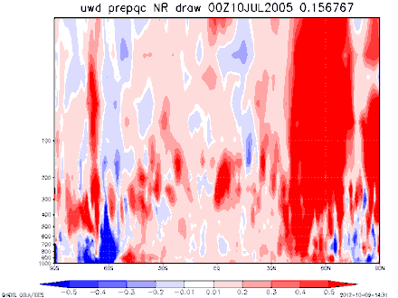
Check for accurate simulated values
Latitude by Height charts of Forecast Impact:
Blue = analysis worse than previous forecast
Red = analysis closer to nature run than previous forecast
AIRS-AQUA
IASI-METOP-A
SSMI/S-F16
ATMS-NPP
CRIS-NPP
All Other Obs.

Slide 12
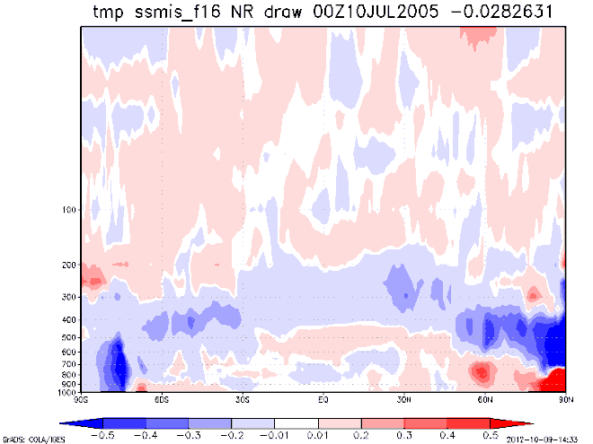
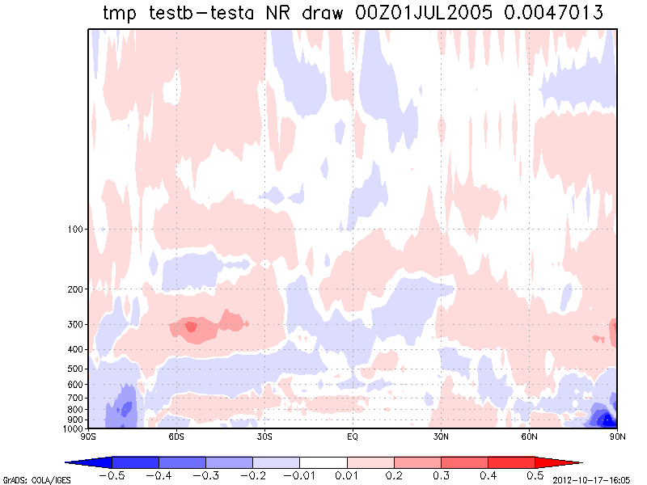

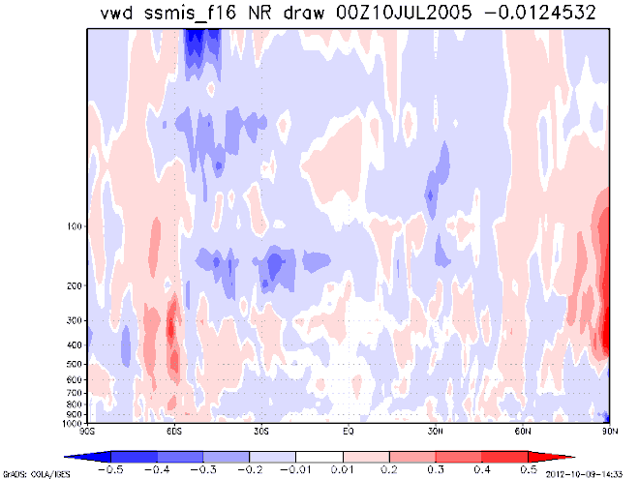
Issues with SSMI/S
Temperature
Negative impacts prominent in upper troposphere
Negative wind impacts less obvious, but still negative nonetheless
Concerns here due to importance of SSMI/S in experimental design
Initial runs suggesting removing “perfectly simulated” SSMI/S data has a positive impact on the model
Hot-Off-The-Press Data (14:10 MDT) suggests improvement in our simulated SSMI/S assimilation
Zonal Wind
Meridional Wind

Slide 13
Representativeness of Simulated Results
Using the same software that will be used to analyze our early-morning-orbit results (VSDB), we compared results for three experiments, one with real data and two with simulated data.
For all three experiments:
July 15 – August 31st 2005 (two-week spin-up)
2005 observing system (“Set A” in M. Masutani’s talk)
“Control” (black curve): no AIRS
“Experiment” (red curve): AIRS included
Differences between experiments:
Real: Real observations
Simper: Simulated observations, no error added
Simerr: Simulated observations, random error added

Slide 14
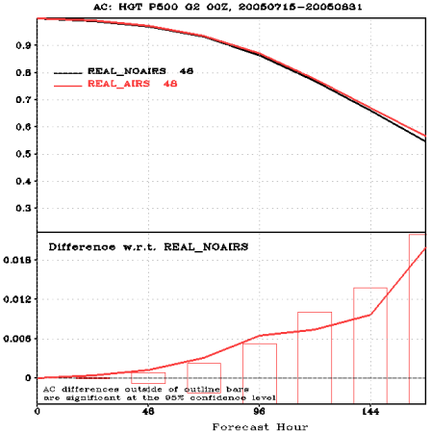
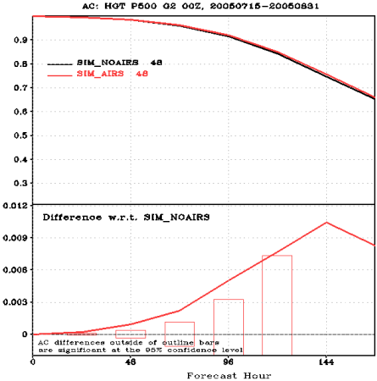
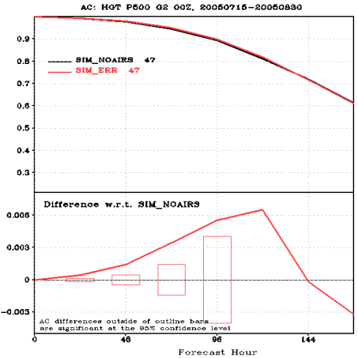
Representativeness of Simulated Results
Magnitude of differences between AIRS vs. NOAIRS changes among experiments; not enough to change results (positive vs. negative impact), but might effect significance of impact
Online archives of VSDB results:
Real: http://www.jcsda.noaa.gov/vsdb/users/scasey/realairs/vsdb.php
Simulated, no error: http://www.jcsda.noaa.gov/vsdb/users/scasey/simperairs/vsdb.php
Simulated, random error: http://www.jcsda.noaa.gov/vsdb/users/scasey/simerrairs/vsdb.php
Real:
Simper:
Simerr:

Slide 15
Summary
Current OSSE work aims to demonstrate the importance of a meteorological satellite in the early-morning orbit
Current simulated obs show largely positive impact on the forecast model; currently investigating potential issue with simulated SSMI/S
Important to point out that these simulations show a best-case (or worst-case) scenario; real observations may show a less-significant impact

