Slide 1
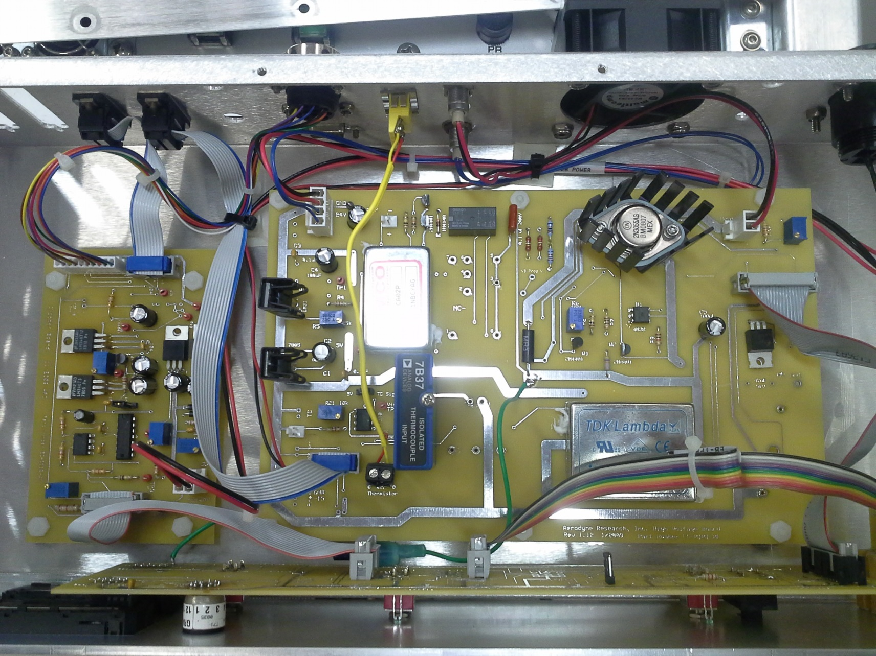
PNNL(Liz) HRToF Ebox
Heater board: Rev 1.12 1/2009
Chopper Board: Rev N/A; 11/2008
Front Panel Board: Rev 1.13, 1/2009

Slide 2
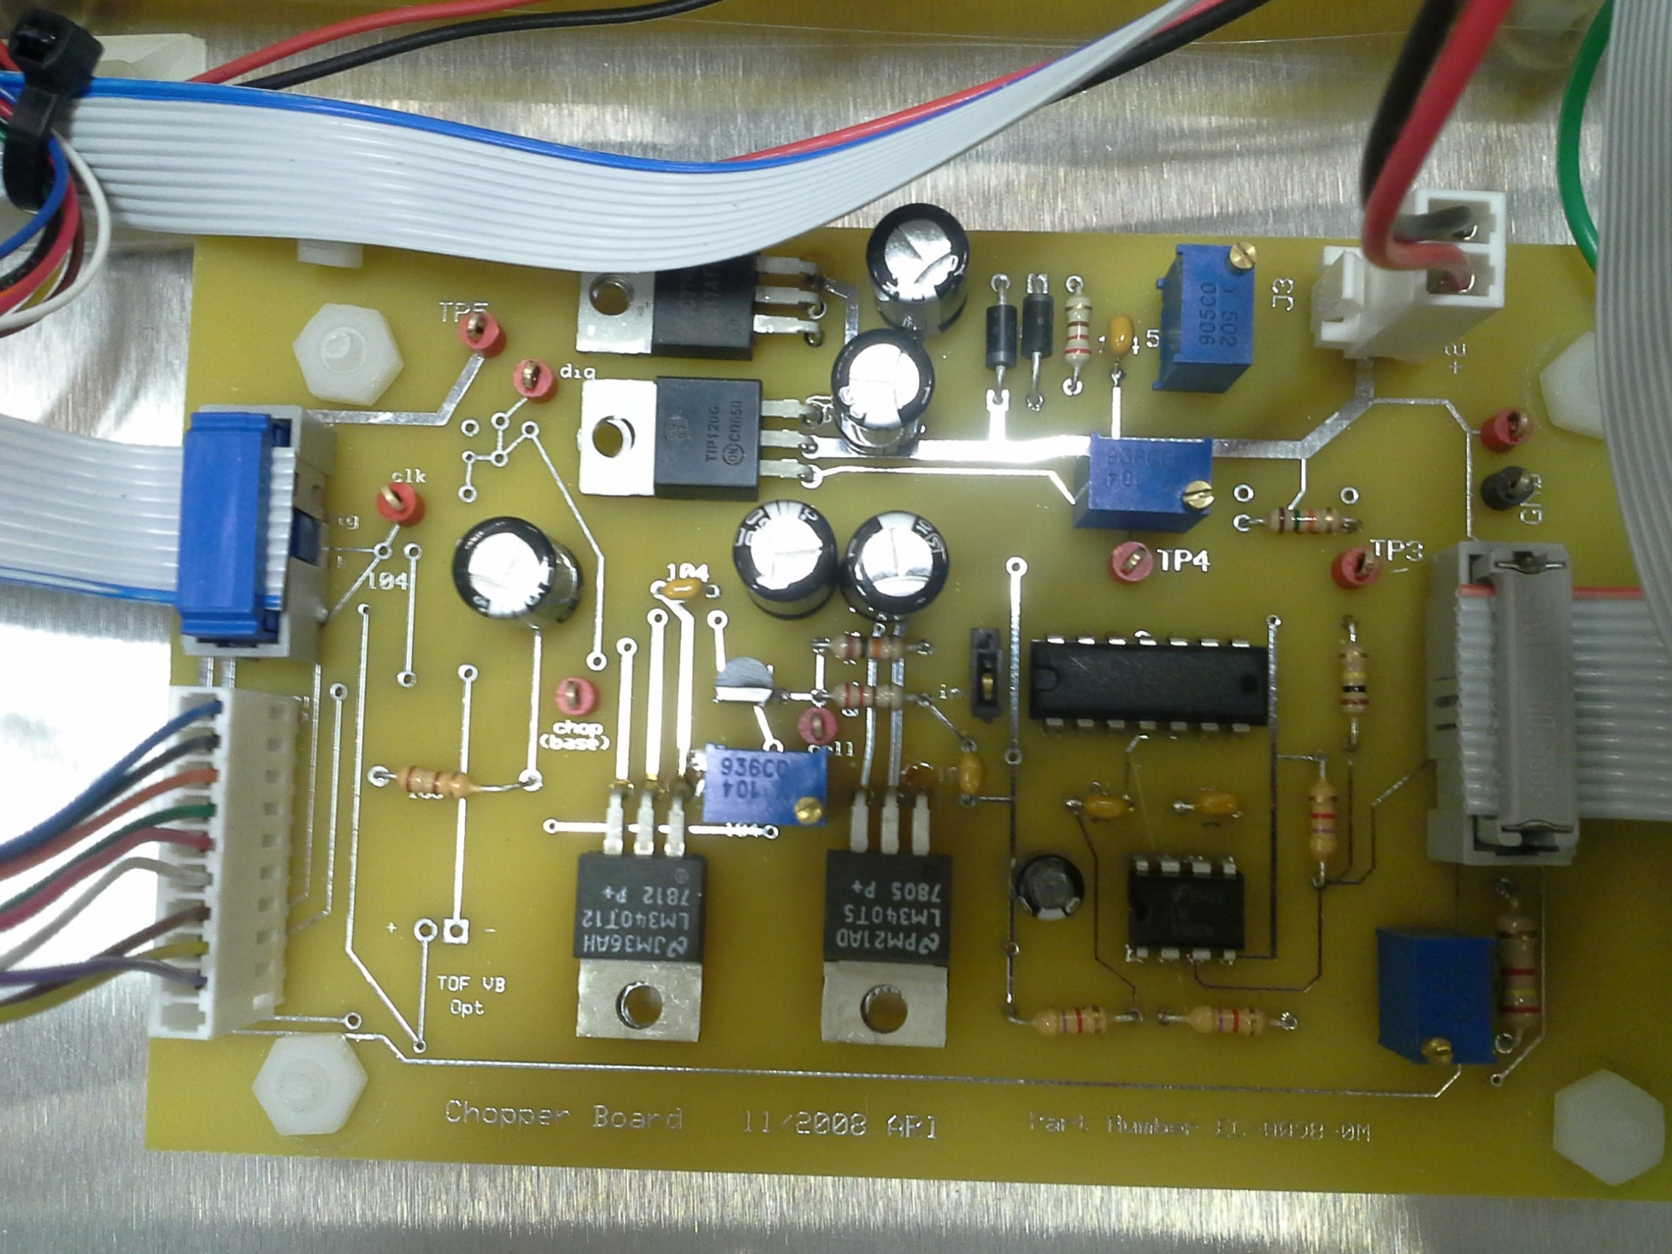

Slide 3
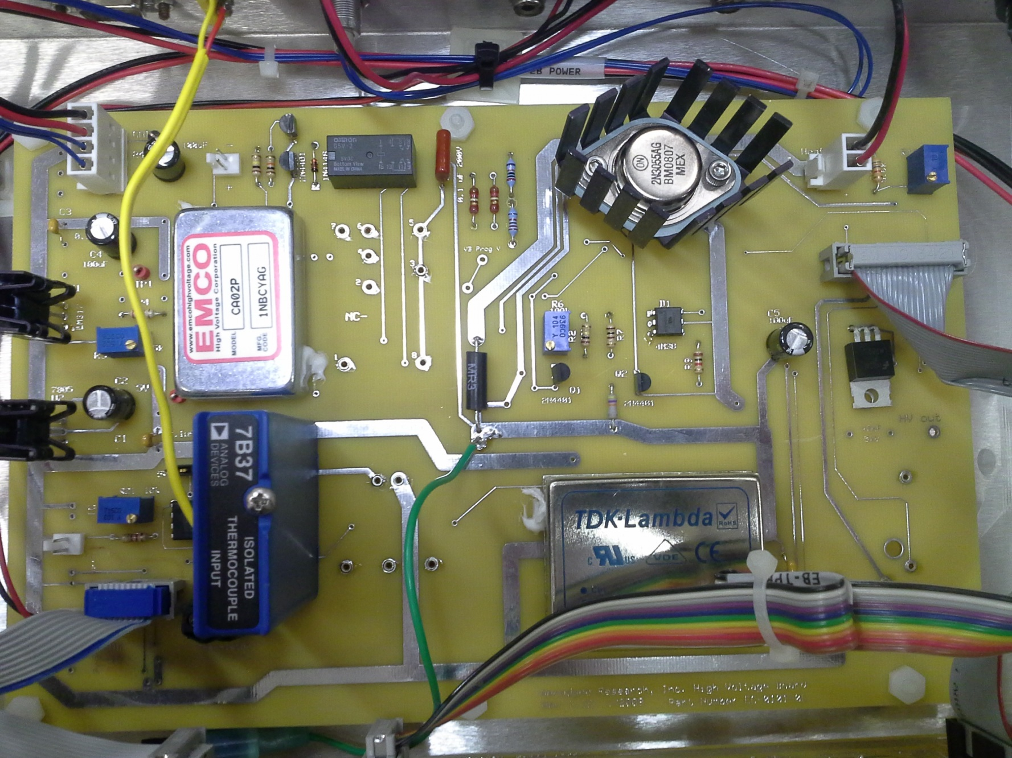

Slide 4
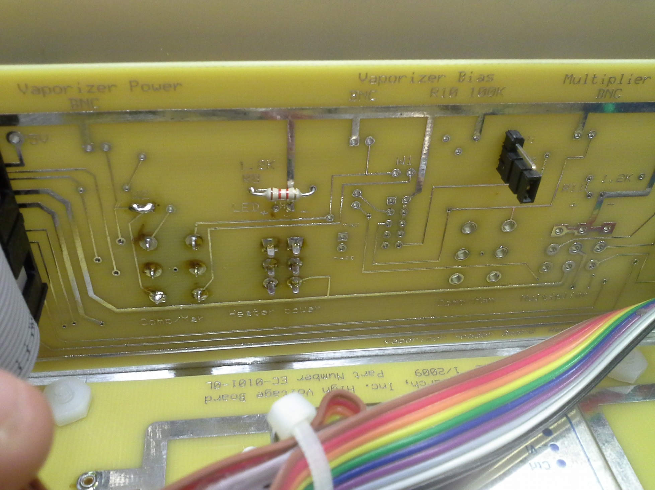

Slide 5
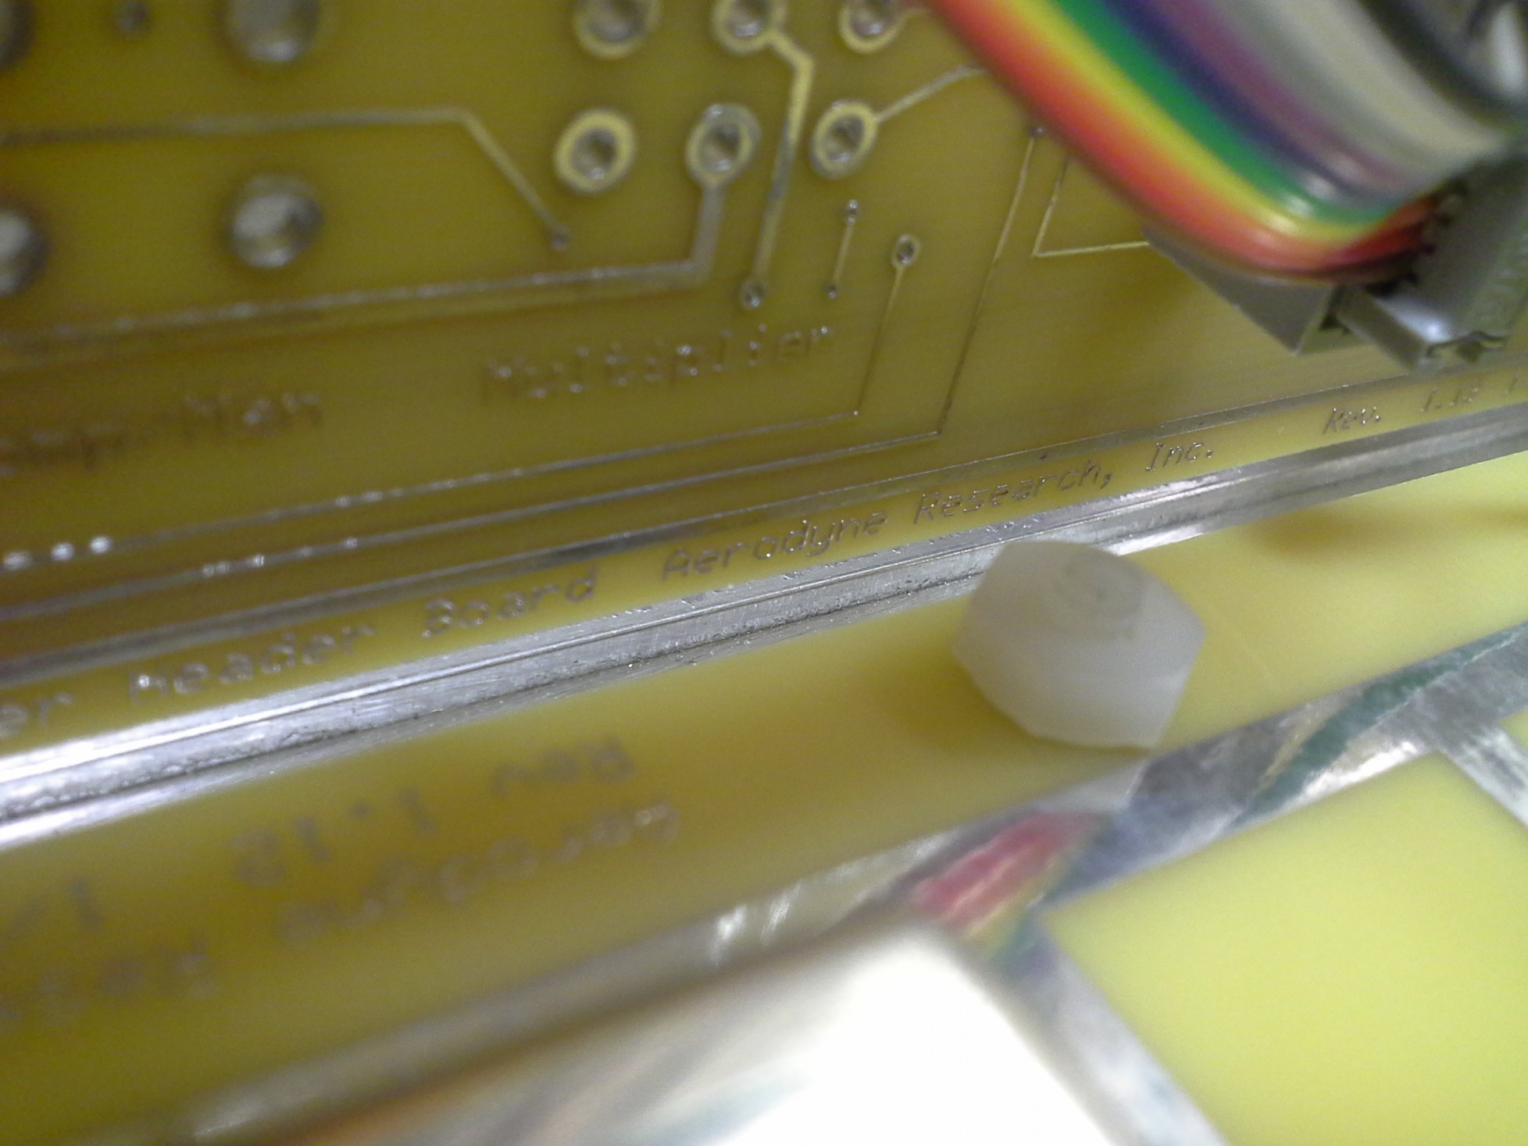

Slide 6
