Slide 1





Identifying Loci for Ocean Forecast Model Error from
Ensembles of Surface Winds based on QuikSCAT and COAMPS
Polly Smith¹, Ralph F. Milliff^{2,3}, Andrew M. Moore¹ and Christopher A. Edwards¹
¹ Ocean Sciences Department, University of California, Santa Cruz
² CoRA Division, NorthWest Research Associates, Boulder, CO
³ Cooperative Institute for Research in Environmental Sciences, University of Colorado, Boulder, CO
Milliff, R.F., A. Bonazzi, C.K. Wikle, N. Pinardi and L.M. Berliner, 2011: Ocean Ensemble Forecasting, Part I: Ensemble
Mediterranean Winds from a Bayesian Hierarchical Model., Quarterly Journal of the Royal Meteorological Society,
137, Part B, 858-878, doi: 10.1002/qj.767.
Moore, A.M., H.G. Arango, G. Broquet, B.S. Powell, J. Zavala-Garay and A.T. Weaver, 2011:
The Regional Ocean Modeling System (ROMS) 4-dimensional variational data assimilation systems. Part I:
System overview and formulation. Progress in Oceanography, 91, 34-49.
Moore, A.M., H.G. Arango, G. Broquet, C. Edwards, M. Veneziani, B. Powell. D. Foley, J. Doyle, D. Costa and P. Robinson, 2011:
The Regional Ocean Modeling System (ROMS) 4-dimensional variational data assimilation systems. Part II:
Performance and application to the California Current System. Progress in Oceanography, 91, 50-73.
Moore, A.M., H.G. Arango, G. Broquet, C. Edwards, M. Veneziani, B. Powell. D. Foley, J. Doyle, D. Costa and P. Robinson, 2011:
The Regional Ocean Modeling System (ROMS) 4-dimensional variational data assimilation systems. Part III:
Observation impact and observation sensitivity in the California Current System. Progress Oceanography, 91, 74-94.
Notes:
So I am going to report on a project wherein scatterometer wind precision, and precise specification of scatterometer wind error properties have been used to isolate times and locations where ocean forecast model error is occurring. This matters because forecast model error is very difficult to identify and track. It is worth identification and tracking because, 1) model error corrupts the forecast; and 2) model error estimates are important but unknown contributors to reanalysis products that are a non-trivial potential eventual outcome of skillful forecast systems.
My collaborators are ocean forecast model experts; they are guided by Prof Andy Moore in the Ocean Sciences Dept at UCSC. Some relavant, and at least in the case of the latter 3, rather good papers are listed here. We all thank the agencies and institutions in whose names we work.

Slide 2
Ocean Data Assimilation (DA); Four-Dimensional Variational (4DVar) Method (in words):
Notes:
The ocean vector winds utility in cracking the model error identification and quantification problem is cast here in terms of a four-dimensional variational data assimilation system (4DVar). In any DA system, the object is to correct a forecast model trajectory in terms of a set of observations that occur in a time interval of interest. The forecast without observational influence is referred to here as a prior. It is often called a first-guess field. The model trajectory corrected by observations over the interval is called the posterior. It is often called the analysis or even reanalysis in specially constrained instances.
In 4DVar, corrections due to observations are implemented iteratively in cycles through tangent linear forward approximations and reversed-in-time adjoint approximations that modify a control vector of inputs, including surface forcing, such that the next forward model step adjusts the trajectory toward an optimal blend of observation and model. The optimality is measured by the minimization of a cost function.
This makes sense if you have heard it before, and it is written on this slide for later reference if you have not.
The points to carry forward are first, the surface wind stress is a control variable in the 4DVAR that can be incremented to improve the analysis. Second, because model error is not accounted for explicitly (i.e. in a strong constraint 4DVar), the corrections to the control variable can become unrealistic eventhough they are leading to a better minimization of the cost function. When and where this is happens, we have discovered a candidate time and location for identifying model error.
Finally, we will judge whether or not the surface wind stress control variable has been incorrectly adjusted to cover for model error by comparing the control vector prior and posterior against an ensemble of winds obtained from a Bayesian Hierarchical Model (BHM) of a kind I have presented to this audience before, and is described for a Mediterranean application in the first paper listed on the cover slide.

Slide 3
Hypothesis:
In a strong constraint 4DVar, places where the wind stress control vector
iterations are driven outside a BHM wind ensemble are candidate loci for
model error.
prior
increment control vector
ITERATE
minimize cost function
posterior
Schematic:
posterior “inside”
posterior “outside”
model error ???
BHM
ensemble
BHM
ensemble
Notes:
So our hypothesis is restated here. The iterative loop between control vector increment, tangent linear forward model and cost function minimization is shown here. Perhaps most usefully, a schematic to demonstrate our idea is depicted at the bottom of the slide. An hypothetical distribution for the ensemble winds from the BHM at a given point and time is shown in red. The latest increment in the implied wind from the 4DVar is shown as a black dot. In instances when the 4DVar has incremented the surface wind stress control vector within some probability bounds defined by the distribution (i.e. the situation at left), we have nothing to say. However, in instances when the increment is forced outside the probability bounds (i.e. the situation at right), we suspect model error.

Slide 4
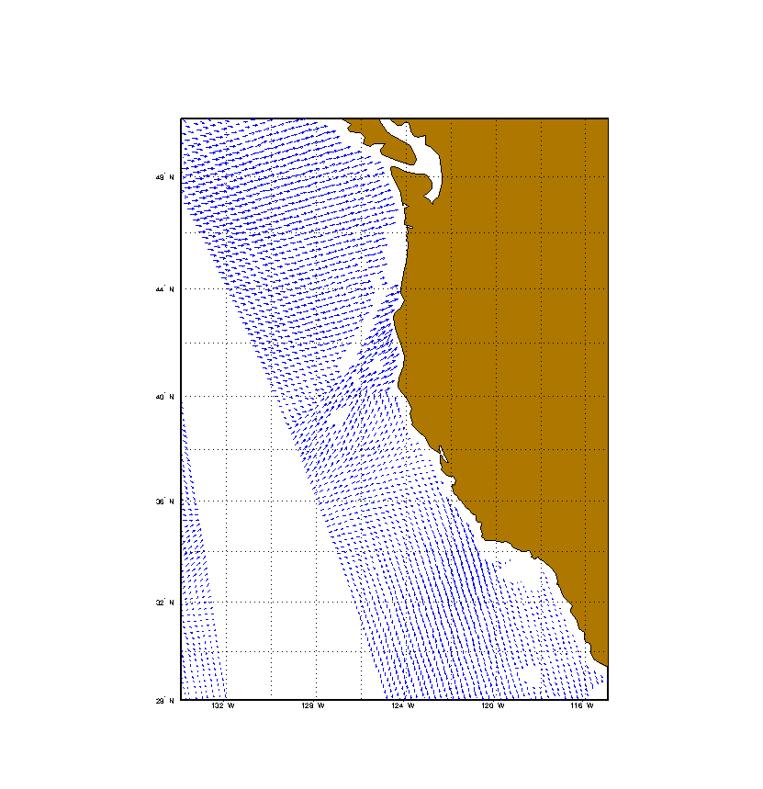
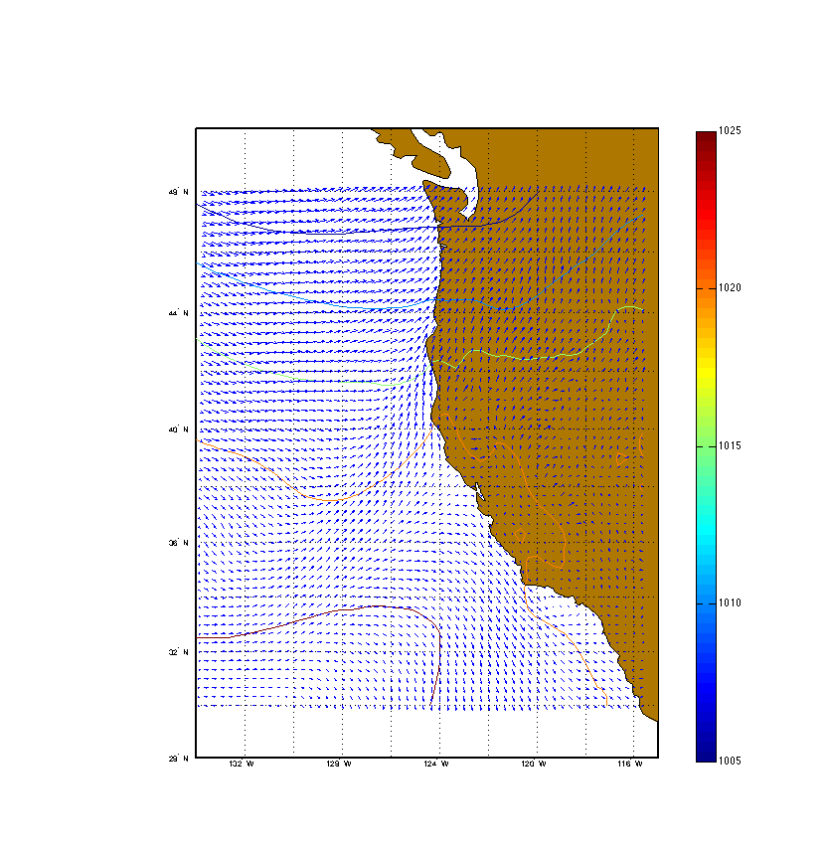
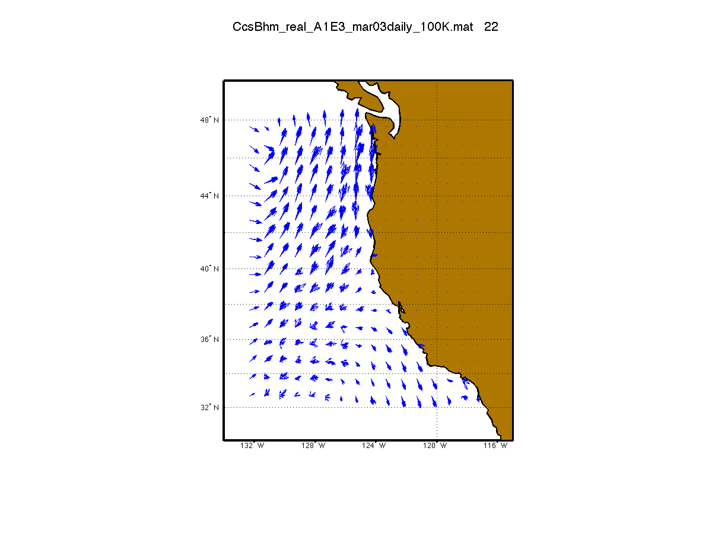
Ensemble Winds from a Bayesian Hierarchical Model (BHM)
[X,θ_{p},θ_{d}|D] ∝ [ D|X,θ_{d} ] [X|θ_{p}] [θ_{p}] [θ_{d}]
posterior likelihood prior parameters
Sample QSCAT
Sample COAMPS
Rayleigh Friction Equations
BHM Posterior Distribution (10 realizations)
EOF expansion SLP anomaly
Geostrophic-ageostrophic approximation
Stochastic Model
Random variables, uncertainty model
every third grid point
22 Mar 2003 1500 UTC
22 Mar 2003 1500 UTC
Data Stage
(likelihood)
Process Model Stage
(prior)
Posterior
Notes:
Before I demonstrate some pilot results, let me remind you of the inputs and outputs of the SVW BHM that is our metric tool for identifying model error. Bayes Theorem is written here for a process X and parameters \theta_d and \theta_p given data D. We partition the righthand side of Bayes Theorem into a data stage (or likelihood) part, a process model (or prior) part, and the convolution of these parts and a number of parameters leads to the posterior distribution of surface winds depicted here at every third point of the output grid. Scatterometer winds enter as part of the data stage, and their error properties are key parts of the convolution of prior and likelihood. This is all described in the first paper that was listed on the cover slide.

Slide 5
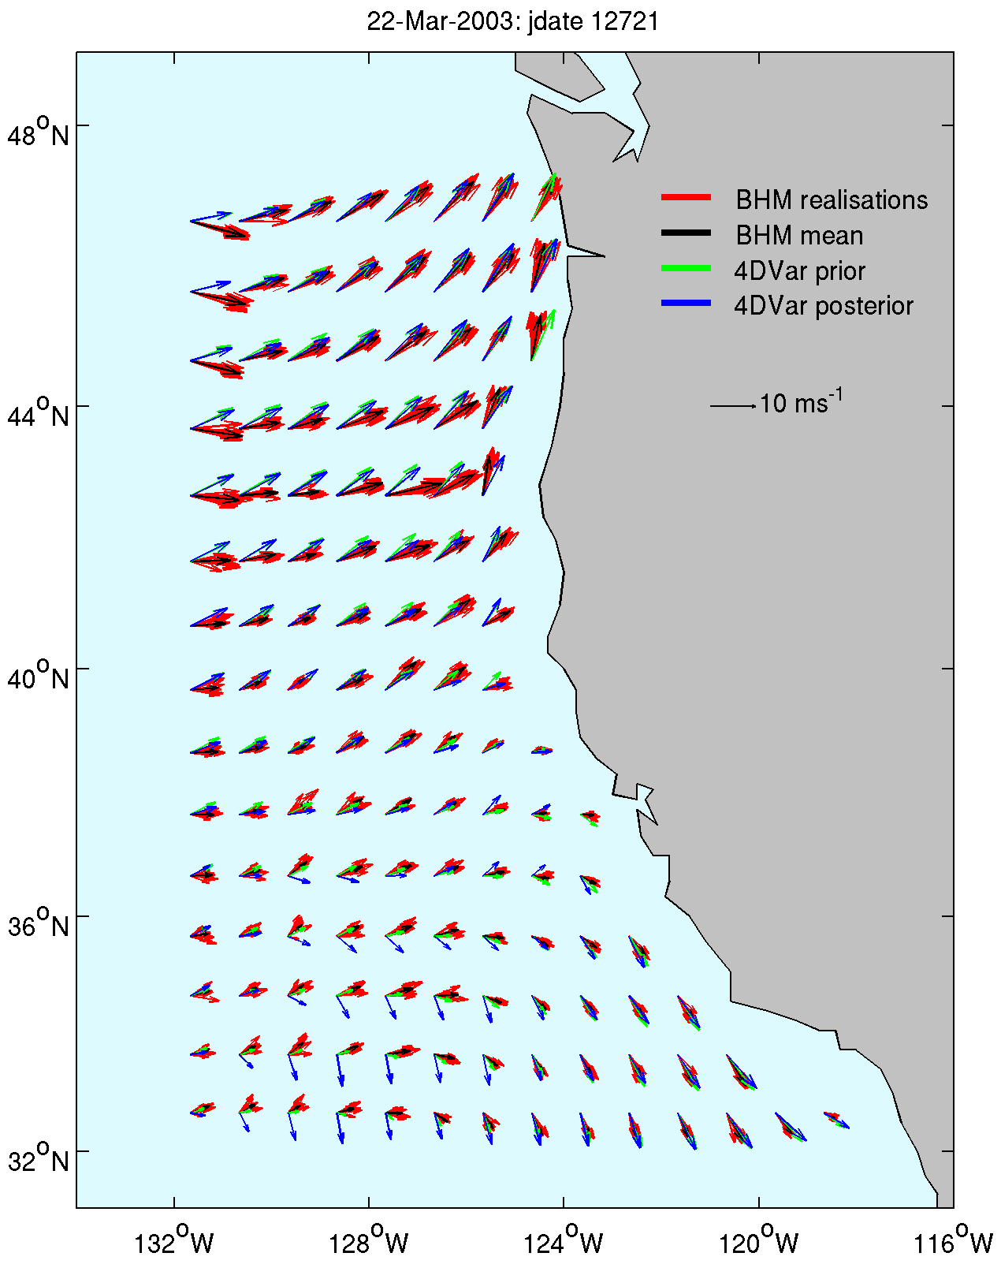
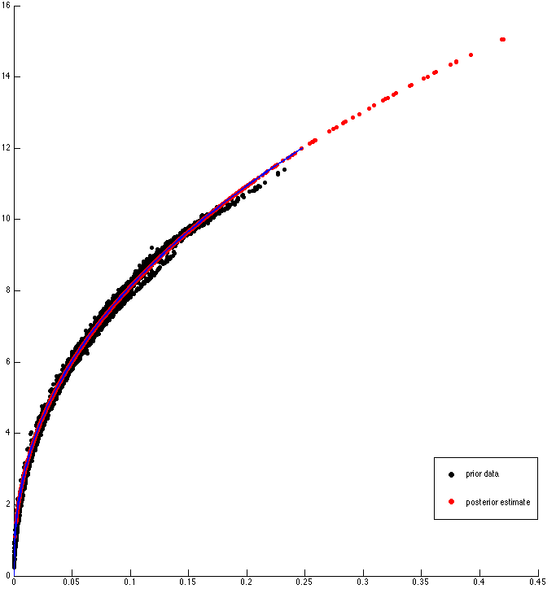
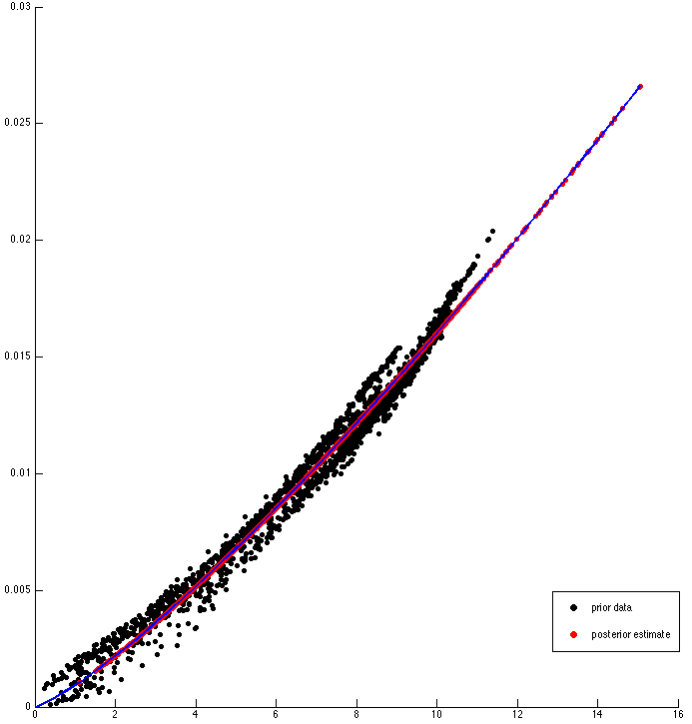
Comparing 4dVar Increments with BHM
Estimate u,v from τ every day
find |u| as function of τ
find c_{D}|u|ρ_{a} as function of |u|
estimate u,v from posterior τ_{x,y} / c_{D}|u|ρ_{a}
every third grid location
wind speed Iu| (ms⁻²)
wind stress τ (Nm⁻²)
conversion factor c_{D}|u|ρ_{a}
wind speed Iu| (ms⁻²)
Notes:
One more thing before we get to the demonstration, I have been flipping back and forth between a wind stress control vector quantity in the 4DVar and ensemble winds in the BHM. In the next implementation of this procedure, we will adapt the surface wind BHM to provide surface wind stress summaries with appropriate uncertainties (i.e. ensembles). In the implementation shown here, we employ a 3-step process to regress wind against wind stress at every point in the domain, every day of the forecast. The regression steps are listed here and their implementations are shown in the two scatter plots.
The map at right is a depiction, again, of every third output grid location, showing a snapshot of the BHM wind ensembles (red), the initial value of the control vector (green, unfortunately also called “prior” here), and the final value of the surface wind implied by the control vector (blue; again unfortunately referred to here as “posterior”).
According to our hypothesis, when the blue vector is very different from the ensemble of red vectors, we should pay attention.

Slide 6
Comparing 4dVar Increments with BHM
Estimate u,v from τ every day
find |u| as function of τ
find c_{D}|u|ρ_{a} as function of |u|
estimate u,v from posterior τ_{x,y} / c_{D}|u|ρ_{a}
every third grid location
wind speed Iu| (ms⁻²)
4dVar prior and posterior outside BHM ensemble. Scatterometer correction to
COAMPS?
wind stress τ (Nm⁻²)
conversion factor c_{D}|u|ρ_{a}
large discrepancies, 4dVar
posterior vs. BHM ensemble;
possible Model Error
wind speed Iu| (ms⁻²)
Notes:
But there are at least two reasons why blue might depart from the red ensemble, and only one of them is consistent with our hypothesis for model error identification. The points circled here are cases when both the blue and green vectors lie outside the BHM ensemble. The initial value and the final value of the control vector are both outside the Bayesian ensemble. These are instances when the scatterometer component of the data stage distribution is correcting the intial value for the control vector which comes only from COAMPS. This is more likely a forcing error and not model error.
However, the region circled in the south is different. Here the initial value for the control vector lies within the BHM ensemble and the final value; i.e. after many iterations through the 4DVar, is very different from the BHM.
This is a candidate region for model error.

Slide 7
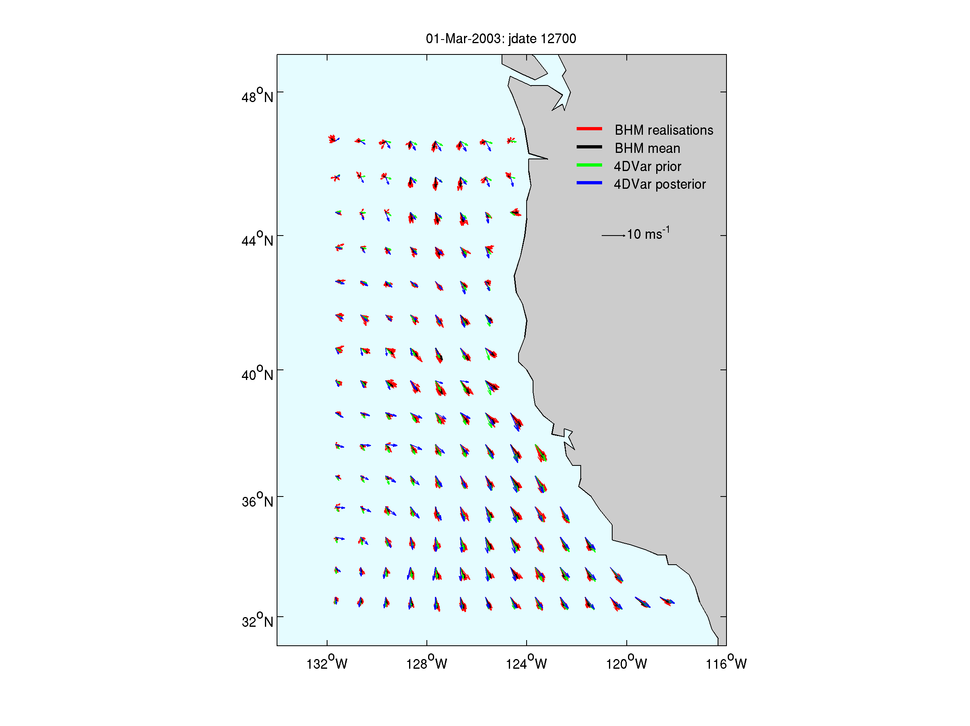

Model Error as a dynamical
function of space, time
Notes:
Importantly, model error is dynamic. Each forecast-analysis step is updated with new control vector information and new observations entering the 4DVar. This is an animation of our model error metric for the month of March, 2003.
This demonstrates what is at least a prototype for the evolution of model error. It is a useful step forward in DA research to have estimates of this space-time process, based on straightforward physical reasoning and independent data;
i.e. the scatterometer winds.

Slide 8
Summary
Ocean forecast model error estimates are important for assessing forecast accuracies
and improving model and observation array designs (strong vs. weak constraint in 4dVar).
Model error is hard to identify.
Precisely specified error properties (uncertainty) in QuikSCAT winds have been used
to help identify regions of probable model error in a state-of-the-art ocean forecast
system.
The probability distributions from a surface wind BHM (based on QuikSCAT and COAMPS)
have quantitative value (see also Pinardi et al., 2011).
Work in Progress
Wind stress distributions can be summarized directly from surface wind BHM posterior
Other forcing control variable fluxes require BHMs as well (e.g. heat, fresh water)
Model error dynamics can be modeled given data stages of the kinds suggested here.
Notes:
So the summary is the summary as written here. What is also interesting to me (and, perhaps a few others) is the prospect for using space and time dependent model error estimates of the kind just demonstrated to develop models, Bayesian models if you are me, for model error dynamics themselves. As noted earlier, these models will feed back to improve the forecasts, improve the forecast models and observation plans, and eventually, to improve reanalyses.

Slide 9
EXTRAS

Slide 10
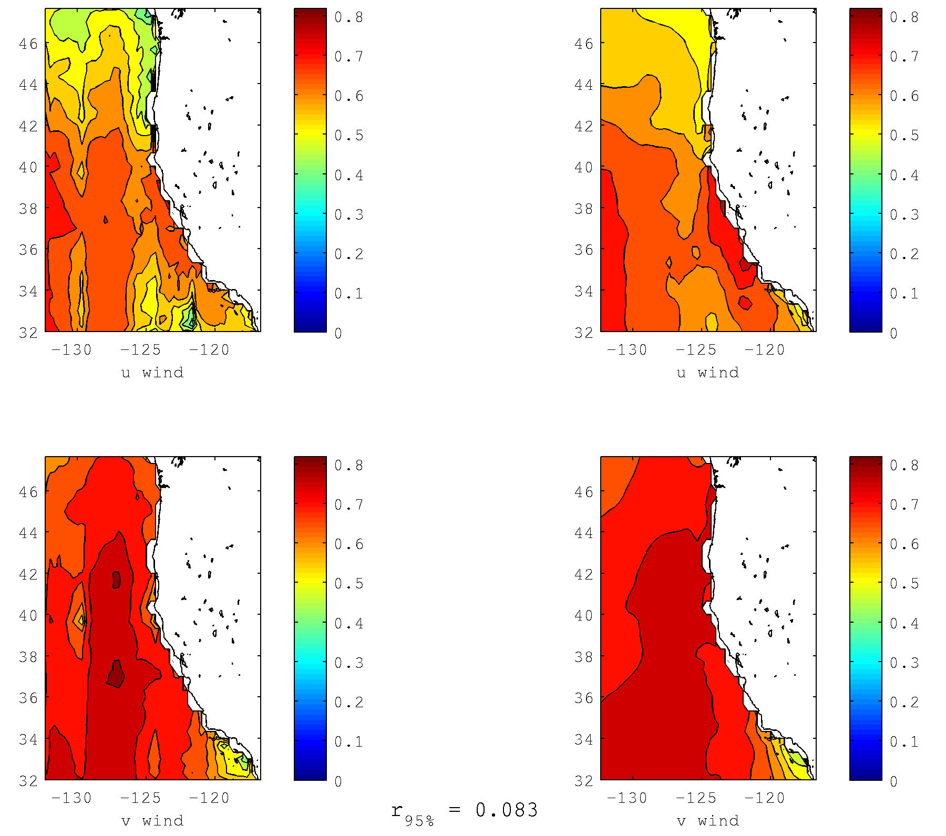
Temporal Autocorrelation Comparison: BHM vs. COAMPS (all of 2003)
AR-1 model for temporal autocorrelation:
BHM
COAMPS
u wind
v wind

