Slide 1
Multi-Platform Analyses of MJO Convection on Sub-Daily Timescales
Jeremiah Brown and Ralph F. Milliff
NWRA, Colorado Research Associates (CoRA) Division
Boulder, CO USA
IOVWST Barcelona, May 2010

Slide 2
Multi-Platform Analyses of MJO Convection on Sub-Daily Timescales
Jeremiah Brown and Ralph F. Milliff
NWRA, Colorado Research Associates (CoRA) Division
Boulder, CO USA
Tropics as a source region for important weather and climate events
(e.g. moisture supply to mid-latitudes, easterly waves, monsoons, TC’s , MJO, ENSO)
Shorter timescales, unique phenomena associated with tropical deep convection
(organization; e.g. mesoscale convective systems or MCS, tropical waves)
Human impacts (e.g. agriculture, fisheries, fresh water supply, drought, flood, fire,…)
IOVWST Barcelona, May 2010

Slide 3
Multi-Platform Analyses of MJO Convection on Sub-Daily Timescales
Jeremiah Brown and Ralph F. Milliff
NWRA, Colorado Research Associates (CoRA) Division
Boulder, CO USA
Tropics as a source region for important weather and climate events
(e.g. moisture supply to mid-latitudes, easterly waves, monsoons, TC’s , MJO, ENSO)
Shorter timescales, unique phenomena associated with tropical deep convection
(organization; e.g. mesoscale convective systems or MCS, tropical waves)
Human impacts (e.g. agriculture, fisheries, fresh water supply, drought, flood, fire,…)
Madden-Julian Oscillation (MJO) as a marker for observation and model capabilities for
tropical processes (slow eastward propagation, large scale, unknown initiation and
propagation mechanisms)
What are the limits imposed by temporal sampling inherent in multiple polar-orbiting
satellite systems?
IOVWST Barcelona, May 2010

Slide 4
Datasets from Multi-Sensor Satellite Observations
Convective Cloud Signatures
Outgoing Longwave Radiation (OLR) Estimates from
Clouds and Earth’s Radiant Energy System (CERES) on
Terra (1030) and Aqua (1330)
daily average, 2.5 degree
Synoptic scale synthesis OLR product (SYN) from NASA Langley (LaRC)
Combines GOES and CERES observations
3-hourly, 1 degree
Zonal Wind and Surface Convergence
Blended QuikSCAT and NCEP Reanalysis (BLN) surface vector winds (SVW) from
Milliff et al., (2004); Chin et al., (1998) (old Level 3 product)
6-hourly (really 12), 0.5 degree
ASCAT L2 NRT retrievals from OSI SAF via JPL PODAAC
12-hourly, 12.5km (really 25)
Wielicki, B. A., B. R. Barkstrom, E. F. Harrison, R. B. Lee III, G. L. Smith, and J. E. Cooper, "Clouds and the Earth's Radiant Energy System (CERES): An Earth Observing System Experiment," Bull. Amer. Meteor. Soc., 77, 853-868, 1996.

Slide 5
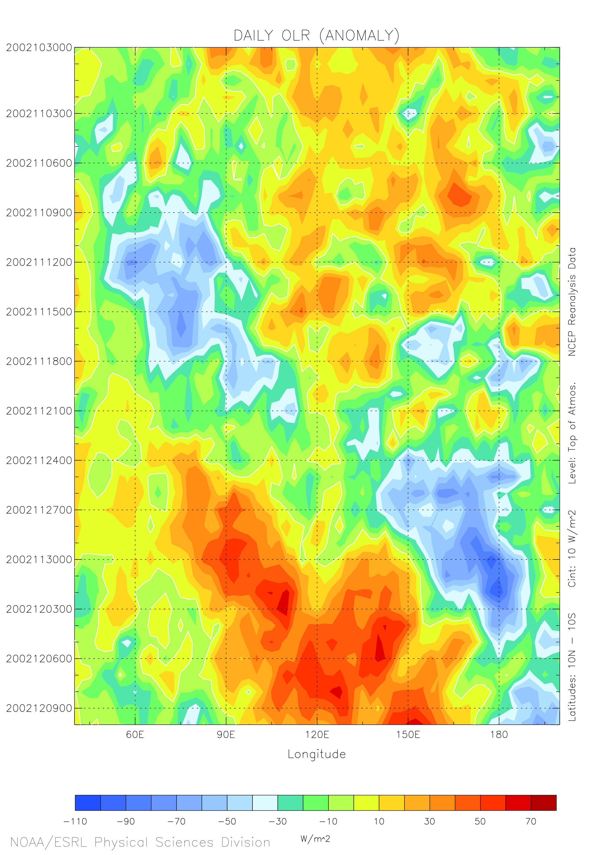
MJO Signal in OLR Anomaly Time vs. Longitude Diagram
Indian Ocean
Western Pacific Ocean
November 2002

Slide 6
MJO in Plan View: 3-hourly OLR anomaly from SYN (top) and running 24hr mean (bottom)
November 2002
MCS organization and variability embedded within MJO cloud shield
smaller, faster, westward difference signals at leading edges, throughout MJO supercluster
active synoptic background affects and is affected by MJO

Slide 7
Recent Conceptual Models of the MJO: Upscale transfers
Convective cloud source

Slide 8
Recent Conceptual Models of the MJO: Upscale transfers
Momentum source

Slide 9
MJO in Plan View: 12-hourly zonal wind (top) and divergence (bottom) from QuikSCAT L3
November 2002
Anomalous easterlies (red) propagate slowly eastward
Divergence extrema associated with leading edge of MJO propagation
zonal wind and divergence associated with background state as well

Slide 10
MJO in Plan View: 3-hourly OLR (SYN; top) and 12-hourly DIV (QuikSCAT L3; bottom)
November 2002
Divergence extrema associated with MCS, embedded within MJO

Slide 11
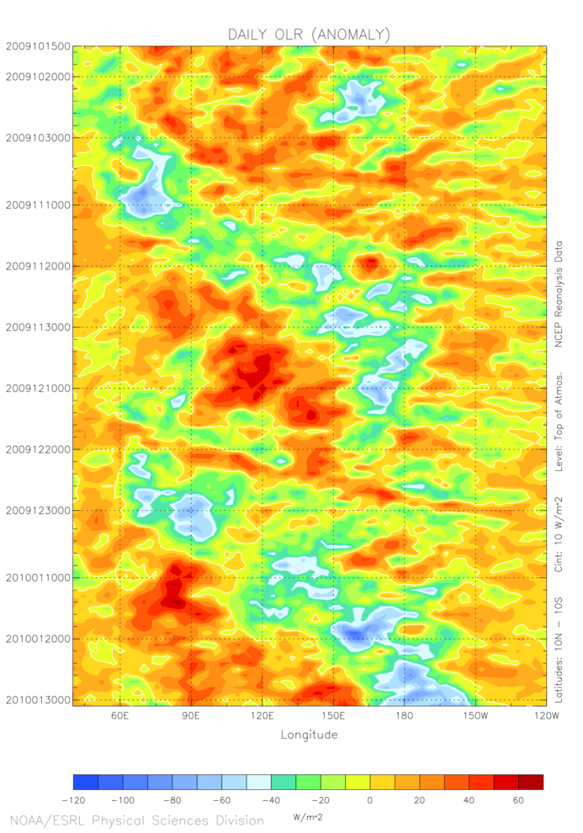
MJO Signal in OLR Anomaly Time vs. Longitude Diagram
Indian Ocean
Western Pacific Ocean
October 2009
November 2009
December 2009
January 2010

Slide 12
MJO in Plan View: 2x-daily zonal wind from ASCAT (L2)
Need L3 products, sufficiently accurate to yield reliable divergence, vorticity fields (CCMP?)

Slide 13
Tropical events have important weather and climate-scale implications
multiple, nested temporal and spatial scales
deep convective plume to MJO, monsoon, ENSO, etc.
MCS building blocks resolvable, organization processes not well understood
challenge to space-borne observing systems
Require simultaneous, O(hourly), high-resolution observations of critical quantities
multi-scale convective cloud systems and momentum (as shown)
moisture (humidity, precip), temperature
coarse resolution vertical structure (i.e. 2-layer)
Bayesian Hierarchical Model (BHM) approach to MJO propagation mechanism in the
tropical Indo-Pacific
data stage inputs from multi-platform satellite observations
new process models (upscale transfers)
Summary:

Slide 14
Supplementary Slides

Slide 15
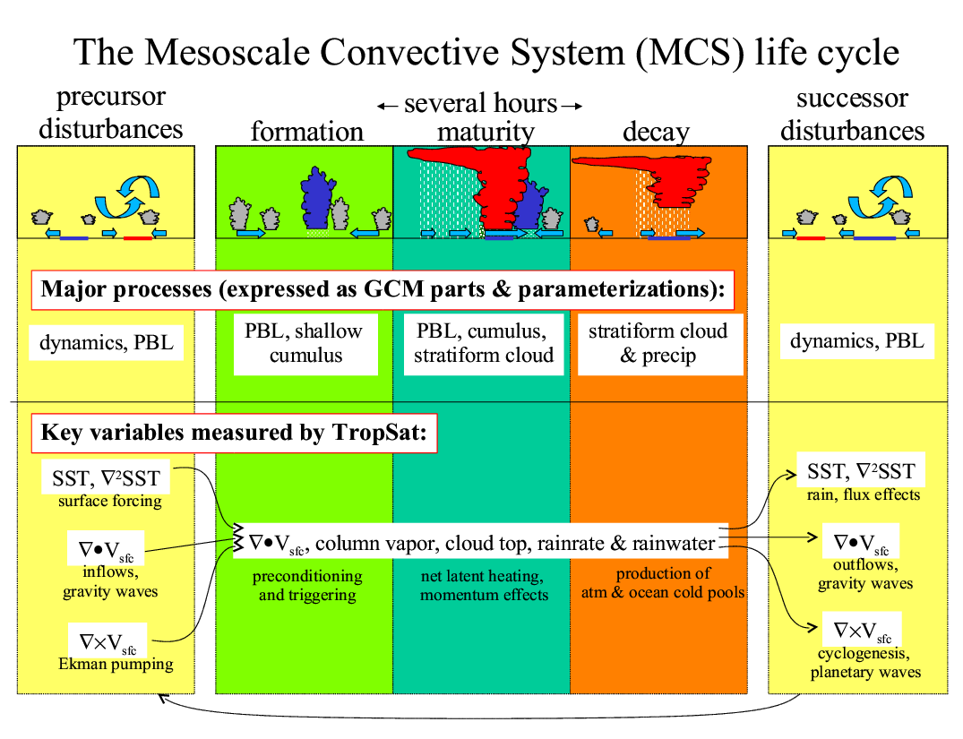

Slide 16
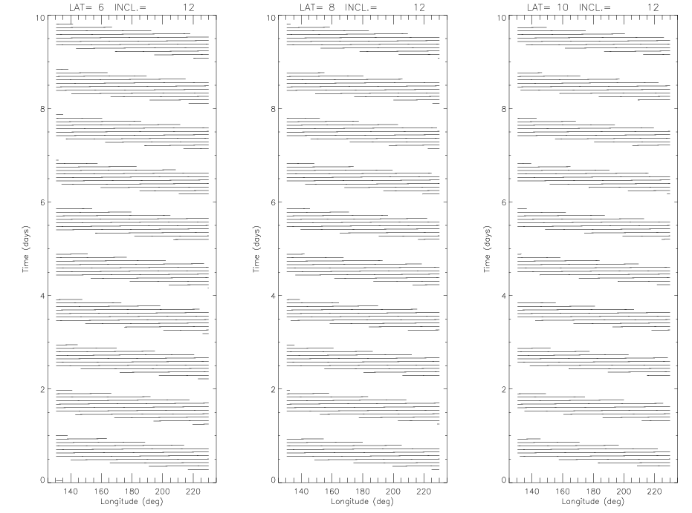
TROPSAT Concept: seeking community interest/input
active/passive microwave instrument
low-inclination orbit
wide swath, MCS resolution
SVW (convergence, curl)
SST, T(z)
Total column H₂O, rain
cloud
Image courtesy S. Nesbitt via B. Mapes 2004

