Slide 1






Earth System Prediction Capability (ESPC)
Presentation to AMS Board on Enterprise Communications
September 2012

Slide 2
ESPC Overview
Introduction
  ESPC is an interagency collaboration between DoD (Navy, Air Force), NOAA, DoE, NASA, and NSF for coordination of research to operations for an earth system analysis and extended range prediction capability.
  It does not replace or take precedence over Agency requirements or resource decisions but rather seeks to improve communication and synergy, especially in the area of global medium range environmental forecasting at the challenging timescales of the weather to climate interface.
Thrusts
  Common prediction requirements and forecast model standards that enable agencies to improve leverage and collaboration.
  A national research agenda that will improve predictions from days to decades.
  Cooperative five-year demonstration projects to inform S&T and R&D efforts.
  Integration of atmosphere-ocean-land-ice and space predictions into a fully coupled global prediction capability.

Slide 3
Charter
Goals (2010)
… establish and maintain a multi-agency initiative that provides leadership and coordination to meet broad, but specific, agency mission requirements and interests for an earth system analysis and prediction/projection framework to support global forecasts from hours to decades at appropriate horizontal and vertical resolutions.
1. A national approach to an earth system numerical prediction capability providing advanced data assimilation, improved numerical model physics and increased computational efficiencies;
2. A common set of requirements and standards that enable agencies to meet their own mission requirements while providing improved leverage and collaboration where these missions can be mutually supportive;
3. A mechanism to develop a national research agenda that will improve earth system projections and predictions from days to decades; and
4. A cooperative set of demonstrations to inform future research and development efforts encompassing Federal, private and academic organizations.
3

Slide 4
Charter Additions(2012)
… a Science Steering Group will be established composed of subject matter experts representing the Department of Commerce (NOAA), the Department of Defense (Navy and Air Force), Department of Energy, the National Aeronautics and Space Administration and the National Science Foundation as recommended by each Agency’s members.
The Program Manager will initially be a Federal employee hired and employed by the US Navy or NOAA. The position rotates every three years with the Deputy Program Manager position. The ESPC Program Office is located within NOAA in Silver Spring, MD and Program Office office space, support staff, internet/ IT services and other administrative functions will be provided by NOAA.
4

Slide 5
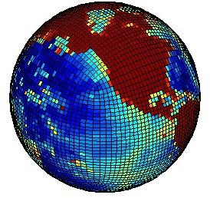
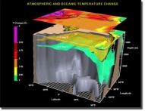
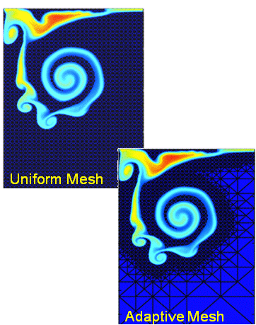
Approach
Seek Sources of Predictability through:
Improved Model Physics
  Coupled global modeling
  Improved resolution & parameterization
Improve Initial Value Problem through
  Joint observational retrievals
  New hybrid DA approaches
Increase Forecast Information through
  Stochastic prediction and post-model processing
  National Multi-model ensembles
  Seamless prediction
Increase System Resolution affordably through
  Efficient Computational Architectures
  Efficient Numerics/ Discretization

Slide 6
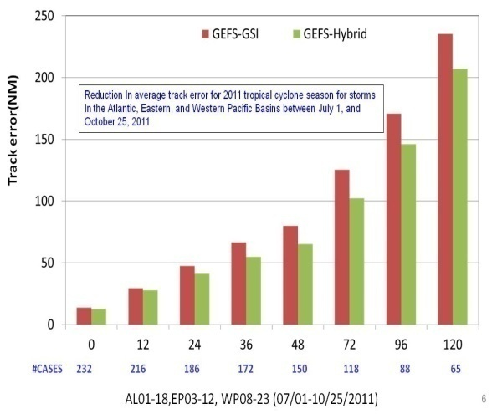
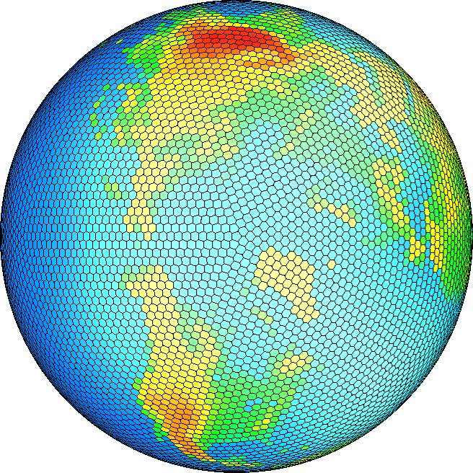
Phase 0: Ongoing Programs (0-100 days)
Global Atmospheric Models in an Inter-agency Multi-Model Ensemble via the National Unified Operational Prediction Capability (NUOPC) – Currently GFS, NOGAPS, GEM.
  Global Multi-model Ensemble is more accurate than
  any of the component models.
  Distributed Production Centers leverage multi-agency and international computer infrastructure and investments.
  Currently 1 deg/0-15 days going to 0.5 deg/0-30 days
Next-generation Global Atmospheric Cloud Resolving Models (GCRM) – Candidates NMMB, FIM/NIM, Cubed Sphere, MPAS, NUMA
  10-15km initially, ultimately 4km or finer horizontal resolution
  Adaptive/unstructured mesh allows computational efficiency
  Improved prediction at weather to climate scales (5-100 days)
  Improved hurricane track/ intensity prediction and regional climate
k
i
lat-lon a ( k, i, j )
NIM: a [ k, indx)

Slide 7
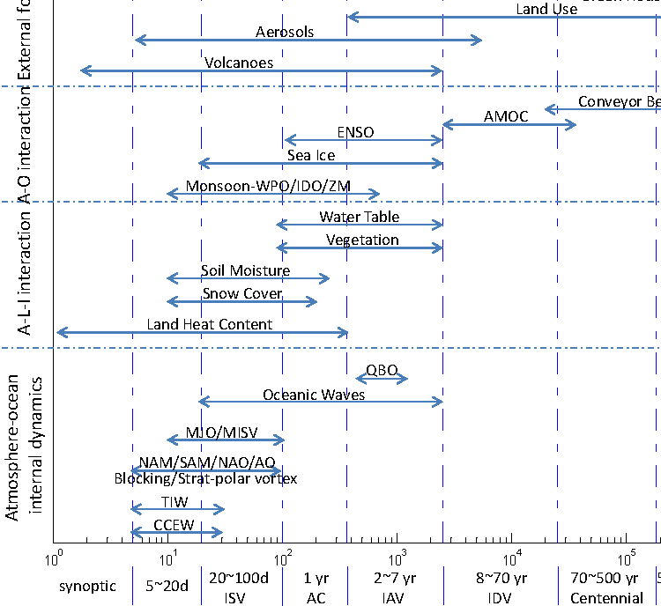
Phase I: Sources of Extended Range Predictability: Subseasonal, Intraseasonal and Interannual (ISI) Timescales
ESPC Focus
Assessment of Intraseasonal to Interannual Climate Prediction and Predictability, 2010, THE NATIONAL ACADEMIES PRESS • 500 Fifth Street, N.W. • Washington, DC 20001

Slide 8

Phase I: An Earth-System Prediction Initiative
An Earth-System Prediction Initiative for the Twenty-First Century (Shapiro et al.)
Addressing the Complexity of the Earth System (Nobre et al.)
Toward a New Generation of World Climate Research and Computing Facilities (Shukla et al.)
Collaboration of the Weather and Climate Communities to Advance Subseasonal-to-Seasonal Prediction
(G. Brunet, M. Shapiro, B. Hoskins, Mitch Moncrieff, Randal Dole, G. Kiladis, B. Kirtman, A. Lorenc, R. Morss, S. Polavarapu, D. Rogers, J. Schaake and J. Shukla

Slide 9
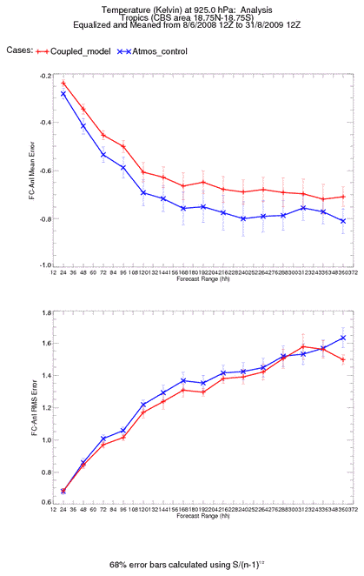
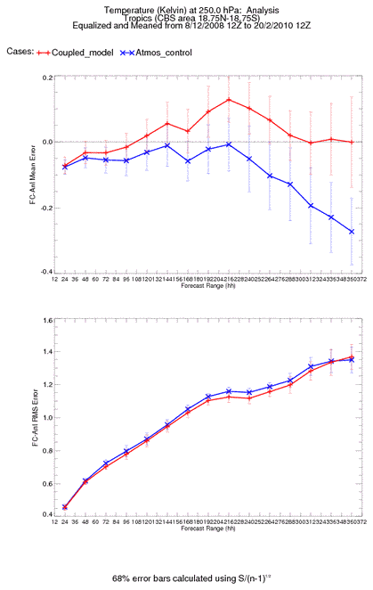
Global Coupled Models
Global air-sea coupled models were first implemented for climate applications but are increasingly being used at subseasonal to ISI timescales.
Benefit is seen especially in the tropics in both atmospheric and oceanic verification with largely comparable skill in extra-tropics and some benefit still seen at higher latitudes from coupling in the Southern Hemisphere.
At week two and beyond, coupling produces skill improvements comparable to doubling resolution in some research cases.
Crown copyright Met Office

Slide 10
Phase I: ESPC Demonstrations
Workshop Results
Interim Science Steering Group (ISSG) Workshop 21-23 March, 2012
    Attended by scientists (ISSG), Operational Forecast Center representatives (for requirements mapping), and inter-agency program managers (for cooperative resourcing of underlying research)
Outcomes:
  The most needed and most scientifically feasible forecast timescales are in the 10-day to 1-2 year range based on our current and near term understanding and capability (ISI Timescales)
  Linkages between climate research (USGCRP, US CLIVAR, etc.), weather research (US THORPEX, USWWRP, etc.) and ESPC development and transition to operations were identified for coordination within the Demonstration Science Teams.
10

Slide 11
Phase I: ESPC Demonstrations
(10 days to 1-2 years)
Extreme Weather Events: Predictability of Blocking Events and High Impact Weather at Lead Times of 1-6 Weeks (Stan Benjamin, ESRL)
Seasonal Tropical Cyclone Threat: Predictability of Tropical Cyclone Likelihood, Mean Track, and Intensity from Weekly to Seasonal Timescales (Melinda Peng, NRL MRY)
Arctic Sea Ice Extent and Seasonal Ice Free Dates: Predictability from Weekly to Seasonal Timescales (Phil Jones, LANL)
Coastal Seas: Predictability of Circulation, Hypoxia, and Harmful Algal Blooms at Lead Times of 1-6 Weeks (Gregg Jacobs, NRL SSC)
Open Ocean: Predictability of the Atlantic Meridional Overturning Circulation (AMOC) from Monthly to Decadal Timescales for Improved Weather and Climate Forecasts (Jim Richman, NRL SSC)
11

Slide 12

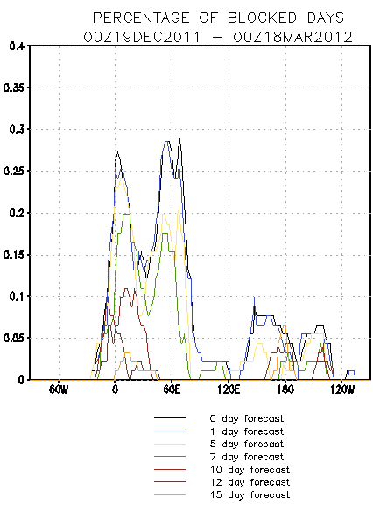
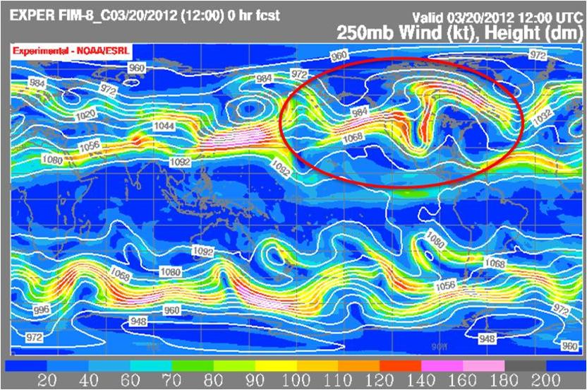
Extreme Weather Events: Predictability of Blocking
Events and High Impact Weather at Lead Times of 1-6 Weeks
ESPC Demonstration #1 – Improved guidance for extreme weather events related to atmospheric blocking flow (flooding, drought, persistent anomalously cold/warm conditions).
Objective:
Apply our current understanding of the blocking process to develop
and assess utility of model diagnostics to current state and forecast.
Thrusts:
  Diagnose longer-term weather anomalies from atmospheric blocking
  ( quasi-stationary events with duration of at least 4 days to 2+ months)
  Predict seasonal statistics (below/normal/above average
  conditions) at various lead times up to six months.
  Predict individual events (onset/ persistence/ cessation)
  Predict outcomes (floods, droughts, fires, extreme temps, snow).
Challenges:
Several possible causes are postulated each with unique sources
of predictability and technical approach. These include MJO
interaction, TCs/extratropical transition, SSW events, and early season snow cover or melting.

Slide 13
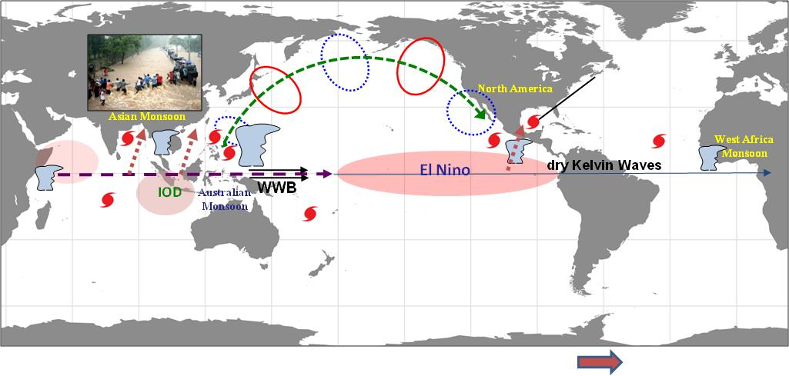
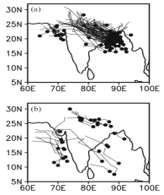
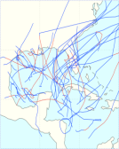
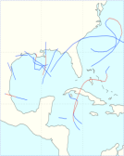
Seasonal Tropical Cyclone Threat: Predictability of
Tropical Cyclone Likelihood, Mean Track, and Intensity from Weekly to Seasonal Timescales
ESPC Demonstration #2 – Improved pre-season guidance of tropical cyclone seasonal track and frequency statistics as well as sub-seasonal outlooks for civil and military planning.
Objectives:
Prediction of seasonal basin scale tropical cyclone
genesis and track distributions and potential intensity.
Thrusts:
  Initial value, short range prediction improvements for
  track and structure.
  Boundary value, longer range probabilistic forecasts of
  maximum likelihood genesis, track, intensity.
  Landfall probability with the accompanying potential
  intensity and precipitation to support resource
  management, evacuation plans, ship routing, etc.
Challenges:
Multi-scale convective processes and interaction between tropical cyclone and the large scale environment, and our understanding and ability to predict them vary widely from basin to basin.
Maloney and Hartmann (2000)
Goswami et al (2003)

Slide 14
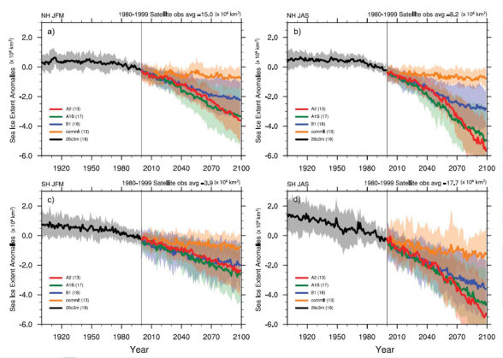
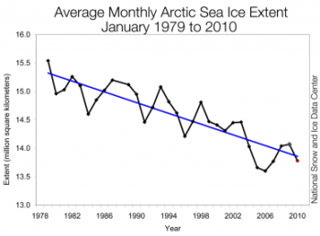
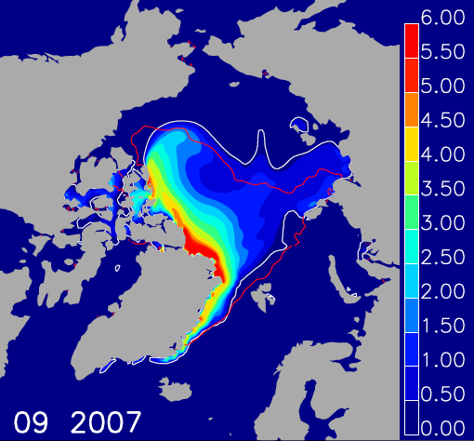
Arctic Sea Ice Extent and Seasonal Ice Free Dates: Predictability from Weekly to Seasonal Timescales
ESPC Demonstration #3 – Improved pre-season guidance of arctic sea ice changes, navigability of Arctic passages, and sub-seasonal forecasts of ice conditions for civil and military planning.
Objectives:
Further explore limits of predictability of sea ice extent and
volume, and freeze and melt onset dates, at 3-12 month leads.
Extend prediction to regional scale areas of interest
(e.g. Northern and Northwest passages).
Extend forecast variables to other ice and atmosphere
properties (ice thickness/movement, marginal ice , snow, fog, etc.)
Thrusts:
  Assessing adequacy of current sea ice models (that produce accurate
  hindcasts) for use as forecast models when conditions are changing.
  Predictability and suitability of different approaches at different
  forecast timescales as ice thins and system persistence is reduced.
Challenges:
Models reproduce historical records well when forced with observations (reanalysis) in a bulk sense, but the fidelity needed for Arctic shipping and other operations is poorly characterized. Predictability of thinning/single year ice and seasonal/annual conditions is uncertain.

Slide 15
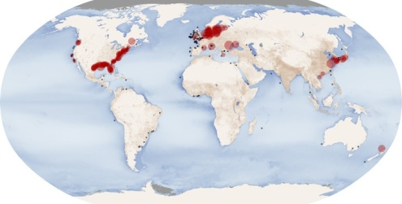
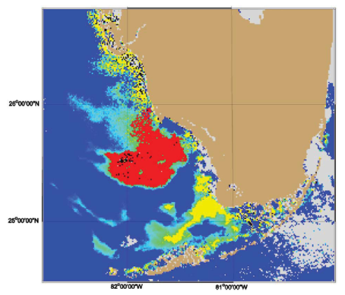
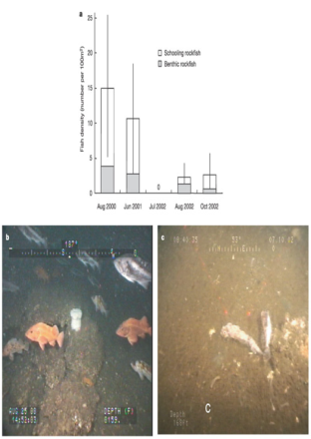
Coastal Seas: Predictability of Circulation, Hypoxia, and Harmful Algal Blooms at Lead Times of 1-6 Weeks
ESPC Demonstration #4 – Establish, at a range of lead times beyond the present weather prediction scales, the forecast skill for Harmful Algal Blooms (HABs) and coastal sea hypoxia.
Objectives:
Identify effects in global forecasts of the physical earth system that lead
to conditions conducive to HABS and hypoxia.
Communicate the global forecasts, uncertainty, and variability to physical
predictions for specific regionally affected areas (downscaling).
Predict impact of globally forecasts on local area biology/chemistry.
Thrusts:
  Relevant physical earth system observations and coupled predictions.
  Local physical conditions in under-observed , high resolution regions
  particular to areas in which HABS and hypoxia are significant concerns.
Challenges:
Precipitation residence times and nutrient loading changes from watershed to coastal waters is not well characterized in forecast models and difficult to efficiently represent numerically in a unified vertical coordinate system.
Upwelling, driven by 3-dimensional air and ocean circulations, and modified by waves, bathymetry, and topography, also a major cause of HABs and hypoxia.

Slide 16
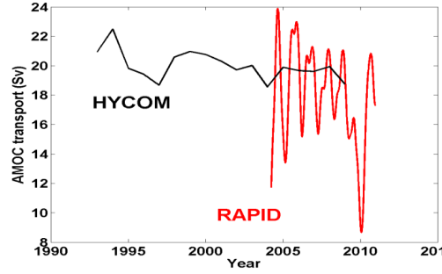
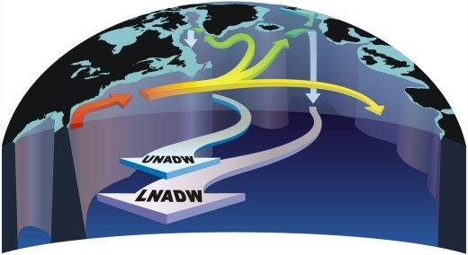
Open Ocean: Predictability of the Atlantic Meridional
Overturning Circulation (AMOC) from Monthly to Decadal Timescales for Improved Weather and Climate Forecasts
ESPC Demonstration #5 – Improved representation of basin scale three dimensional ocean circulation from months to years for use in coupled climate and weather models.
Objectives:
Assess model representation and predictability of ocean circulation
from monthly to decadal timescales using RAPID and other long
duration multi-level ocean observational datasets.
Thrusts:
  Build upon the existing IPCC, ECCO, HYCOM and USGCRP/CLIVAR
  efforts to assess basic predictability of the net transport and sensitivity
  to forcing in order to identify knowledge gaps and design new studies.
  Conduct high resolution coupled model simulations to look at
  detailed structure and air-ocean feedback.
  Challenges:
It is not clear what is predictable about the AMOC. The AMOC is thought to be an important driver for the oceanic meridional heat flux and sea surface temperature, although the link between the AMOC and climate is not clear.
Recent climate model studies have shown a slowdown in the AMOC with possible impacts on European regional seasonal climate, ENSO and hurricanes in the Atlantic Ocean.

Slide 17
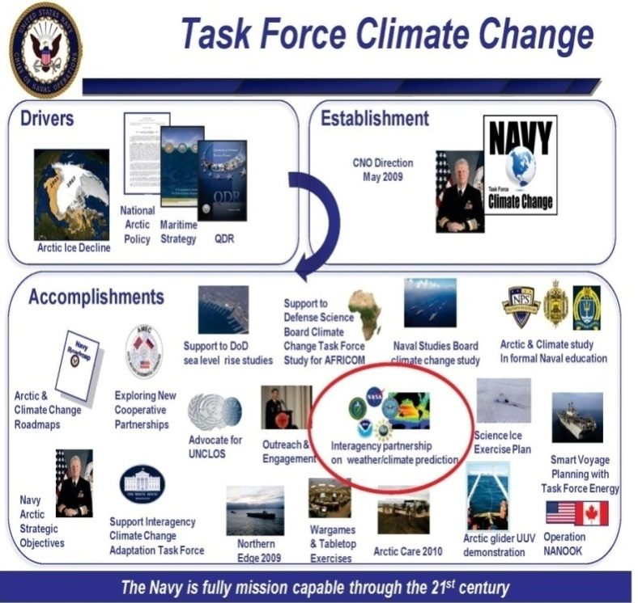
Phase II: Decadal Prediction
(5-30+ years)
Decadal to multi-decadal prediction issue is more
complex and more focused on the forced problem
and limits of predictability
  Physical – solar variability, aerosols,
  volcanic, albedo, glacial and sea ice melt,
  ocean circulation and acidification,
  desertification…
  Biogeochemical – ocean microbial, migrations
  including human, plant and animal….
  Societal – deforestation, agriculture,
  urbanization, industrial…
  Political – carbon limits, economic cycles,
  policy, water resources, warfare, …
Leverage National and International ongoing efforts in defining “operational” capability at these timescales: availability and reliability of information against decision requirements and format and mechanism for operational product generation, validation, and distribution.
17

Slide 18
ESPC Program Office Updates
Program Manager (Dr. Daniel Eleuterio) from Navy/ONR and Deputy Program Manager (Dr. Jessie Carman) from NOAA/OAR/OWAQ.
ESPC Website at www.espc.oar.noaa.gov
Outreach through AMS, AGU, THORPEX, USGCRP, NOAA Environmental Modeling Group, National Ocean Council, etc.
18

Slide 19
NUOPC/ESPC Relationship and Strategy
Implementation
2012
Operations/Sustainment/Transitions
2010
~2015-2016
2018
~2025
NUOPC
IOC
FOC
ESPC
DEMO
IOC
FOC
Plan R&D
Design/Develop/Implement
NUOPC
  Implement operational, global, multi-model atmospheric ensemble system
  Develop common NUOPC research agenda and lead common model architecture (CMA)
  Transition ESPC accomplishments/advancements
ESPC
  Focus on next generation system, integrated earth system prediction at extended ranges
  Develop common ESPC research agenda and support common model architecture (CMA) enhancements for ESPC systems
  Coordinate interagency R&D efforts, engaging multiple federal, private and academic organizations towards extended range prediction beyond current operational forecast ranges through leverage of weather and climate communities
19

Slide 20
ESG Membership
Dr. Bob Detrick | Assistant Administrator, NOAA Office of Oceanic and Atmospheric Research (OAR)
Ms. Laura Furgione | Assistant Administrator, NOAA Office of Weather Services (NWS) (Acting)
RDML Brian Brown | Commander, Naval Meteorology and Oceanography Command
RADM Jon White | Oceanographer/Navigator of the Navy
Dr. Frank Herr | Head, Ocean Battlespace Sensing Dept, ONR
Dr. Fred Lewis | Air Force Deputy Director of Weather
Dr. Jack Kaye | Assoc. Director, Earth Science Research, NASA
Dr. Gary Geernaert | Director, Climate and Environmental Science Division, DOE
Dr. Marge Cavanaugh | Assistant Director for Geosciences, NSF (Acting)

Slide 21
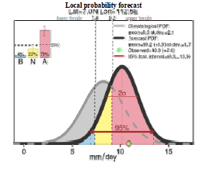
ISI Prediction: Challenge and Opportunity
High resolution, ensemble, and global coupled model approaches will bring a significant increase in data volume and computational cost.
What forecast products are most needed and how do we characterize the return on this investment?
• The ESPC demonstrations seek to exploit potential sources of predictability in the coupled system that exceed the limit in predictability of deterministic NWP approaches. However, forecast skill from these ensemble-based products will vary depending on the presence of low-order modes in the initial conditions.
What do you see as the biggest utility of long range products with quantifiable but variable confidence levels?
• Are there better ways of establishing prediction credibility?
Are there better ways of communicating ensemble-based products and data?
Example NMME seasonal product.
Monthly predictability of the NAO based on strong/weak MJO in Initial Conditions.
21

