Slide 1

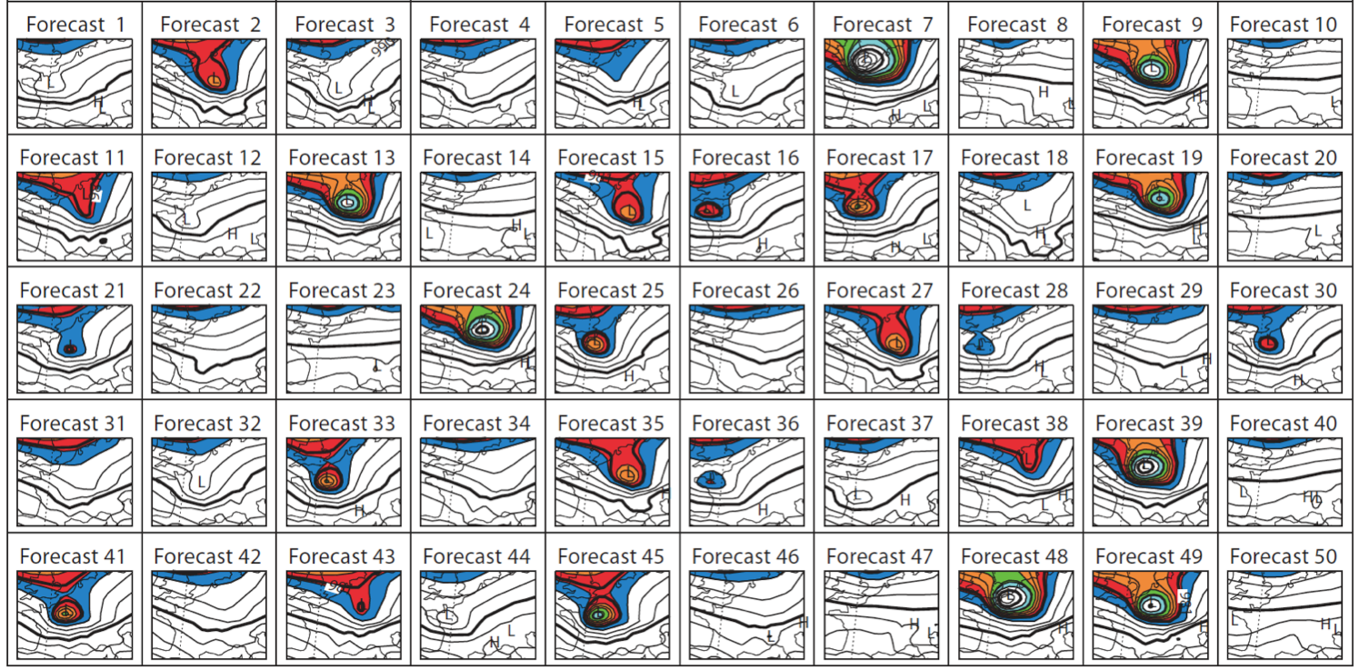
Ensemble-based data assimilation and ensemble prediction research at ESRL
Tom Hamill, Jeff Whitaker, Brian Etherton, and Zoltan Toth
with contributions from Phil Pegion, Gary Bates, Don Murray, others

Slide 2
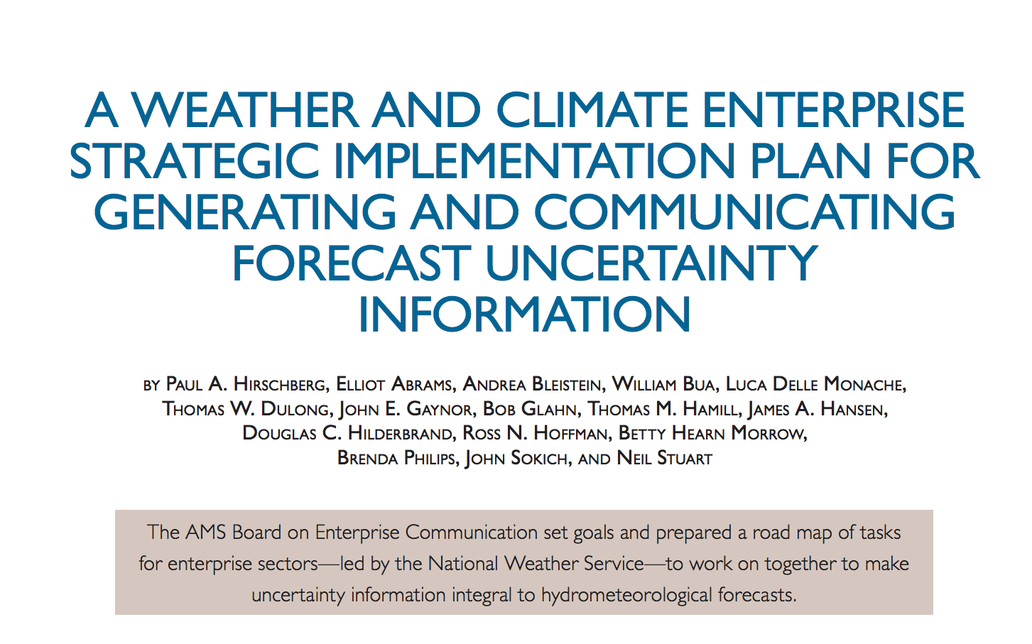
recall the recent BAMS article sanctioned by your committee

Slide 3
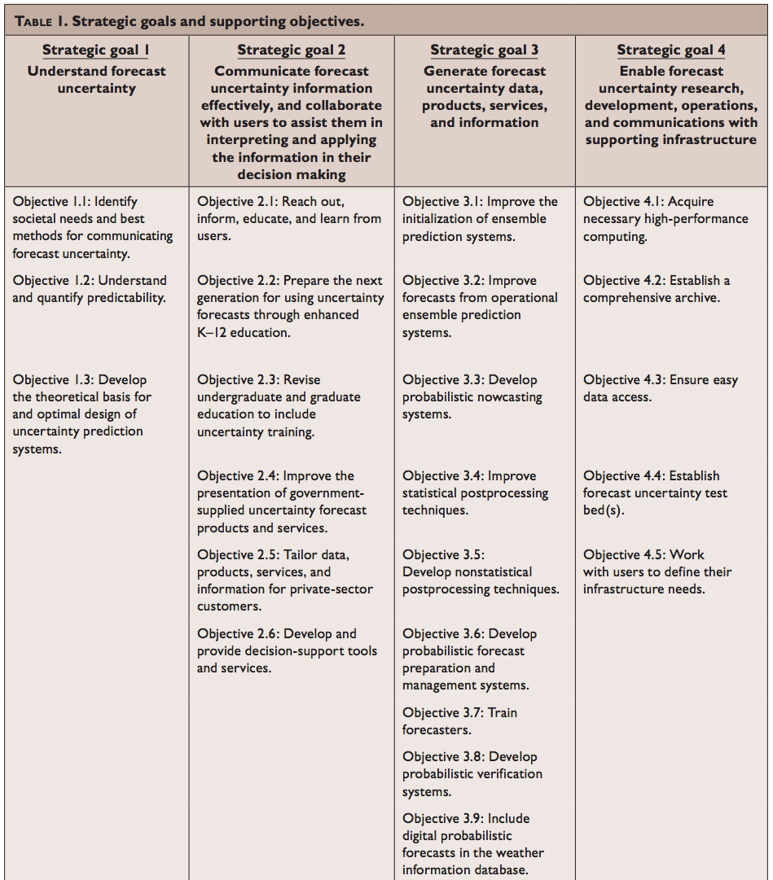
Table from BAMS article
Let’s talk about
these today
ESRL also
working on
these, but
won’t cover
them here.

Slide 4
Scientifically, what must be done to produce high-quality ensembles?
ensemble
members’
trajectories
t=t+Δt
t=0
reality
If this situation happens more than infrequently,
we need to improve our ensemble prediction system.

Slide 5
Scientifically, what must be done to produce high-quality ensembles?
ensemble
members’
trajectories
t=t+Δt
Problem 1: Specifying
the initial conditions
t=0
Theory tells us we want to
sample the ensemble from
the distribution of plausible
analysis states.
reality

Slide 6
The ensemble Kalman filter (EnKF)
A way of improving the accuracy of initial conditions.
A theoretically justifiable way of initializing ensemble forecasts.
At ESRL, we have:
  Developed these ideas from scratch, going back 10+ years.
  Developed and published the first ever paper on hybrid variational-ensemble techniques.
  Tested the EnKF and hybrids extensively in global models.
  Worked with NCEP to operationally implement a hybrid EnKF system.

Slide 7
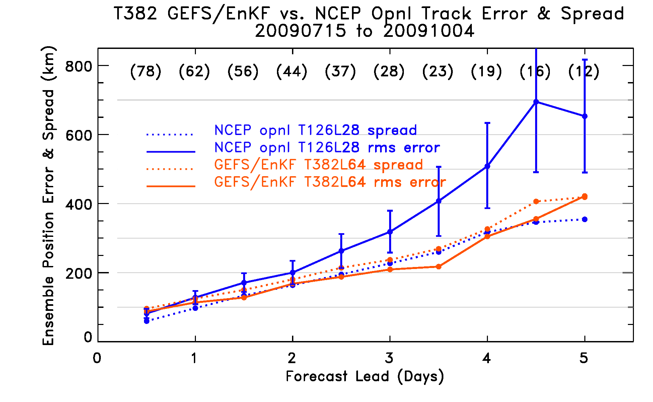
Experimental T382 GEFS/EnKF vs. then-operational T126 GEFS/ETR, 2009
The combination of higher resolution and EnKF dramatically improved hurricane tracks.
Ref: Hamill, T. M., J. S. Whitaker, M. Fiorino, and S. J. Benjamin, 2011: Global ensemble predictions
of 2009's tropical cyclones initialized with an ensemble Kalman filter. Mon. Wea. Rev., 139, 668-688.

Slide 8
Result of ESRL’s EnKF development
Operational implementation in “hybrid data assimilation system” at NCEP, 22 May 2012
  EnKF information blended in with their static covariance model to produce better quality initial conditions.
Working with NCEP ensemble team to replace method of providing initial perturbations for medium-range forecasts. Implementation next year?

Slide 9
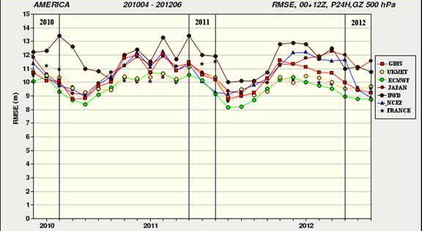
500 hPa height errors from various international global models
implementation of hybrid EnKF at NCEP
c/o Gilbert Brunet, CMC

Slide 10
Scientifically, what must be done to produce high-quality ensembles?
t=t+Δt
ensemble
members
t=0
Problem 2: Dealing with
model error and uncertainty
reality

Slide 11
Dealing with model uncertainty
Make the forecast model better
  e.g., higher resolution, improved dynamics, improved physical parameterizations, coupled land-ocean-atmosphere-chemistry-ecosystem.
Estimate the uncertainty due to the forecast model imperfections in the ensemble system
  provide more spread
  possibly reduce bias (systematic error)
Post-process: detect discrepancies between past forecasts and observations, correct current forecast.

Slide 12
Simulating model uncertainty: schemes we’re currently testing in
NCEP Global Ensemble Forecast System (GEFS)
Stochastically-perturbed total tendencies (STTP) – operational NCEP scheme
Stochastically-perturbed physics tendencies (SPPT) – operational ECMWF scheme.
Vorticity confinement (VC) – under development at UKMET and ECMWF.
Stochastically-perturbed boundary-layer humidity (SHUM).
More information in supplementary slides

Slide 13
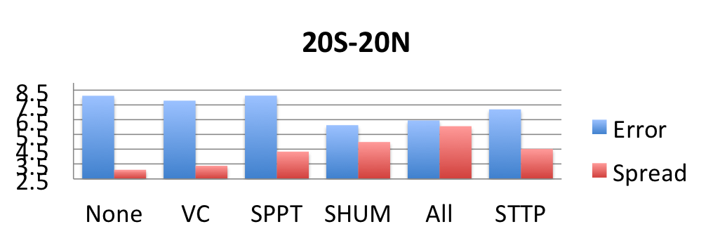
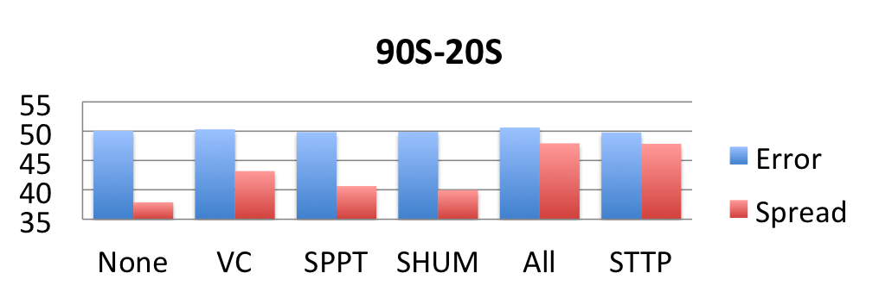
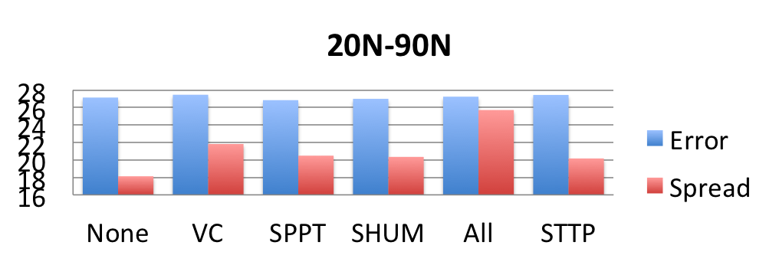
Day +5 500 hPa height forecast statistics
tested July
2012, N. Hem
summer.
Desire consistency
in magnitudes of
spread and error.
NCEP operational
SPPT adds spread
primarily in the
wintertime
hemisphere,
SPPT and SHUM
add spread more
in the tropics.
(NCEP
operational)
(NCEP
operational)

Slide 14
Dealing with model uncertainty
Make the forecast model better
  e.g., higher resolution, improved dynamics, improved physical parameterizations, coupled land-ocean-atmosphere-chemistry-ecosystem.
Estimate the uncertainty due to the forecast model imperfections in the ensemble system
  provide more spread
  possibly reduce bias (systematic error)
Post-process: detect discrepancies between past forecasts and observations, correct current forecast.

Slide 15
Making reliable forecasts for rare events complicated w/o large training sample
A heavy precipitation event like the one today are the ones you care about the most. How
can you statistically post-process today’s forecast given past short sample of forecasts and
observations?

Slide 16
GEFS reforecast data set
Developed by ESRL (on DOE computers) for 2012 NCEP GEFS.
Every day, 1985-present, we have 11-member ensemble reforecasts computed to day + 16.
Convenient download of data (next slide).
CPC, EMC, HPC, MDL using this data for product development. More to follow. We hope to get wider enterprise, universities using it also.

Slide 17
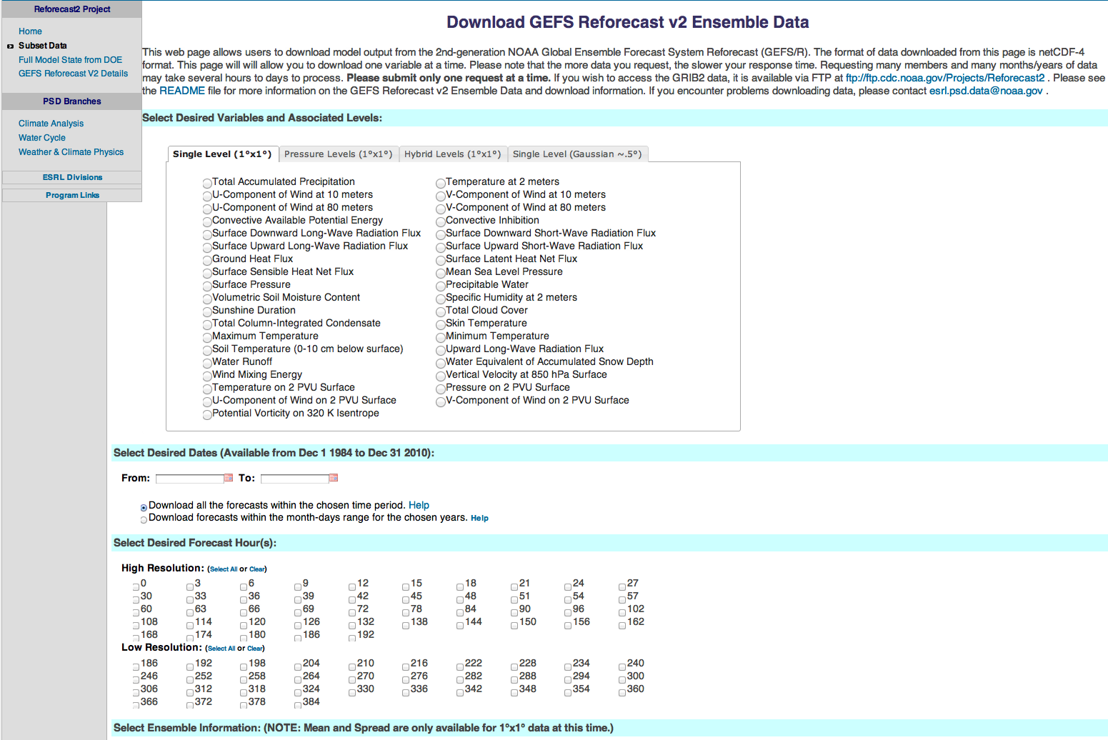
http://esrl.noaa.gov/psd/forecasts/reforecast2/download.html

Slide 18
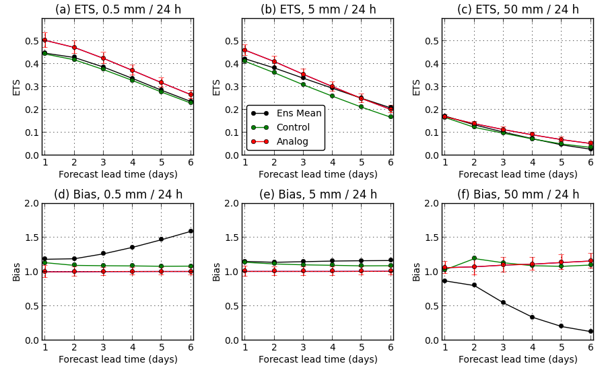
Example: improving deterministic precipitation forecasts with statistical post-processing.

Slide 19
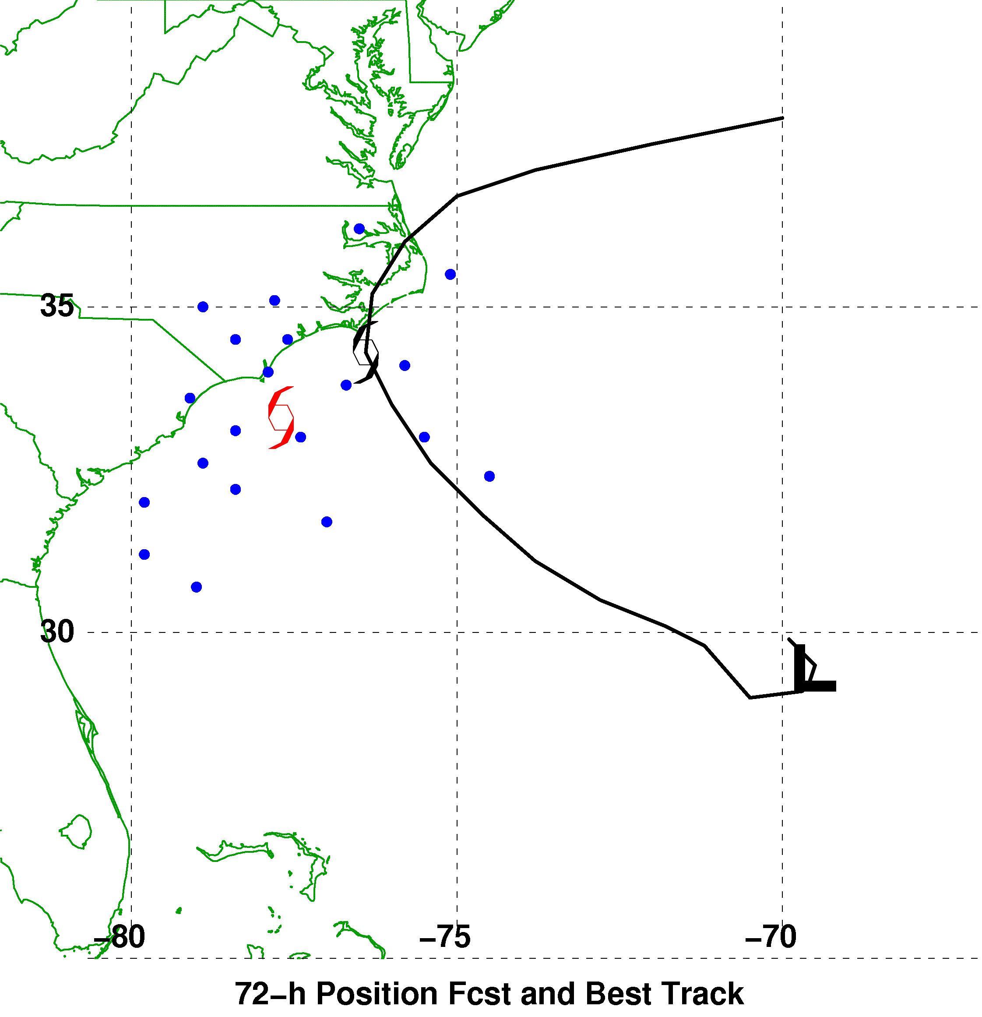
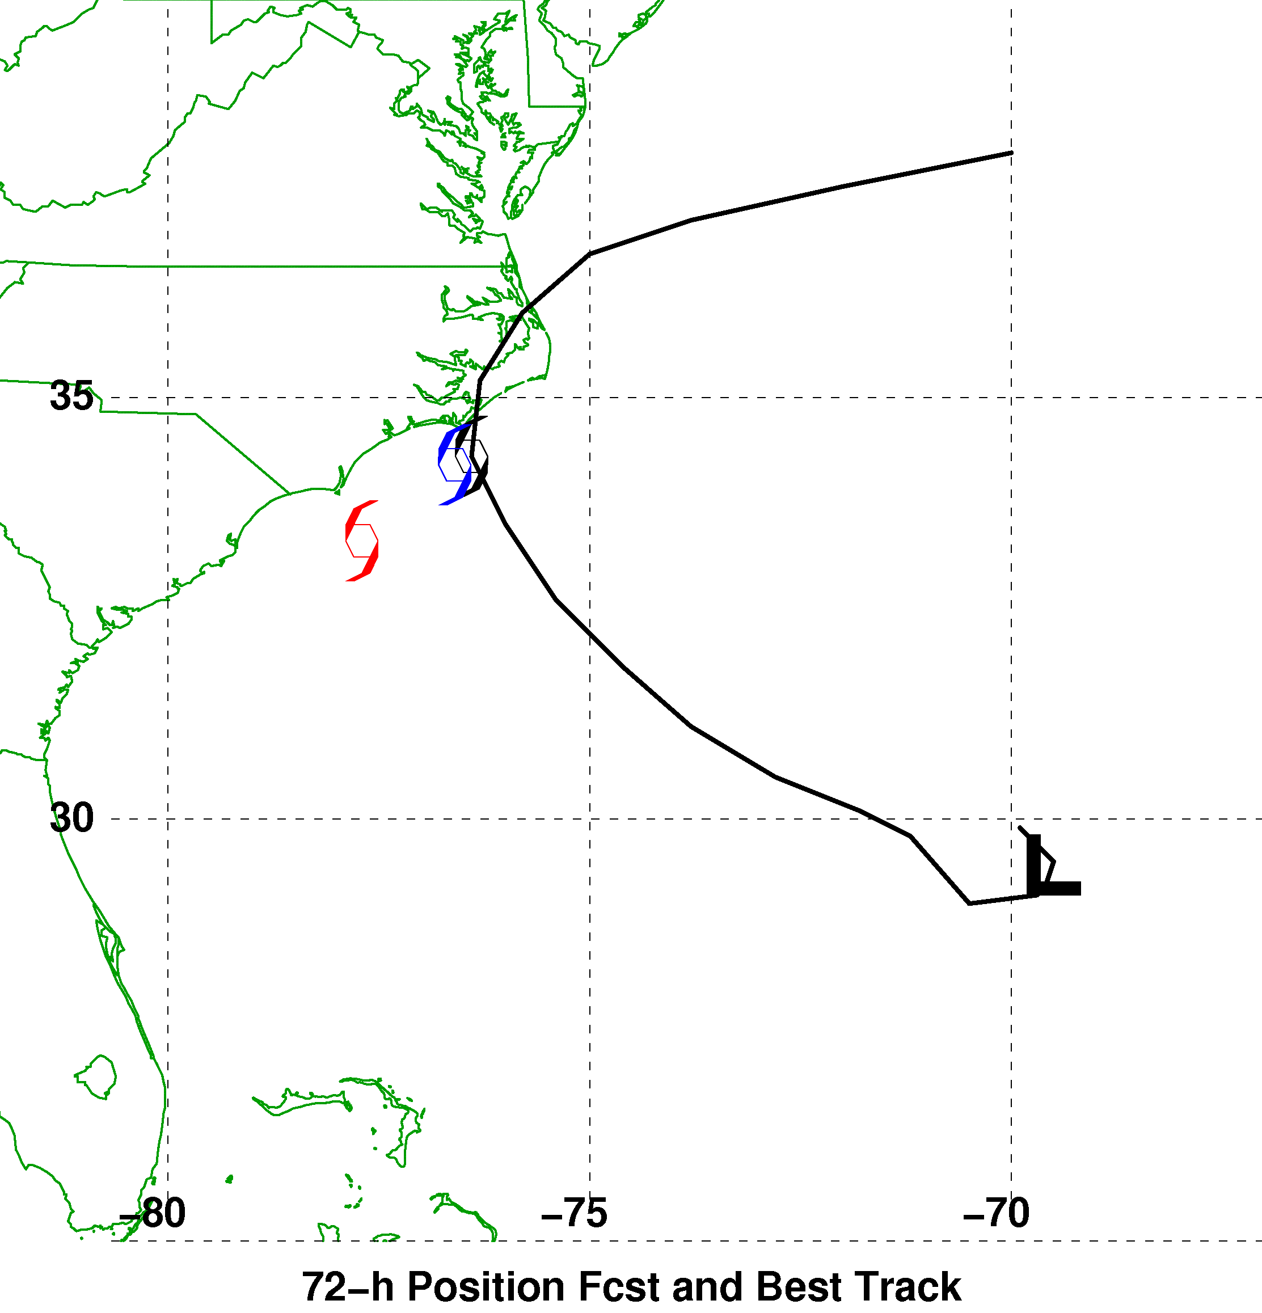

A synthetic example of using reforecasts
to make track error bias corrections
72-h Forecast Verifying 1200 UTC 9 September
Ensemble Mean, Reforecast Analog,
and Observed Positions
Reforecast Analog
Position Errors
N
Bias-Corrected Ensemble Mean Position
and Probability Ellipse
W
E
Observed
S
Error (km)
Red : mean forecast position
Blue dot: forecast positions of +72-h forecast analogs
End of red tail ___ : observed positions at +72 h

Slide 20
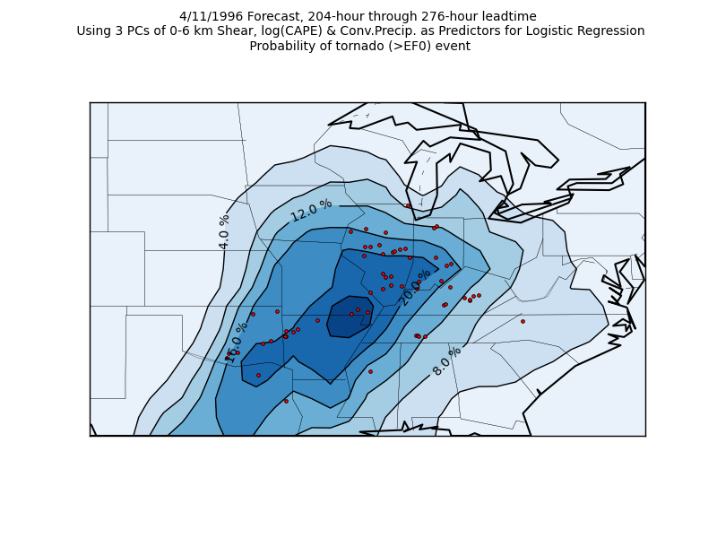
Application: extended-range tornado forecasting
Francisco Alvarez,
St. Louis University,
is working with me
and others on using the
reforecasts to make
extended-range
predictions of
tornado probabilities.
Ph.D. work,
in progress.

Slide 21
Conclusions
ESRL is NOAA’s center of expertise for development of improvements to global ensemble prediction systems, advanced data assimilation techniques.
We have a strong track record of success in research to operations.
Our EnKF, model uncertainty, reforecast work will improve operational forecasts, facilitate wider enterprise generating value-added products.
If you like what you see and want NOAA to do more ensemble prediction development, let NOAA management know.

Slide 22
Future challenges
Refinement of EnKF algorithm
  Dealing with position errors in features
  Sampling error from small ensemble
  Better methods of treating model uncertainty
  Advanced hybrid methods, including 4D-Var/EnKF hybrids.
Further improving representations of model uncertainty.
Reforecasting.
  Help NCEP determine how to do this regularly, operationally.
  Develop advanced experimental products fully utilizing reforecasts, e.g., for renewable-energy sector.
Improve collaborations with NCEP so we have faster R2O.
Improve decision support -- help users make better decisions with ensemble guidance.

Slide 23
Backup slides: background on ensemble Kalman filter, hybrid data assimilation, model uncertainty

Slide 24
Scientifically, what must be done to produce high-quality ensembles?
ensemble
members’
trajectories
t=t+Δt
t=0
reality
If this situation happens more than infrequently,
we need to improve our ensemble prediction system.

Slide 25
Scientifically, what must be done to produce high-quality ensembles?
ensemble
members’
trajectories
t=t+Δt
Problem 1: Specifying
the initial conditions
t=0
Theory tells us we want to
sample the ensemble from
the distribution of plausible
analysis states. How do we
determine what is a range
of plausible analysis states?
reality

Slide 26
Scientifically, what must be done to produce high-quality ensembles?
ensemble
members’
trajectories
t=t+Δt
Problem 1: Specifying
the initial conditions
t=0
What’s to say we shouldn’t
be sampling from this
distribution instead?
reality

Slide 27
State estimation (“data assimilation”)
observations for time t
+ observation-error
statistics
forecast for time t
data assimilation
state estimate for time t
weather
forecast
model
forecast for time t+Δt
+ forecast-error
statistics
+ analysis-error
statistics
To get a reasonable estimate of the state and its uncertainty,
we need observations, forecast(s), observation-error statistics,
and forecast-error statistics.

Slide 28
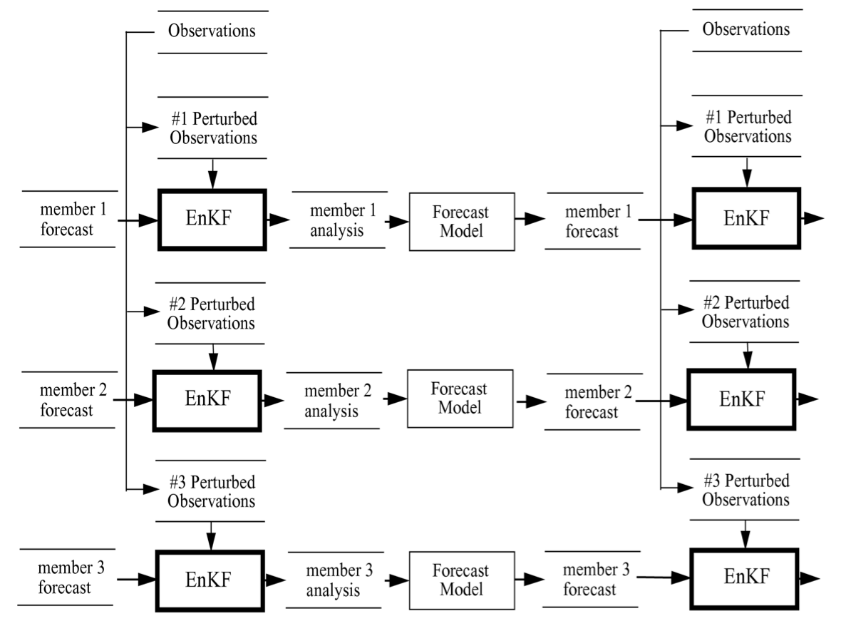
The ensemble Kalman filter: a schematic
(This schematic
is a bit of an
inappropriate
simplification,
for EnKF uses
every member
to estimate
background-
error covariances)

Slide 29
The ensemble Kalman filter (EnKF) : a schematic
uncertainty in the observations
is simulated by adding noise
to the control observations
(consistent with error statistics)
to create distinct sets of
perturbed observations
(This schematic
is a bit of an
inappropriate
simplification,
for EnKF uses
every member
to estimate
background-
error covariances)

Slide 30
The ensemble Kalman filter (EnKF) : a schematic
uncertainty in the first-guess
forecast is simulated by conducting
parallel ensembles of data
assimilation cycles, creating
ensembles of analyses.
(This schematic
is a bit of an
inappropriate
simplification,
for EnKF uses
every member
to estimate
background-
error covariances)

Slide 31
Variational Data Assimilation
J : Penalty (Fit to background + Fit to observations + Constraints)
x’ : Analysis increment (x_{a} – x_{b}) ; where x_{b} is a background
B_{Var} : Background error covariance
H : Observations (forward) operator
R : Observation error covariance (Instrument + representativeness)
y_{o}’ : Observation innovations
J_{c} : Constraints (physical quantities, balance/noise, etc.)
c/o Daryl Kleist,
EMC
B is typically static and estimated a-priori/offline

Slide 32
Why Hybrid?
 | VAR (3D, 4D) | EnKF | Hybrid | References
Benefit from use of flow dependent ensemble covariance instead of static B |  | x | x | Hamill and Snyder 2000; Wang et al. 2007b,2008ab, 2009b, Wang 2011; Buehner et al. 2010ab
Robust for small ensemble |  |  | x | Wang et al. 2007b, 2009b; Buehner et al. 2010b
Better localization for integrated measure, e.g. satellite radiance |  |  | x | Campbell et al. 2009
Easy framework to add various constraints | x |  | x
Framework to treat non-Gaussianity | x |  | x
Use of various existing capabilities in VAR | x |  | x

Slide 33
Hybrid variational-ensemble concept
Incorporate ensemble perturbations directly into variational cost function through extended control variable
  Lorenc (2003), Buehner (2005), Wang et. al. (2007), etc.
β_{f} & β_{e}: weighting coefficients for fixed and ensemble covariance respectively
x_{t}: (total increment) sum of increment from fixed/static B (x_{f}) and ensemble B
α_{k}: extended control variable; :ensemble perturbation
L: correlation matrix [localization on ensemble perturbations]

Slide 34
SPPT
Perturbed Physics tendencies
Original tendencies
from gbphys
r- vertical weight: 1 from surface to 100 hPa, damps to zero at 50 hPa
μ- horizontal weights: ranges from -1.0 to 1.0, a red noise process with a
  Temporal timescale of 6 hours
  e-folding spatial scale of 500 km

Slide 35
STTP
S formed from random linear combinations of ensemble tendency perturbations (entire ensemble must be run concurrently).

Slide 36
Vorticity confinement

Slide 37
Stochastic BL humidity
SPPT only modulates existing physics tendency (cannot change sign, trigger new convection).
Triggers in convection schemes very sensitive to BL humidity.
Vertical weight r decays exponentially from surface. Random pattern μ has a (very small) amplitude of 0.00375.

Slide 38
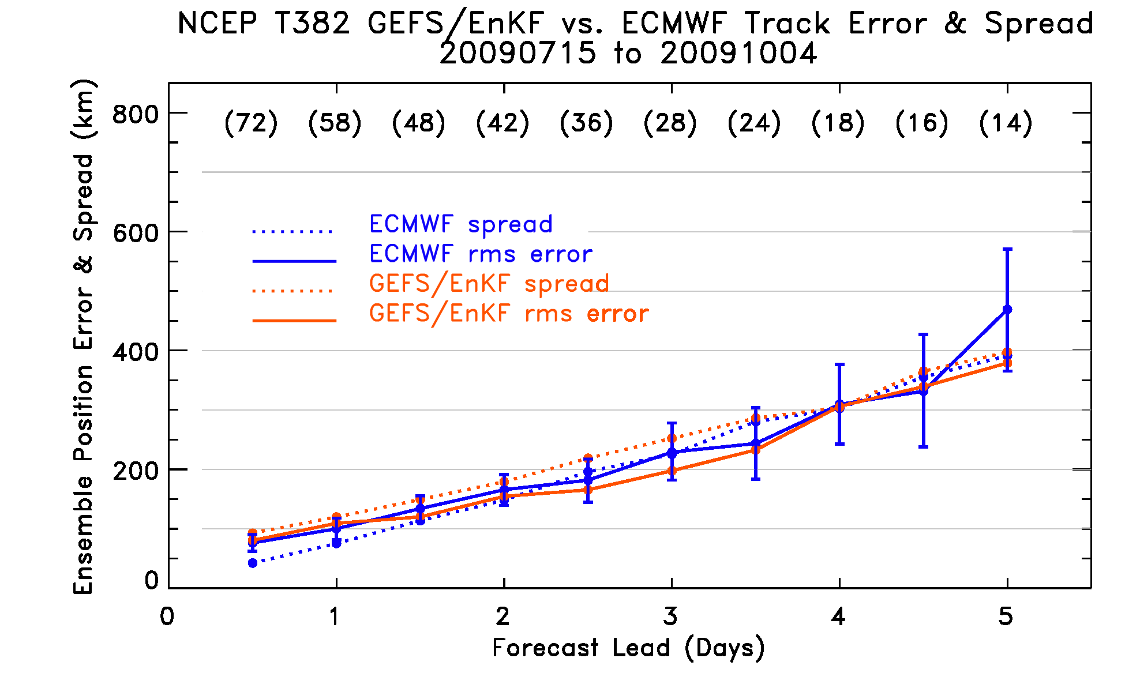
T382 GEFS/EnKF vs. operational T399 ECMWF
competitive with ECMWF in position error

Slide 39
Multi-model ensembles?
Better than reforecast calibrated?
A year or two ago, I worked on comparing TIGGE multi-model global ensembles to ECMWF reforecast calibrated ensemble guidance.
2-meter temperature over Europe.
Precipitation over CONUS.
Conclusions may be skewed by “small” ECMWF reforecast data set (1x weekly, 5 members, 18 years).

Slide 40
Previously, reforecast vs. multi-model, T_{sfc}
Reforecast calibrated
more skillful than
TIGGE multi-model
for 2-meter temps
ECMWF’s forecasts were corrected here using a blend of bias correction from the past
30 days of forecasts and a more sophisticated regression approach using reforecasts.
courtesy of Renate Hagedorn, ECMWF & DWD. Hagedorn et al., QJRMS, submitted.

Slide 41
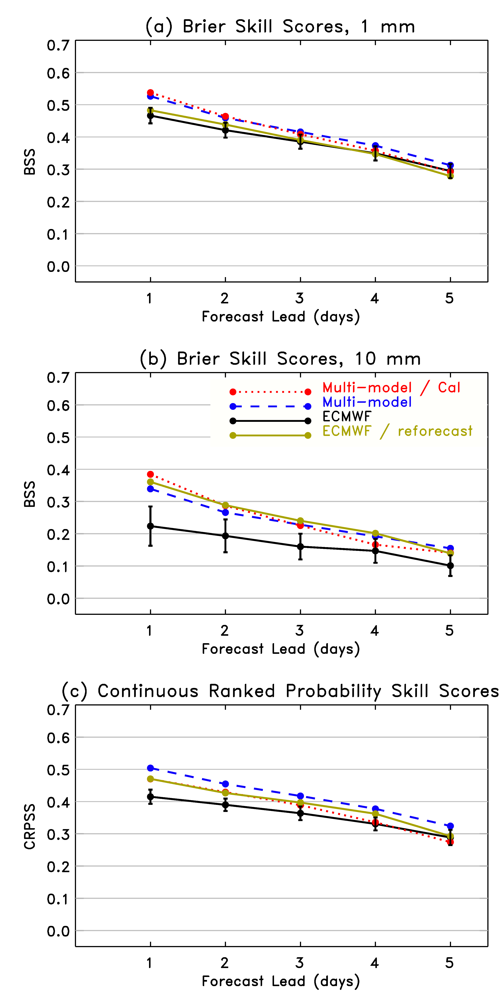
Skill scores for multi-model and reforecast-calibrated
Notes:
(1) Impressive skills of multi-model.
(2) Reforecast doesn’t improve the 1-mm forecasts much, improves the 10-mm forecasts a lot.
(3) Calibration of multi-model using prior 30 days of forecasts doesn’t add much overall.

Slide 42
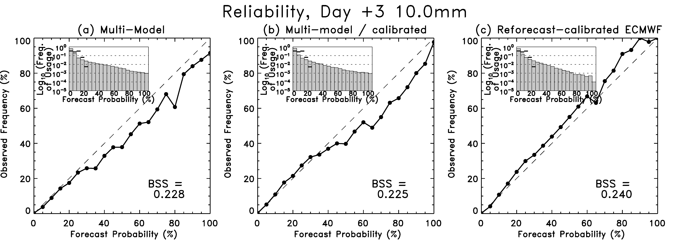
Multi-model slightly over-forecasts probabilities, and is substantially
sharper. Reforecast calibrated slightly under-forecasts and is less sharp.

